Slide 1
Readme Notes
Basic Matlab code following the Region Growing IDEAL algorithm, originally described by Huanzhou Yu and Scott Reeder.
Code written for teaching / demonstration purposes.
  Because of this, there are lots of interactive features.
  I use it as a teaching tool, and often ask students as a project to make it run faster and more efficient.
The code illustrates some of the ad hoc nature of RG algorithm, which requires a fair amount of user adjustments. Code also implements voxel independent (VI) IDEAL (no RG), but note that VI IDEAL can lead to severe water-fat swaps in complicated data sets.
Not really meant for large data set reconstructions as it is relatively SLOW.
Single-coil or Multi-coil reconstruction.
  (e.g. one pass of the routine yields one coil’s worth of data, no coil combining)
  Output is output.mat.
Tested successfully on
  Windows 7 (v7.10.0.499, 64bit R2010a)
  Windows XP (v7.11.0.584, 32bit R2010b)
  Mac OS (v7.11.0.584, 64bit “maci64” R2010b)
  Linux

Slide 2
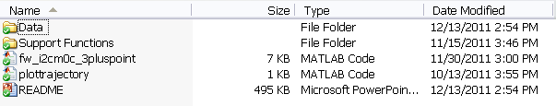
Readme Notes
The algorithm performs fairly well in data sets where the anatomy is continuous. However, region growing field map estimation fails in anatomies such as the heart (data provided by Peter Kellman), due to large air (no signal) areas (e.g. lungs).
Hernando’s graph cut method for field map estimation is more robust in these cases.
Directory tree:
  ../ test_fw_i2cm0c_3plupoint*.m
    Once implemented, code will add path for ../Support Functions and ../Data
  ../Support Functions
    Ancillary support functions are all kept here
  ../Data
    Input .mat files should be kept here
    There is currently a zip file there with a variety of test .mat data sets.

Slide 3
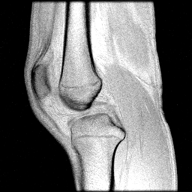
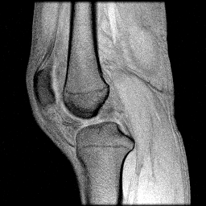
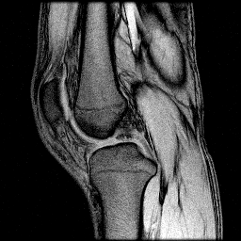

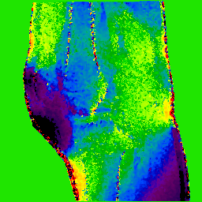
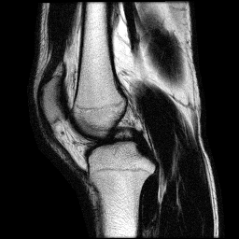
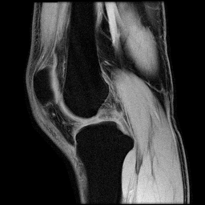
INPUT (structure)
imDataParams.images [Nx Ny Nz Ncoils N_TE]
imDataParams.TE
imDataParams.FieldStrength
imDataParams.PrecessionIsClockwise
test_fw_i2cm0c_3pluspoin*t.m
load_data.m
Modify this to load new data in ../Data subfolder
Voxel Independent or Region Grow IDEAL?
RG
Voxel Independent
getlowresdata.m
BOTTLENECK
Good place to ask students to find novel ways to speed up
code
run_ideal.m
run_ideal.m
Fieldmap Estimate
regiongrowloop.m
final_wf_decomp.m
OUTPUT
RG square spiral out trajectory
of last implemented slice (just for fun)
OUTPUT (structure)
output.mat
outputParams.water
outputParams.fat
outputParams.fieldmap
plottrajectory.m

