Slide 1
Is Ruby on Rails ready for Business ?

Slide 2
Is Ruby on Rails ready for Business ?
What do you think?

Slide 3
Is Ruby on Rails ready for Business ?
What do you think?
What will you think tonight?

Slide 4
Wiki & Wireless
www.rubyonrailscamp.com (MaxWiki)
  Keep adding to the wiki: session notes, ideas, links, etc. The Wiki will be our reference, and information for the community.
Tag: use RoRCamp

Slide 5
Food & Drinks
Free Lunch: Cafetaria (thanks, IBM!)
Barista: until 2pm (thanks, BlueBox!)
Snacks…
Afterwards: Sushi/Teriyaki
@ Sushi Boat (cash bar)

Slide 6

Sponsors

Slide 7



(866) 518-YARD (9273)
You write it. We run it.
Reliability, Ease of Use, and Scalability.
We are your operations staff!
People
• Fully managed 24/7.
• Proven Rails experts.
• We’ll support you now and 5 years from now.
Technology
• Clustered architecture provides high reliability and scalability.
• Simple point & click web control panel.
What our customers say!
Amen! Thanks for everything -- we really appreciate it. You guys are pros.
Sam Dorman, TheBallot.org
The great thing about Engine Yard is having people like Ezra and Tom supporting us.
Jim Greer, CEO of Kongregate
www.engineyard.com

Slide 8




Sponsors

Slide 9
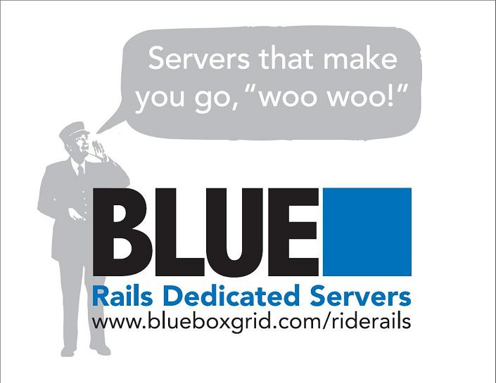
Sponsors

Slide 10




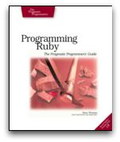

Sponsors
RoR Boot Camp – Atlanta Dec 11-14th

Slide 11
Schedule
9-9:45 Opening
10-11 Session 1
11:15-12:15 Session 2
12:30-1:30 Lunch
1:30-2:45 SpeedGeeking !!
3:00-4:00 Session 3
4:15-5:15 Session 4
5:30-6:00 Closing
6:45 Dinner

Slide 12
Prizes!

Slide 13
What is more valuable – Carbon or Silicon?

