Slide 1


Modeling of retrovirus budding
The roles of dimensionality reduction and cooperativity in a rule-based model of Gag assembly
Presentation by: Justin Gray
Dr. Margaret Johnson’s Lab
Notes:
Hi everyone, my name is Justin Gray. I did my first rotation in Dr. Margaret Johnson’s lab. I will be presenting on the modeling of retrovirus budding and specifically the roles that dimensionality reduction and cooperativity play in a rule-based model of Gag assembly.

Slide 2
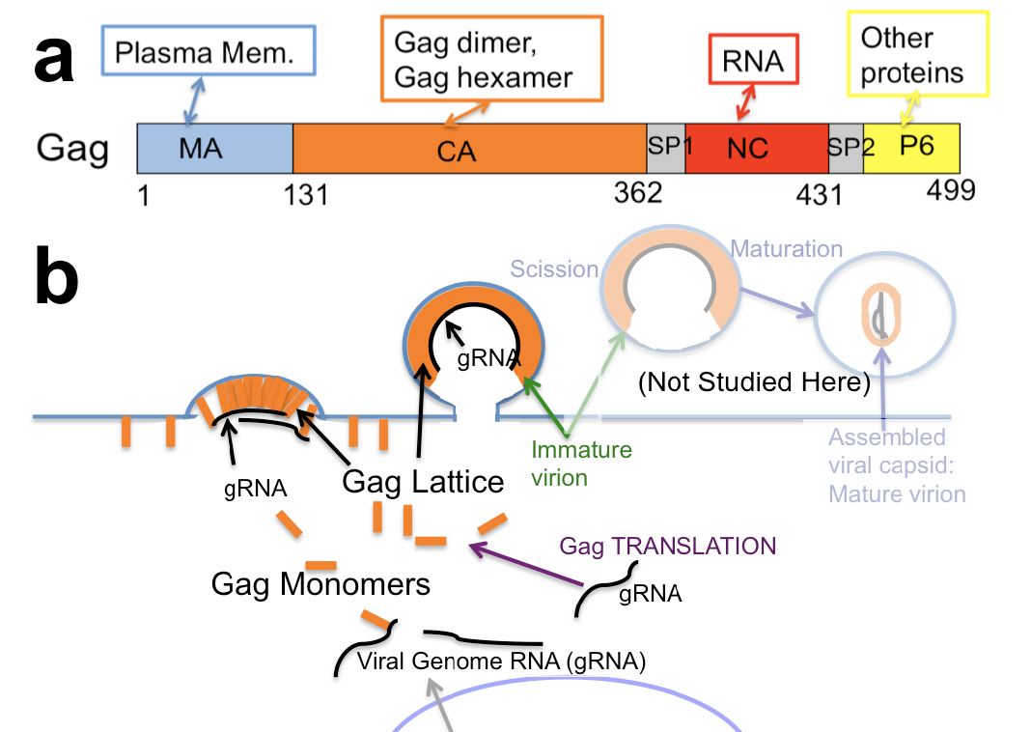
2500 Gag molecules
Dimensionality reduction (PIP₂)
Notes:
As a general overview of the gag assembly pathway, the viral RNA is first used as a template to produce Gag monomers. These bind to PIP2 on the membrane. The tethering of Gag to the membrane causes a dimensionality reduction, where the Gag molecule is now searching in a two dimensional plane rather than three dimensional. This results in an increase rate of lattice formation on the membrane. Once 2500 of these Gag molecules bind they form an immature virion and bud. In this model we only simulate lattice formation until it hits 2500 Gag molecules, then the complex is deleted form the simulation.

Slide 3
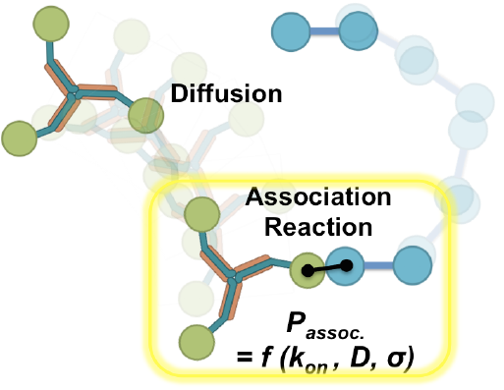
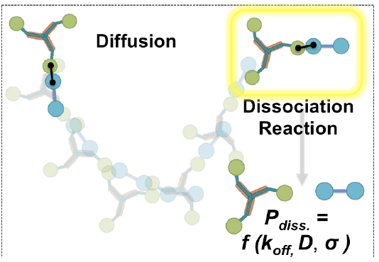
Gag has multiple binding domains
Many binding rates are unknown
Reaction-diffusion will bring in spatial resolution
A toy-model will allow for parameter sweeps
Notes:
Gag has multiple domains that facilitate budding, included a plasma membrane domain that binds PIP2. A self-interacting domain that allows Gag to dimerize and hexamerize. As well as a RNA binding domain that binds different secondary structures of RNA with both high and low affinity. Modeling this system is important because many of the binding contants have not been experimentally determined and these need to be known to do more comprehensive models such as reaciton-diffusion, which brings in spatial resolution. To facilitate this process we did parameter sweeps to determine how the different parameters impacted lattice formation

Slide 4
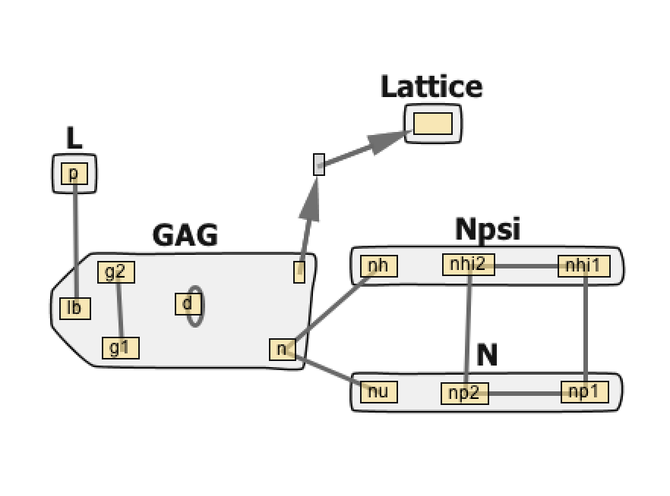
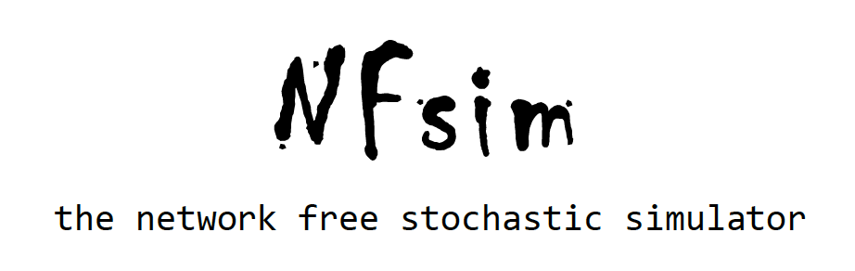
BioNetGen (BNGL)
Model
Language Nfsim uses to define reaction rules
A + B --> A.B. (rate)
Lattice
PIP₂
Gag
Psi (high)
Simulates large protein networks well
Long time scales
Non-spatial
TARpolyA (low)
http://michaelsneddon.net/nfsim/
Notes:
To simulate the system I designed a model using BioNetGen which allows you to give it molecules such as A and B and have them bind at specific rates. This model was then ran on Nfsim which is a network free stochastic simulator. Importantly this simulator is able to handle large protein networks and polymers, and can simulate reactions at long time scales. However, space is not captured. The model I built is on the right. Gag has multiple domains, with the polymerization domain here, the PIP2 binding domain here,the dimerization domain, and the RNA binding domain. As you can see the RNA is made by forming a heteropolymer with both high and low binding molecules that oligomerize. Also once enough Gag molecules have bound together, a lattice is created and the Gags are deleted from the simulation.

Slide 5
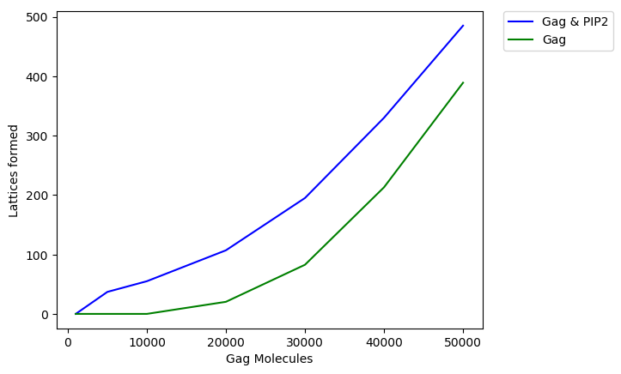
Dimensionality reduction is captured in the model
10 seconds are simulated in all experiments
Notes:
This plot shows the amount of lattices formed over 10 seconds of time simulated when dimensionality reduction is included. This is represented by the blue line where both Gag and PIP2 are present and the green line represents the absense of the lipid binding partnet. On the X axis, there is an increasing amount of Gag molecules. I hope you can appreciate that adding in dimensionality reduction results in more lattices being formed.

Slide 6
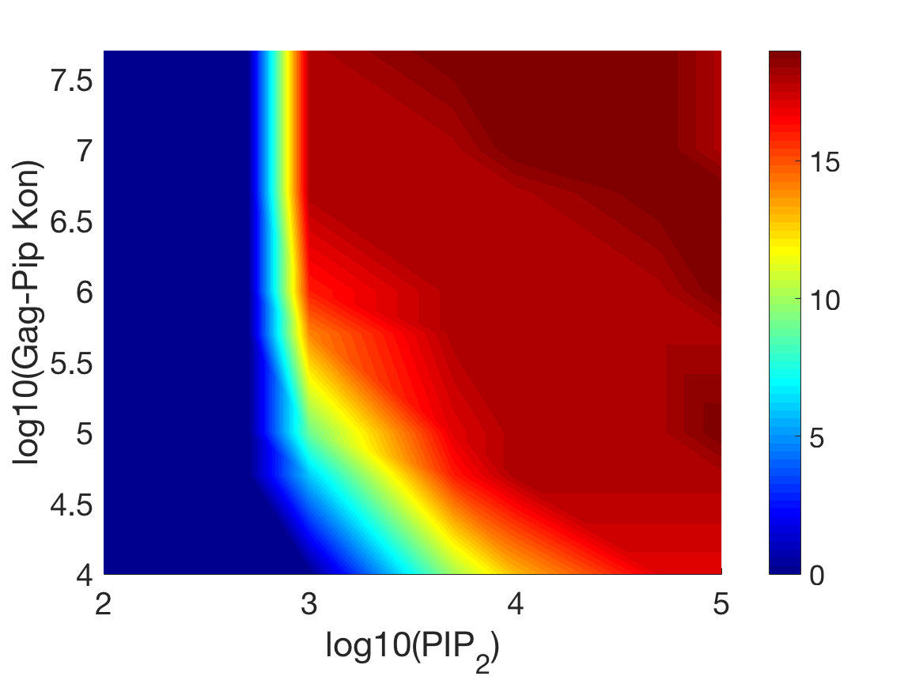
Gag-PIP₂ binding and PIP₂ concentration influence lattice formation
Lattices Formed
Notes:
This is a phase diagram showing the effect that changing PIP2 concentration and the Gag-PIP binding rate have on lattice formation. Of interest, when the binding rate is higher, there’s more of an on-off behavior of lattice formation, however when it is lower, the formation varies across a larger PIP2 range. Some studies have shown the Gag-Pip Kon value to be around to 10^6 mark which lends support to on-off nature of lattice formation in regards to lipid binding.

Slide 7
Gag-PIP₂ binding and PIP₂ concentration influence lattice formation
Lattices Formed
Notes:
This is a phase diagram showing the effect that changing PIP2 concentration and the Gag-PIP binding rate have on lattice formation. Of interest, when the binding rate is higher, there’s more of an on-off behavior of lattice formation, however when it is lower, the formation varies across a larger PIP2 range. Some studies have shown the Gag-Pip Kon value to be around to 10^6 mark which lends support to on-off nature of lattice formation in regards to lipid binding.

Slide 8
Gag-PIP₂ binding and PIP₂ concentration influence lattice formation
Lytic
vs
Lysogenic?
Lattices Formed
Notes:
This is a phase diagram showing the effect that changing PIP2 concentration and the Gag-PIP binding rate have on lattice formation. Of interest, when the binding rate is higher, there’s more of an on-off behavior of lattice formation, however when it is lower, the formation varies across a larger PIP2 range. Some studies have shown the Gag-Pip Kon value to be around to 10^6 mark which lends support to on-off nature of lattice formation in regards to lipid binding.

Slide 9
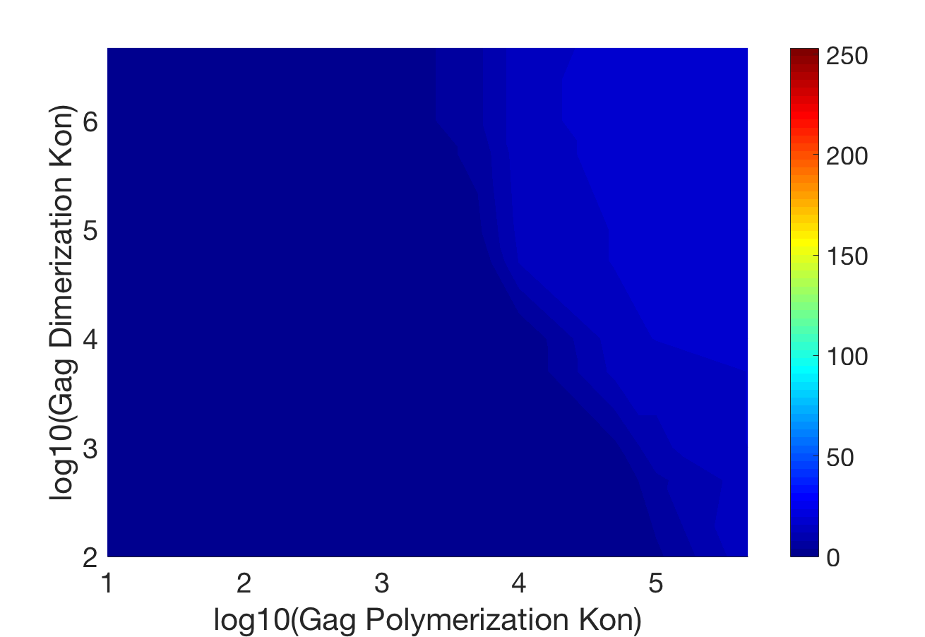
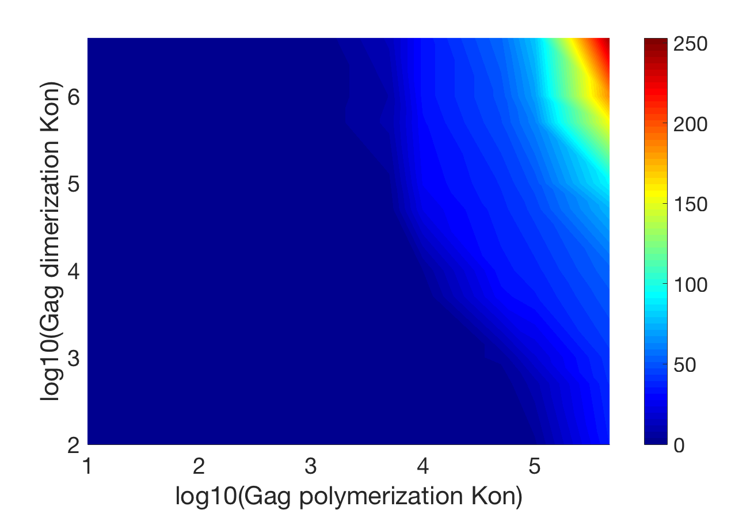
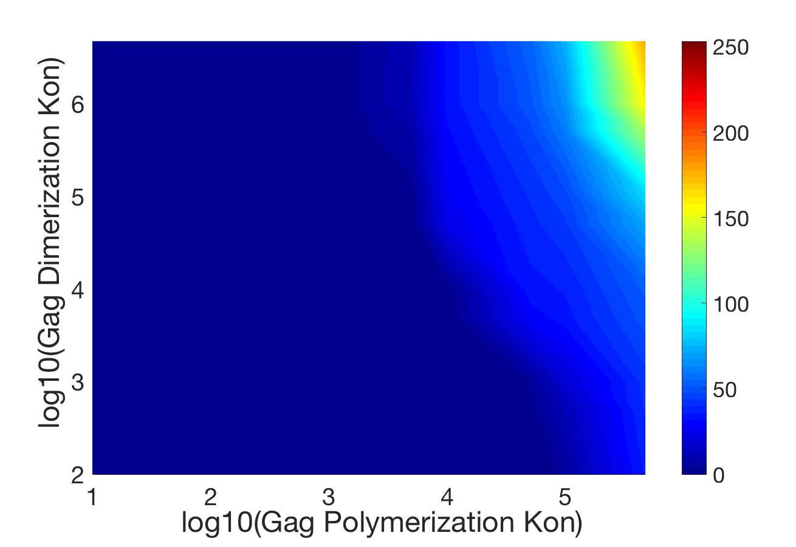
Gag dimerization, polymerization, and production rate all impact lattice formation
1000 Gag*s⁻¹
100000 Gag*s⁻¹
Lattices Formed
Lattices Formed
10000 Gag*s⁻¹
Lattices Formed
Notes:
I also wanted to characterize the self-interactions of Gag, specifically how Gag polymerization, dimerization, and rate of Gag production impact lattice formation. Interestingly, these factors have to be above a certain threshold for lattice formation to occur. Gag production rate also has a particularly potent effect on lattice formation, going from around 18 lattices formed max on the left up to 250 on the right. Notably, this is with the amount of Gag capped in the system to reduce computational intensity, yet it would be important to see what changes would occur when it isn’t capped.

Slide 10
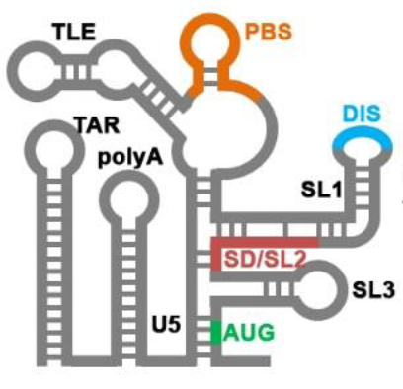
Gag-RNA interactions
High (Psi) and low (TARpolyA, etc..) binding affinity regions.
Possible cooperativity between Gag and RNA binding
Psi
Erik Olson et al. (2015) Viruses
Notes:
Gag-RNA interactions were the next point of study because it bears some of the most interesting points of study. Gag’s interaction with RNA can be either high or low affinity depending on the region of RNA bound, with Psi representing the high binding affinity and TARpolyA representing the low binding affinity. Of interest, some publications have shown that Gag binding to RNA might induce a conformational change that increases binding affinity for other Gags. This cooperativity between Gag and RNA is one of the behaviors that I sought to capture in the model.

Slide 11
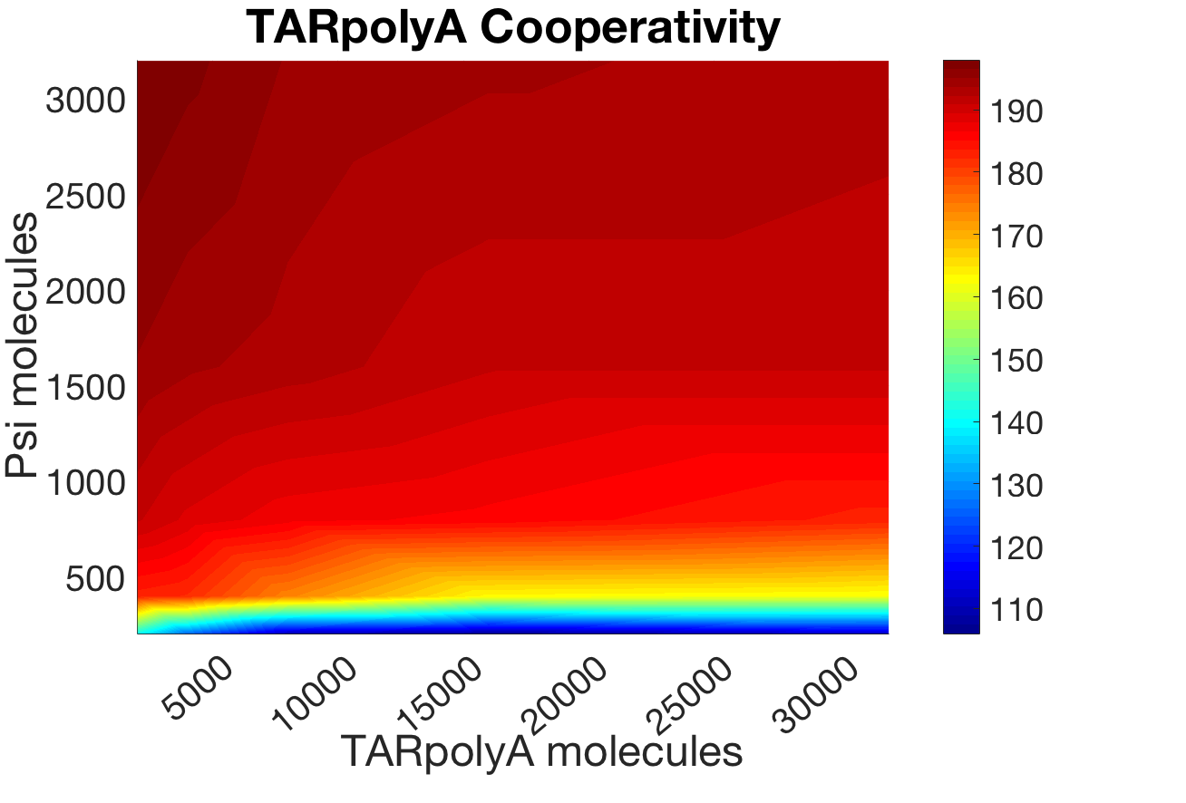
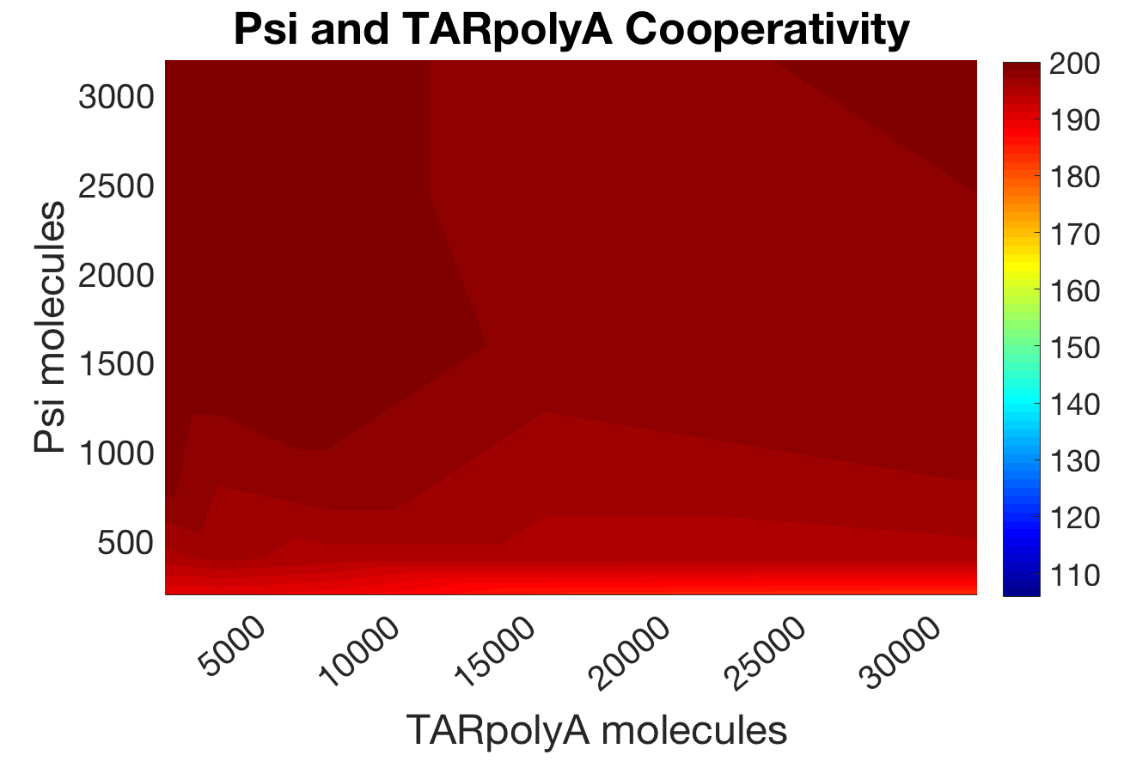
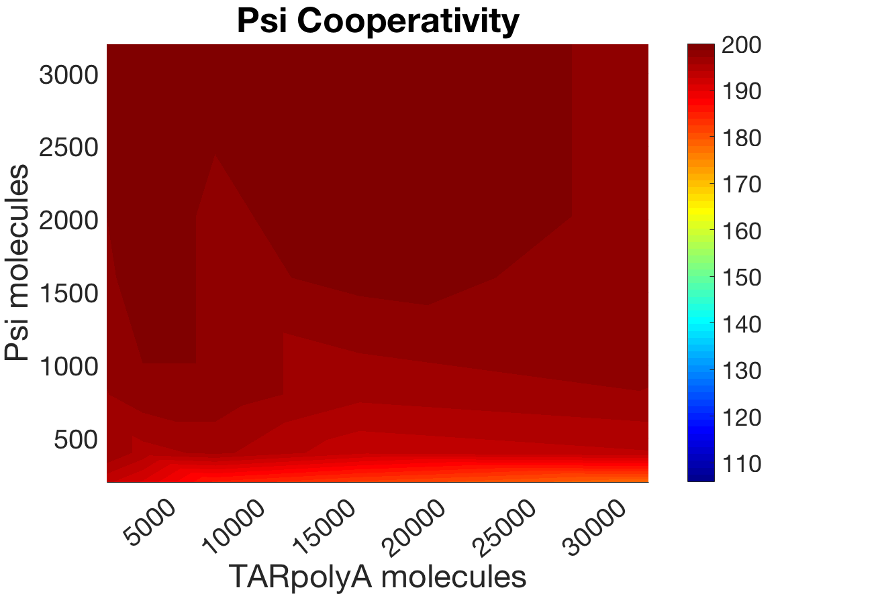
Does RNA cooperativity increase lattice formation?
Lattices Formed
Lattices Formed
Lattices Formed
No cooperativity: 42 Lattices formed
Notes:
I included low and high binding cooperativity in different models and also put them together in one model. In the TARpolyA cooperativity model you can see that there’s a sharp decrease in lattice formation when you decrease the Psi molecules but this isn’t observed in the other two models. The increase in lattice formation at higher Psi concentrations may have been due to an increase rate of gRNA binding to Gag on the membrane, which confers dimensionality reduction for the RNA as well. Interestingly all models reach a similar equilibrium when the Psi molecules are increased, and this equilibrium is around 3 fold higher than the model that did not include cooperativity. In the future it will be important to do a larger range of values to determine if the number of TARpolyA binding sites has an effect on lattice formation.

Slide 12
Conclusions
The model captures dimensionality reduction
PIP₂ mediated lattice formation is likely an all or nothing event
Dimerization, polymerization and production rate of Gag all influence lattice formation
RNA cooperativity shows interesting observations

Slide 13
Acknowledgements
Margaret Johnson
David Holland
Matthew Varga
Sewwandi Rathnayake
Dariush Mohammadyani

Slide 14
Future directions (for lab)
Look into Gag-pol and see if that has different binding rates/functions
Make Gag polymerization stop at 6 Gags (to form hexamers)
Do a different range for Psi and TARpolyA for cooperativity
Psi is not the only high affinity domain and TARpolyA is not the only low affinity
Gag can also bind mRNA so add that in there
Most of all, do these simulations using a super computer and run the simulation with cellular volumes and concentrations of gag/pip/rna.
Try to find if anyone has characterized the binding affinity for the dimerization and polymerization of Gag
Look into the possibility of changes in the pathway between the lytic and lysogenic cycles.
Contact me @ gjustinmgray@gmail.com if there are any questions.

Slide 15
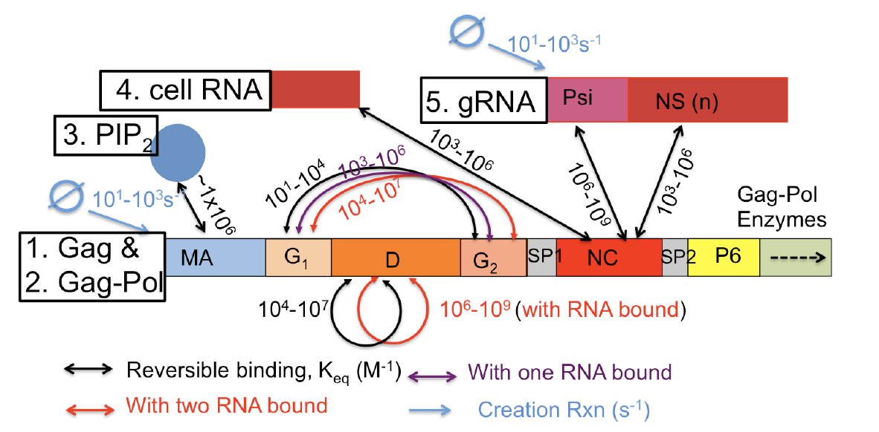

Slide 16
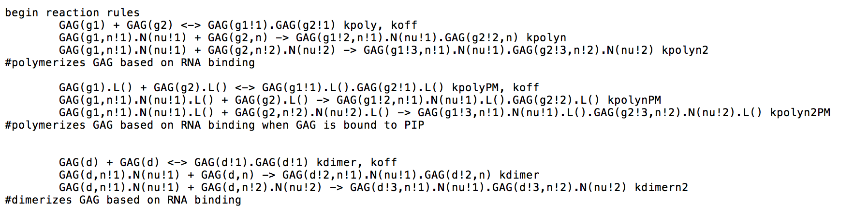

Slide 17
