Slide 1
Intergalactic Defenders
Team 8:
Alexander Gambino
Constantino Mamani Violeta
Pawel-Stanislaw Obiedzinski
Maksym Perepichka

Slide 2
What is it?
3-D space shooter game
Dodge asteroids and enemy droid’s projectiles
Destroy enough enemy droids to move on and defend the next planet

Slide 3
Main Menu
Create texture to be used for main menu using photo editing software.
Final implementation will include selectable buttons to start game and adjust difficulty.
Difficulty settings will scale the projectile and enemy speeds by a factor.

Slide 4
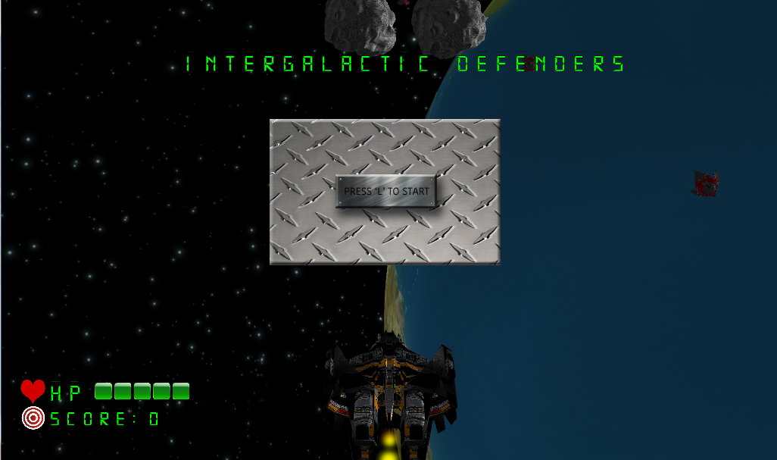
Main Menu

Slide 5
User Interface/HUD
UI is handled by 3 classes: Font class, Health Bar class and 2D Icon class.
2D Icon class loads textures and allows the texture to be displayed at a static position, always facing the camera.
Font class loads a texture atlas for a font and calculates UVs to select specific characters from the texture atlas and display them.
Health Bar class handles HP logic and displaying HP on the HUD.
2D Shader applied to Font and UI Icons.

Slide 6
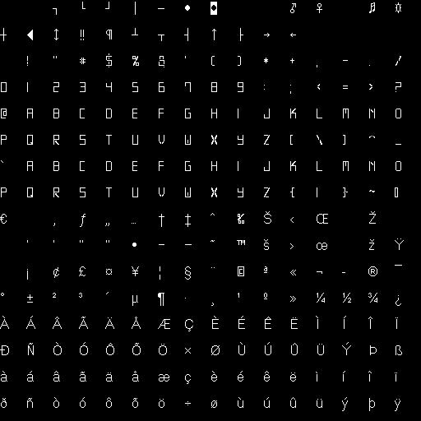
Font Texture Atlas

Slide 7
Follow Camera
Stationary Camera
With Look At Vector
Updated Towards the Player Ship

Slide 8
Textures
Using the FreeImage Library
Avoiding Repetitive Loading of Textures by Recycling Texture Buffers

Slide 9
Models
Using the AssImp Library
Recycling Mesh VBO for Repetitive Models

Slide 10
Bloom
Achieved by Comparing Adjacent Texture Samples from the Frame Buffer
And Altering Texel Color to Light Intensity of the Sampled Texture

Slide 11
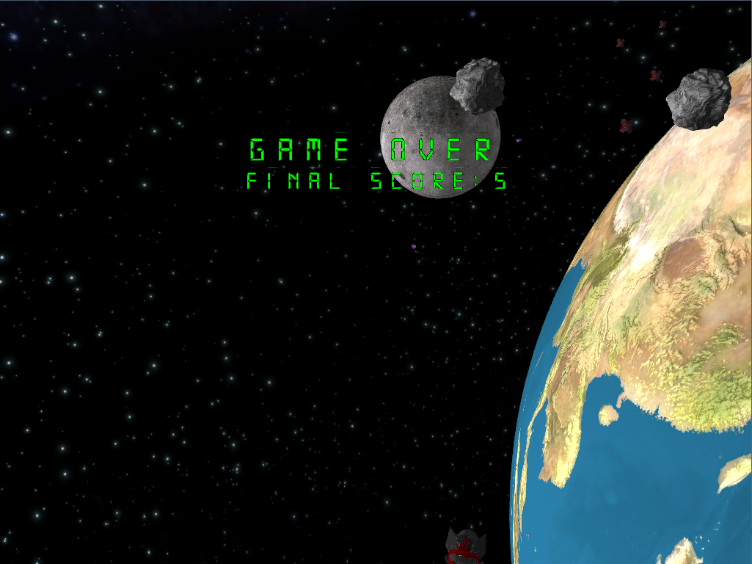
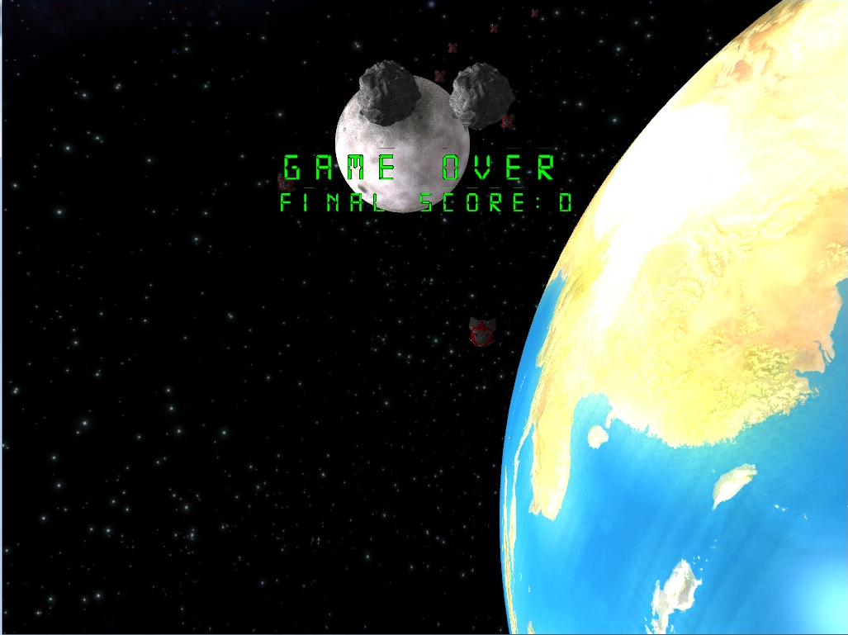
Bloom

Slide 12
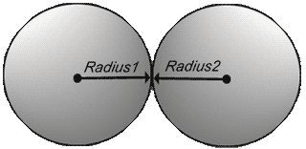
Sphere Collison

Slide 13
Sphere Collison
Achieved by Calculating distance Between Center of Models
And Comparing Distance to Summed Radius

Slide 14
Ship Disintegration
Upon the Player Death, the ship is set to Disintegrate
Achieve by Displacing Model Triangles in the Direction of Their Normal Vectors

Slide 15
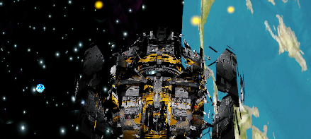
Ship Disintegration

Slide 16
Background
The background is a series of rotating planet models.
Achieved by having models rotate around themselves as well as rotate around the world axis.

Slide 17
Background

Slide 18
Movement
Right-left movement: A and D keys displaces the ship left and right, between a range of values.
Right left movement banks the ship, achieved by rotating the ships around the Z axis

Slide 19
Movement (contd.)
Acceleration and deceleration achieved by adjusting the speed of the background and enemies.
The ship doesn’t move in the Z-axis, it is all an illusion!

Slide 20
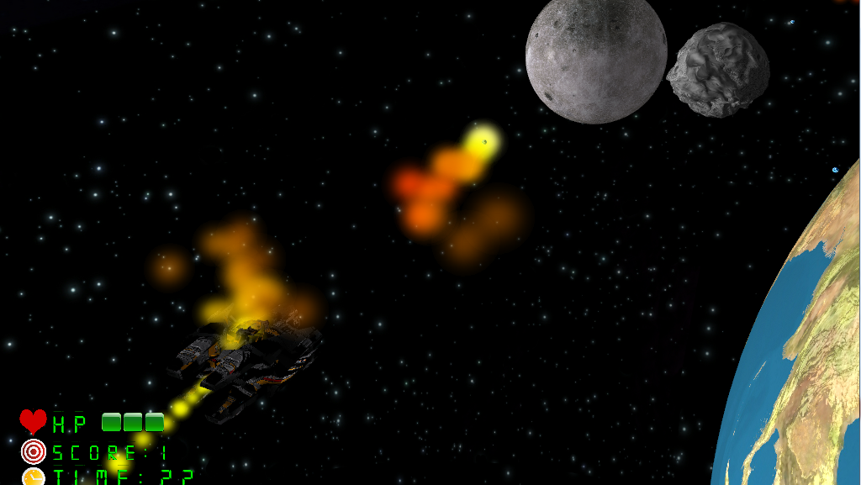
Movement (contd.)

Slide 21
Level framework
Multiple levels achieved by having multiple scenes and reinitializing World.
Levels can have their own axis of rotation, self rotation and orbit rotation constants, etc. Very powerful effect…

Slide 22
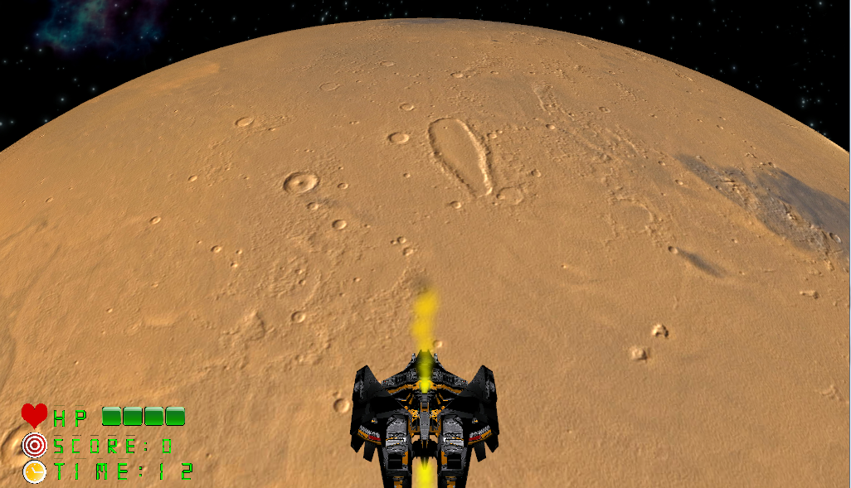
Level framework

Slide 23
Lighting
Since the player doesn’t actually move, the world light must rotate with the sun.
Gives the effect of dynamic lighting.

Slide 24
Generating enemies and their positions
Enemies and other objects such as meteors are created and placed randomly in the space.
However, we have borders, and they shouldn't appear outside of it. Then each enemy move toward the player at specific velocity.
Once they pass the player, they will be moved back randomly making it a new enemy or object. I didn't make the projectiles and their positions.

Slide 25
Enemy Explosion
When only have one particle emitter for the explosion because we can only shoot one enemy at the time since the fireball is linear.
So when an enemy dies, we set the position of the explosion where that enemy is and then few second after either the particle emitter is placed on another enemy or is removed from view.

Slide 26
Player Explosion
The player starts at full HP, as it continues to take damage and lose HP the player releases particles at a rate that increments according to the damage taken. This simulates explosions on the player ship.
For this, there are 3 particles emitters that are called depending on the HP. Each has different particle descriptor. Once the HP is empty, then the player ship explodes.

Slide 27
Player's Fireball
The player automatically shoots fireballs in a linear direction and if they collide with the enemy, then it explodes.
The fireball is a particle emitter that uses particle descriptor for the effect. There are as many fireballs as there are player projectiles. Basically, the projectile is on fire.

