Slide 1
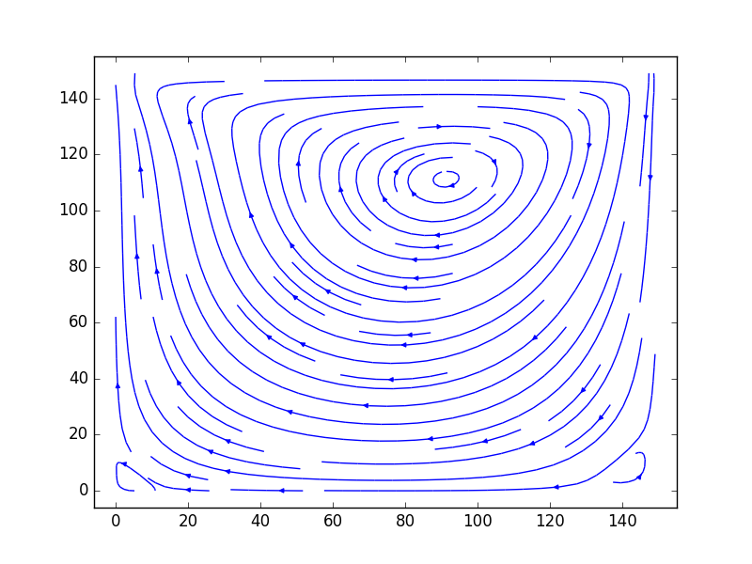
Lattice Boltzmann on DFE
This app demonstrates a simple fluid dynamics algorithm on DFE.
Concepts such as muxes and stream offsets are demonstrated in the context of a fixed grid Finite Difference Type simulation.

