Slide 1
Lattice Boltzmann on DFE

Slide 2
Lattice Boltzman
The lattice Boltzmann method (LBM) is a finite difference type algorithm for fluid dynamics at the mesoscopic level.
Instead of treating a fluid as a macroscopic field, probabilistic distributions of fluid particles are modelled.
Distributions of particles flow and collide and the macroscopic fluid variables are observed as emergent behaviour.

Slide 3


The Boltzmann Equation
The Boltzmann gas equation model the behaviour of a distribution of particles as a pair of processes, free flight and some collision integral.
There are many models for a collision integral but the simplest is relaxation to a local equilibrium.
Navier-Stokes equations may be recovered from the Boltzmann equation via integration.

Slide 4

Discretization
The Boltzmann equation may be relatively simply discretized onto a regular grid, giving the lattice Boltzmann Method.
Navier-Stokes equations is now recovered by summation (with some discretization errors).
Many variations exist to generalize the physics or improve stability.

Slide 5
Offsets and muxes in lattice Boltzmann on DFE
In lattice Boltzmann particles fly from one lattice site to another, this is achieved on DFE by stream offsets.
Near walls particles may come from different directions (they bounce off walls).
The DFE pipeline must mux between all the possible direction a particle came from

Slide 6
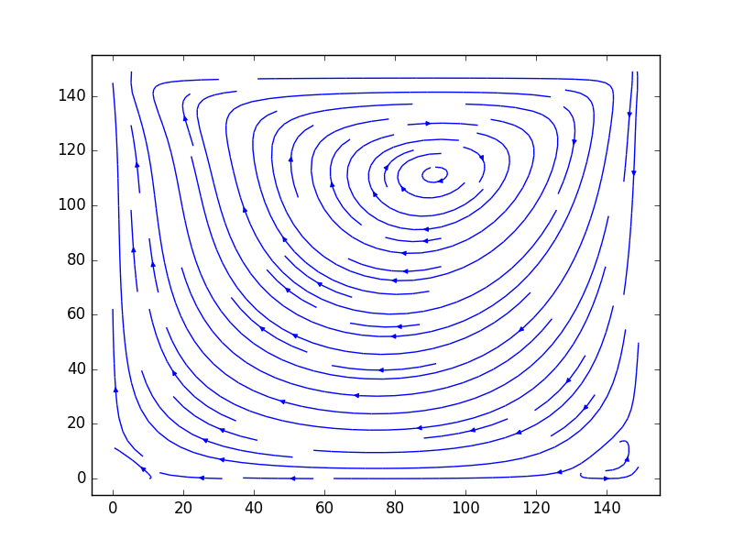
Lid Driven Cavity
To demonstrate lattice Boltzmann on DFE we can use the simple lid driven cavity example.
A 2D fluid in a box has its motion driven by one boundary (the lid).
This causes the fluid to spin inside the box and at low viscosities generates a turbulent flow where vortices are shed.

