Slide 1
Player Performance Predictor
for Daily Fantasy Football

Slide 2
Context
$203 Billion Industry in 2020
Growing
Random… or is it?

Slide 3
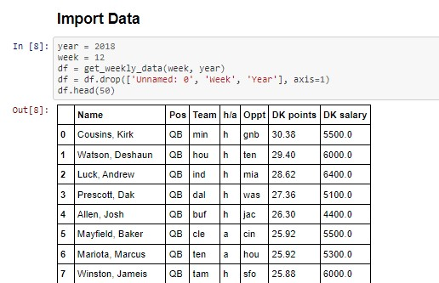
Data
Sources:
Draftkings.com
Pro-football-reference.com
Rotoguru.net

Slide 4
The Problem
Growth
Popularity
Difficulty
Profitability

Slide 5
Solution
Use data to build a model that predicts which players will have a good day and which won’t, increasing odds of winning (and perhaps becoming profitable).

Slide 6
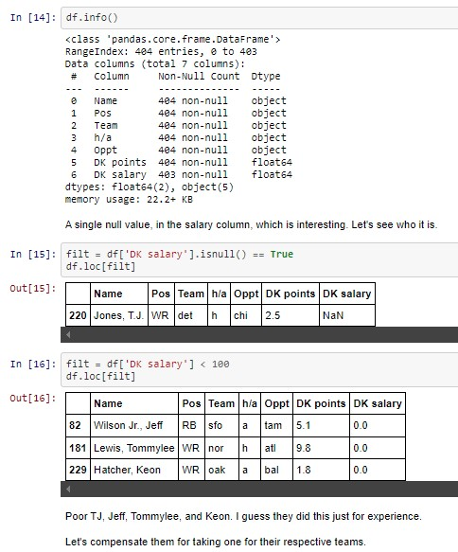
Data Wrangling
Thank goodness for dedicated sports fans!
Biggest hurdle was collecting it all
Scraper
CSVs

Slide 7
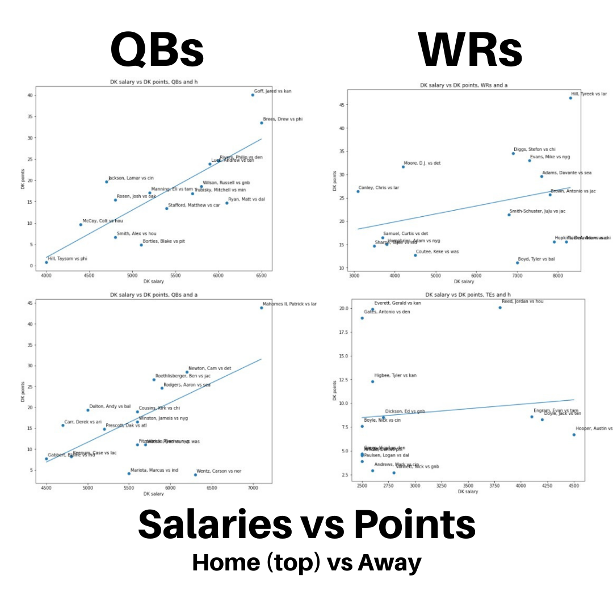
Data Exploration
If spending up is necessary, it makes sense to do it on QBs and RBs (not shown) at home vs anywhere else
Many times though, doesn’t make sense

Slide 8
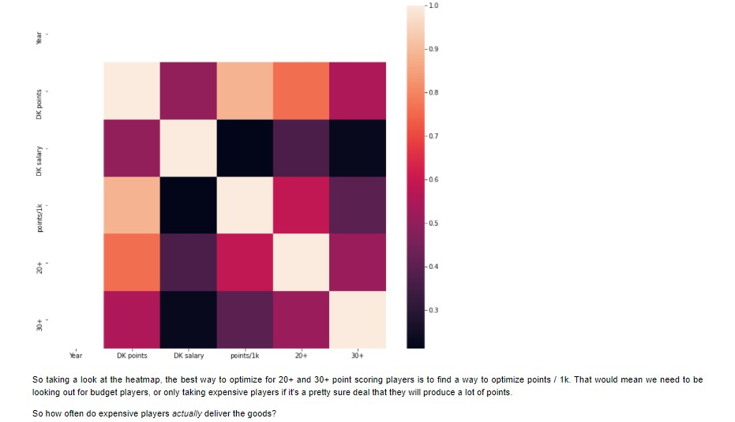
Data Exploration cont’d
20+ point scores correlated most with points / 1k
Suggests moderate price tags are advantageous

Slide 9
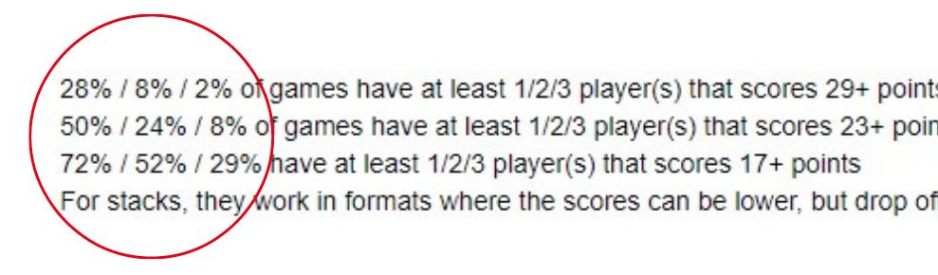
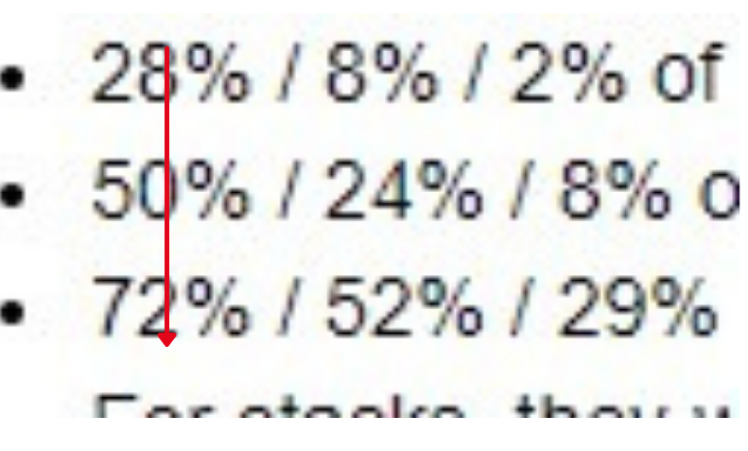
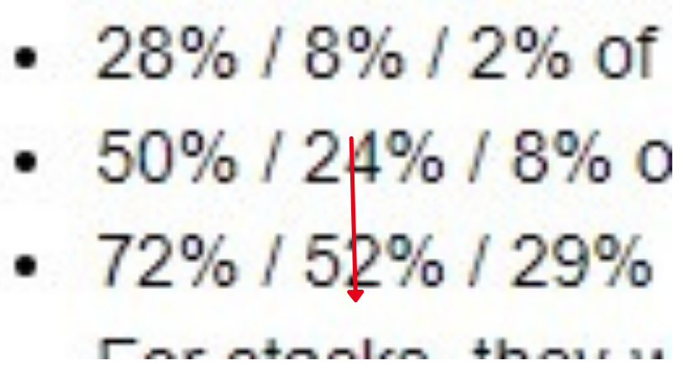
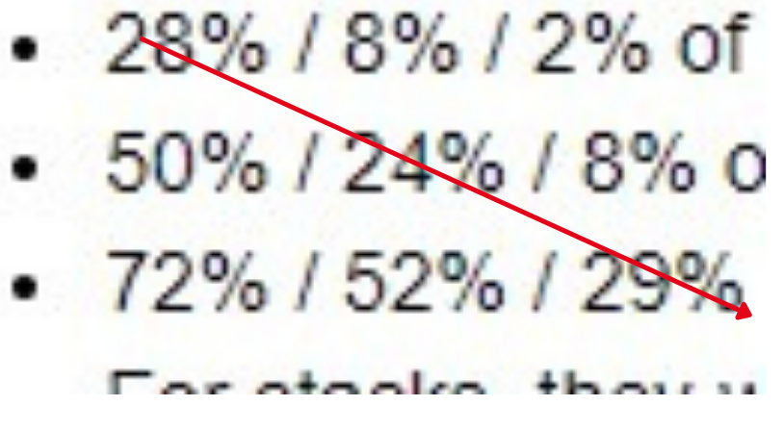
Data Exploration cont’d
Stacking - choosing multiple players from the same team
Most probable, middle points, middle slots… goldilocks.
Least probable, most points, most slots… better off chasing 2%
Deceptive, middle probability, low points, low slots… ignore.

Slide 10
Model Selection
10 models tested
2 chosen
1 filter model - Gradient Boost
1 picking model - AdaBoost

Slide 11
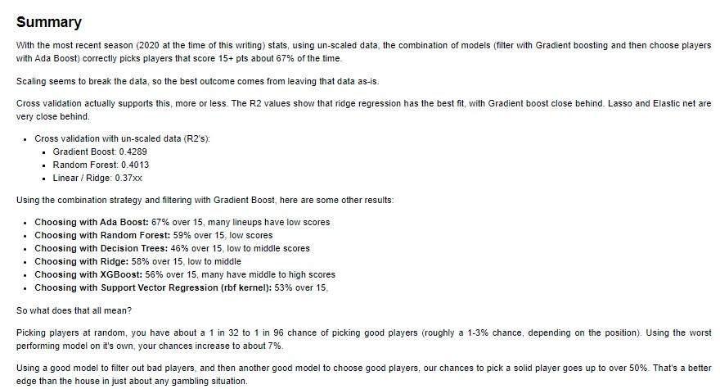
Model Selection

Slide 12
Takeaways
Choose moderately priced players, playing at home
If necessary, spend up on RBs and QBs
Pick players based on matchups, not ability
Stacks seem to work well in lower scoring game types

Slide 13
Future
Paid data
Other sports (MLB, NBA, etc)
College sports (way more data)

Slide 14
Questions?

