Slide 1

HarmonyState
Storage Devices
Alert handling
Why it will work ?
What we together could improve ?

Slide 2
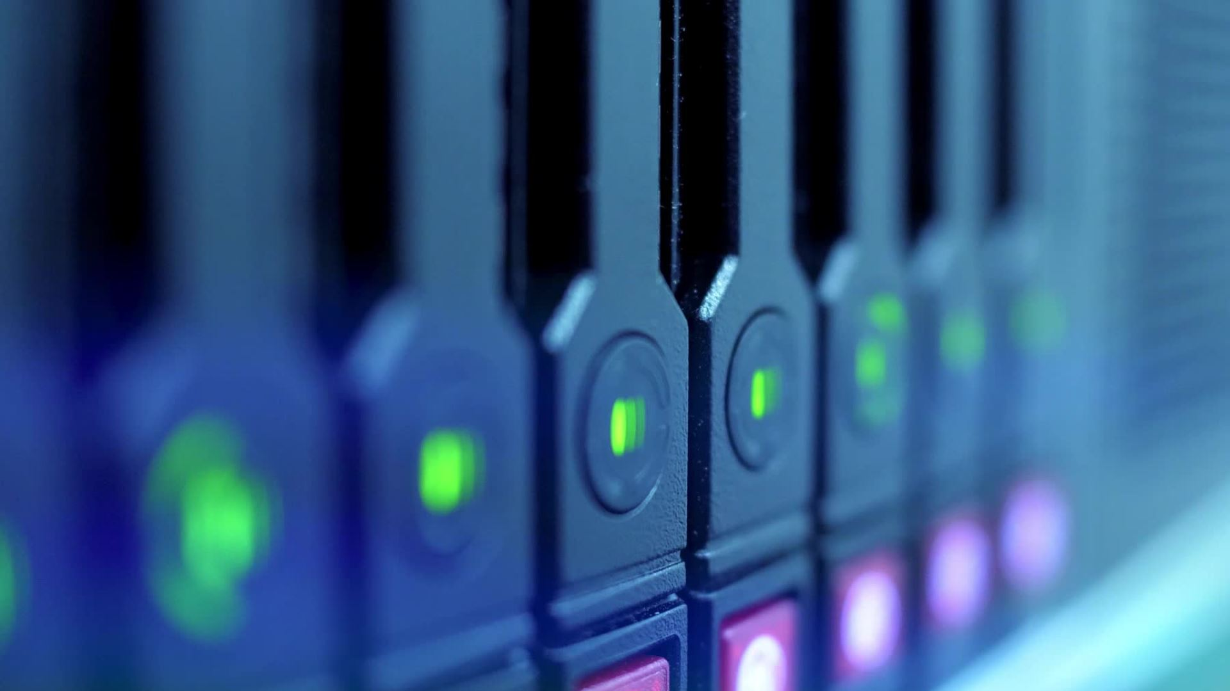
Storage Devices
Large quantity of data
Low reactivity
Not immediate treatement
Datalake​

Slide 3

Alert handling
High reactivity
Must be as efficient as possible
Spark the best solution​

Slide 4
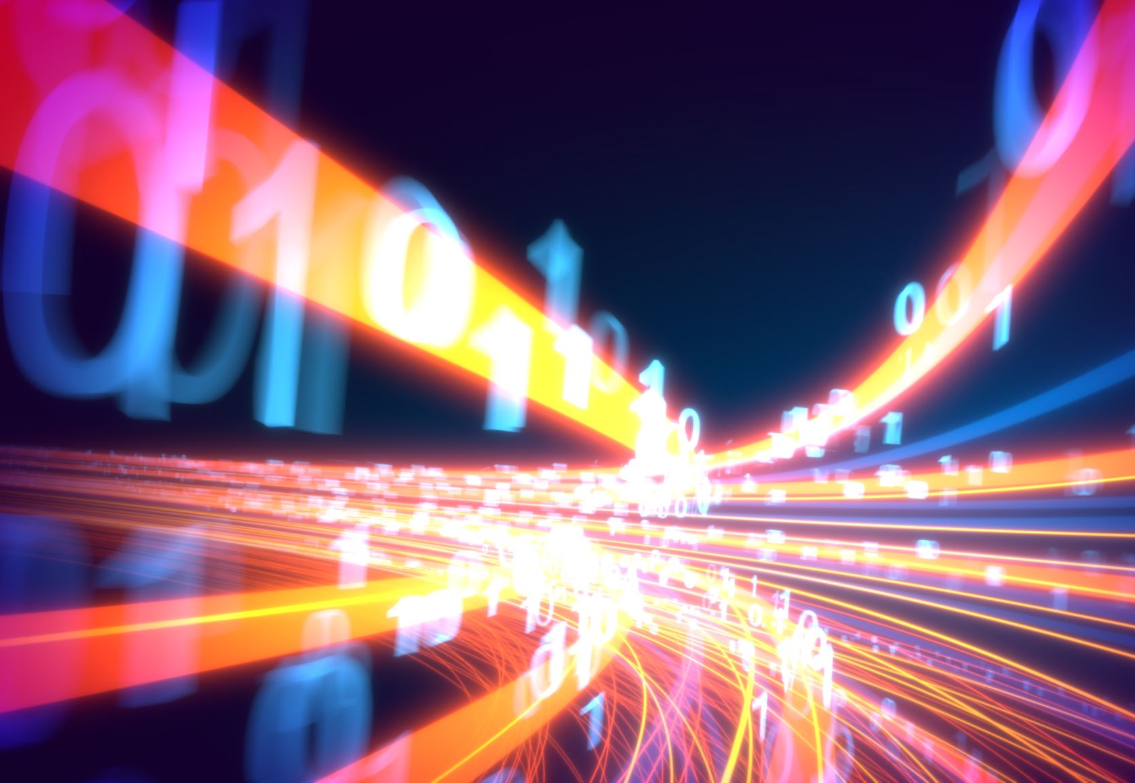
Alert handling
Scalable along a very large stream of data
Big data
The three Vs

Slide 5
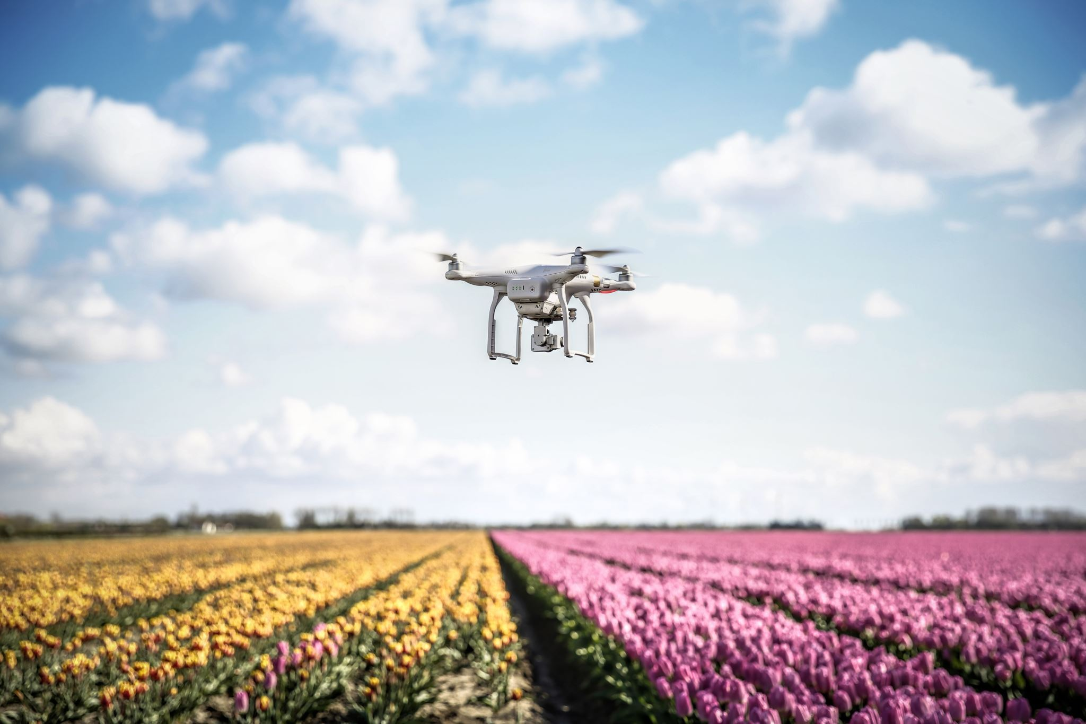
Make the system slightly better
Add an information to the drone's report
Faster handling of alerts
Data handled faster

Slide 6
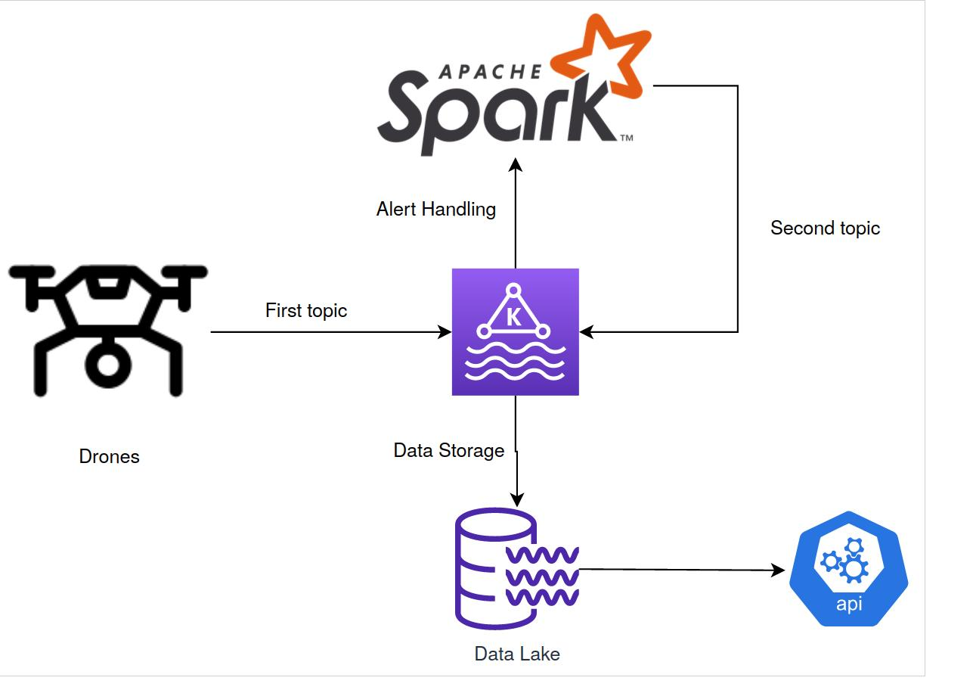
Architecture

