Slide 1
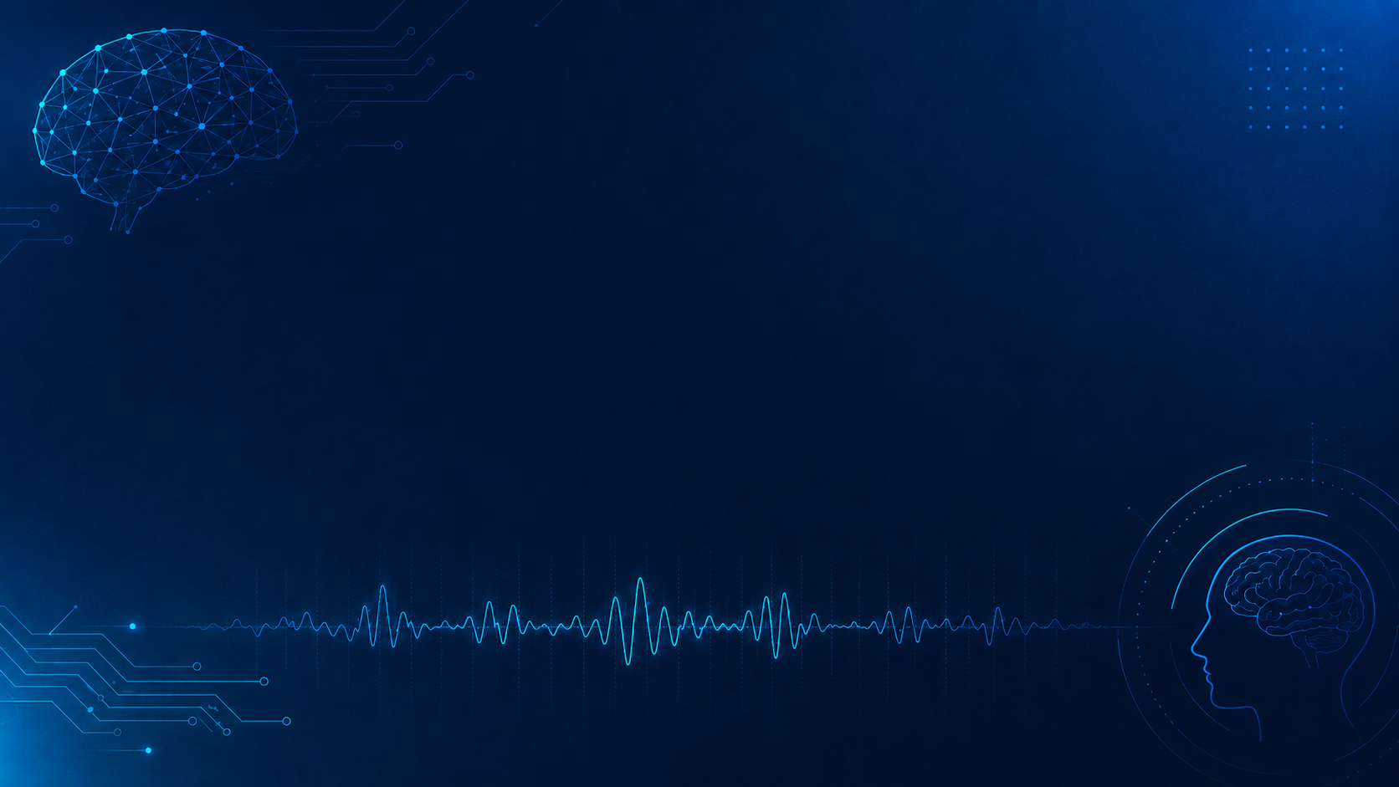
EEG-Experimente und Analyse
Introduction & Overview
Group 5: Grischa Staar, Maximilian Englisch, Jinghao Zhang,
Lawan Mai

Slide 2
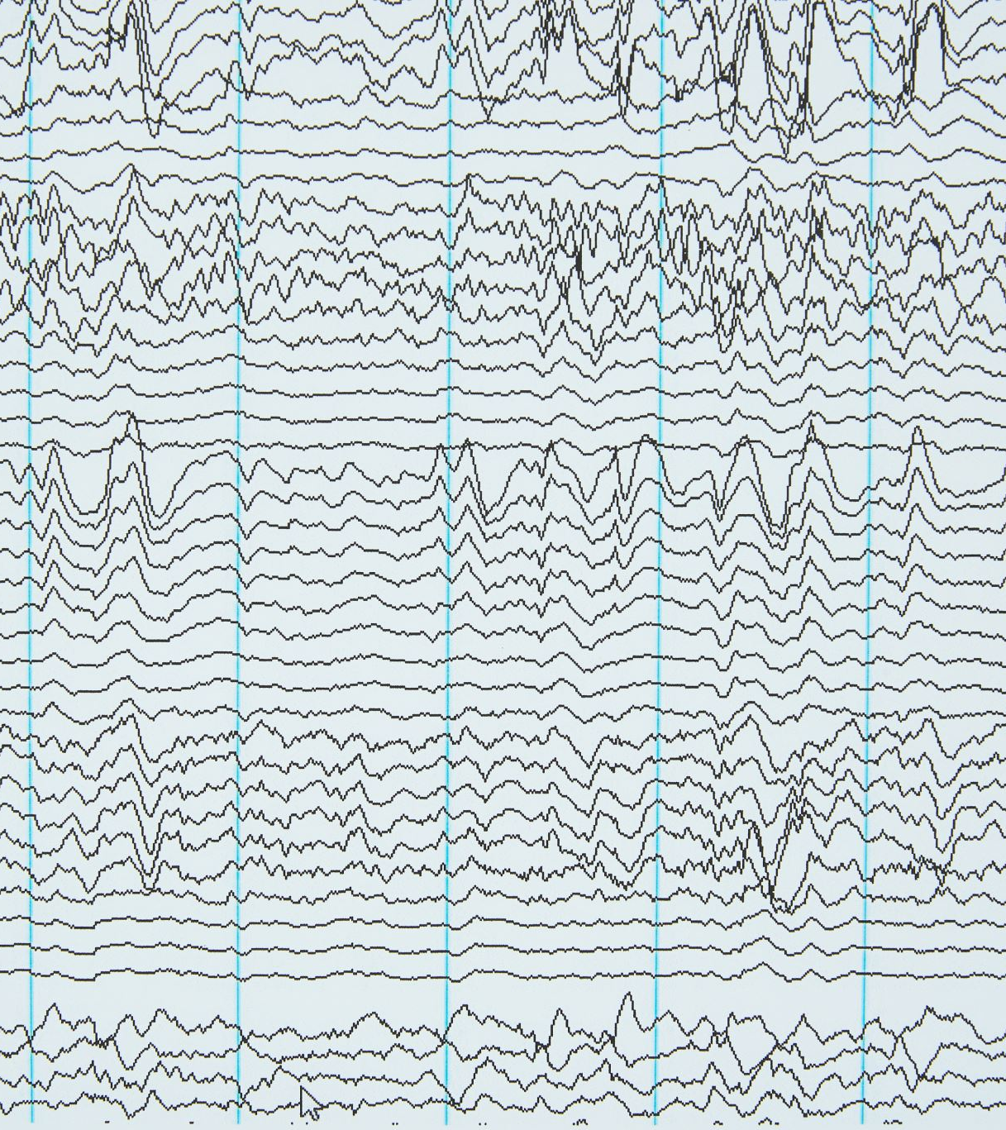
Electroencephalography, EEG
Non-invasive recording of electrical brain activity from the scalp
First used on humans in 1924 (Hans Berger)
Neurons produce electrical signals, EEG can detect activity from multiple synchronized neurons
Signals must be amplified to be displayed and analysed
EEG cannot see "deep" into the brain, only activity of the cortex

Slide 3
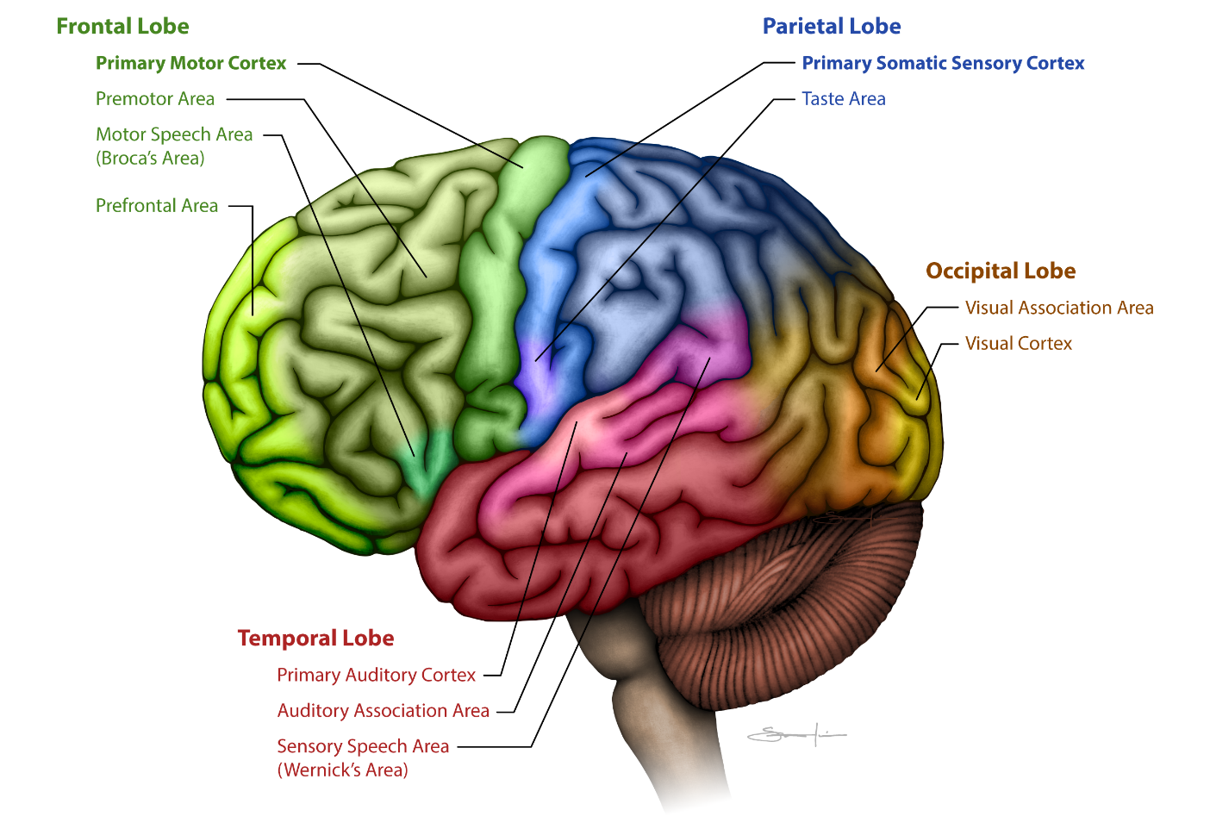

Slide 4
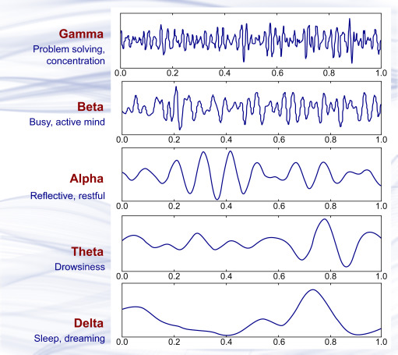
Brain Waves

Slide 5
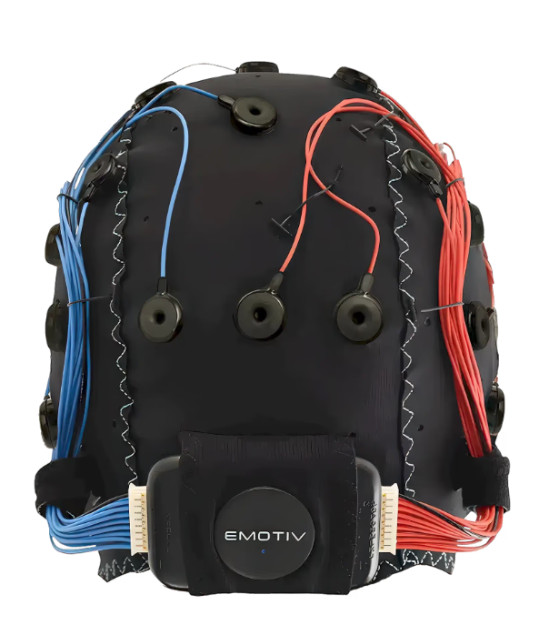
Emotiv Flex 2 Saline

Slide 6
Emotive Flex 2 Saline
Overview
Wireless EEG system for measuring electrical brain activity
Works with saline sensors (saltwater solution)
Connection via Bluetooth
Features
32 silver chloride EEG sensors
Battery life up to 6 hours
Flexible sensor placement on the scalp
Flexible cap size
Limitations
Correct sensor placement is important
Saline solution may dry out over time and reduce signal quality

Slide 7
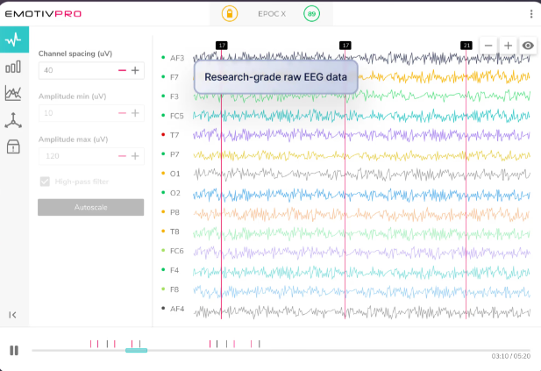
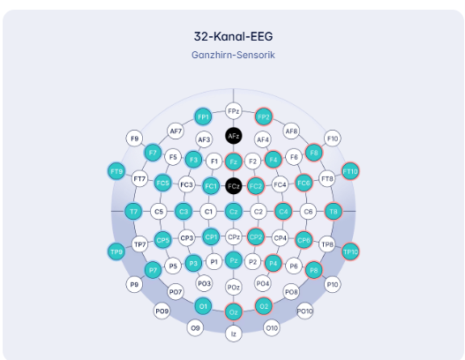
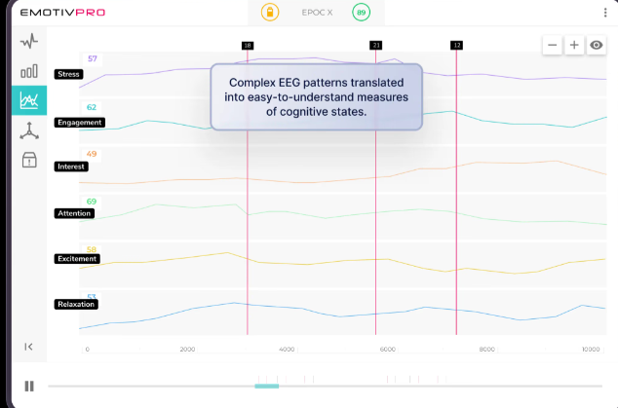
EmotivPRO

Slide 8


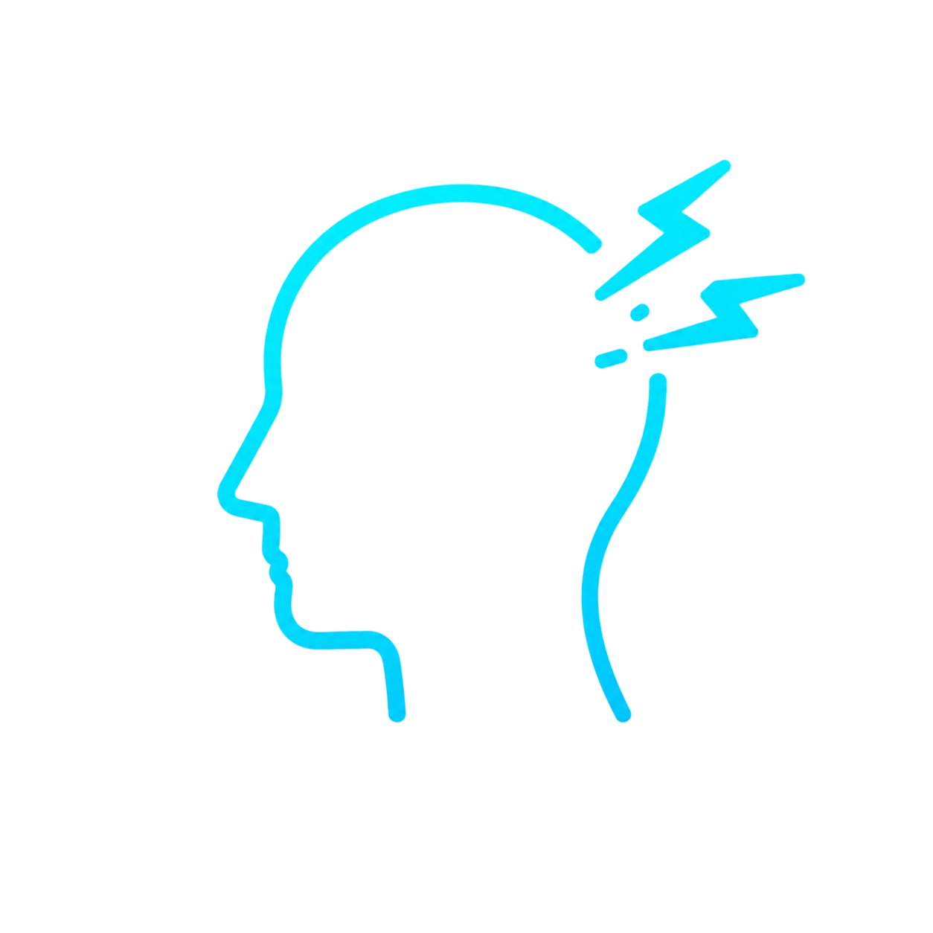

Current Challenges in EEG
1. Low signal-to-noise ratio (SNR)
2. Multiple types of artifacts
3. Limitations of foundation models

Slide 9
Proposed Solutions
Challenge 1: Low SNR
Artifact detection and correction to improve signal quality.
Challenge 2: Multiple artifacts
Use task-specific or hybrid methods
Challenge 3: Foundation model limitations
Integrating brain-inspired algorithms into foundation models

Slide 10
Recent Solution: EEG-X
EEG-X:
Encodes electrode positions
Reconstructs artifact-removed EEG signals
Uses DiCT projection
  compares EEG signals more reliably
  reduces sensitivity to noise
  captures frequency and shape patterns

Slide 11

Possible Experiments
Experiment 1: Studying the Uncanny Valley Effect in AI-NLR via EEG
Setup:
  Presentation of AI-generated videos featuring characters with varying levels of realism (e.g., Realistic, Near-Realistic, Comic).
  The characters read news content (e.g., technical information or weather reports).
  Integrated with diverse audio resources (e.g., high-quality voice clones vs. basic mechanical/robotic voices).
Hypotheses:
  H1 (Incongruence Stress): High visual realism combined with robotic audio leads to significantly higher Stress levels in the participant.
  H2 (Engagement Drop): Incongruent (uncanny) moments lead to a measurable decrease in the Engagement level.
Evaluation:
  Analysis of cognitive patterns using the built-in EmotivPro Performance Metrics (detection of Stress, Engagement, and Interest).

Slide 12
Possible Experiments
Experiment 2: Expert vs. Plain Language in Dialogue
Setup:
  Live dialogue between a "consultant" and the participant (EEG wearer).
  Variable: Use of technical/complex language resources vs. simplified/plain language resources.
Hypotheses:
  H1 (Cognitive Load): Technical jargon leads to excessive Focus levels and eventual mental fatigue.
  H2 (Frustration): Lack of clarity in expert language triggers measurable Stress peaks.
  H3 (Engagement): Plain language resources sustain higher Engagement and social connection.
Evaluation:
  Comparison of Performance Metrics (Focus, Stress, Engagement) in EmotivPro.
  Analysis of Frontal Theta Power as a marker for mental effort.

Slide 13
Possible Experiments
Experiment 2: Expert vs. Plain Language in Dialogue
Setup:
  Live dialogue between a "consultant" and the participant (EEG wearer).
  Variable: Use of technical/complex language resources vs. simplified/plain language resources.
Hypotheses:
  H1 (Cognitive Load): Technical jargon leads to excessive Focus levels and eventual mental fatigue.
  H2 (Frustration): Lack of clarity in expert language triggers measurable Stress peaks.
  H3 (Engagement): Plain language resources sustain higher Engagement and social connection.
Evaluation:
  Comparison of Performance Metrics (Focus, Stress, Engagement) in EmotivPro.
  Analysis of Frontal Theta Power as a marker for mental effort.
! It is also possible to use attention and excitement metrics, as well as conduct experiments with multilingual dialogues. !

Slide 14
Evaluation
Artifact Suppression & Filtering
  filtering for motion artifacts (jaw/muscle activity) and eye blinks to ensure signal purity.
Environmental Noise Control
  identify potential electromagnetic noise from monitors or external hardware.
Baseline Calibration
  Record a dedicated resting baseline for each participant
Precision Event-Marking
  Evaluate data based on timestamps synchronized exactly with the onset of visual or auditory stimuli.
Metric Smoothing & Lag Consideration
  Account for temporal lag inherent in translated metrics compared to raw EEG data.

Slide 15
References
https://www.sciencedirect.com/topics/agricultural-and-biological-sciences/brain-waves
https://books.byui.edu/bio_264_anatomy_phy_I/1111_cerebral_cortex
https://www.learningeeg.com/basic-eeg-electrophysiology
https://www.emotiv.com/de/flex?product-variant=saline
https://pmc.ncbi.nlm.nih.gov/articles/PMC11652537/
https://pmc.ncbi.nlm.nih.gov/articles/PMC8521924/
https://openreview.net/forum?id=pJlXo9TlW1

