Slide 1
A Data Analysis Portfolio project | Maximilián Cenkner

Slide 2
DATA ANALYSIS POINTS
POINT 1: Animal numbers
POINT 2: Most observed animal
POINT 3: Most observed category

Slide 3
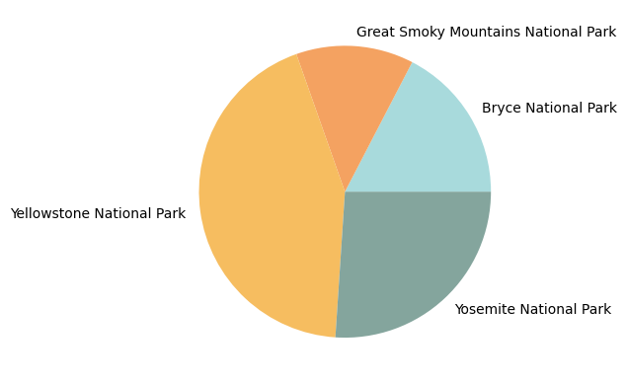
POINT 1: Animal numbers
An analysis of all listed parks showed that Yellowstone National Park is by far the park with the most animals – with around 45% of all animals observed in this park.
The Yosemite National Park is in the second place, and its population accounting for around 25% of all observations.

Slide 4
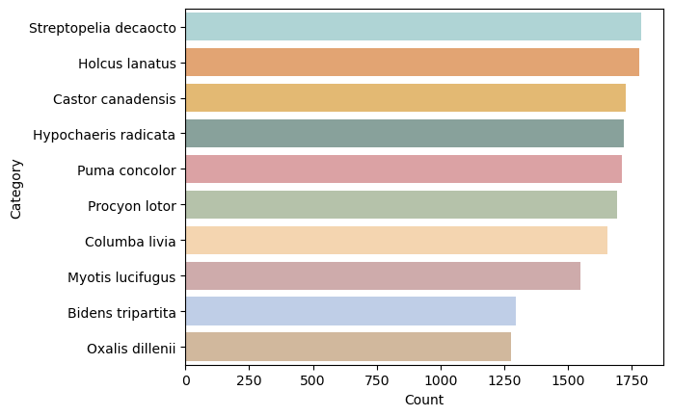
POINT 2: Most observed animal
Streptopelia decaocto was the most observed animal among all the listed parks, with around 1750 observations total.
Very close to Streptopelia decaocto is Holcus lanatus, with its observations sitting just beneath 1750.

Slide 5
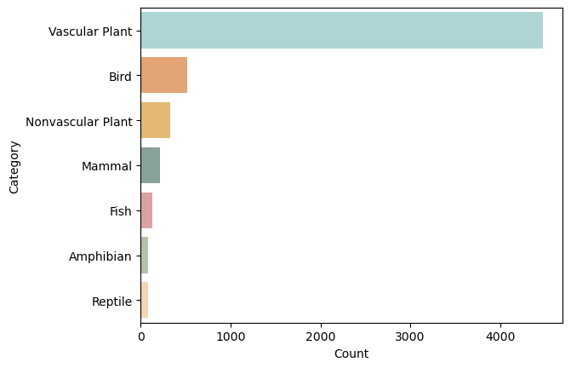
POINT 3: Most observed category
Among all the national parks, Vascular Plants are by far the most observed organisms, with over 4000 observations.

Slide 6
A Data Analysis Portfolio project | Maximilián Cenkner

