Slide 1
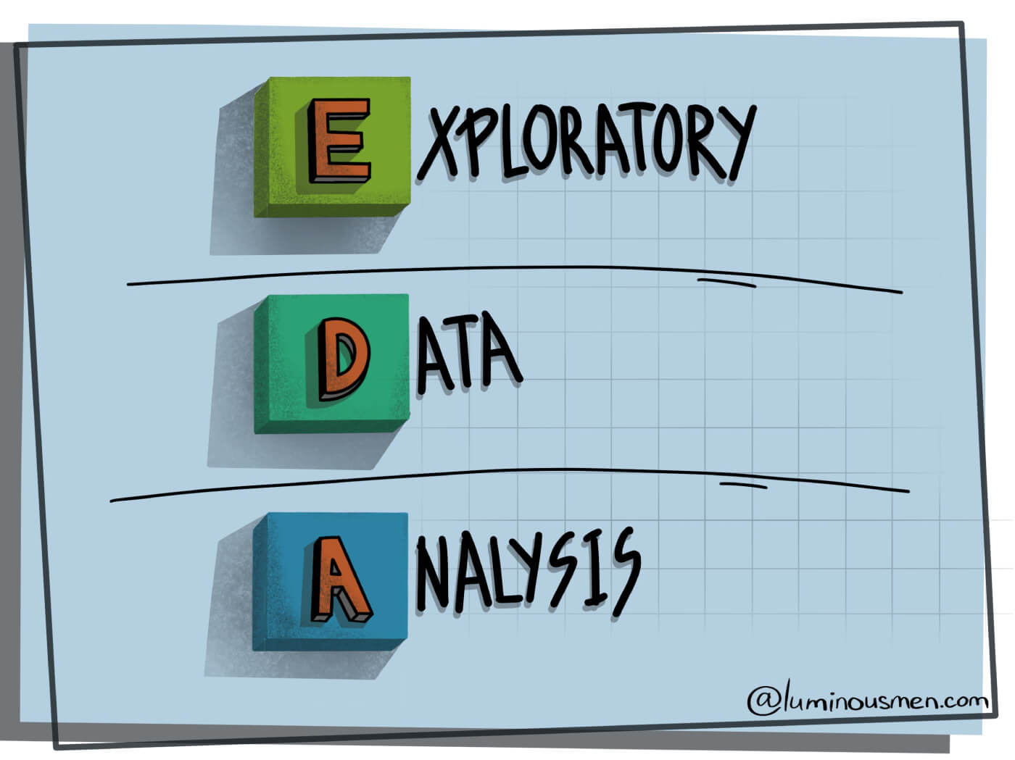
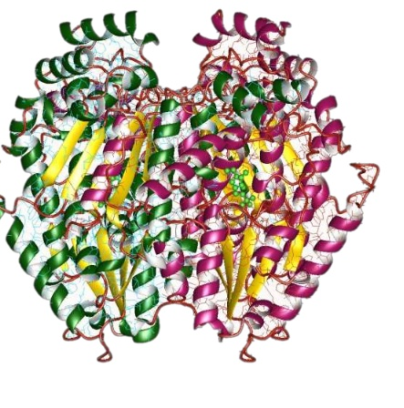
ENZYMES

Slide 2
ENZYMES Overview
600 enzymes
Graph representation of an enzyme
6 EC enzyme labels: reflect catalyzed chemical reaction

Slide 3
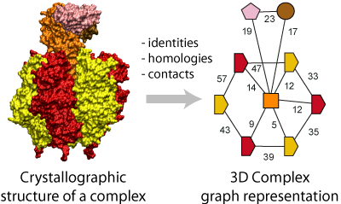
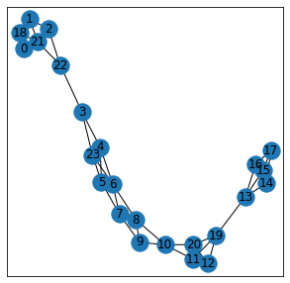
Example graph
Node represent secondary structure elements (SSE)
- Helix,sheet or turn
Edge connects two SSE that are neighbors along the amino acid sequence or are one of three nearest neighbors in space

Slide 4
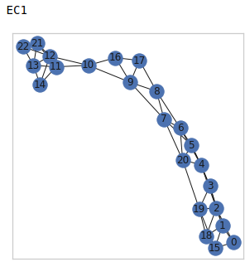
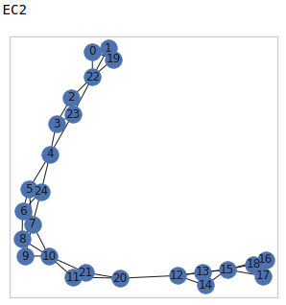
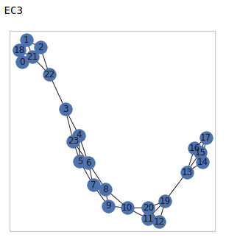
Examples of representative enzymes

Slide 5
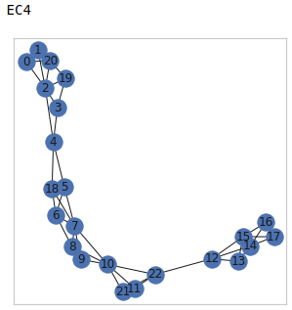
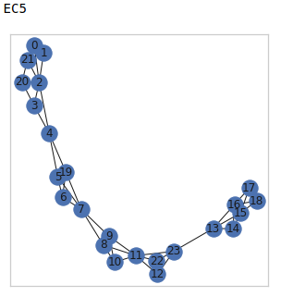
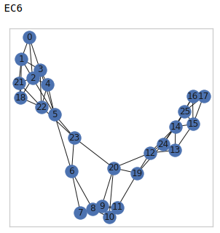
Examples of representative enzymes

Slide 6
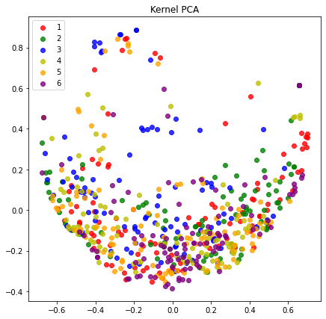
Dimensionality Reduction on unprocessed data
We see some outlier points which are far separated from the main cluster

Slide 7
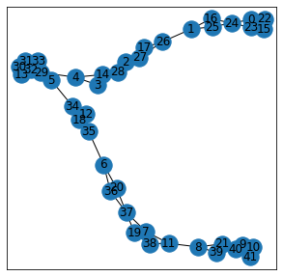
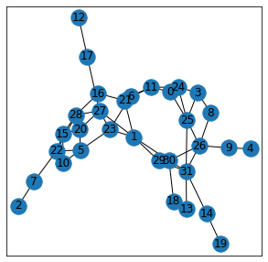
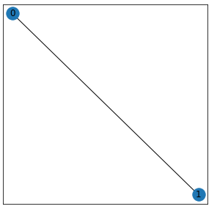
Visualizing outliers: unique structure and high/low number of edges/nodes

Slide 8
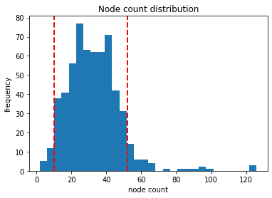
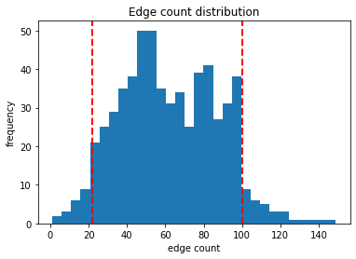
Preprocessing: removing outliers and graphs with extreme edge/node counts

Slide 9
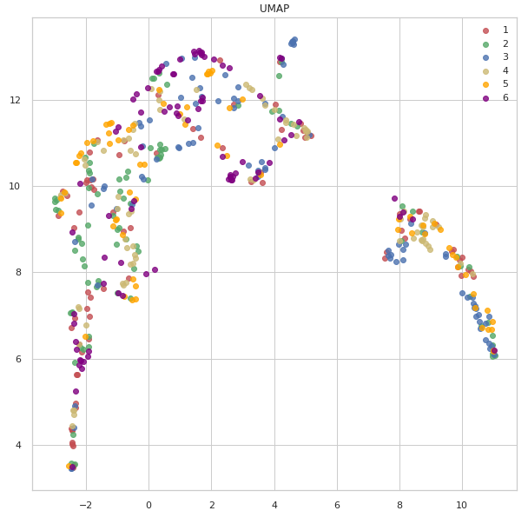
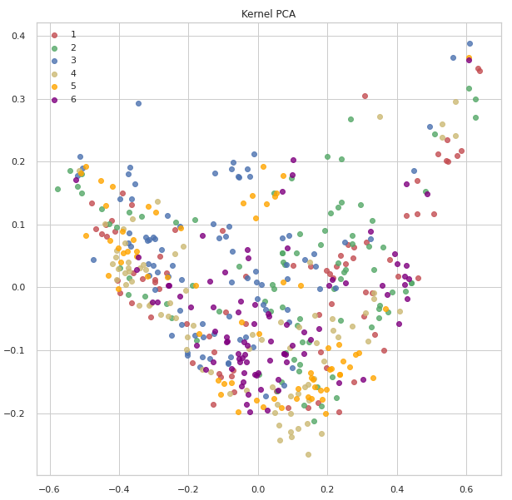
Dimensionality Reduction on labeled dataset: WL4

Slide 10
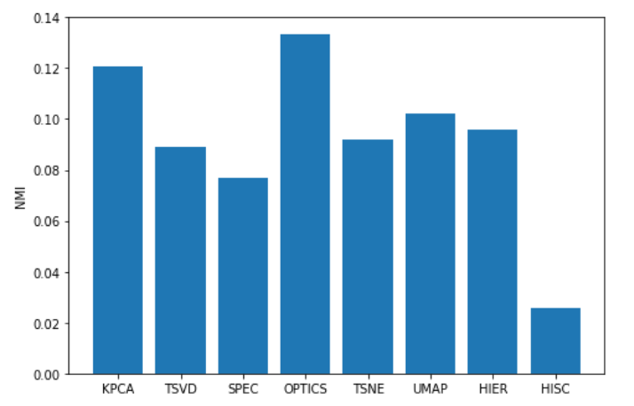
Cluster evaluation based on NMI

Slide 11
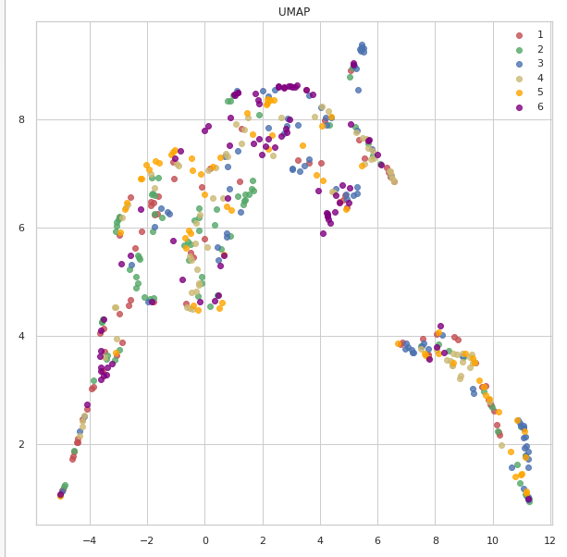
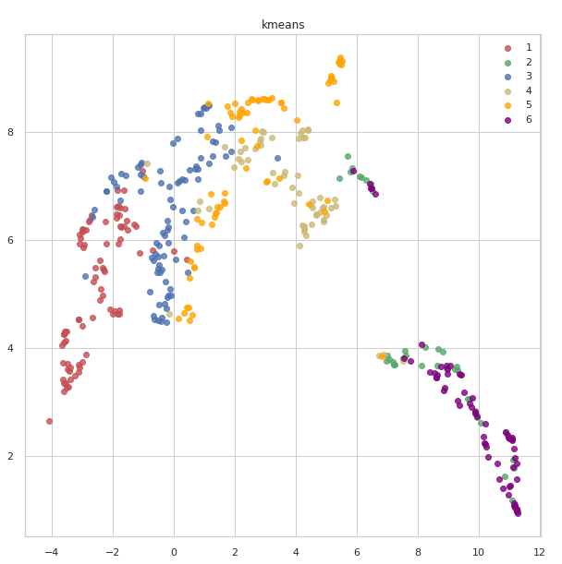
Clusters do not represent the true labels
True labels
Kmeans Clusters

Slide 12
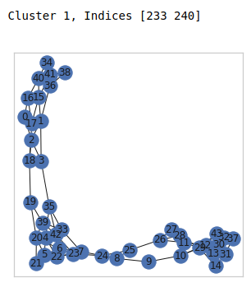
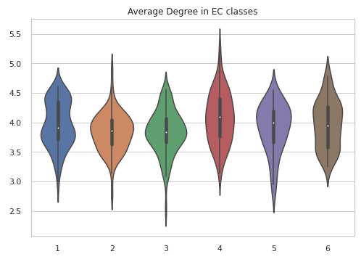
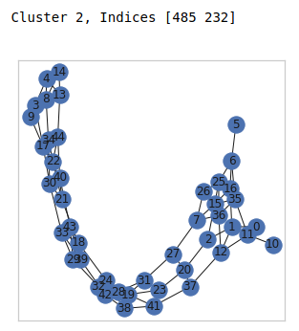
Clusters have different degree distributions

Slide 13
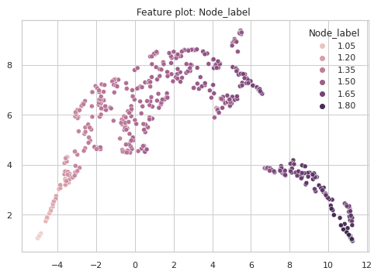
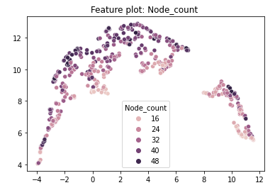
DR describes node labels and node count

Slide 14
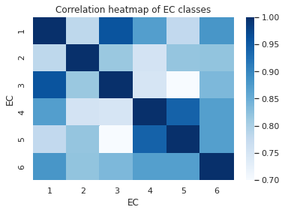
True label analysis based on node properties
We notice higher correlation between EC 4,5
Also EC 1,3 are highly correlated

Slide 15
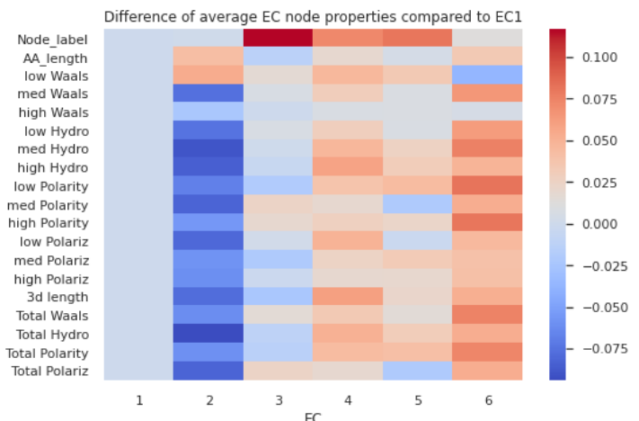
Difference between EC1 and other EC classes

Slide 16
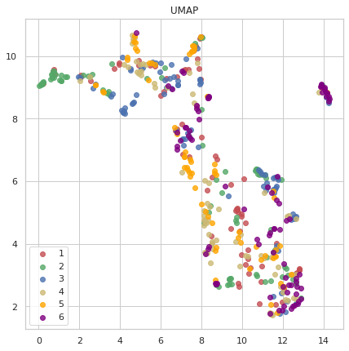
UMAP of only node attribute data (wtihout labels)

Slide 17
SVM accuracy comparison of kernels
WL iterations 1-5 With preprocessing | 0,44898
 | 0,56122
 | 0,57143
 | 0,62245
 | 0,61225
WL iterations 1-5 WithOUT preprocessing | 0,45834
 | 0,575
 | 0,625
 | 0,625
 | 0,60834
Graphlet | 0,32653
Shortest Paths | 0,48979

Slide 18
Conclusion
UMAP vector representation is strongly driven by node labels (SSE elements), edge/node count
Clusters do not represent the ground truth labels
Clusters are formed based on different SSE composition, and structural differences e.g. degree distribution
Node attributes play also an important role in EC classification which could be used for building better kernels

Slide 19
Thank you for your attention!

Slide 20
NMI values for the 3 kernels (with removing the extreme values first)
 | WL iter 3 | Graphlet | Shortest Paths
Kmeans | 0,1018 | 0,0828 | 0,1091
Hierarchical Ward | 0,2079 | 0,1710 | 0,1866
Hierarchical Complete | 0,1774 | 0,1576 | 0,1601
Hierarchical Average | 0,0446 | 0,0887 | 0,0602
Hierarchical Single | 0,0338 | 0,0551 | 0,0508
Subkmeans | 0,0833 | 0,0717 | 0,0754

Slide 21
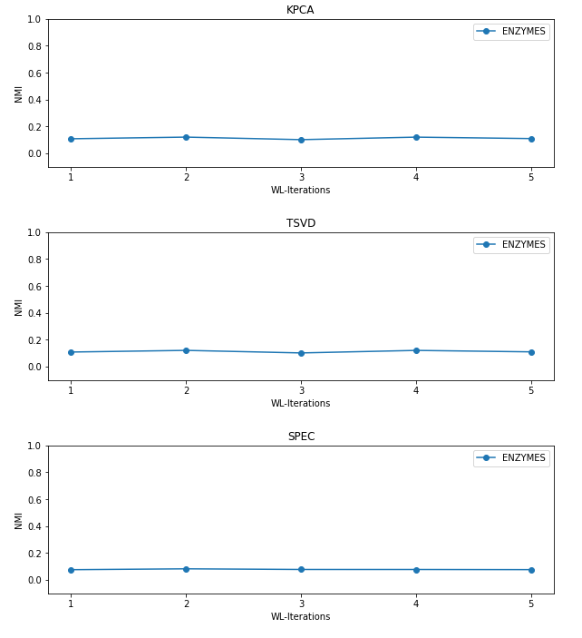
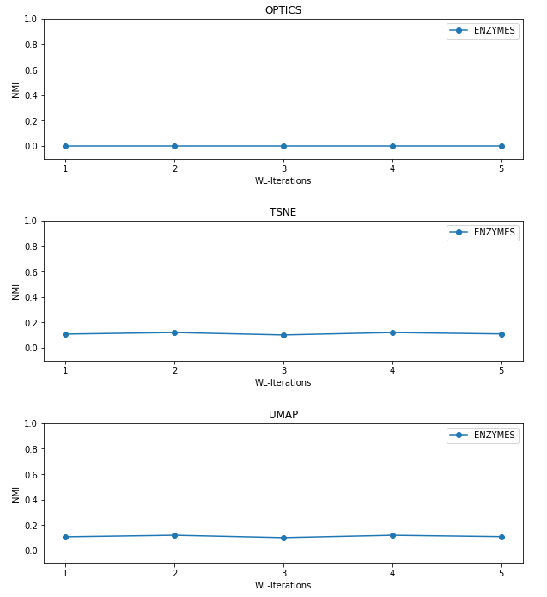
Overview of NMI performance for different representations

Slide 22
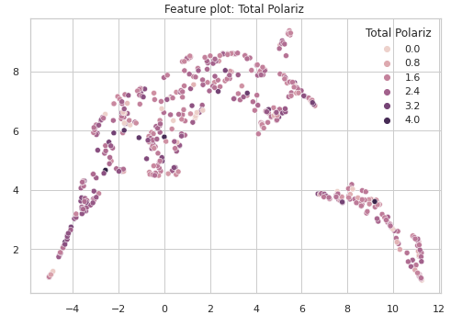
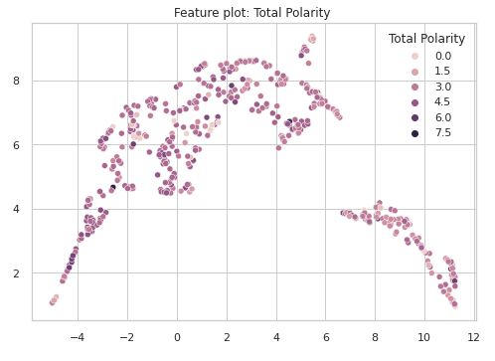

Slide 23
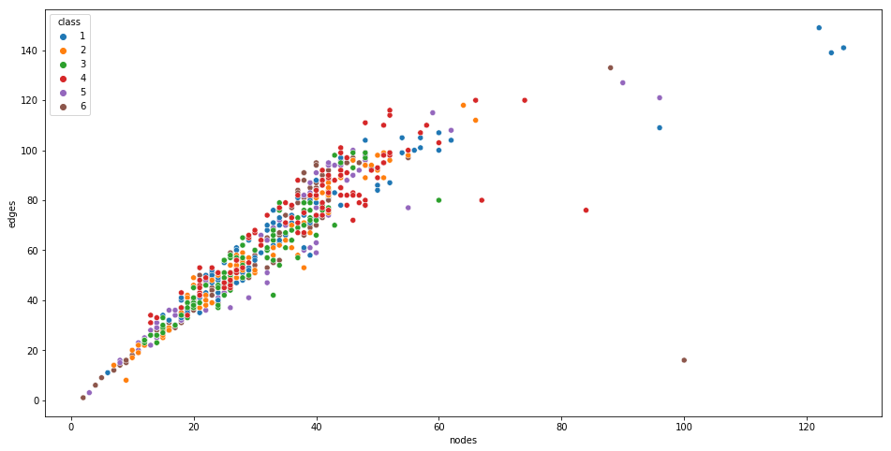
Scatter plot of avg. nodes and avg. edges

