Slide 1
Intermediate Progress Report
HiSC algorithm / Enzymes dataset
Data Mining Group 9:
RAPHAEL BEDNARSKY, MAXIMILIAN FAISSNER,
PETER HUNYADI, LAURA JAHN, NIKOLA VINKO
Presentation: Maximilian Faissner

Slide 2
Overview
HiSC algorithm
Comparison with OPTICS (related clustering algorithm)
Algorithm overview
Applying HiSC on test inputs / Visualization
Exploratory Data analysis of the Enzymes dataset
Presentation by Nikola Vinko

Slide 3
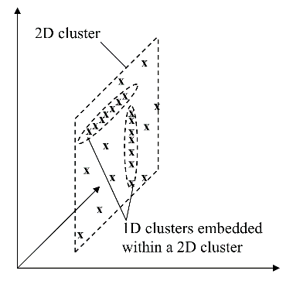
Finding nested subspace clusters
k-dimensional subspace cluster, embedded into l-dimensional subspace cluster (k < l)

Slide 4
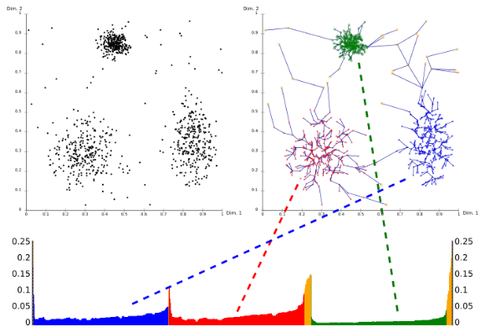
HiSC as OPTICS extension
OPTICS:
DBSCAN-based approach
Outputs datapoints in a computed ordering with help of reachability distances (kNN)
Reachability plot:
x-axis: data points in ordered succession
y-axis: reachability distance
valleys correspond to clusters (labels are not computed)
HiSC extension:
Top-Down based (axis-parallel) subspace extension
Each datapoint is assigned to a subspace dimension & weighted reachability distance
OPTICS reachability plot (from https://de.wikipedia.org/wiki/OPTICS)

Slide 5
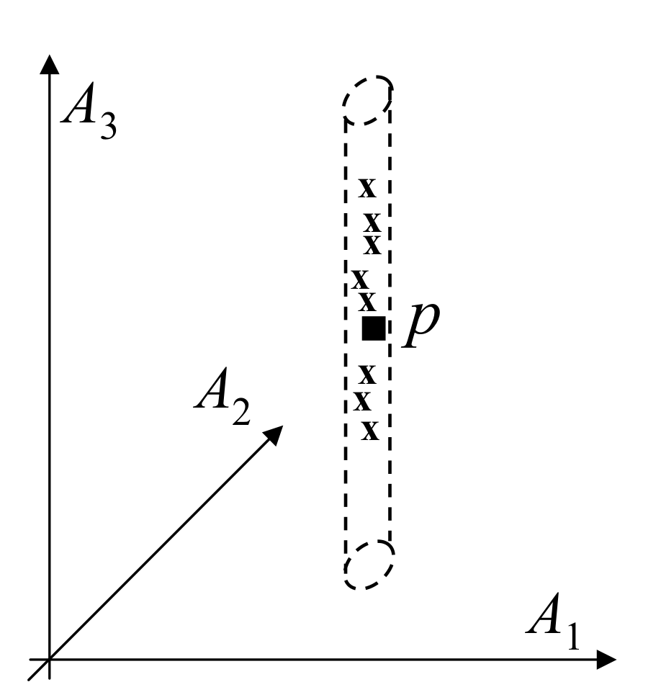
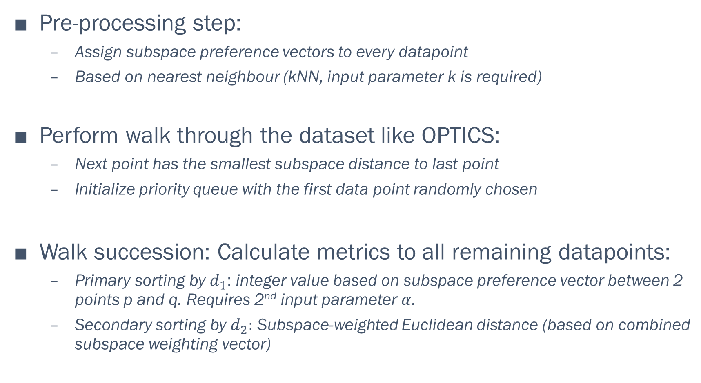
HiSC algorithm overview
Pre-processing step:
Assign subspace preference vectors to every datapoint
Based on nearest neighbour (kNN, input parameter k is required)
Perform walk through the dataset like OPTICS:
Next point has the smallest subspace distance to last point
Initialize priority queue with the first data point randomly chosen
Walk succession: Calculate metrics to all remaining datapoints:
Primary sorting by $d_{1}$: integer value based on subspace preference vector between 2 points p and q. Requires 2nd input parameter $α$.
Secondary sorting by $d_{2}:$ Subspace-weighted Euclidean distance (based on combined subspace weighting vector)
Subspace dimensionality of a single point

Slide 6
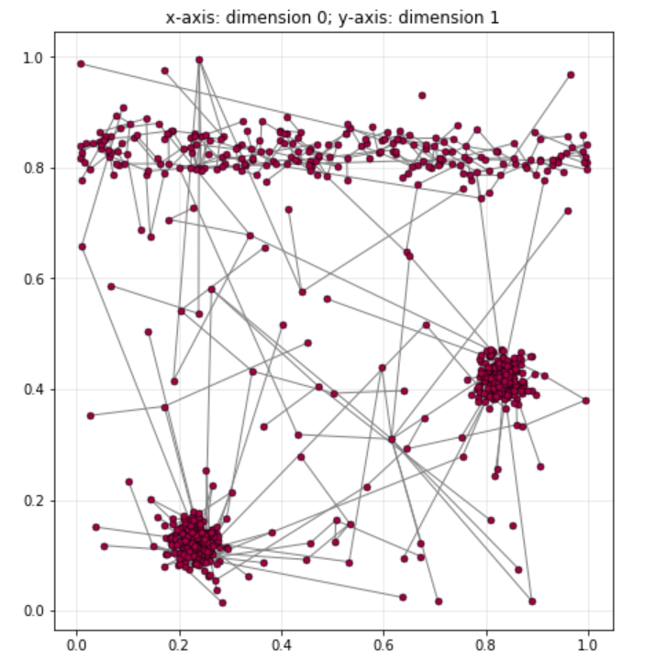
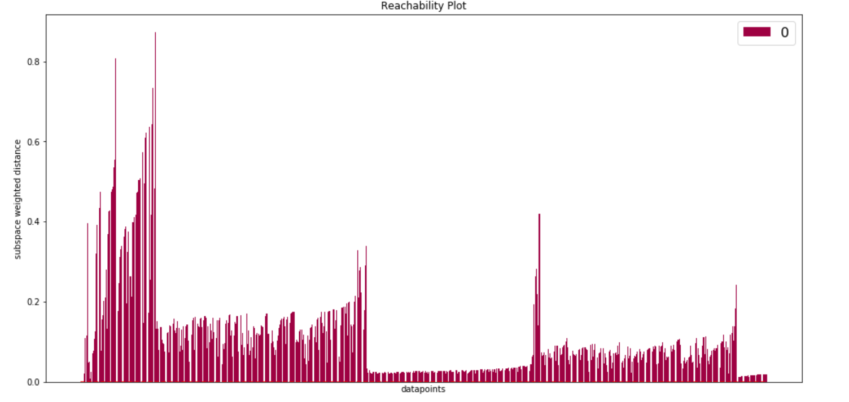
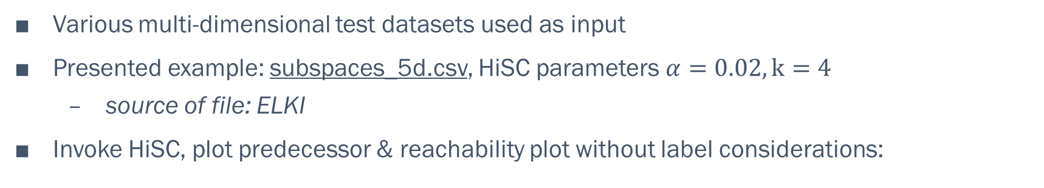
Verification & Visualization
Various multi-dimensional test datasets used as input
Presented example: subspaces_5d.csv, HiSC parameters $α=0.02, k=4$
source of file: ELKI
Invoke HiSC, plot predecessor & reachability plot without label considerations:
Predecessor plot (2d representation)
Reachability plot without labels

Slide 7
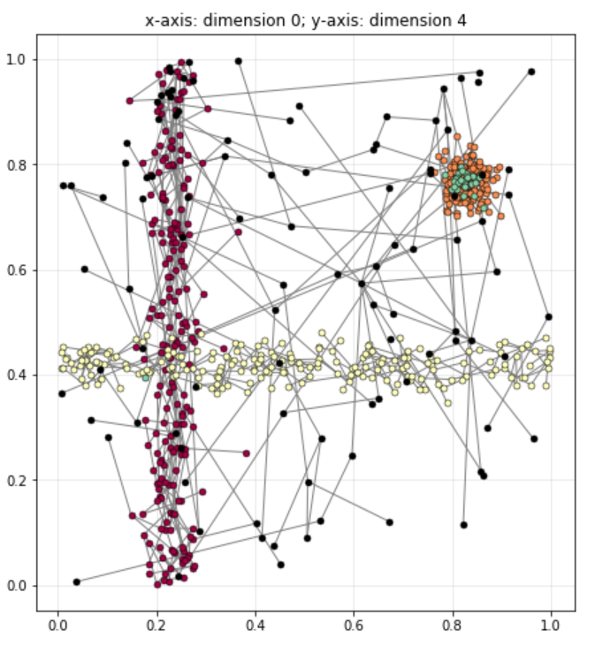
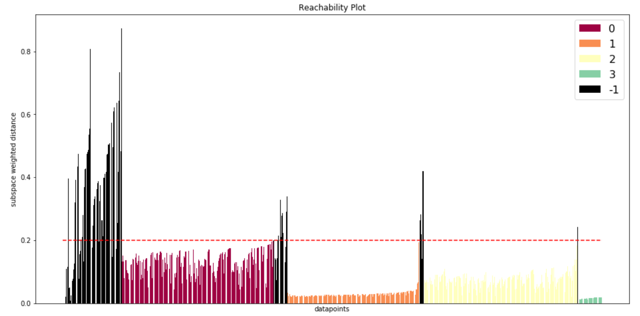
Cluster Generation
Set threshold weighted distance k (y-axis of reachability plot)
Assign all consecutive points to same cluster, if:
Below threshold value k
A minimum number of points are present in a cluster
Predecessor plot (2d representation)
Reachability plot with predicted labels

Slide 8
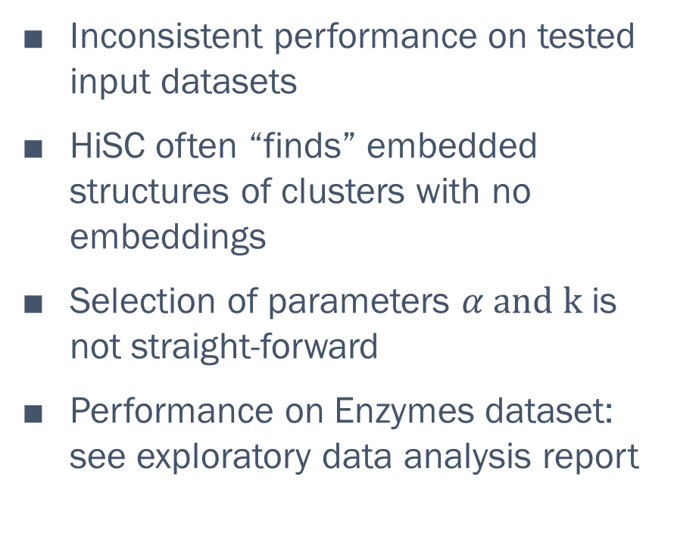
Discussion
Inconsistent performance on tested input datasets
HiSC often “finds” embedded structures of clusters with no embeddings
Selection of parameters $α and k$ is not straight-forward
Performance on Enzymes dataset: see exploratory data analysis report

Slide 9
Why HiSC?
Preferably density-based method
no assumptions about underlying populations
often used for biological input data
Preferably hierarchical method
Discover relationships among enzyme groups
Choice among algorithms implemented in ELKI
DiSH (density-based optimal projective clustering)
HiSC (Finding hierarchies of subspace clusters)

