Slide 1
Spyral Narwhals - “SoundMaze”
A survival game engine designed for the visually impaired.
Garreth Nedved, Gerritt Dorland, Jeremy Nicholson, Ryan Mann

Slide 2
PURPOSE
Using the Unity engine, create a game that is equally accessible to both the visually and non-visually impaired.
Use only sounds to successfully guide players through levels.
Make the game simple enough to be easily learned, but difficult enough to not be patronizing.

Slide 3
DESIGN
We used MVC:
Due to how Unity functions, however, our MVC designs had to get mixed together in objects.
  Was more useful making the components of an object (sounds, how it moves)
View is pared down to only sounds played by an object
Model was the largest part of our project
  Saved the object translations from the Controller
  All of our background data such as where an object is, its vector, and any associated arrays and data
Controller handled how it moves
  Player: User input controls
  Monster: Stack of movements
  Rays: Split or not? Destroy self or not?

Slide 4
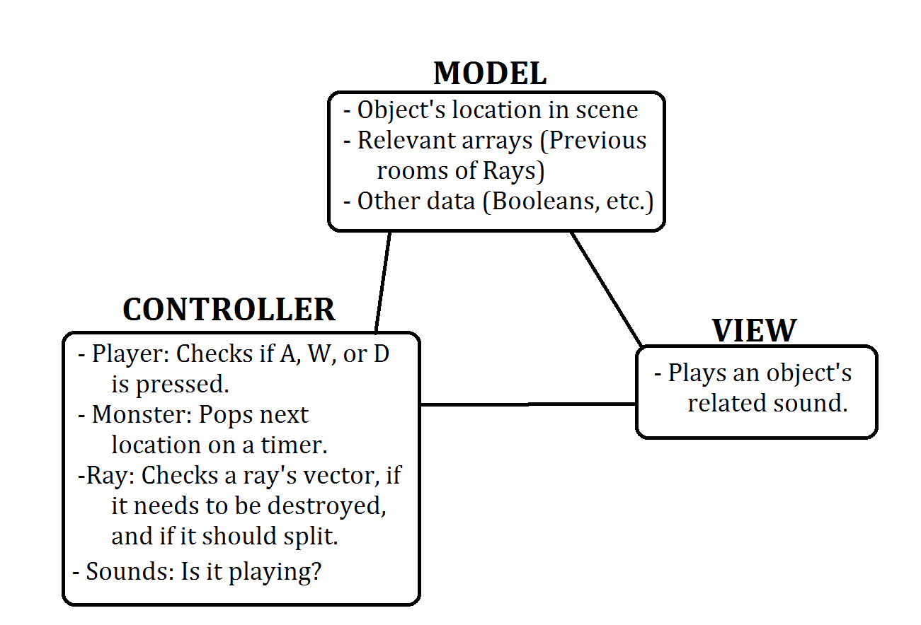
OBJECT MVC DESIGN

Slide 5
VERIFICATION
Verification for games is awkward!
Unit testing is difficult – much of it ends up redundant in our case due to Unity's structure.
The engine handles rendering and shading. As such, controls and visuals testing comes down to observation tests.
What we do have thoroughly tested is our raycasting, room variables, and player movement

Slide 6
VERIFICATION
How We Test
First, we have an external level that runs an integration test. This test mainly checks that player movement remains valid. Not part of the main program!
Second, we run a quick unit test on our raycasting system in another level before loading the first level.
  Quickly runs rays through various situations, and will throw an exception if a ray acts in an unexpected manner

Slide 7
TEAMWORK
To keep on schedule, we split into two groups: Design/Research and Coding.
We needed people looking for solutions before we even reached a problem. Short on time.
Design took ideas for solutions, and proved them on paper.
Lead design then took the solutions to Coding and used Paired Programming (agile programming) to translate the designs into the game.
Unity isn't very friendly with source control, so having one person manage the master was the easiest way.

Slide 8
WHAT WENT RIGHT?
The way we broke down our team worked fairly well, considering Unity's limitations.
Pre-designing systems allowed us to avoid huge hurdles before we even reached them.
We designed very abstract systems before “game-ifying” the project, making everything abstract enough to quickly build new levels.
Our systems work well with Unity, allowing us to use Unity's built-in level editor to add and remove elements (rooms, player location, goal point, etc.) simply by clicking and dragging it. No script editing is required – the game will still work.

Slide 9
WHAT WENT WRONG?
We allowed ourselves to wait six whole weeks before abandoning the original project.
We didn't account for unit testing until the very end.
Often, we took a lot of Unity's framework for granted. We went into this project assuming Unity had soundcasting systems built in.
We have more of a prototypical engine than a full game.

Slide 10
THE LAST TWO SPRINTS
( 11/25 – 12/3 )

Slide 11
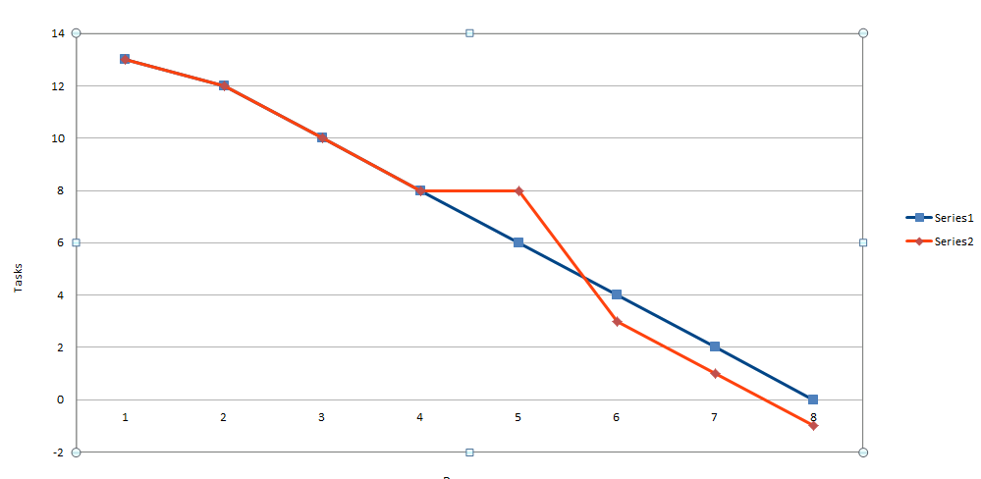
THE LAST TWO SPRINTS
( 11/26 – 12/3 )

Slide 12
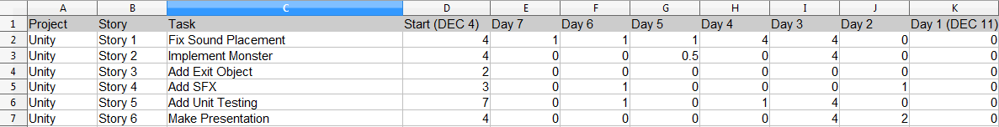
THE LAST TWO SPRINTS
( 12/4 – 12/11 )

Slide 13
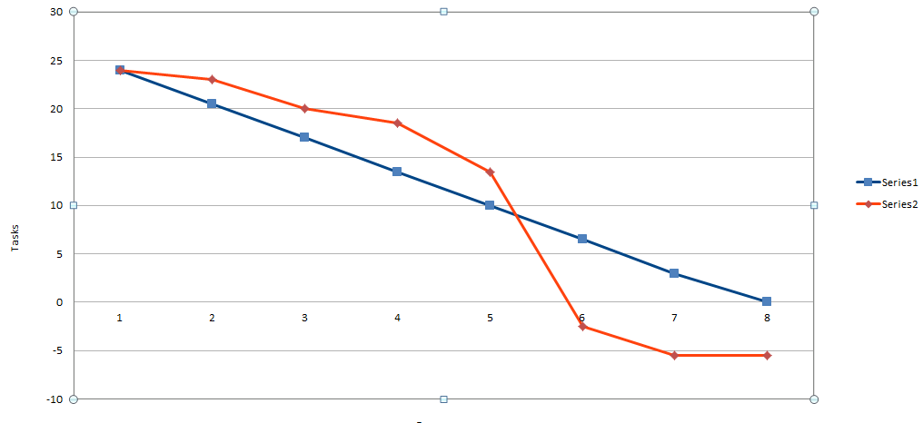
THE LAST TWO SPRINTS
(12/4 – 12/11)
Unit Tests and Fixing
Sound Placement

Slide 14
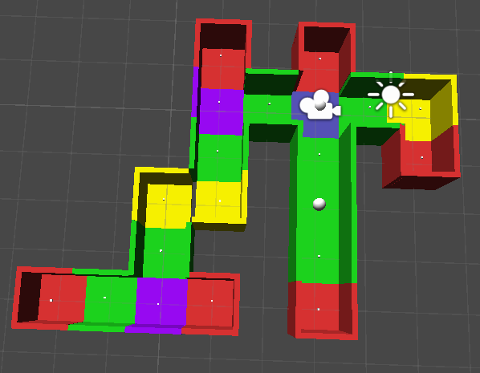
DEMO

Slide 15

DEMO

Slide 16
DEMO
Try out our demo game during our Demos on Monday!

Slide 17
CONCLUSION
A great start!
The game's systems and backbone is functioning and intact.
We built it to be easily extensible, meaning adding levels and content is as easy as dropping assets into a level.
Did we achieve our goals? Sort of.
  We'll find out how well our directionalized sound system works at the demos. We haven't had any QA yet!
  We do have a very comprehensive prototype, however, that will be very easy to flesh out into a polished game.

