Slide 1
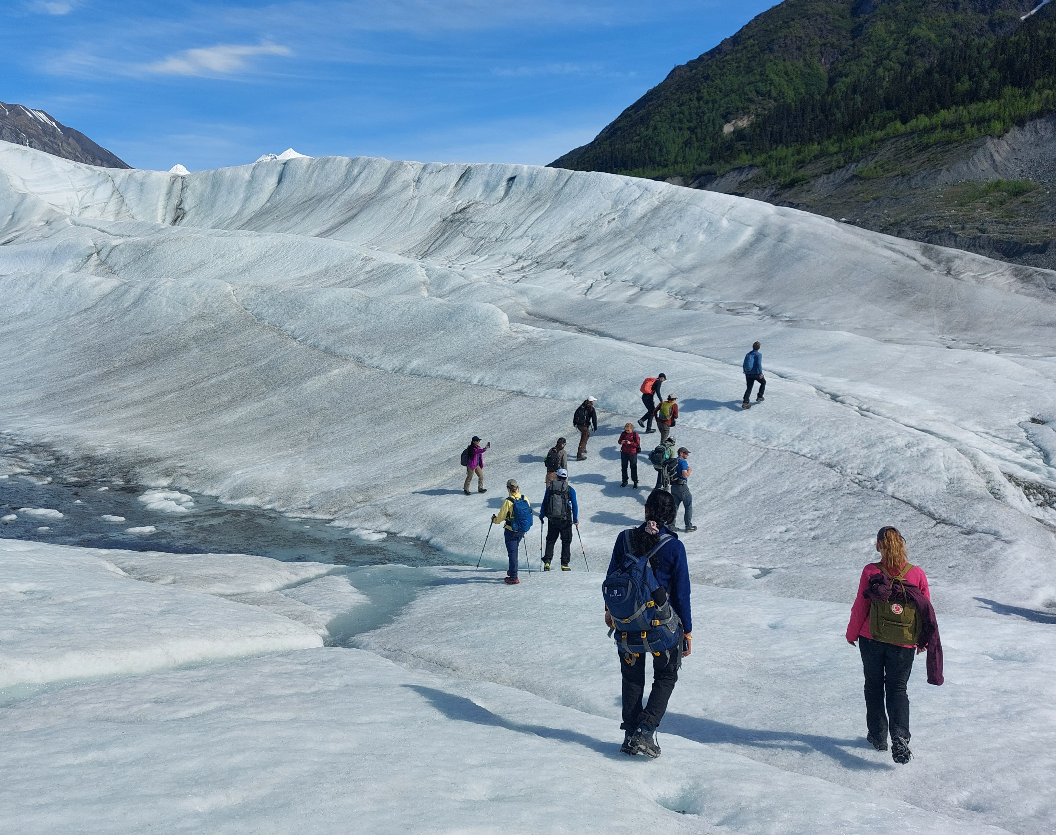
Stoke equation and Wavy Bed
Alaska Glaciology Summer School 2024
Project 14
Student: Max, Niya
Advisor: Ed

Slide 2
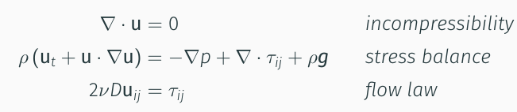
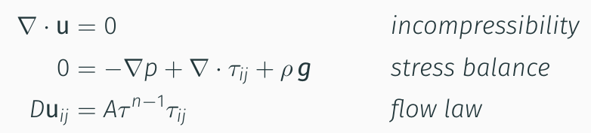
Goal
What is Navier Stoke Equation, What relationship it explain
What is Stoke equation, and why it is suitable for ice
Navier Stoke: 3 words explanation TODO
Stoke: 3 words explanation TODO
Notes:
1. Stoke equation is important for understanding how ice experience stress and strain within a glacier

Slide 3
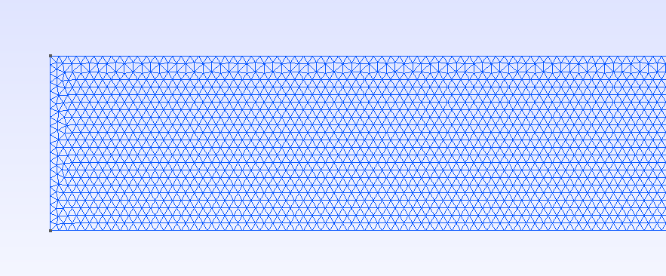

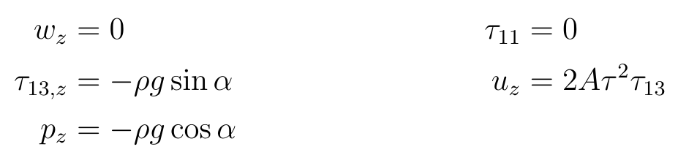
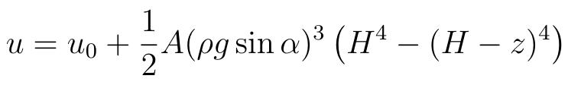
Goal
What is slab-on-slope equation
What is slab-on-slope equation
Classic, an exact solution to stoke equation, as a case of simplified glacier
How slab is not change in the length direction
Our plan: modify slab on slope to understand stoke equation solve for a different geometry
Notes:
2. Use synthetic 1D glacier model to study how the bed of the ice affect the solution of stoke equation

Slide 4
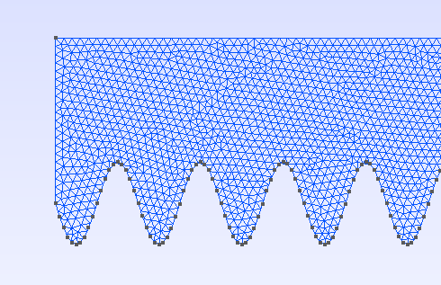
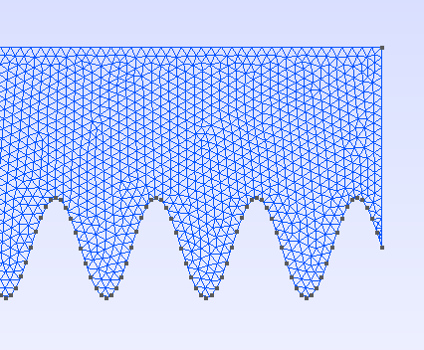
Method
Wavy bed Glacier configuration
(use note to clarify wave amplitude, number of waves, wavelength, glacier length, and glacier thickness, angle of inclination, and boundary condition)
Notes:
Boundary condition: input flow from left is 0, stress on the right is ?, top surface boundary condition, bed velocity = 0

Slide 5
Method
Wave Magnitude | Glacier average thickness | Glacier length
100 m | 400 m | 20000 m
Glacier Configuration 1
Wavelength: TODOm
Wavelength: TODOm
Wavelength: TODOm
Wavelength: TODOm

Slide 6
Method
Block Average Thickness
Block Length
Wave Amplitude
Wavelength
Domain.py
(Geometry Generator)
.geo file, documenting geometry
gmsh
(Mesh Generator)
Velocity
Pressure
Effective Viscosity
Flow.py
(Stoke Solver with firedrake)
.msh file, meshed geometry

Slide 7
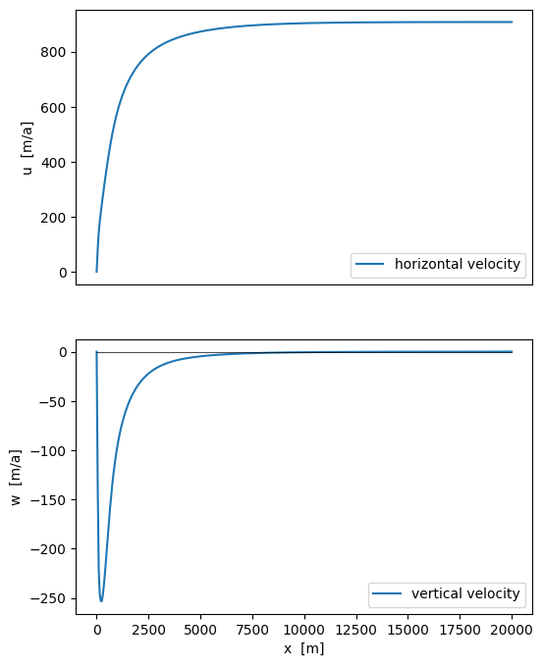
Results
Slab On Slope: where to cut-off
Surface velocity of Slab on Slope Case
Velocity x
Velocity y
viscosity
pressure

Slide 8
Results
How wavelength affect velocity pattern

Slide 9
Results
X-y picture analysis of average surface velocity?

Slide 10
Discussion

Slide 11
Conclusion

Slide 12
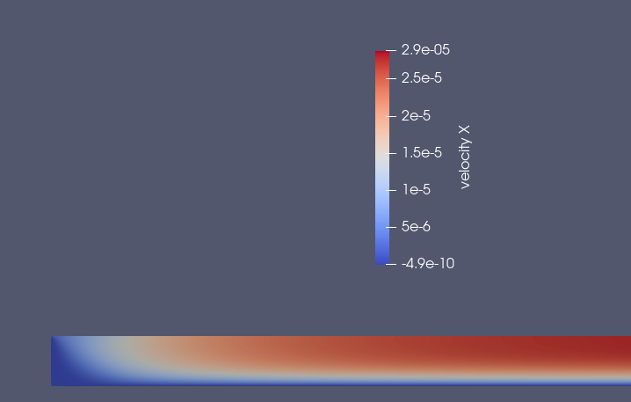
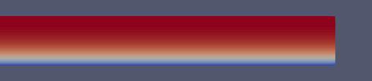
Trash Can

