Slide 1

04/28/2020 | CIS 627 161 BIG DATA ANALYTICS CAPTSTONE | Max Franke
Classification of news headlines with impact on the stock price change

Slide 2
Agenda
1
Problem and results summary
2
Data and tidying
3
Models and parameters
4
Technical analysis and findings

Slide 3
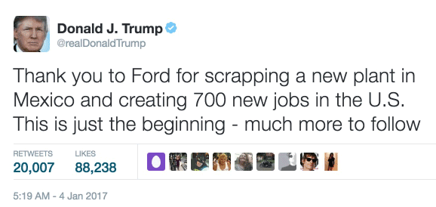
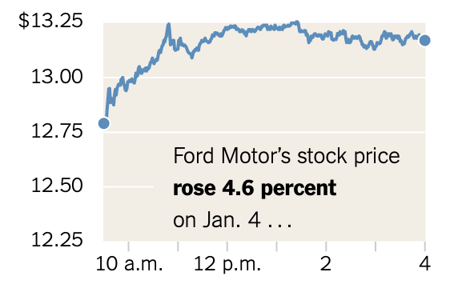
1
Problem and results summary
Maximizing the accuracy by predicting the close price difference
(1) = positive price change; (2) negative price change
Hidden Layer |  |  | epochs | Accuracy
1 | 2 | 3
5 | 80 | 5 | 10,000 | 0.65217391
40 | 80 | 5 | 10 | 0.62318841
80 | 80 | 80 | 10 | 0.62318841
40 | 80 | 5 | 100 | 0.62318841
40 | 20 | 5 | 10 | 0.60869565
Minimizing the MSE by predicting the close price difference
Hidden Layer |  |  | epochs | MSE
1 | 2 | 3
80 | 80 | 10 | 10,000 | 0.03937635
20 | 80 | 5 | 10,000 | 0.24899562
80 | 40 | 80 | 10,000 | 0.26936258
40 | 80 | 5 | 10,000 | 0.27109301
40 | 10 | 40 | 10,000 | 0.27588953
Picture Source: https://www.nytimes.com/2017/02/16/business/dealbook/trump-tweets-stock-market-trading-bots.html?_r=0

Slide 4
2
Data and tidying
Average price difference for each tag
Filtering
Result: Symbol, Counts, Tag, Price Difference from minute 1 to minute 15
Subset the news (headline and description) for the stock symbol
Frequency tags
Iterate through each headline of the subset and count the words, result: table of the most frequently mentioned tags
(e.g. update)
Create input data
Weighted average of counts and price difference (after 3 minutes)
Input |  |  |  |  | Output
Close price | Volume | Tag 1 | Tag 2 | Tag 3 | Price difference
150.163 | 822,766 | -0.1407 | 0.1759 | -0.0137 | -0.0678

Slide 5


Slide 6
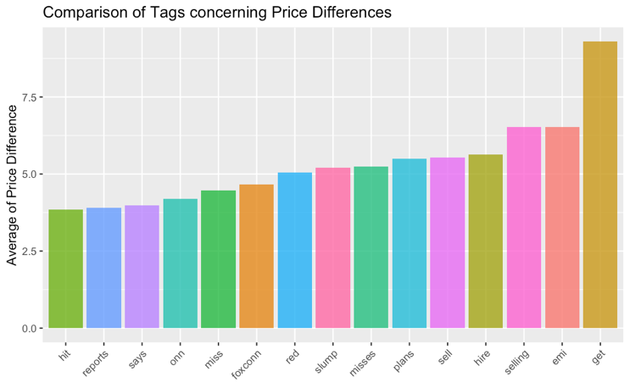
4
Technical analysis and findings
Hidden Layer |  |  | epochs
1 | 2 | 3
80 | 80 | 10 | 10,000 | MSE
5 | 80 | 5 | 10,000 | ACC
Best deep neural network structure

Slide 7

Thank you
Max Franke

