Slide 1
Net Zero Carbon Metrics
John Gunstone

Slide 2
Background Info

Slide 3
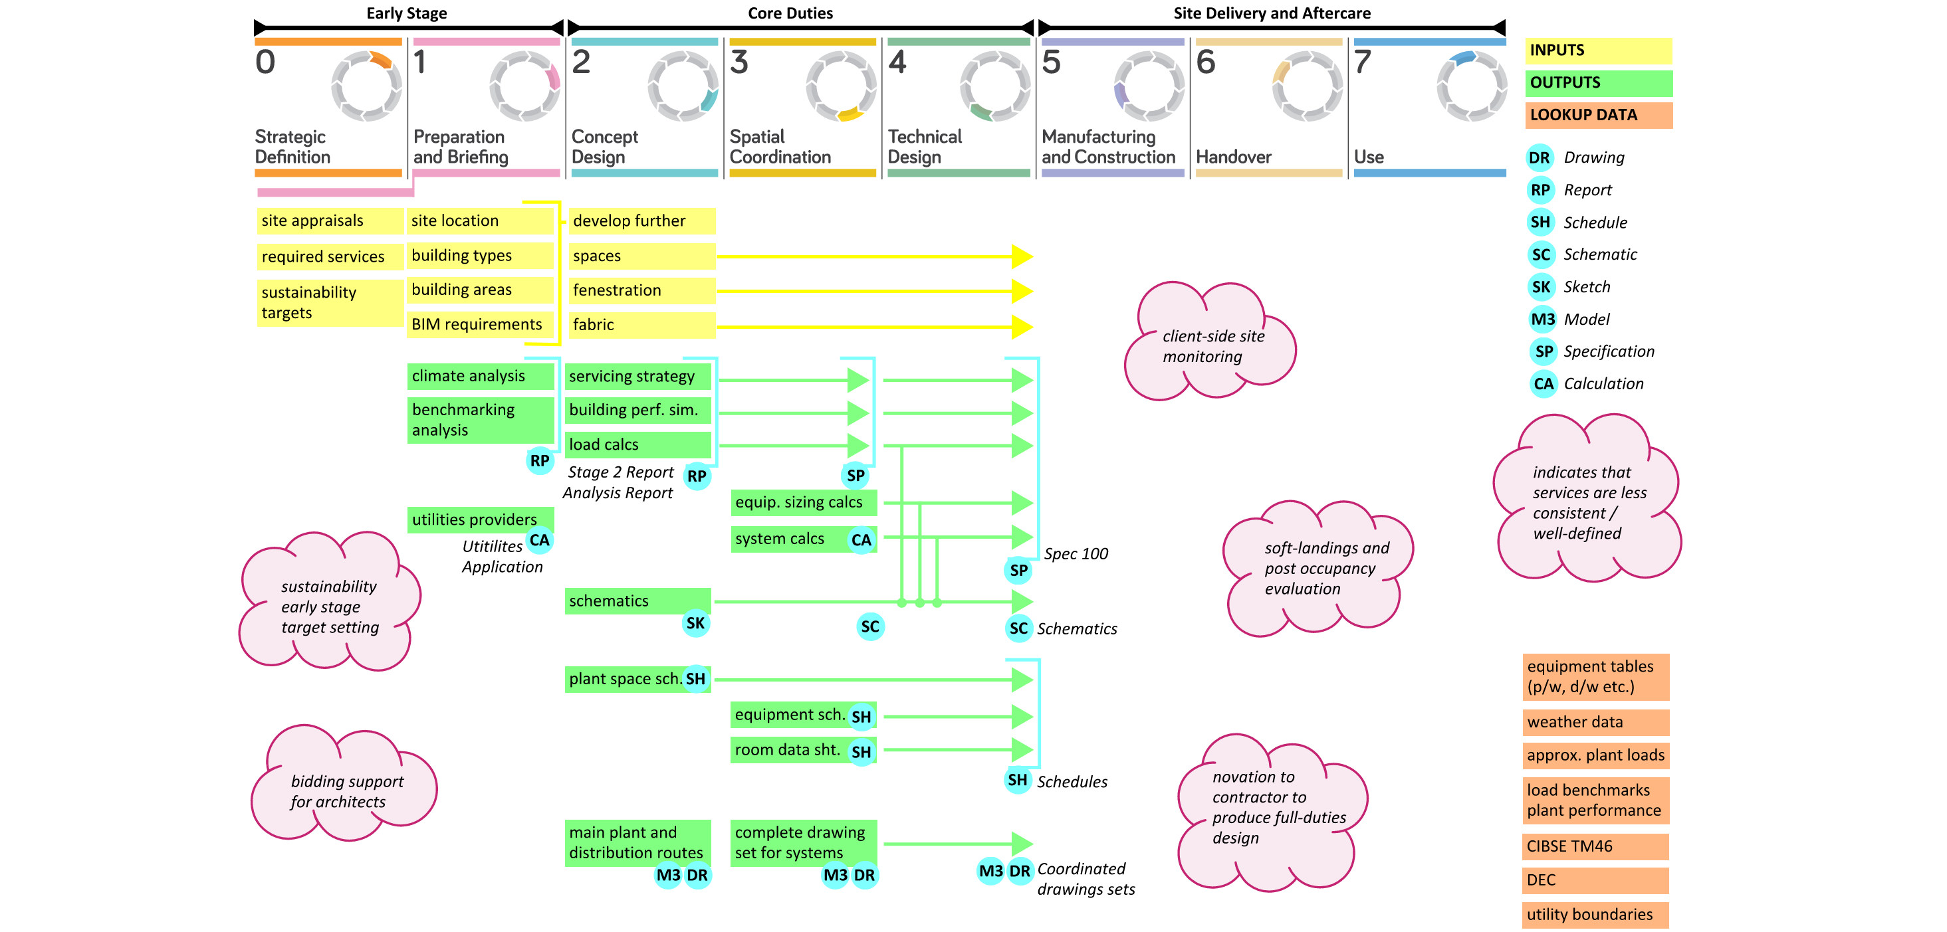
Overview of Information supporting Core Service

Slide 4
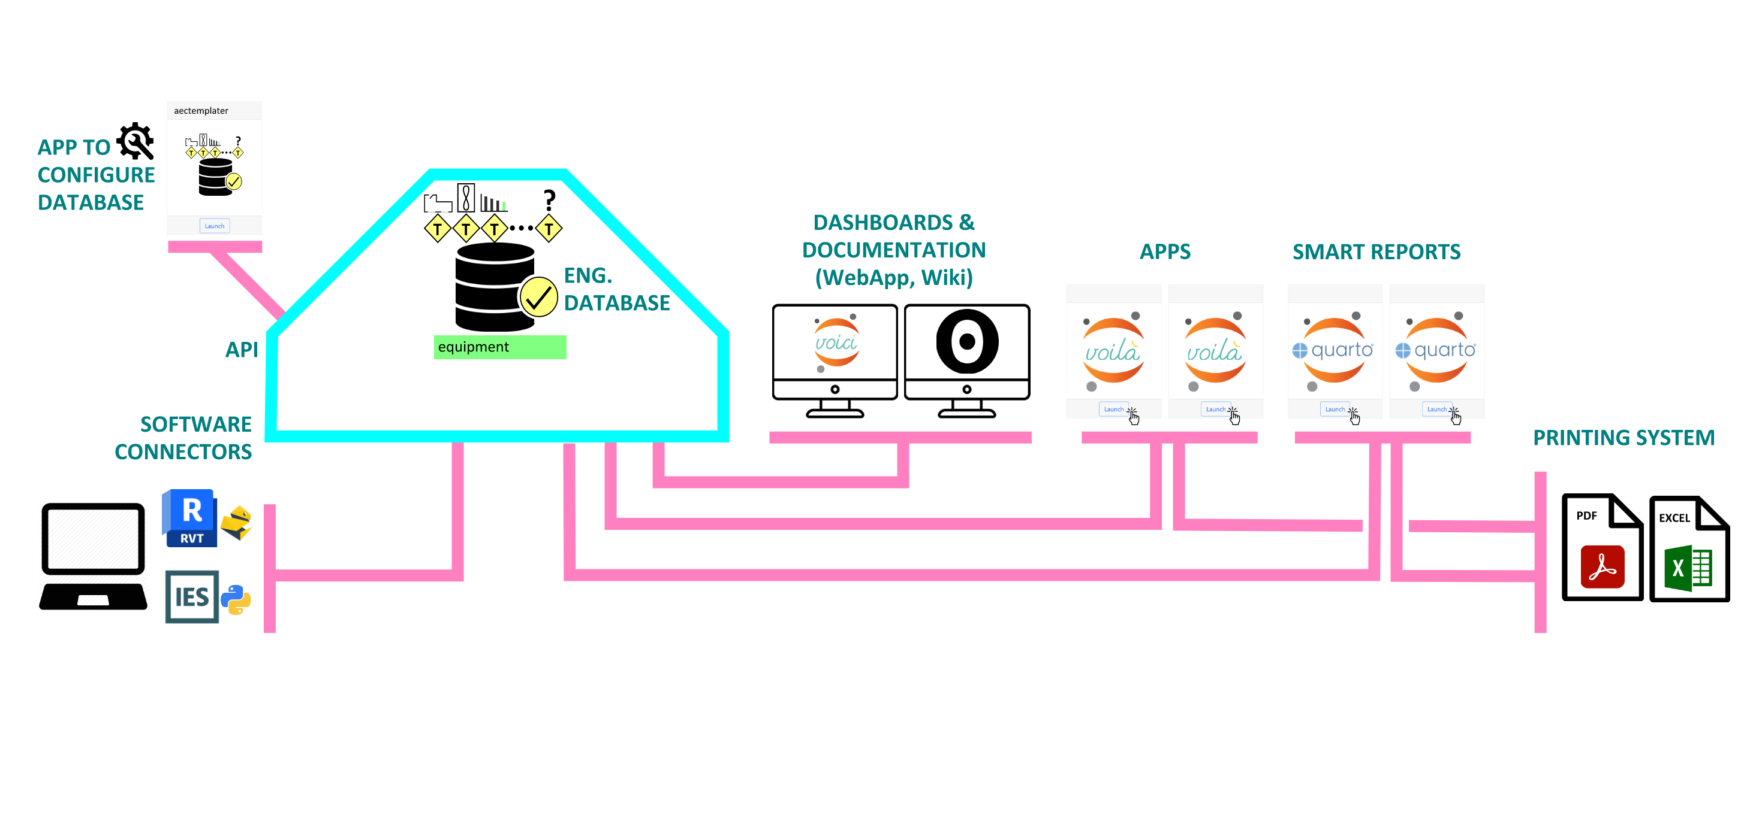
Digital Infrastructure - Tech Stack

Slide 5
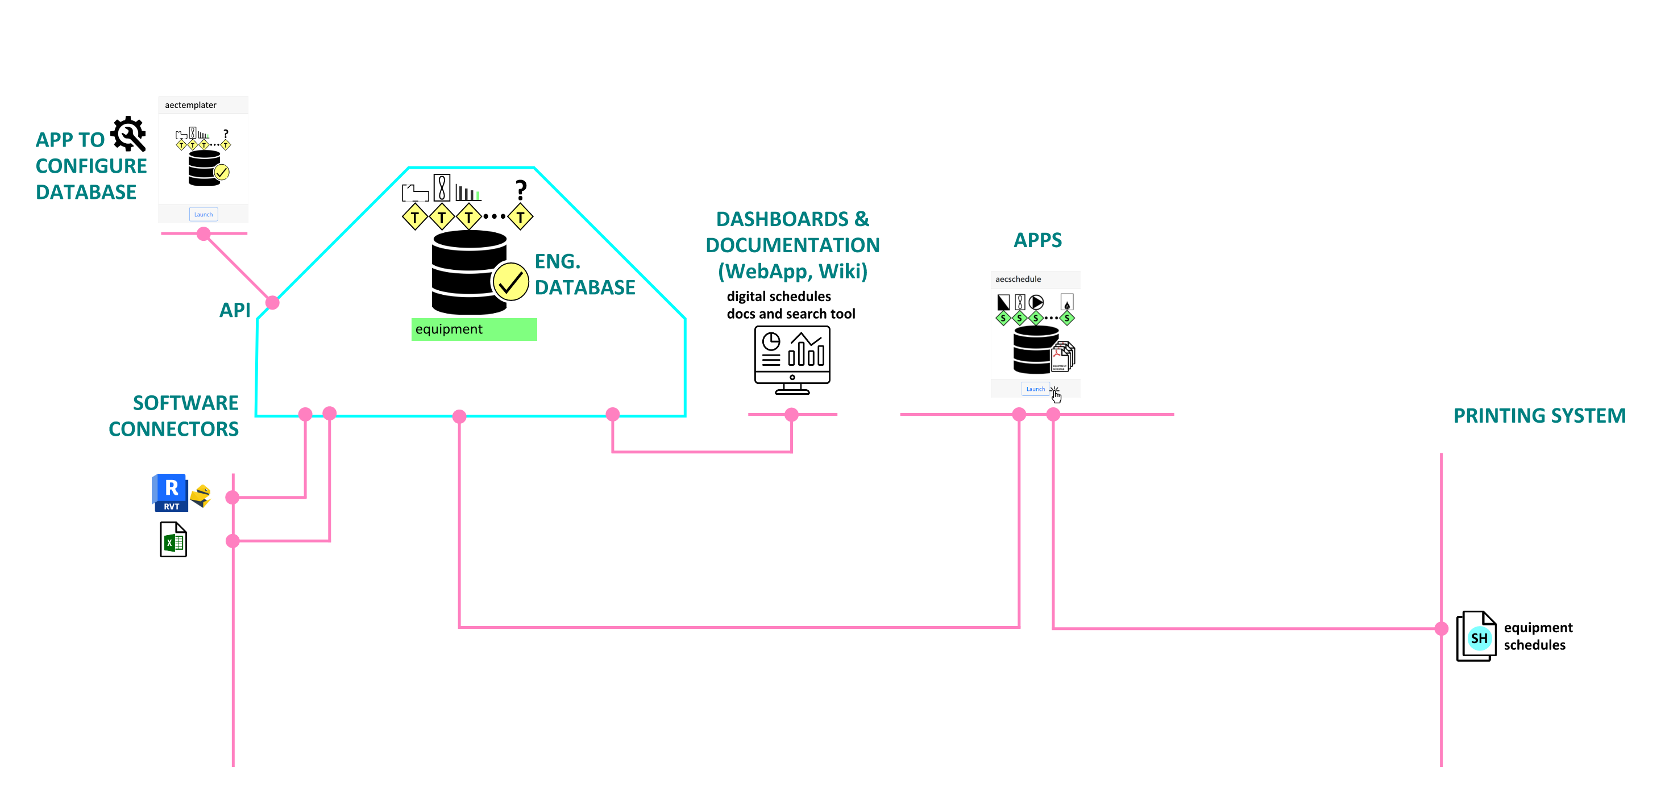
Digital Schedules - Equipment

Slide 6
Digital Schedules - Equipment - Links
templates and properties
aecschedule app on toolbox
for saving project data to templates
documentation on the Wiki
features live dashboard of adoption
and equipment browser

Slide 7
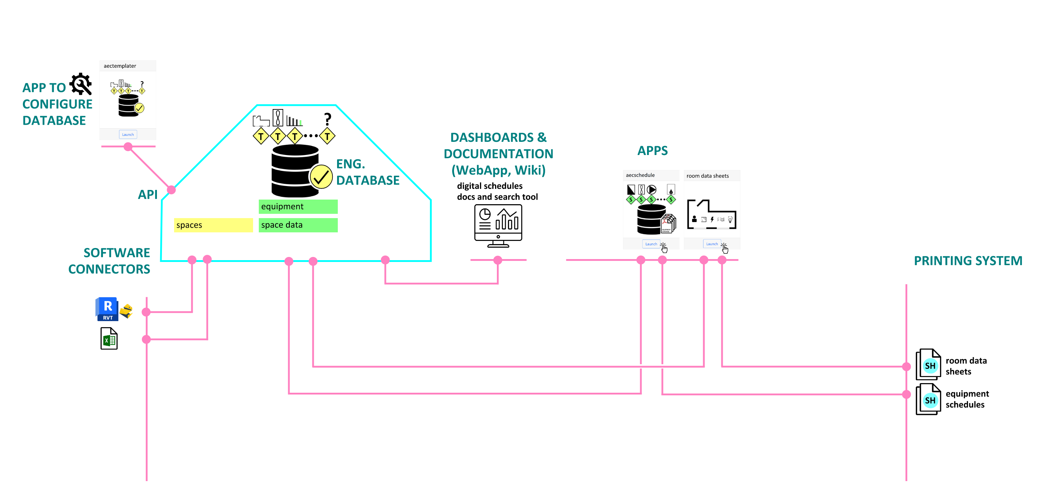
Digital Schedules - Room Data Sheets

Slide 8
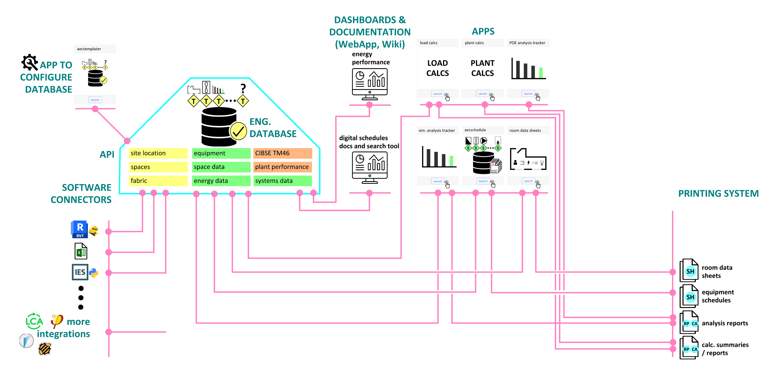
Digital Infrastructure - More Apps

Slide 9
Digital Infrastructure - POE App
POE app on toolbox
live dashboard on Wiki
(likely to migrate it to WebApp instead)

Slide 10
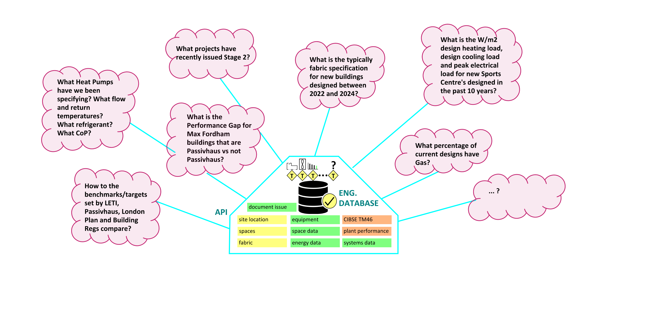
Digital Infrastructure - Growing Structured Data

Slide 11
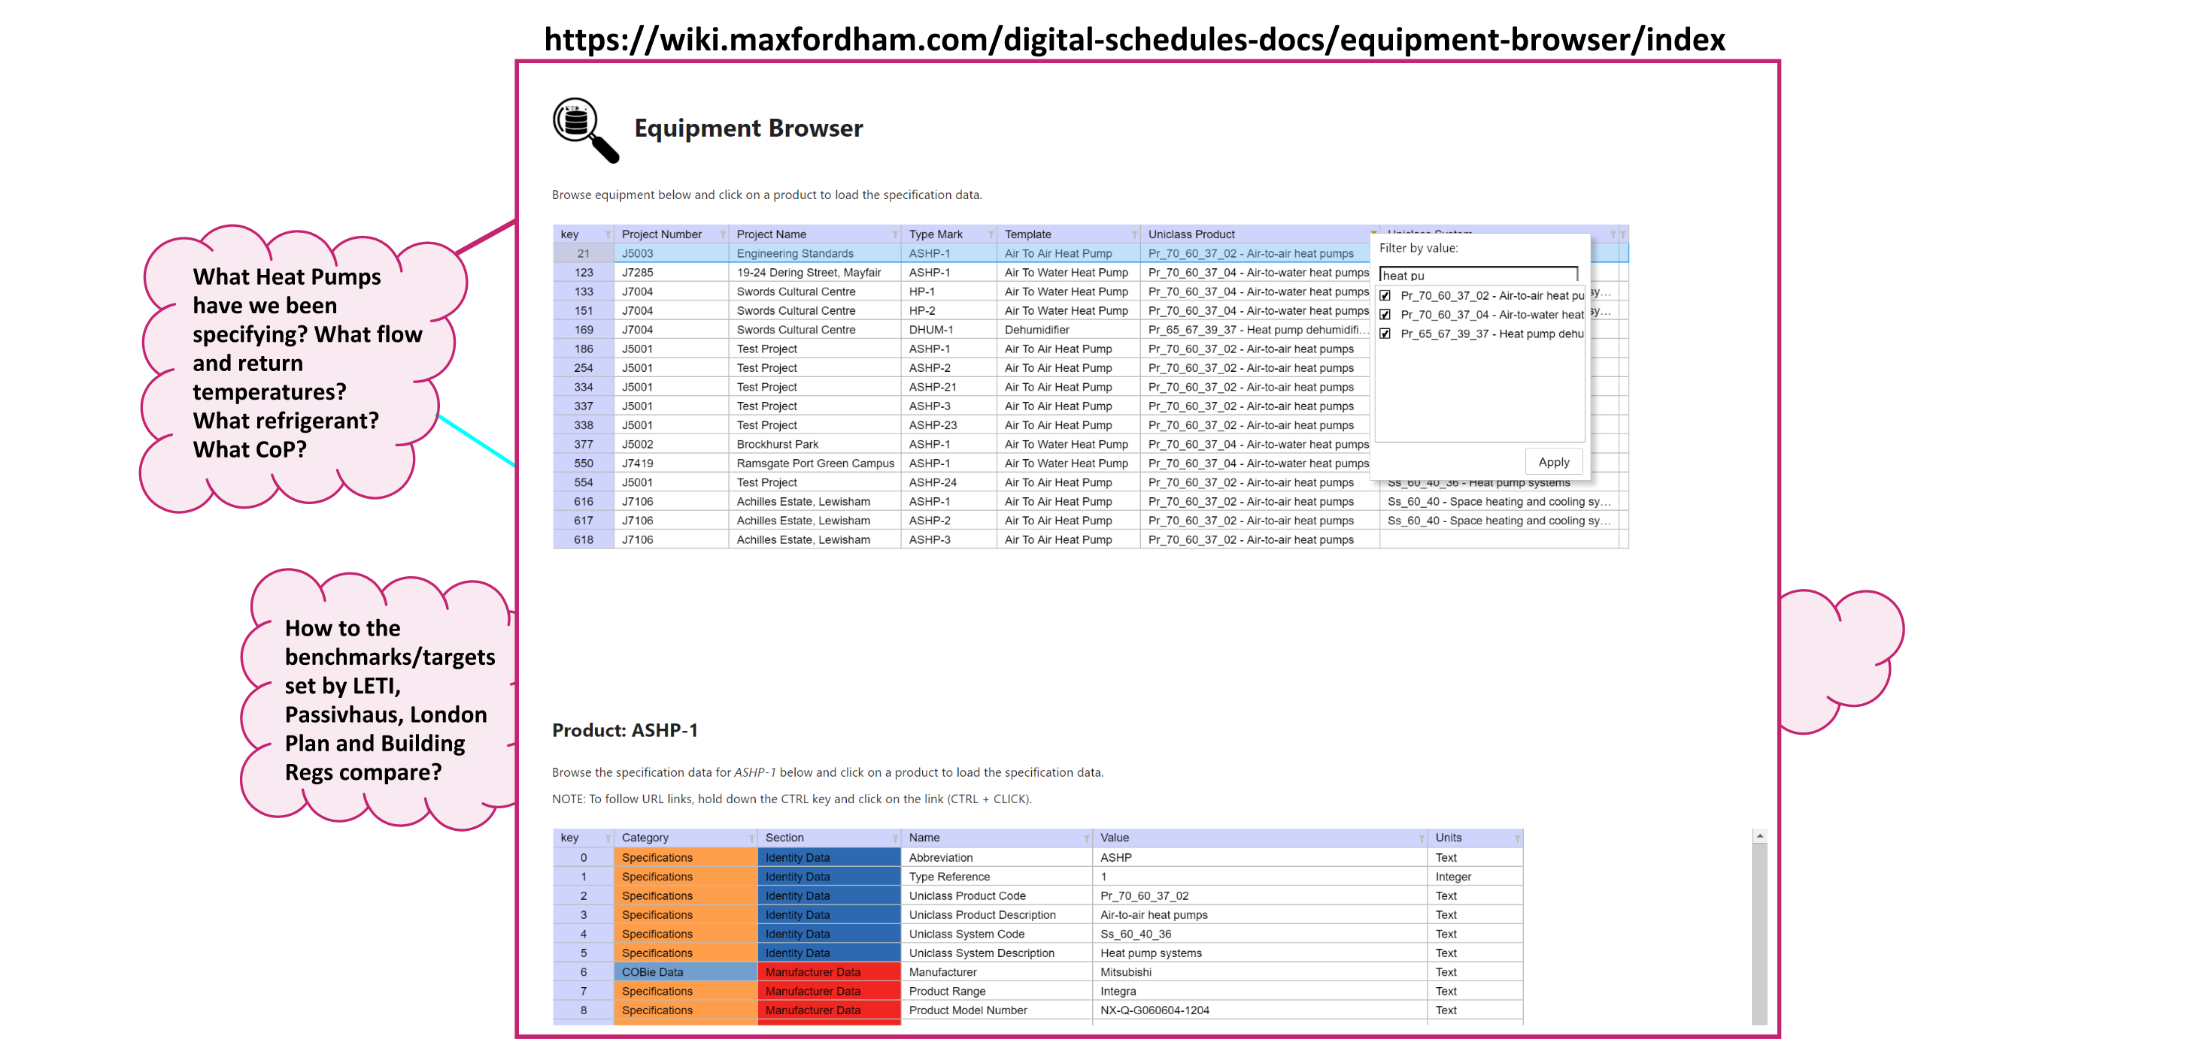
Digital Infrastructure - Engineering Insight / Dashboards

Slide 12
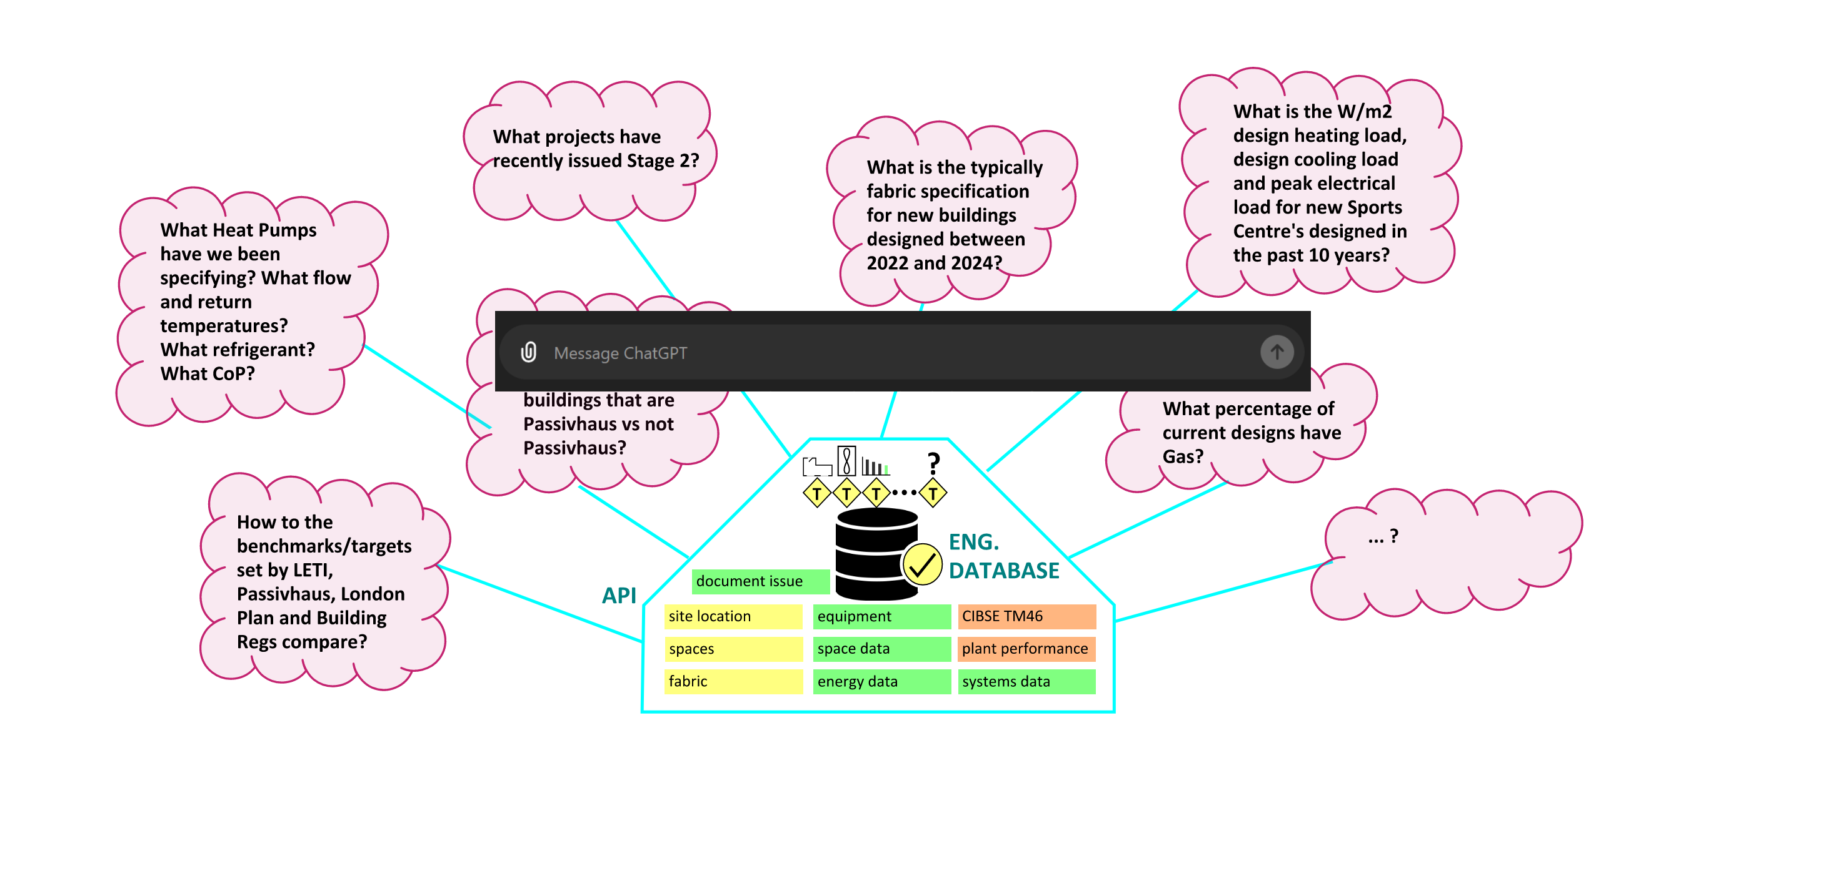
Digital Infrastructure - Engineering AI

Slide 13
Monitor Realtime Engineering Data
Dont try and capture data on the side!
Apps that collate / operate on structured data have monitoring built-in
The collected data drives insight, review and lessons learnt
Our designs should contain all the data we need! Use it!

Slide 14
Data added by apps will be integrated into the WebApp

Slide 15
WIP Demo

