Slide 1
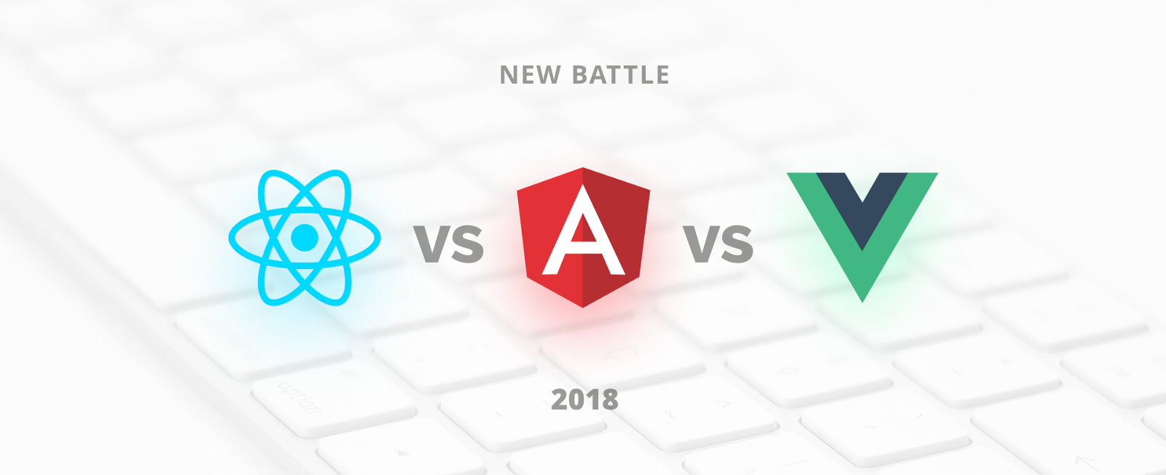

Slide 2
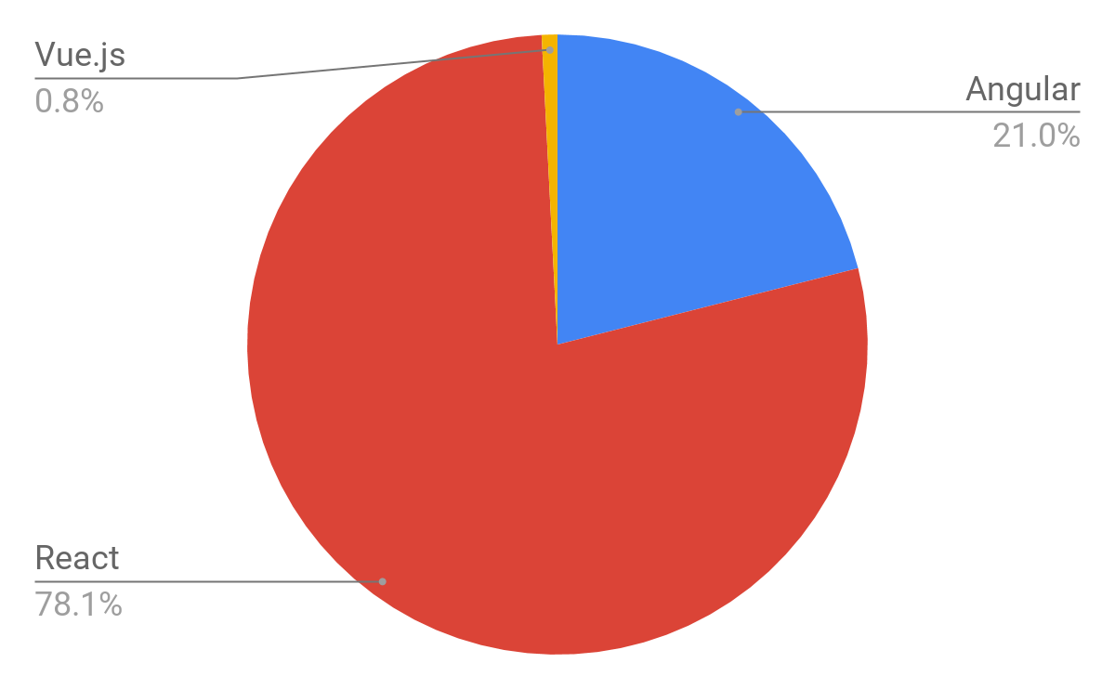

Slide 3
Pros and Cons
Angular
React
Vue
Angular is superheroic JavaScript MVVM framework, founded in 2009, which is awesome for building highly interactive web applications.
ReactJS is a JavaScript library, open sourced by Facebook in 2013, which is great for building huge web applications where data is changeable on a regular basis.
Vue.js is a JavaScript framework, launched in 2013, which perfectly fits for creating highly adaptable user interfaces and sophisticated Single-page applications.

Slide 4
How To Start
Install Node.js
npm i –g create-react-app
create-react-app react-app
npm start

Slide 5
