Slide 1
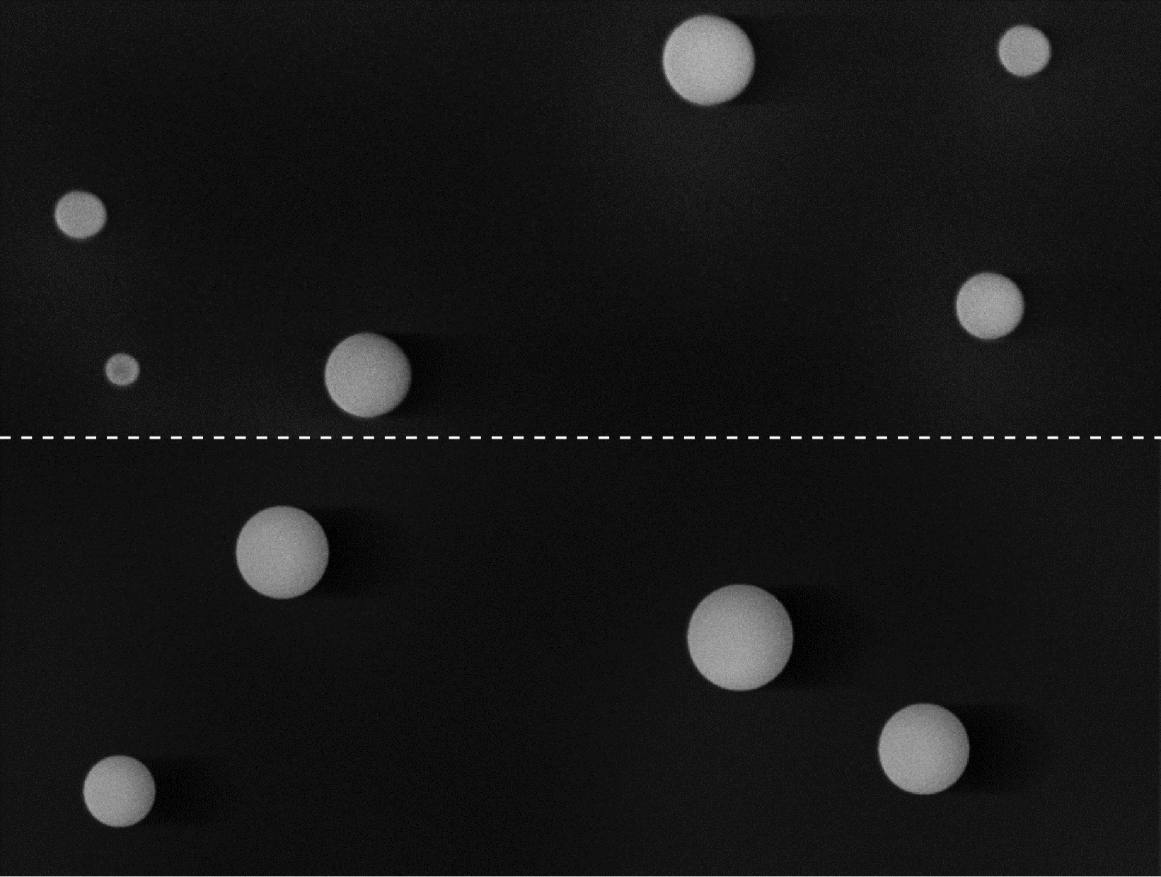
SEM Image Synthesis
real SEM image
synthetic SEM image

Slide 2
TEM vs. SEM
TEM | SEM
Image formation: based on primary electrons (PE) ⇒ 1 ray per pixel suffices to determine transmission length of PE ⇒ raytracing: feasible | Image formation: based on secondary electrons (SE) ⇒ 1 incident ray per pixel ⇒ n rays per incident ray to simulate SE ⇒ raytracing: infeasible
Characteristic image features: internal structure of agglomerates: ⇒ may be visible uniform distortions ⇒ predominantly noise and blur | Characteristic image features: internal structure of agglomerates ⇒ usually invisible very versatile image distortions ⇒ noise, blur, shadowing, etc.
Synthesis: rendering technique: raytracing ⇒ physical accuracy: high ⇒ realism: high | Synthesis: rendering technique: rasterization ⇒ physical accuracy: medium ⇒ realism: high

