Slide 1
Software Foundations
Logical Foundations — Basics

Slide 2
Coq Syntax
Vernacular: Check, Theorem, Proof, Qed, ...
Gallina: match, if, forall, ...
Ltac: intros, simpl, reflexivity, destruct, ...

Slide 3


Slide 4
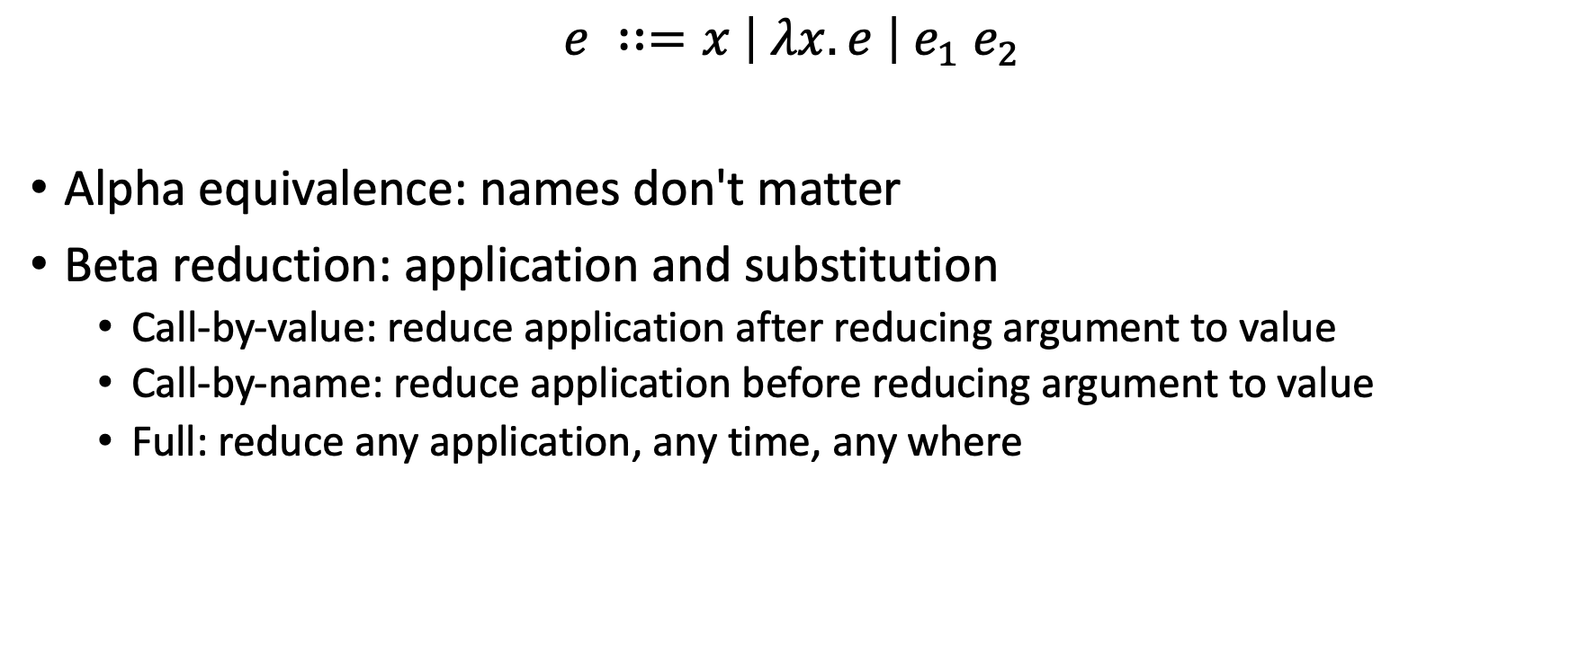
Lambda Calculus
$$e ∷=x \left| λx.e \right| e_{1} e_{2}$$
Alpha equivalence: names don't matter
Beta reduction: application and substitution
Call-by-value: reduce application after reducing argument to value
Call-by-name: reduce application before reducing argument to value
Full: reduce any application, any time, any where

Slide 5
Confluence
e
e₁
e₂
e'

Slide 6
Reduction tactics
[simpl]: "human readable" smart choices about reductions
[cbn]: newer than [simpl], some say it's even smarter
[cbv]: fully compute

Slide 7
[reflexivity]
Finishes a proof "by reflexivity of equality"
To prove [e1 = e2], fully reduce [e1] and [e2]
If the results are alpha-equivalent, succeed
Otherwise fail
So never necessary to [simpl] before [reflexivity]

Slide 8

Gallina
More than $λ$

Slide 9
Gallina adds...
Definitions (delta reduction)
Inductive types, pattern matching, recursion (iota reduction)
Let bindings (zeta reduction)
[cbv] takes flags to selectively enable each kind of reduction
[compute] is shorthand for [beta delta iota zeta]

Slide 10
Convertibility
[e1] and [e2] are definitionally equal aka convertible if they fully reduce to alpha equivalent terms.
That's what [=] means.
Convertibility is decidable in Coq: Gallina is strongly normalizing.
That's what [reflexivity] does.

Slide 11
[simpl]'s smarts
Roughly:
[simpl] does full reduction,
except it won't [delta] reduce
unless an [iota] reduction is immediately triggered.
That is,
names won't be expanded
unless doing so causes a pattern match to simplify.

Slide 12
Recursion
Reduction of recursive call is iota, not beta

Slide 13
[simpl]'s smarts (again)
Roughly:
[simpl] does full reduction,
except it won't [delta] reduce
unless an [iota] reduction is immediately triggered.
That is,
recursive functions won't be expanded
unless doing so causes a function application to simplify.

