Slide 1
Software Foundations
Logical Foundations — Preface
Notes:
We begin with Software Foundations, volume 1, which is titled "Logical Foundations", and with the Preface chapter in it. Right off the bat, I'm going to deviate from the textbook already and give you my own take on why this material is so exciting.

Slide 2

This and other stock photos in this lecture series are licensed by Michael Clarkson from Storyblocks through Screenflow.
Notes:
An undergraduate CS major takes their first programming class, which is taught in Python. Many of the undergraduate’s classmates turn in programs that raise exceptions and lose points. But this clever undergraduate discovers type hinting and mypy, a static type checker for Python. The type errors are eliminated, the exceptions are gone, and the programmer gets the top score on the assignment.

Slide 3
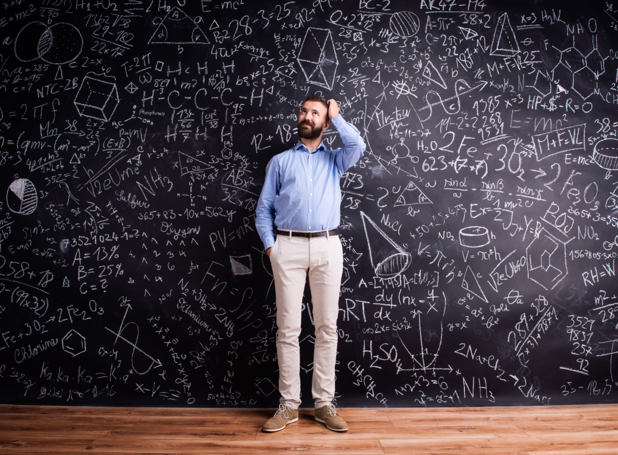
Notes:
A mathematician finds a proof of a theorem for which there is a $1 million prize. The catch is, the proof requires checking 1,834 special cases by hand. It would take 100 person-years to do that. So the mathematician writes a program that checks them mechanically in about 1000 hours. The prize committee is deadlocked: half of them want to award it, but the other half don’t accept this technique as truly proving the theorem.

Slide 4

Notes:
A PhD student develops the next big programming language, the one that everyone is going to want to adopt for smart contracts stored on the blockchain . It has an easy-to-use type system that hides incredible complexity from developers. The correctness of that type system is established by a 200 page proof in a dissertation. The student’s doctoral committee —a trio of busy professors— doesn’t have time to check all the proofs. But they form a startup anyway. Two years later, the money is all gone because an unnoticed error means the language can never succeed.

Slide 5
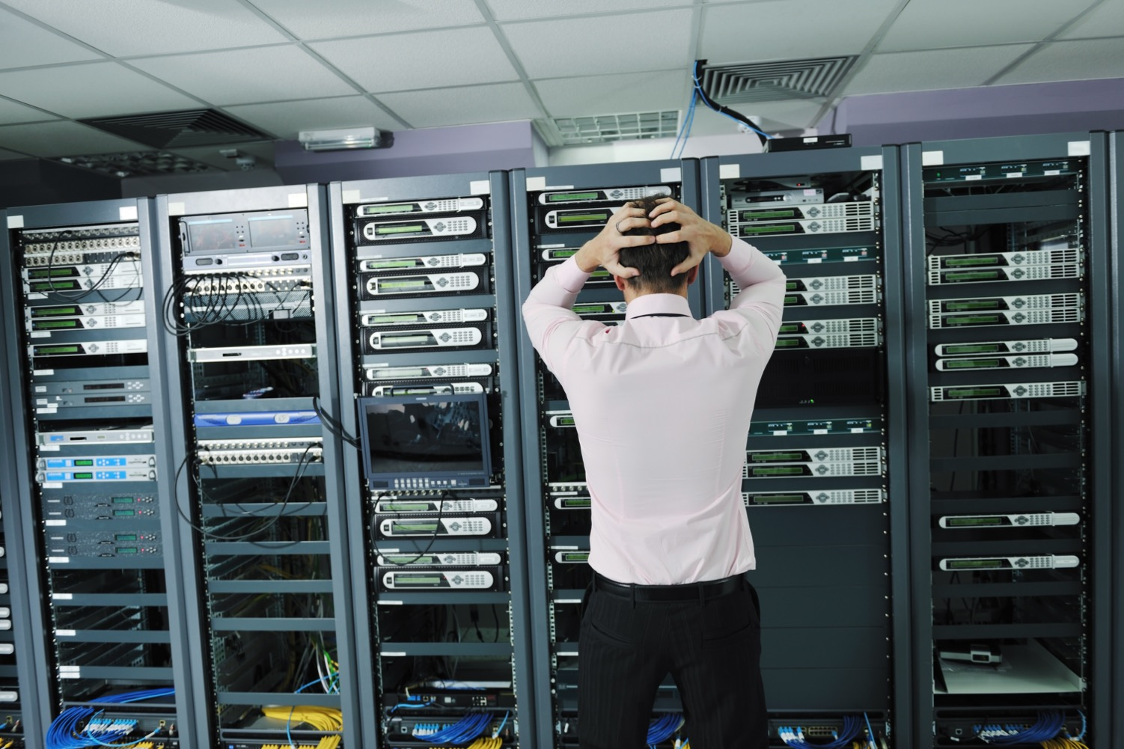
Notes:
A developer at a FAANG company pushes new code into production. Within minutes, the company’s services become unavailable. The outage is all over the news that day. Stock prices fall and profits are down, at least temporarily.

Slide 6
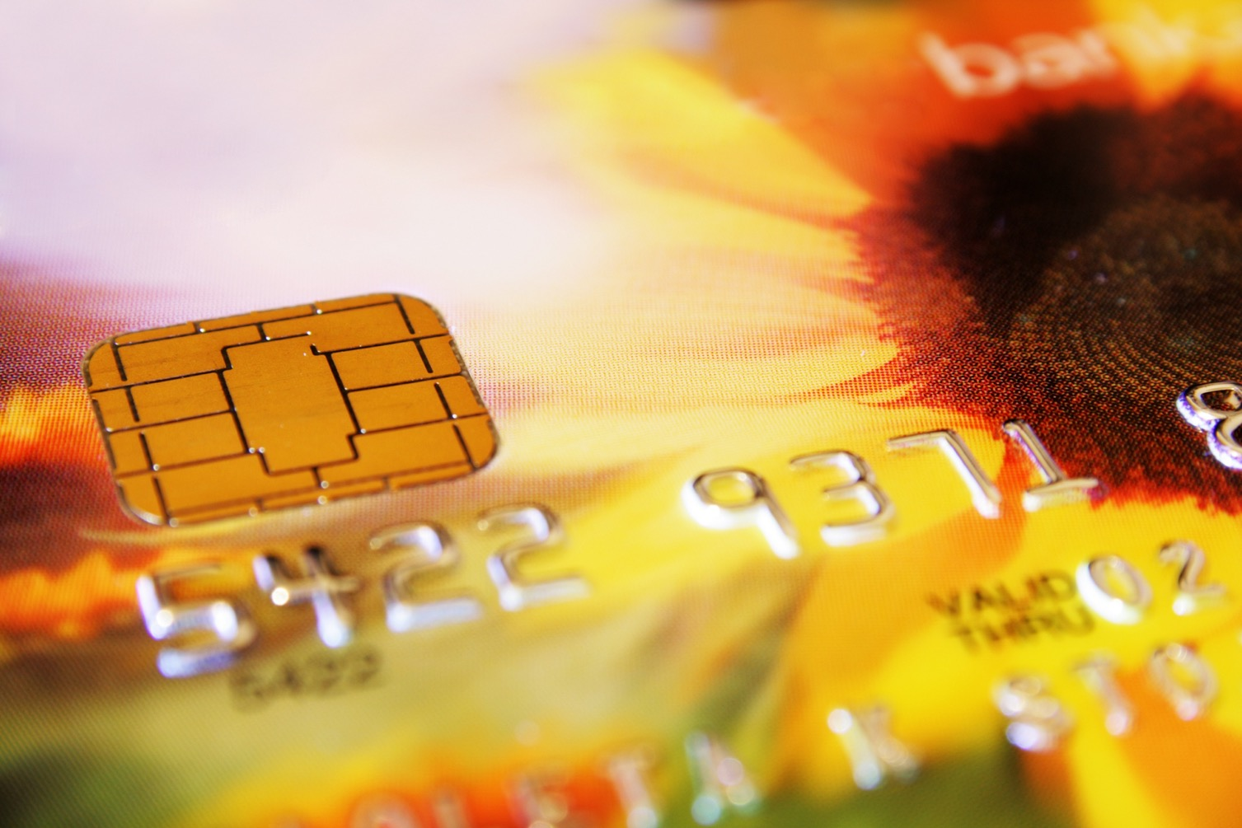
Notes:
A bank changes from magnetic-stripe cards to cards that have an embedded microprocessor running Java code. The cards can be used to conduct transactions at ATMs and point-of-sale (POS) terminals throughout the world. The intent was to defeat common forms of fraud. But, an error in the code could enable massive banking fraud.

Slide 7

Notes:
A medical device is implanted in a patient’s body, or is used for external treatment. The device runs a program that manipulates energy, or dispenses radiation, or administers chemicals. The correctness of the program is literally is a matter of life or death.

Slide 8
#AmIRite
How do I know the code is correct?
Notes:
From the smallest to the biggest situations, these programmers want to know that their code is correct. Maybe you have, too. But how would you know?

Slide 9
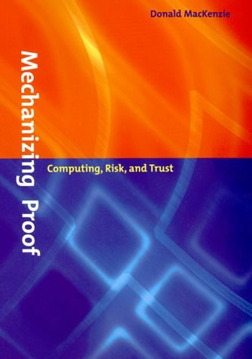
Sources of Knowledge
[MacKenzie 2001]
Authority
Inductive reasoning
Deductive reasoning

Slide 10
Type Systems

Slide 11
The Software Crisis

Slide 12
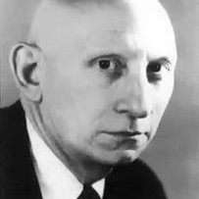
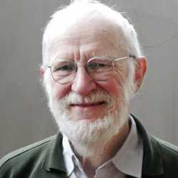
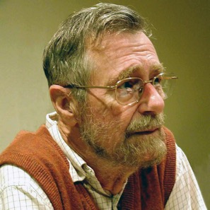
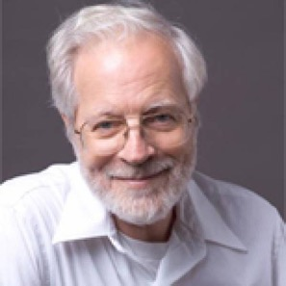

Slide 13
Robert Barton:
"We were all guilty, essentially of concealing the fact that big pieces of software were increasingly disaster areas."
Everybody else:
"YES!"

Slide 14
Dijkstra:
"When the system has been delivered we shall not live in ... perpetual fear [...], for we shall have proved the correctness [...] with a rigor and explicitness that is unusual for the great majority of mathematical proofs."

Slide 15
Formal Methods
Formal specifications
Formal specifications + proofs about programs
Formal specifications + proofs about programs + machine checking

Slide 16
Foundations of Mathematics

Slide 17
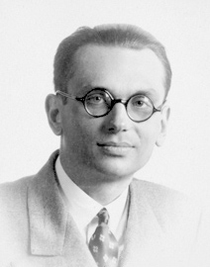
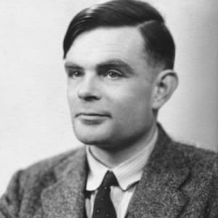
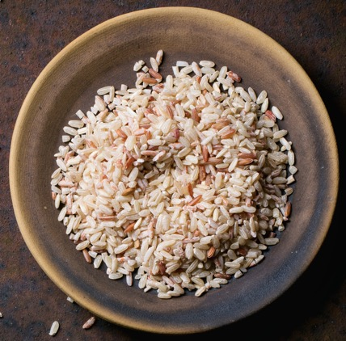

Slide 18
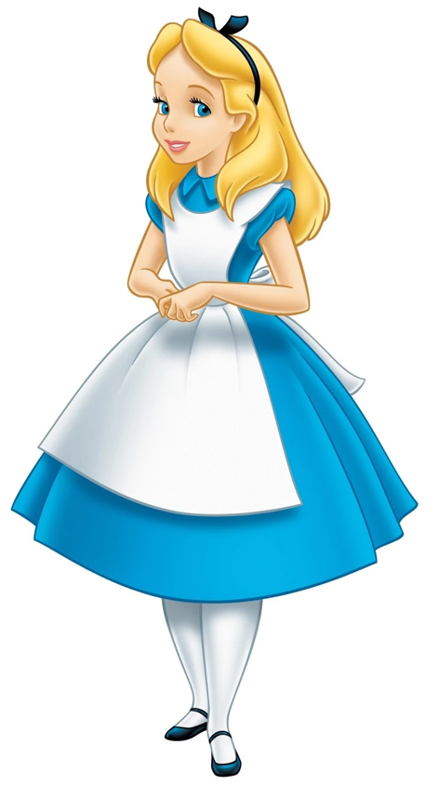
Alice:
"Why, sometimes I've believed as many as six impossible things before breakfast."

Slide 19
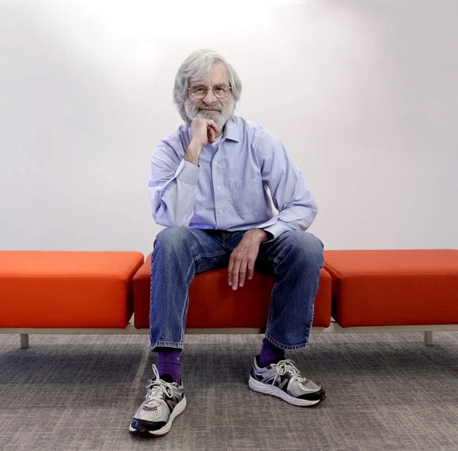
TLA+
Intel: cache coherence protocol
Microsoft: Xbox 360
Amazon: DynamoDB, S3, etc.

Slide 20
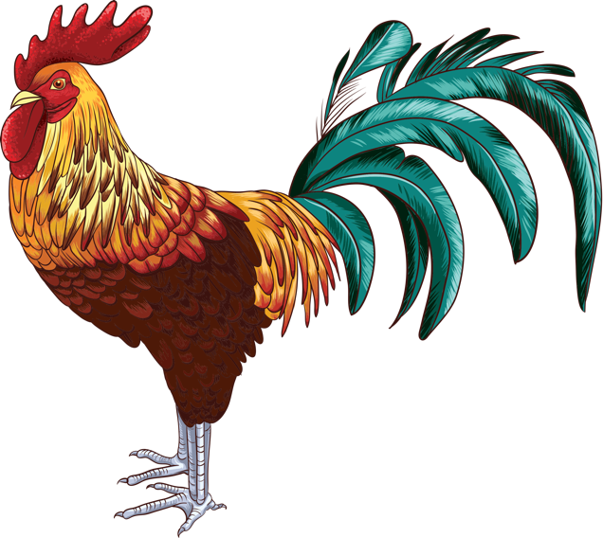
Coq

Slide 21
Coq wiki:
"[The similarity to a vulgar word] has already led to some women turning away from Coq and others getting harassed when they said they were working on Coq. It also makes some English conversations about Coq with lay persons simply more difficult."
Class rule: we don't joke about the name.

Slide 22
Coq
"Rooster": a symbol of France
Calculus of constructions
Thierry Coquand
Won 2013 ACM Software System Award
See Coq'Art book

Slide 23
Type Theory
Martin-Löf
NuPRL [Robert Constable]
Calculus of Constructions [Gérard Huet and Thierry Coquand]
Calculus of Inductive Constructions [Coquand and Christine Paulin-Mohring]

Slide 24
Coq Features
Define computable functions and logical predicates
State mathematical theorems and software specifications
Develop formal proofs of theorems, interactively
Machine-check those proofs
Extract verified programs to OCaml, Haskell, Scheme

Slide 25
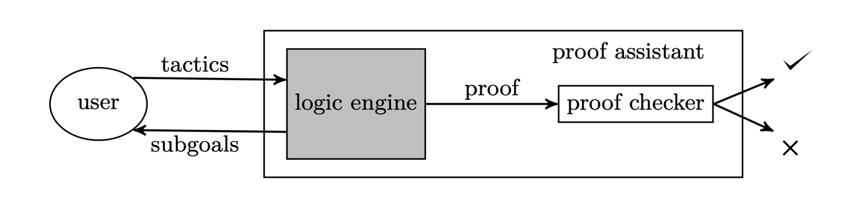
Image source: QED at large, Ringer et al., 2019

Slide 26
Benefits of Studying Software Foundations
Formulate functions and predicates in a type theory
State formal theorems and formal software specifications
Prove theorems completely formally with a proof assistant
Understand proof-checking as type-checking
(Coq expertise is a side effect)

Slide 27
Three Recent Great Works in Formal Verification

Slide 28
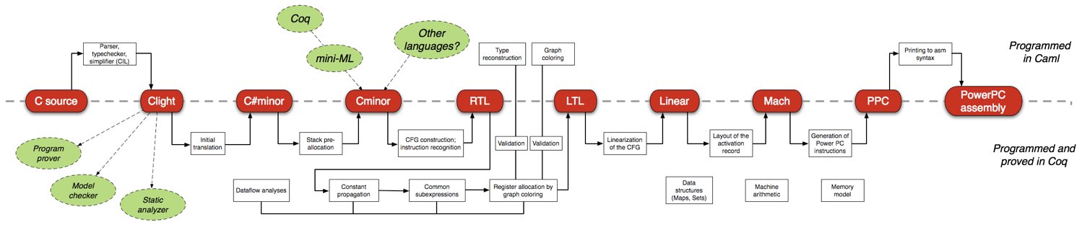
CompCert
"﻿CompCert is the only compiler we have tested for which Csmith cannot find wrong-code errors. This is not for lack of trying: we have devoted about six CPU-years to the task. The apparent unbreakability of CompCert supports a strong argument that developing compiler optimizations within a proof framework, where safety checks are explicit and machine-checked, has tangible benefits for compiler users." [Yang et al. 2011]
[Leroy et al. 2009ff]

Slide 29
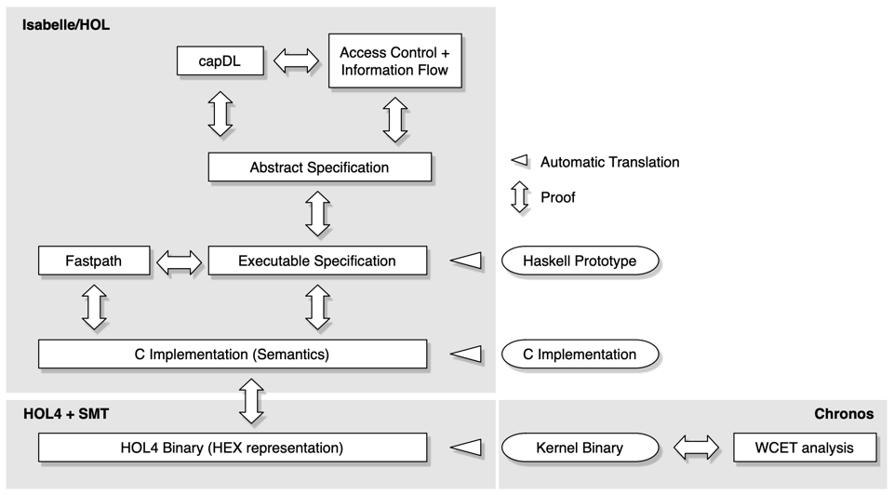
seL4
[Klein et al. 2009ff]

Slide 30
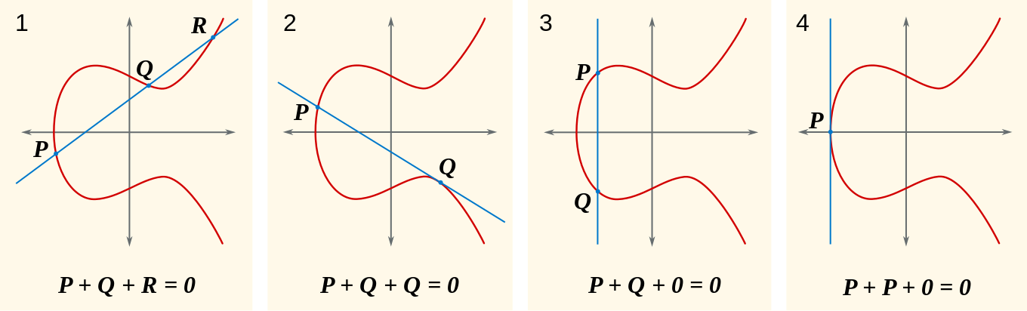
Fiat Cryptography
[Chlipala et al. 2019ff]

Slide 31
Formal Methods are Controversial
[Hall 1990]
"Formal methods are controversial. Their advocates claim they can revolutionize development. Their detractors think they are impossibly difficult. Meanwhile, for most people, formal methods are so unfamiliar that it is difficult to judge the competing claims. […] [S]ome of the beliefs about formal methods have been exaggerated and have acquired almost the status of myths."

Slide 32
7 Myths
[Hall 1990]
Formal methods can guarantee that software is perfect
Formal methods are all about theorem proving
Formal methods are only useful for safety-critical systems
Formal methods require highly trained mathematicians
Formal methods increase the cost of development
Formal methods are unacceptable to users
Formal methods are not used on real, large-scale software

Slide 33
