Slide 1
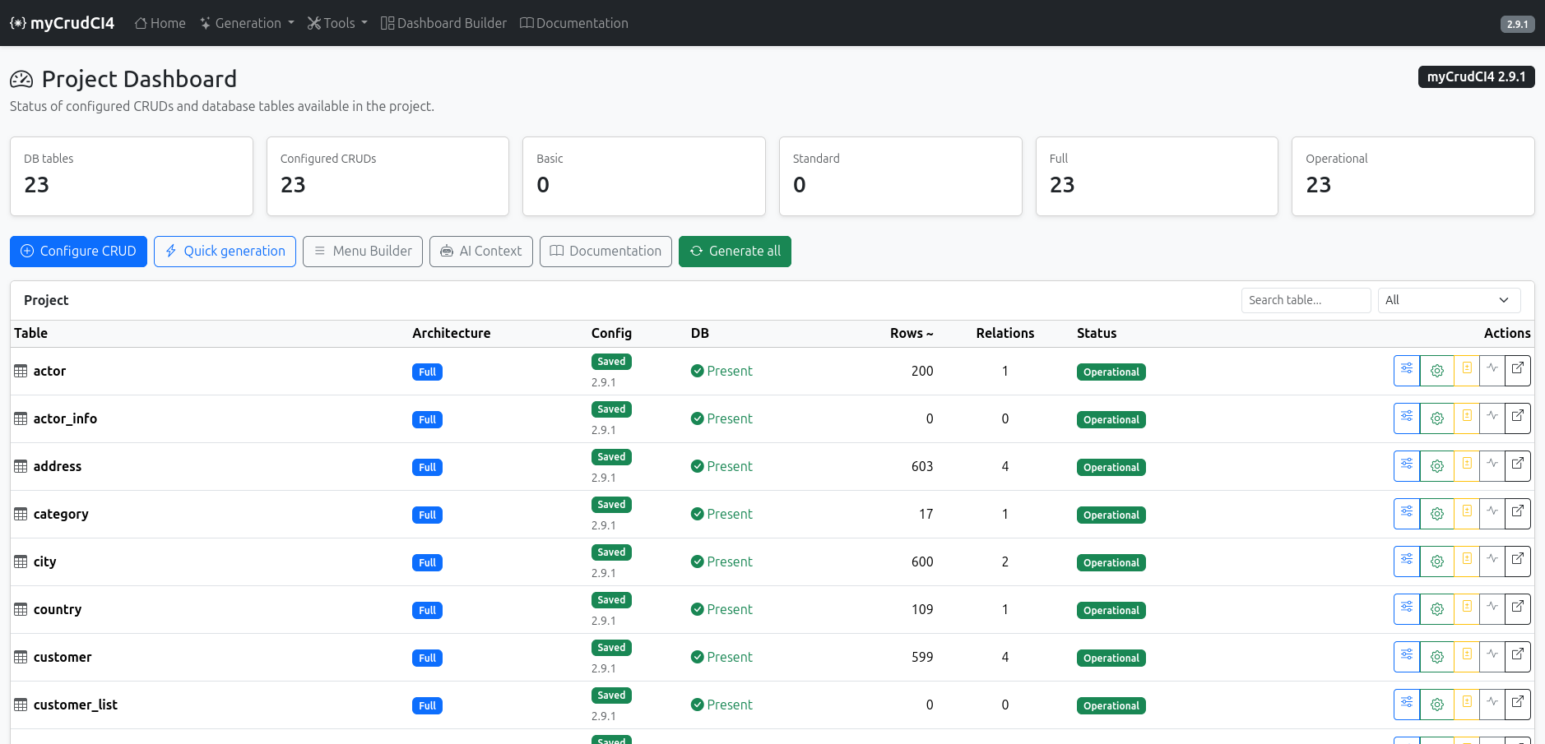
myCrudCI4
CRUD & Application Scaffolding Generator for CodeIgniter 4
Stable release 2.9.1
schema → builder → staging → publish
Basic • Standard • Full
Generate readable CI4 code from a real database schema, inspect it, then publish it when ready.
github.com/maxgamb/myCrudCI4

Slide 2
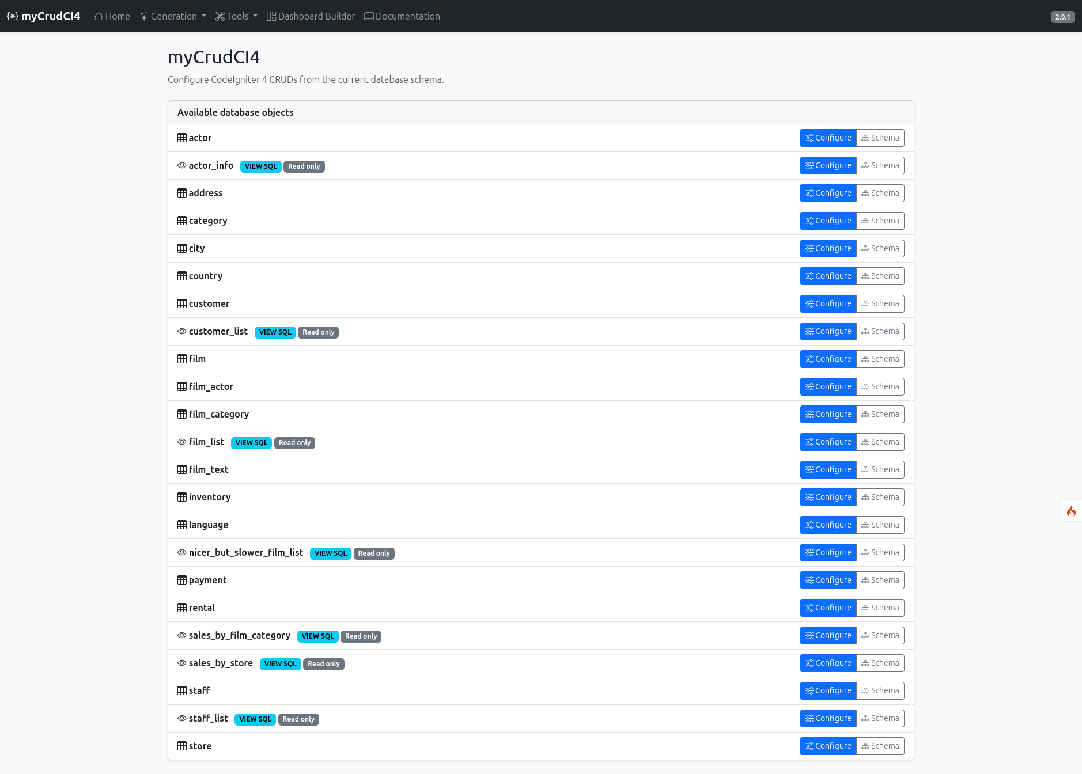
myCrudCI4 2.9.1
Why myCrudCI4?
A practical workflow for CI4 projects that start from an existing database.
Turns database tables and views into configured CRUD resources.
Keeps generated code readable: Models, Controllers, Views, Rules, Services and APIs.
Writes first to app/Generated so developers can review before publishing.
Supports real relationships, navigation, exports, uploads, APIs and dashboards.
23
3
1
Sakila tables detected
Architectures
Review staging area
myCrudCI4 • Community preview • 2

Slide 3
myCrudCI4 2.9.1
Install, configure, generate
A stable GitHub release can be cloned and tested like a normal CodeIgniter 4 project.
Configure the DB in .env.
git clone --branch v2.9.1 --depth 1 https://github.com/maxgamb/myCrudCI4.git myCrudCI4
cd myCrudCI4
composer install
cp env .env # configure database
php spark serve
open http://localhost:8080/index.php/mycrud
Open the myCrudCI4 interface.
Use Quick Global for initial setup.
Use Builder for detailed customization.
Generate to staging, then publish.
myCrudCI4 • Community preview • 3

Slide 4
myCrudCI4 2.9.1
Project Dashboard
A single overview of database objects, configured CRUDs and operational status.
DB
Generate
Search
Status
Actions
schema-aware
all configured CRUDs
project tables
saved / operational
configure / inspect
myCrudCI4 • Community preview • 4

Slide 5
myCrudCI4 2.9.1
Quick Global: start from the database
Select tables, detect views, and create persistent configurations fast.
DATABASE OBJECTS
Tables and SQL views are listed side by side.
Read-only resources are recognized by the schema.
Configuration is saved into app/MyCrudConfig/.
The release itself remains clean until the user configures a project.
Quick Global is the fastest path from schema discovery to a first generated application.
myCrudCI4 • Community preview • 5

Slide 6
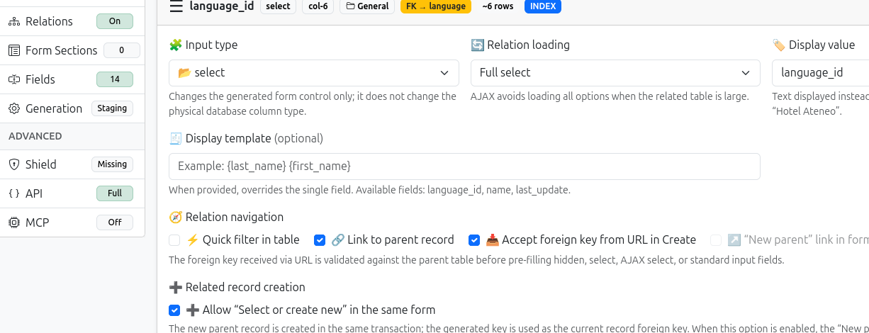
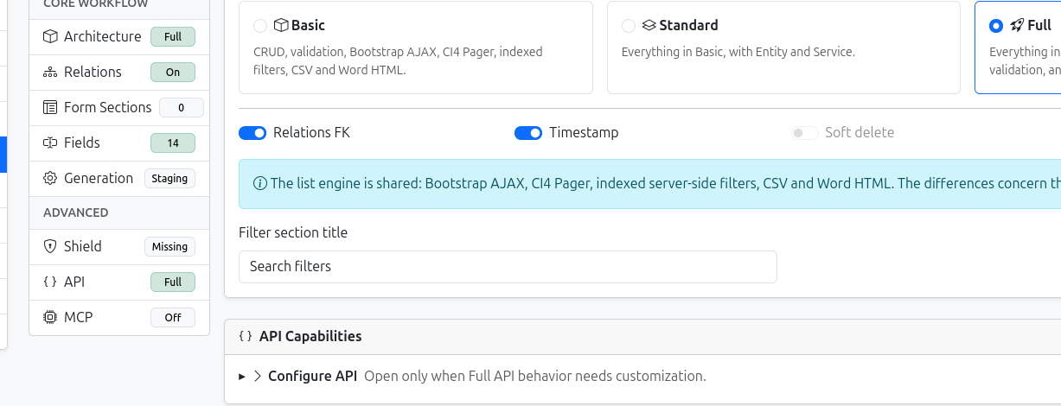
myCrudCI4 2.9.1
Builder: customize architecture and fields
Choose Basic, Standard or Full, then tune how every field behaves.
Full architecture adds REST API, resources, API validation and OpenAPI.
Fields combine database facts with application choices.
Schema remains authoritative for PK, FK, nullability and DB-managed timestamps.
Generation writes to staging until the developer publishes.
myCrudCI4 • Community preview • 6

Slide 7
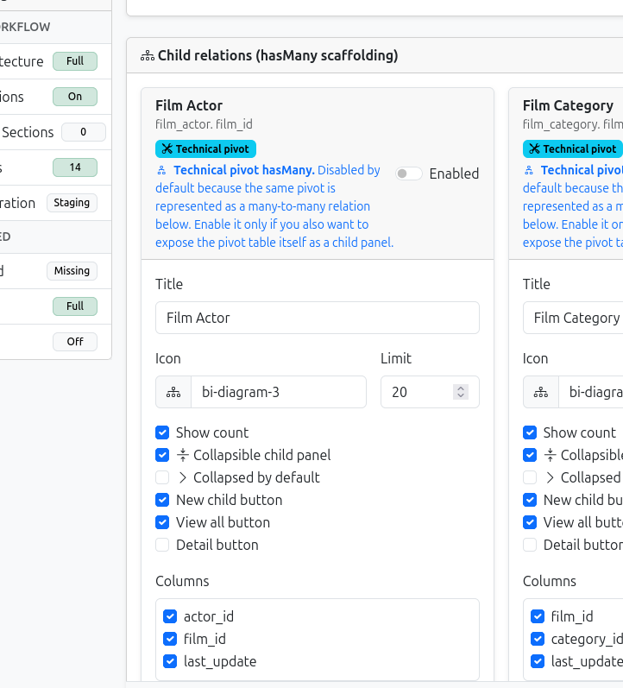
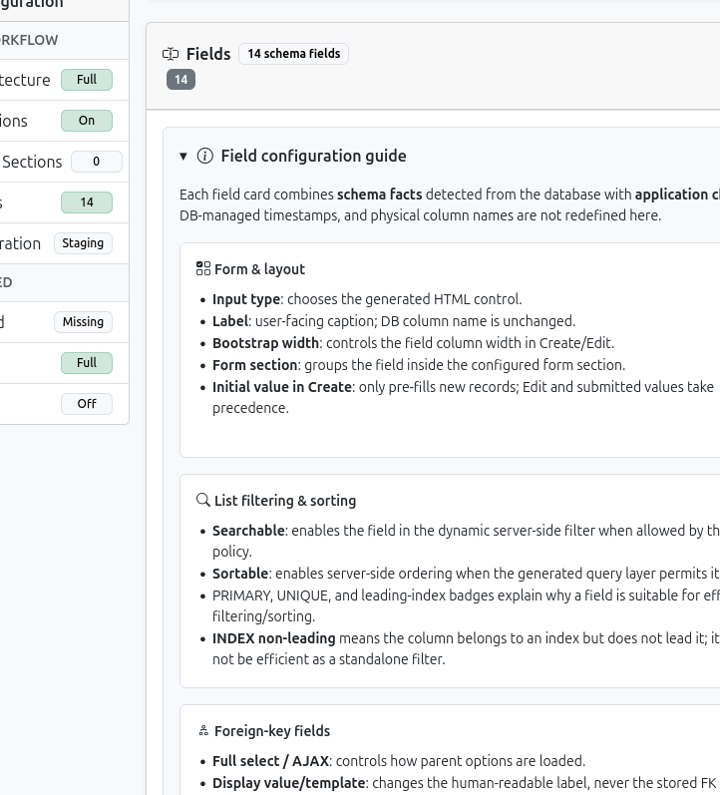
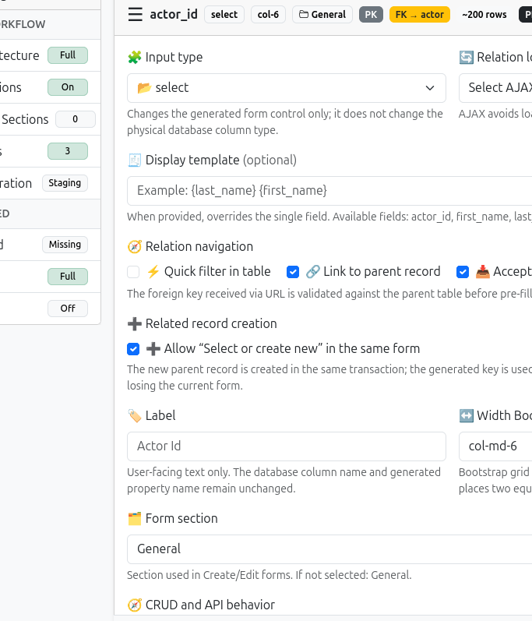
myCrudCI4 2.9.1
Relationships are first-class
Foreign keys, contextual navigation, hasMany panels and many-to-many pivots are generated explicitly.
BelongsTo
Child panels
Pivot-aware M:N
myCrudCI4 • Community preview • 7

Slide 8
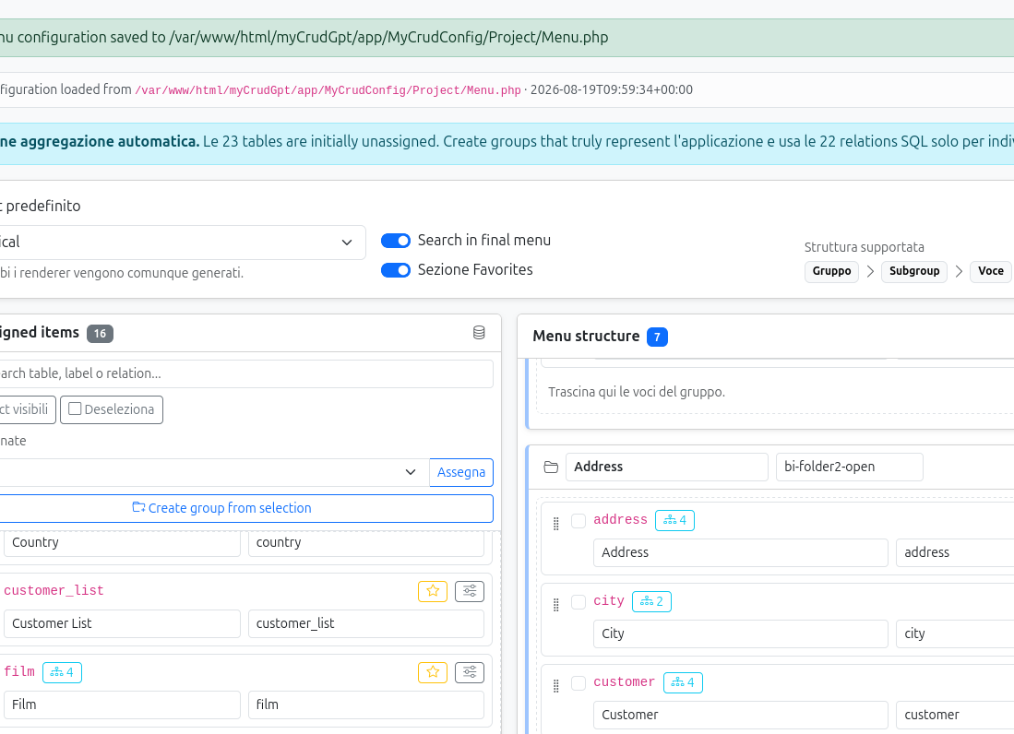
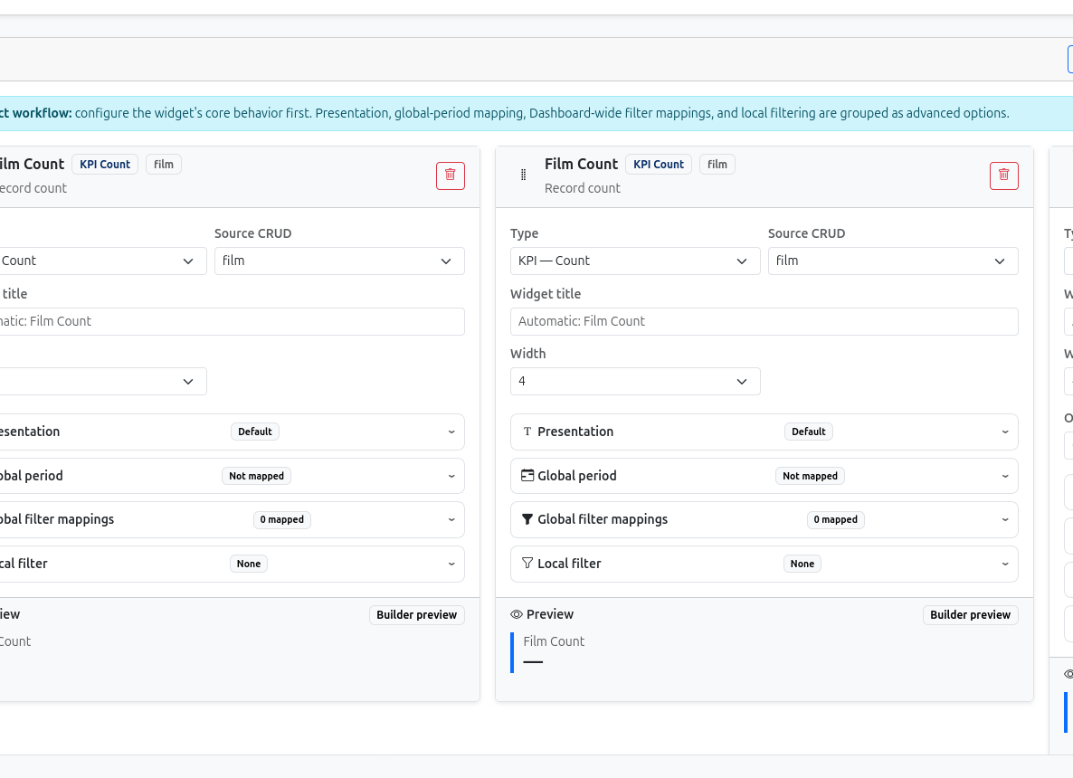
myCrudCI4 2.9.1
Menus and dashboards are generated too
The generator helps structure navigation and build operational dashboards from configured CRUDs.
Menu Builder
Dashboard Builder
Menu groups, favorites, relation hints
KPI, aggregate, chart, recent records
myCrudCI4 • Community preview • 8

Slide 9
myCrudCI4 2.9.1
Generator-only release layout
The repository contains the tool. Your application project contains the generated code.
1
Configure
2
Generate
3
Review
4
Publish
app/MyCrudConfig
app/Generated
staging code
app/ runtime
Stable repository: generator, Builder, commands, diagnostics and documentation.
User project: configurations, app/Generated, published CRUDs and custom extensions.
Recommended customization point
app/Services/Extensions/<Entity>ServiceExtension.php
myCrudCI4 • Community preview • 9

Slide 10
myCrudCI4 2.9.1
Share with the CodeIgniter community
Position it as a working open-source generator and invite architectural feedback.
What to highlight
Built for CodeIgniter 4 projects with existing databases.
Generated code is inspectable before publishing.
Supports Basic, Standard and Full architectures.
Includes Builder, Quick Global, Menu and Dashboard Builder.
Looking for community feedback on architecture and conventions.
github.com/maxgamb/myCrudCI4
Stable: v2.9.1
myCrudCI4 • Community preview • 10

