Slide 1

Développement
Atteindre
Durée de vie

Slide 2
Demographisch
Verbringen
Lebenszeit

Slide 3

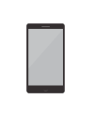



Key insights
Spend
Lifetime
Best performing
Best performing
Best performing
Best performing
Best performing
Demographic
Device
Platform
Ad Set
Ad
Male 25-34
Mobile app
facebook
Change the world by being yourself
Simplicity is the ultimate sophistication
With spend of 1368 EUR
With spend of 4443 EUR
With spend of 2534 EUR
With spend of 3643 EUR
With spend of 1523 EUR

Slide 4




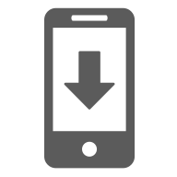
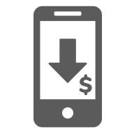
Results
As long as you like
Spend
Reach
Frequency
5008 Yen
8631 Yen
2.34 Yen
1000 Yen
9632 Yen
3.31 Yen
CPC
App Installs
Cost per App Install
5008 Yen
543 Yen
75 Yen
1000 Yen
654 Yen
85 Yen

