Slide 1

Development
Reach
Lifetime

Slide 2
Demographic
Spend
Lifetime

Slide 3

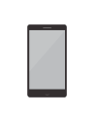



Key Insights
Spend
Lifetime
Best performing
Best performing
Best performing
Best performing
Best performing
Demographic
Device
Platform
Ad Set
Ad
Male 25-34
Mobile_app
facebook
Always on – Rocking it with long name
Always on – Rocking it with long name
With spend of 1.368 kr.
With spend of 4.443 kr.
With spend of 2.534 kr.
With spend of 3.643 kr.
With spend of 1.368 kr.

Slide 4




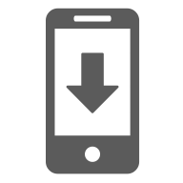
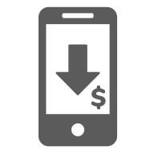
Results
Lifetime
Spend
Reach
Frequency
5.008 kr.
8.631
1023
1.000 kr.
9.231
2312
CPC
App Installs
Cost per App Install
2,34 kr.
543
75 kr.
2,31 kr.
465
85 kr.

