Slide 1
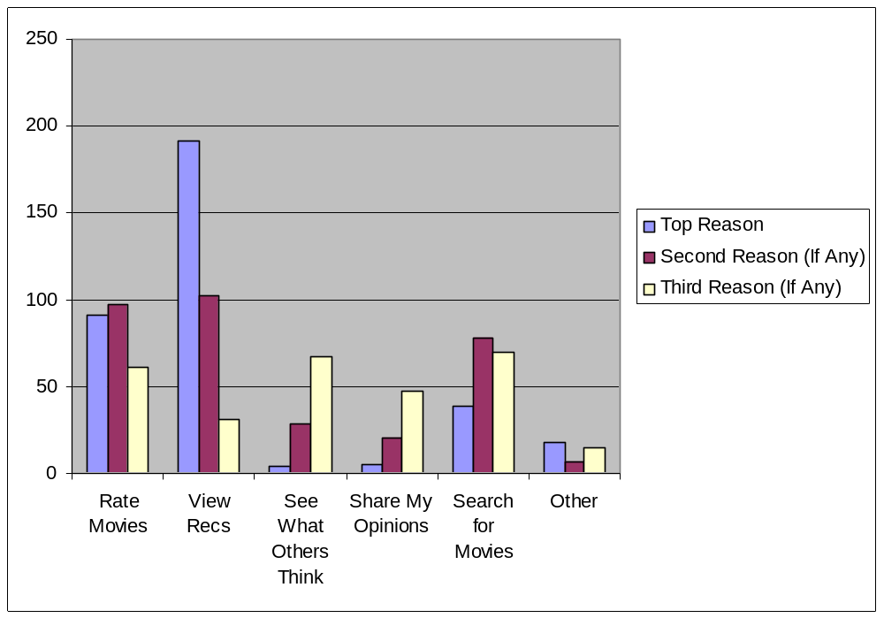
Rank Your Top 3 Reasons for Using MovieLens

Slide 2
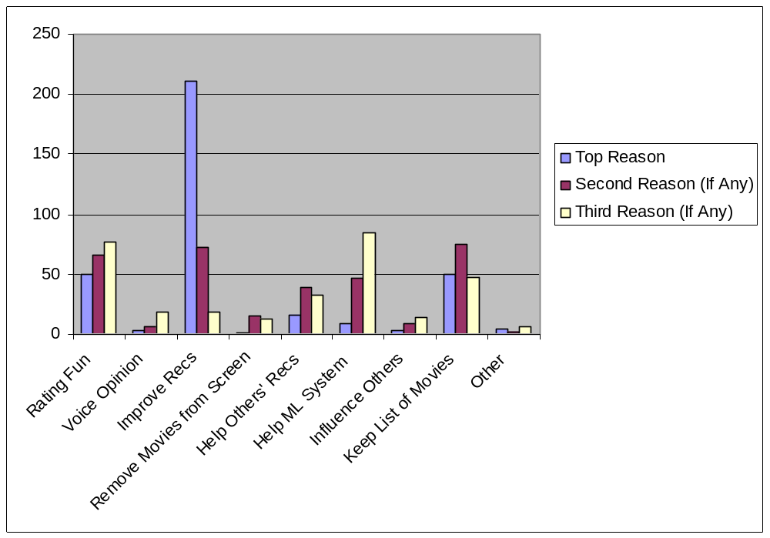
Rank your top 3 reasons to rate movies

Slide 3
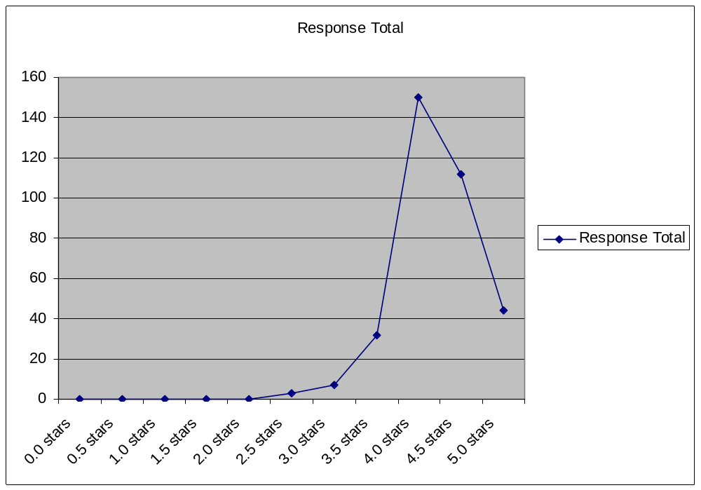
Rate MovieLens as you would rate a movie

Slide 4
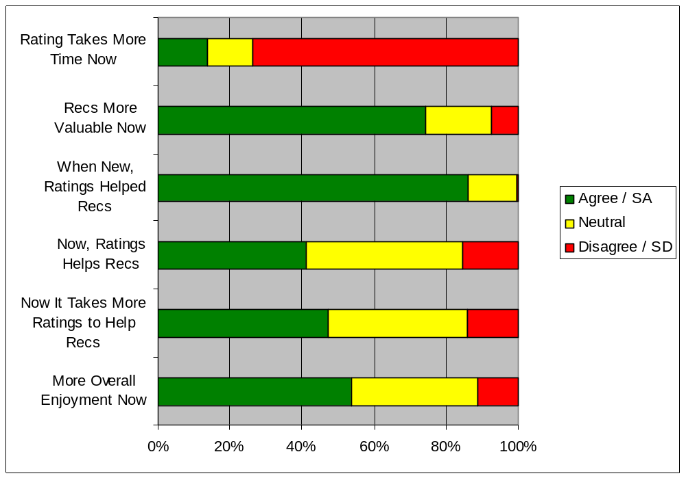
Compare your experiences: new user vs. now

Slide 5
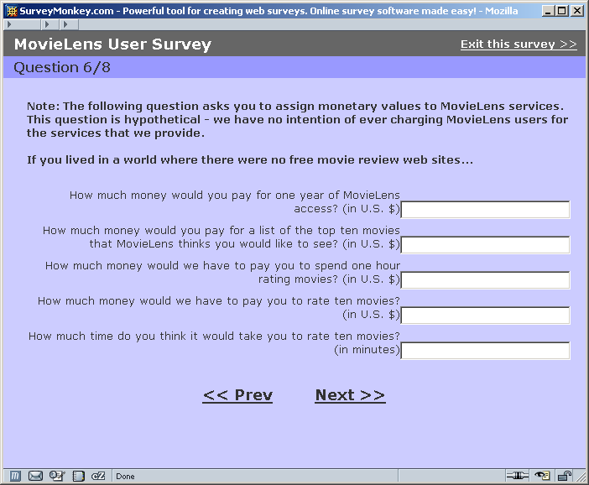
Median:
$10.00
$0.00
$5.00
$.50
5 Minutes

Slide 6
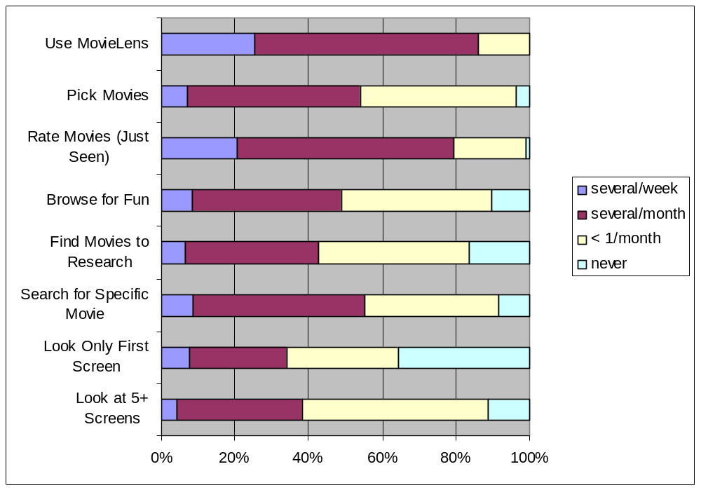
Frequency of Activities

Slide 7
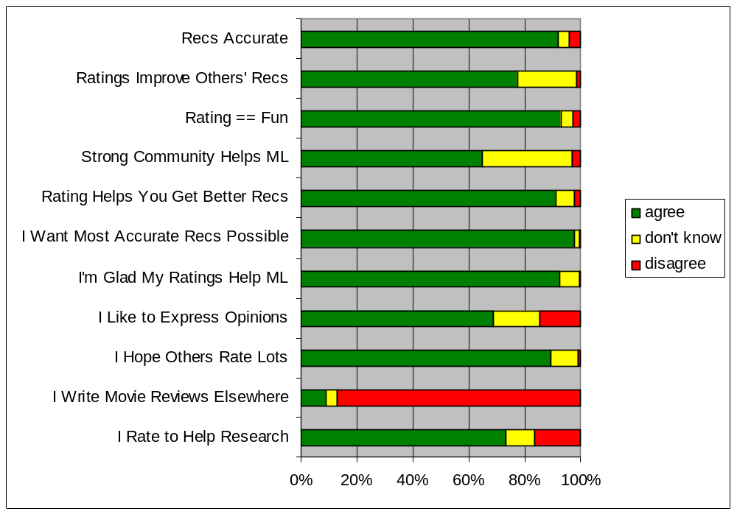
User Beliefs

