Slide 1
Power Sequence Generator
Haru Chen
haruc@Supermicro.com
6/08/2026

Slide 2
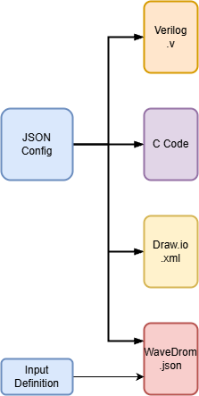
Why this tool?
One model – many deliverables
Power-up/down has many rails, PG signals, and timing constraints.
Specs drift when JSON, RTL, firmware, and diagrams are edited by hand.
PowerSequenceGenerator keeps one JSON source of truth.
It generates Verilog, C Code, Draw.io, and WaveDrom from the same graph.

Slide 3
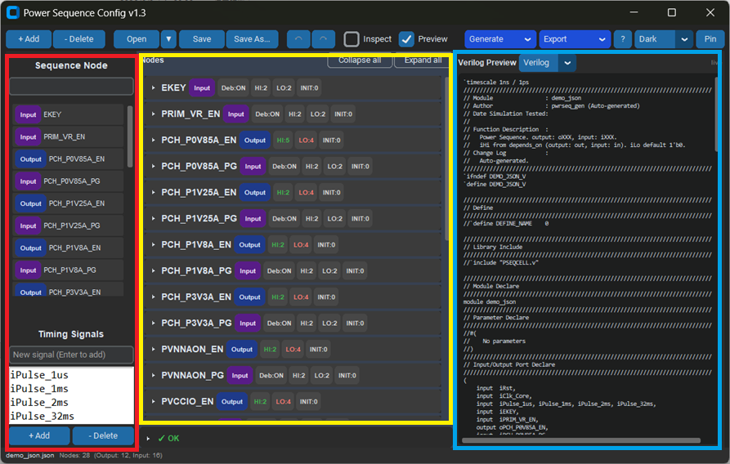
UI
Signals Declare Area: declare input/output and timing signals.
Nodes Configuration Area: Configurate input/output behavior.
Output Preview Area: Preview Verilog, C Language, and Wave Drom code.

Slide 4
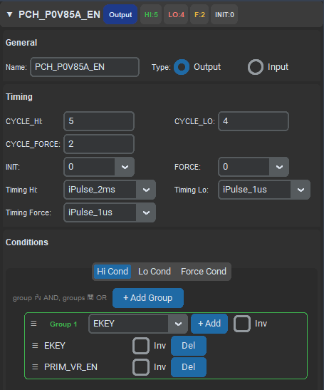
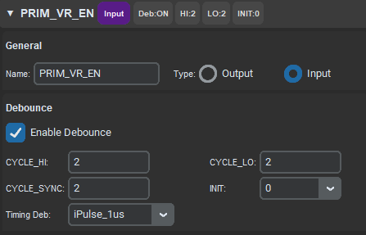
Configuration model
Input
Debounce:
Enable Debounce or Not
CYCLE_*: Debounce cycle.
Timing Deb: Debounce Timing Signals
INIT: Initial level
Output
CYCLE_*: Delay cycle for condition asserted.
INIT: Initial level
Timing *: Delay Timing Signals.

Slide 5
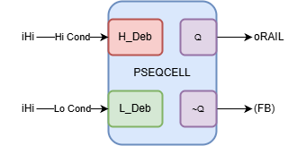
PSEQCELL in RTL
Aligned with PSEQCELL.v
Ports: iHi, iLo, iForce ➔ internal sequence FSM.
Q maps to oRAIL; ~Q used for feedback paths.
Parameters from JSON: CYCLE_HI/LO, RECOVER, etc.
DEB instances for debounced inputs.

Slide 6
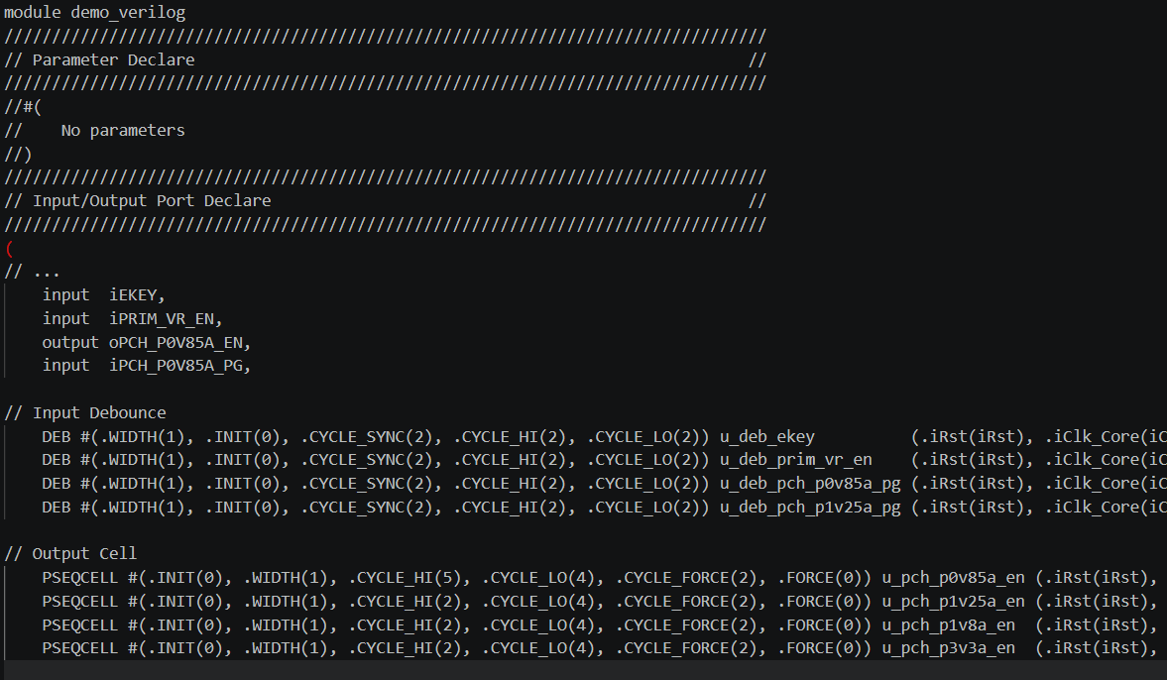
Verilog Generation
Auto-generated module
DEB instances
PSEQCELL instances

Slide 7
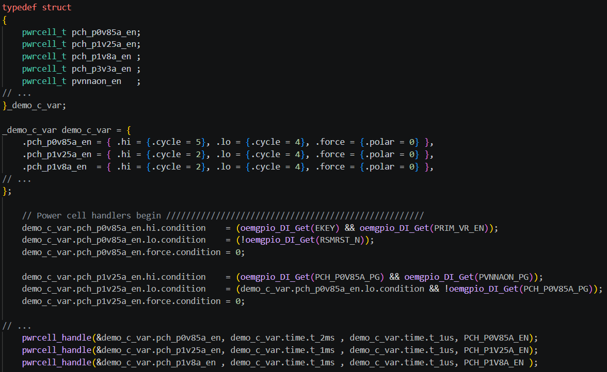
C Code Generation
Pwrcell_t scaffolding (reference: pwrcell.c/h)

Slide 8
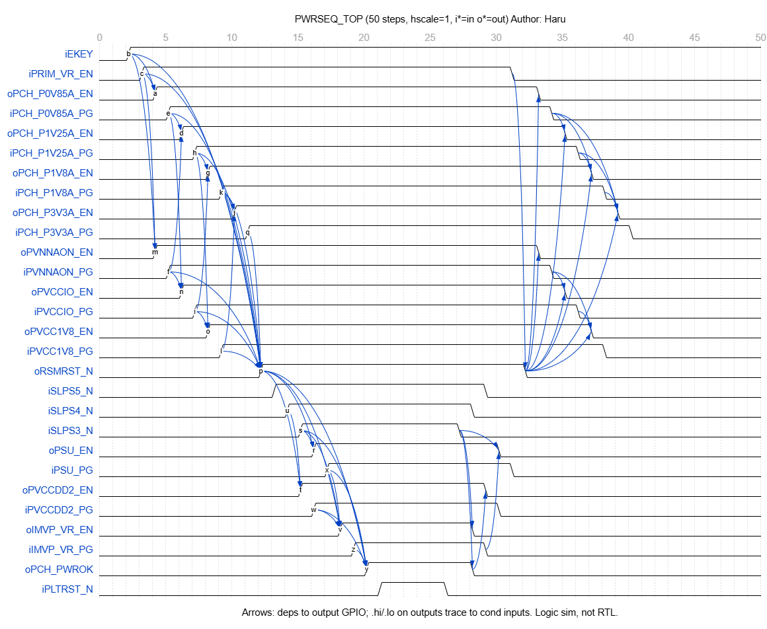
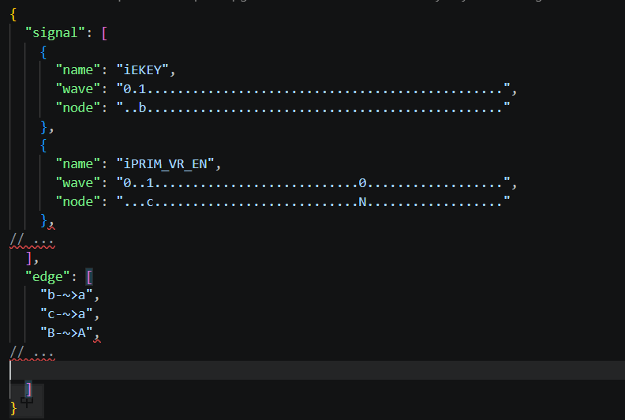
Provided WaveDrom Timing
Simulated from dependency graph (not RTL cycle-accurate)

Slide 9
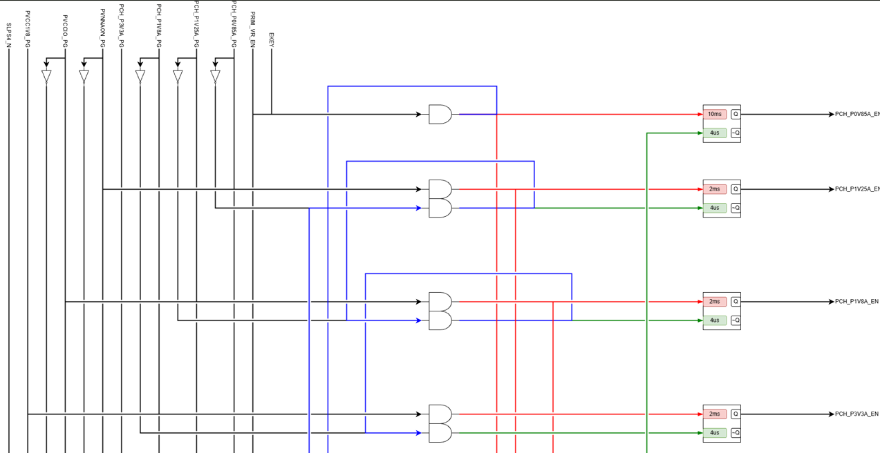
Tooling & Quality

