Slide 1
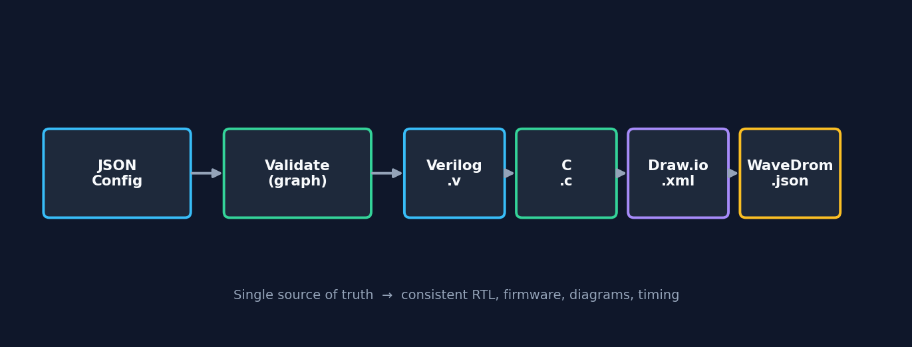
Power Sequence Generator
From dependency graph to RTL, firmware, and documentation
pwrseq_gen · v1.3 · PSEQCELL-based power sequencing

Slide 2
Why this tool?
One model — many deliverables
Power-up/down has many rails, PG signals, and timing constraints.
Specs drift when JSON, RTL, firmware, and diagrams are edited by hand.
pwrseq_gen keeps one JSON source of truth, such as doc/demo_json.json.
It generates Verilog, C, Draw.io, and WaveDrom from the same graph.

Slide 3
End-to-end pipeline
Author in GUI or JSON → validate → generate / export
The provided doc/demo_* files show the resulting JSON, Verilog, C, Draw.io, and WaveDrom artifacts.

Slide 4
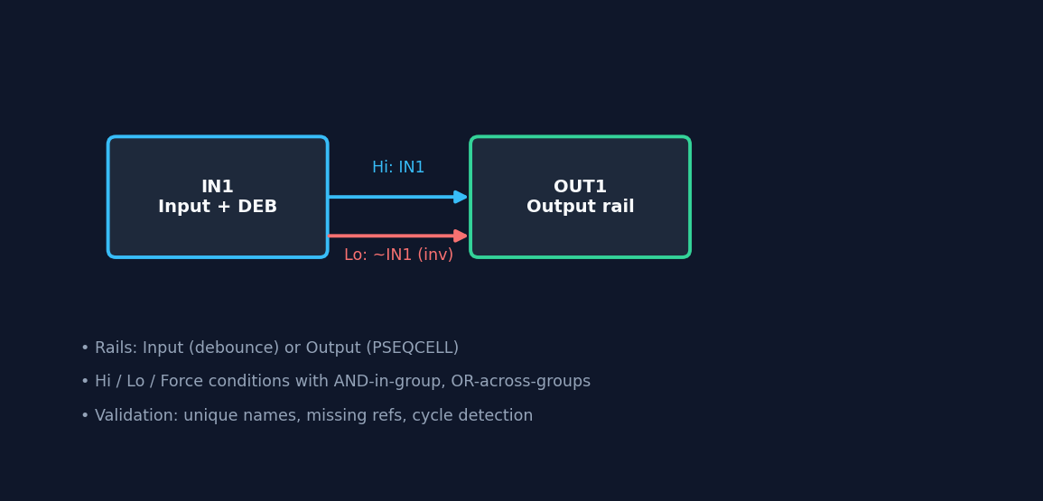
Configuration model
Rails, conditions, validation
Node = Input (debounce) or Output (PSEQCELL).
Hi / Lo / Force: AND inside group, OR across groups.
Invert & use-mode (node / Hi / Lo / self feedback).
Timing: CYCLE_*, RECOVER, INIT, FORCE, OD.
Validator catches duplicates, missing refs, cycles.

Slide 5
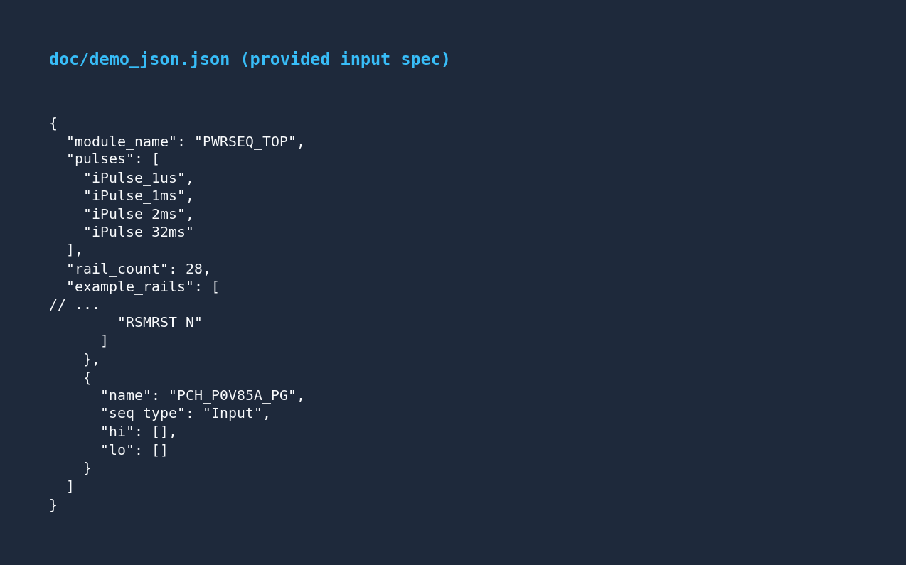
Provided input spec
doc/demo_json.json — project-level power sequence configuration
This user-provided demo config is the primary example used in this deck.

Slide 6
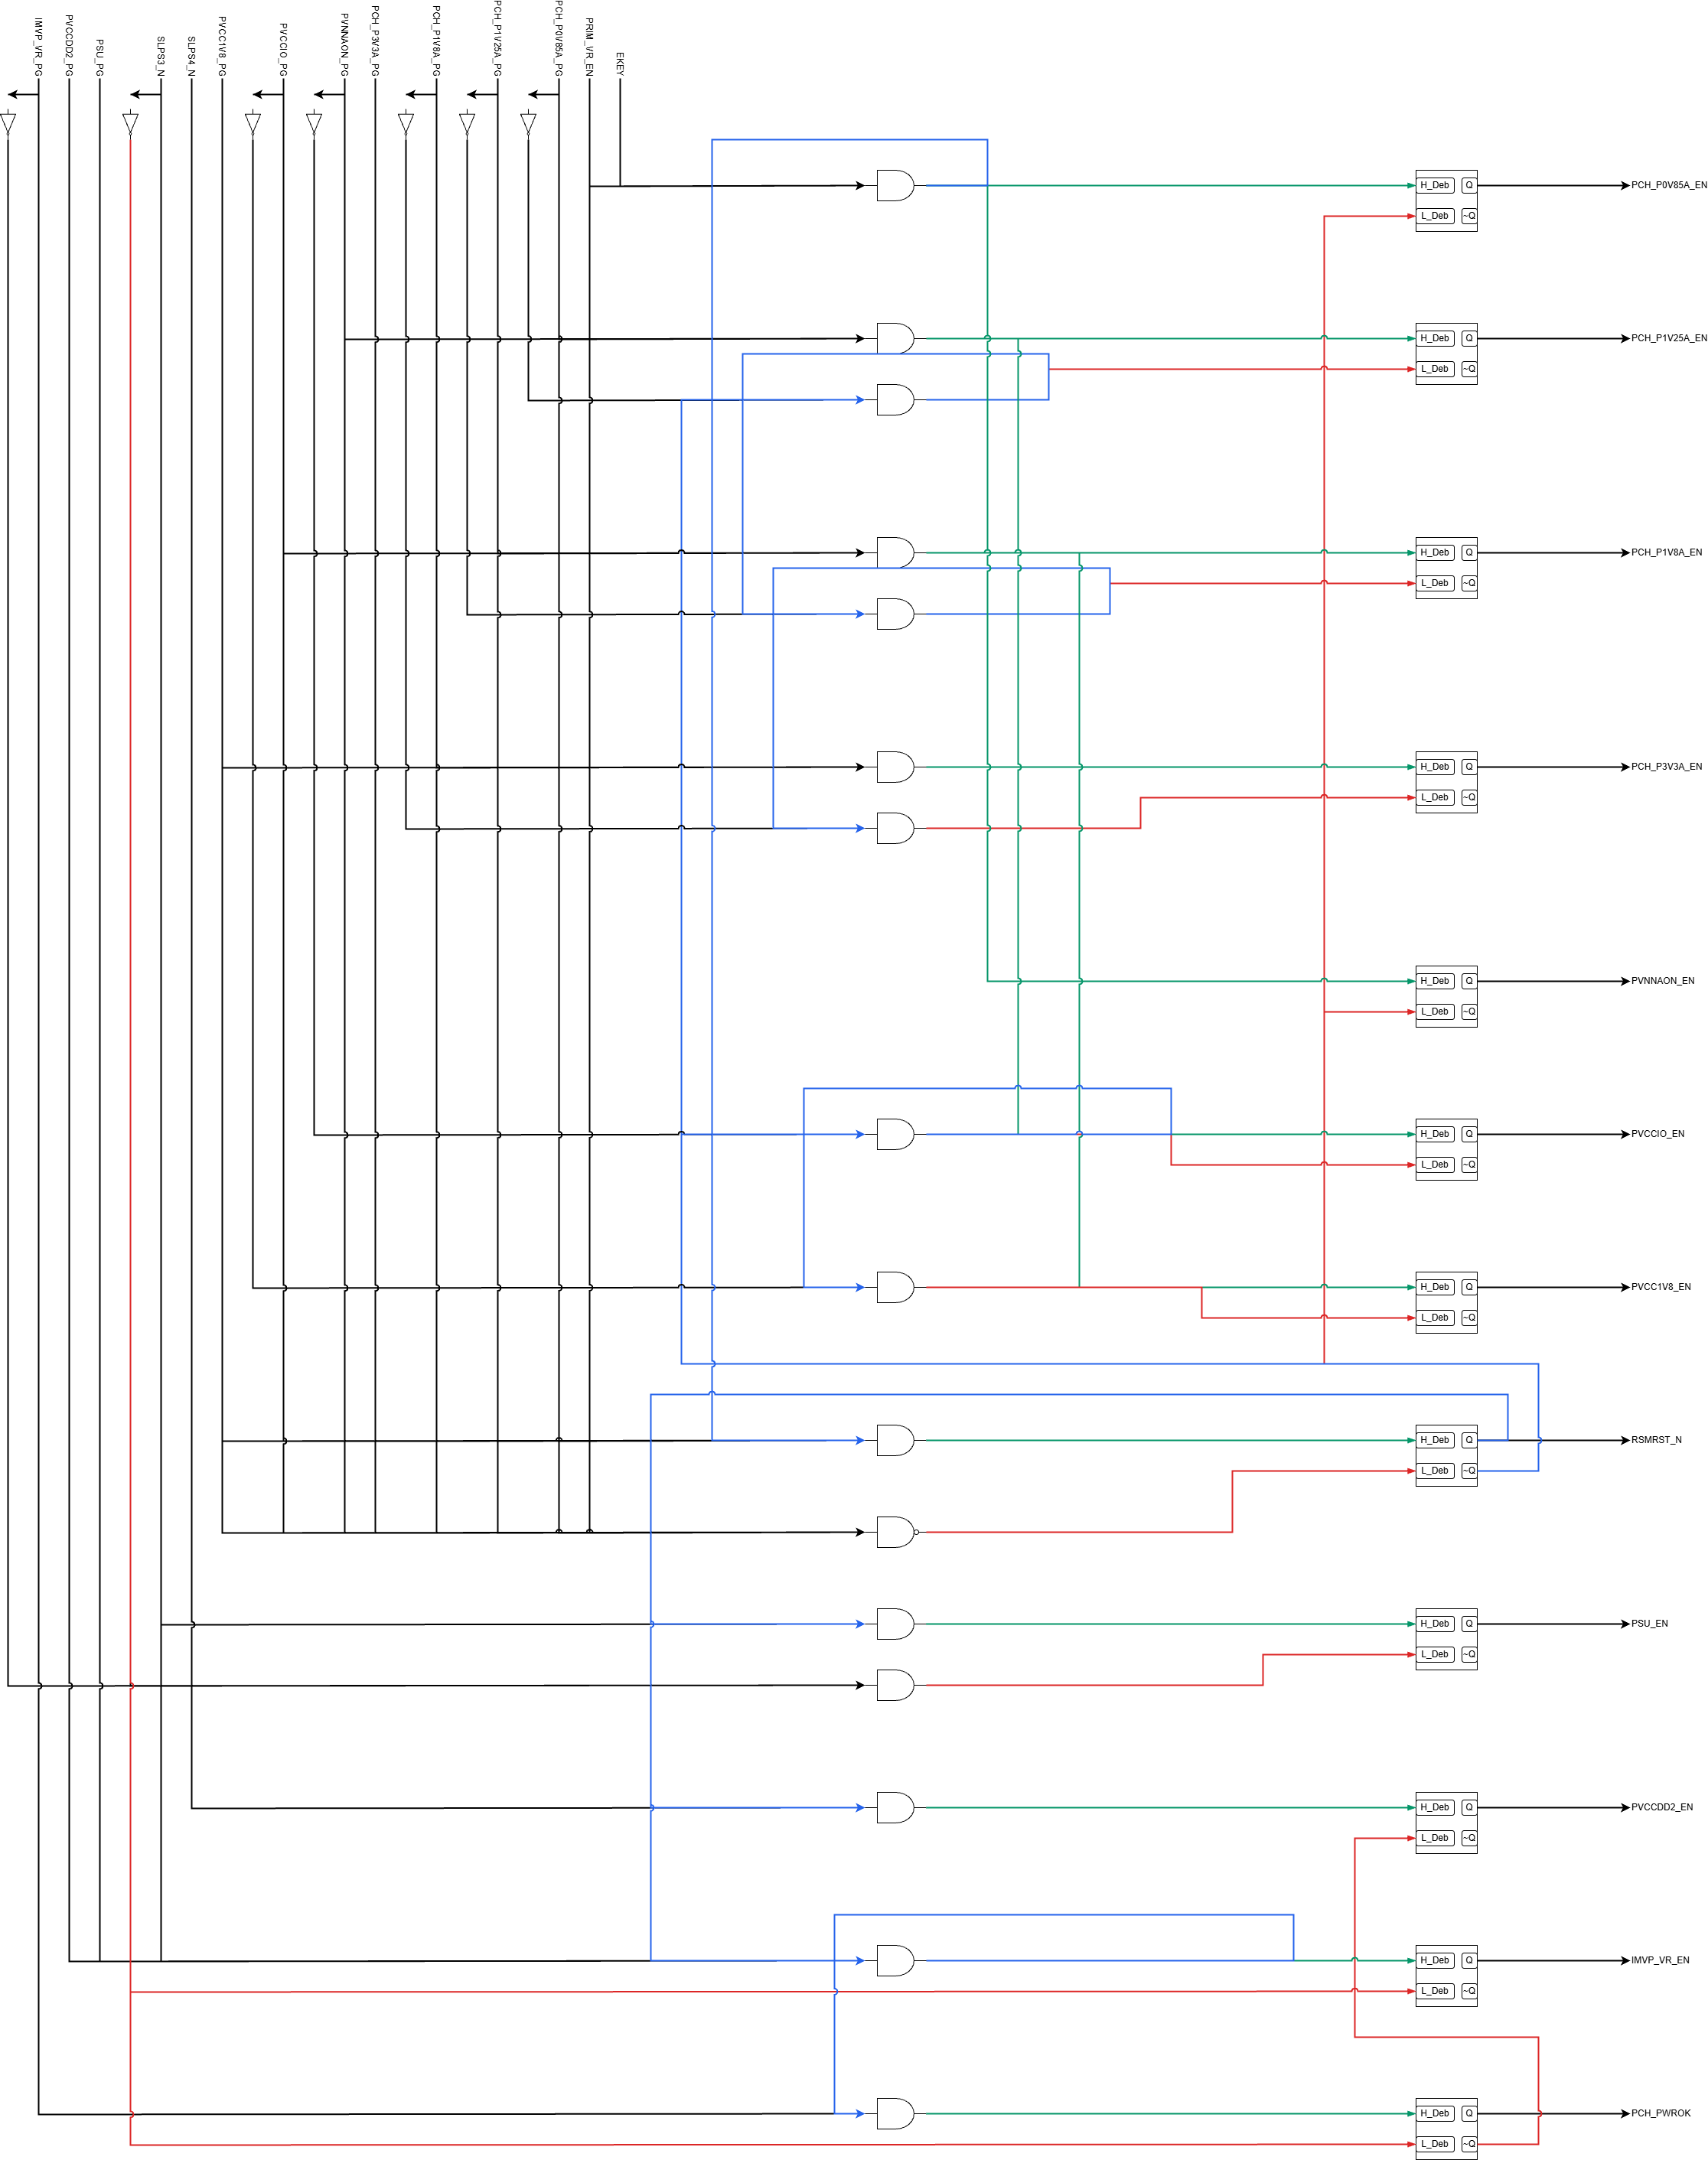
Provided Draw.io output
doc/demo_drawio_png.png — dependency graph rendered from the demo config
This is the provided Draw.io diagram asset, not a replacement generated from output/test.json.

Slide 7
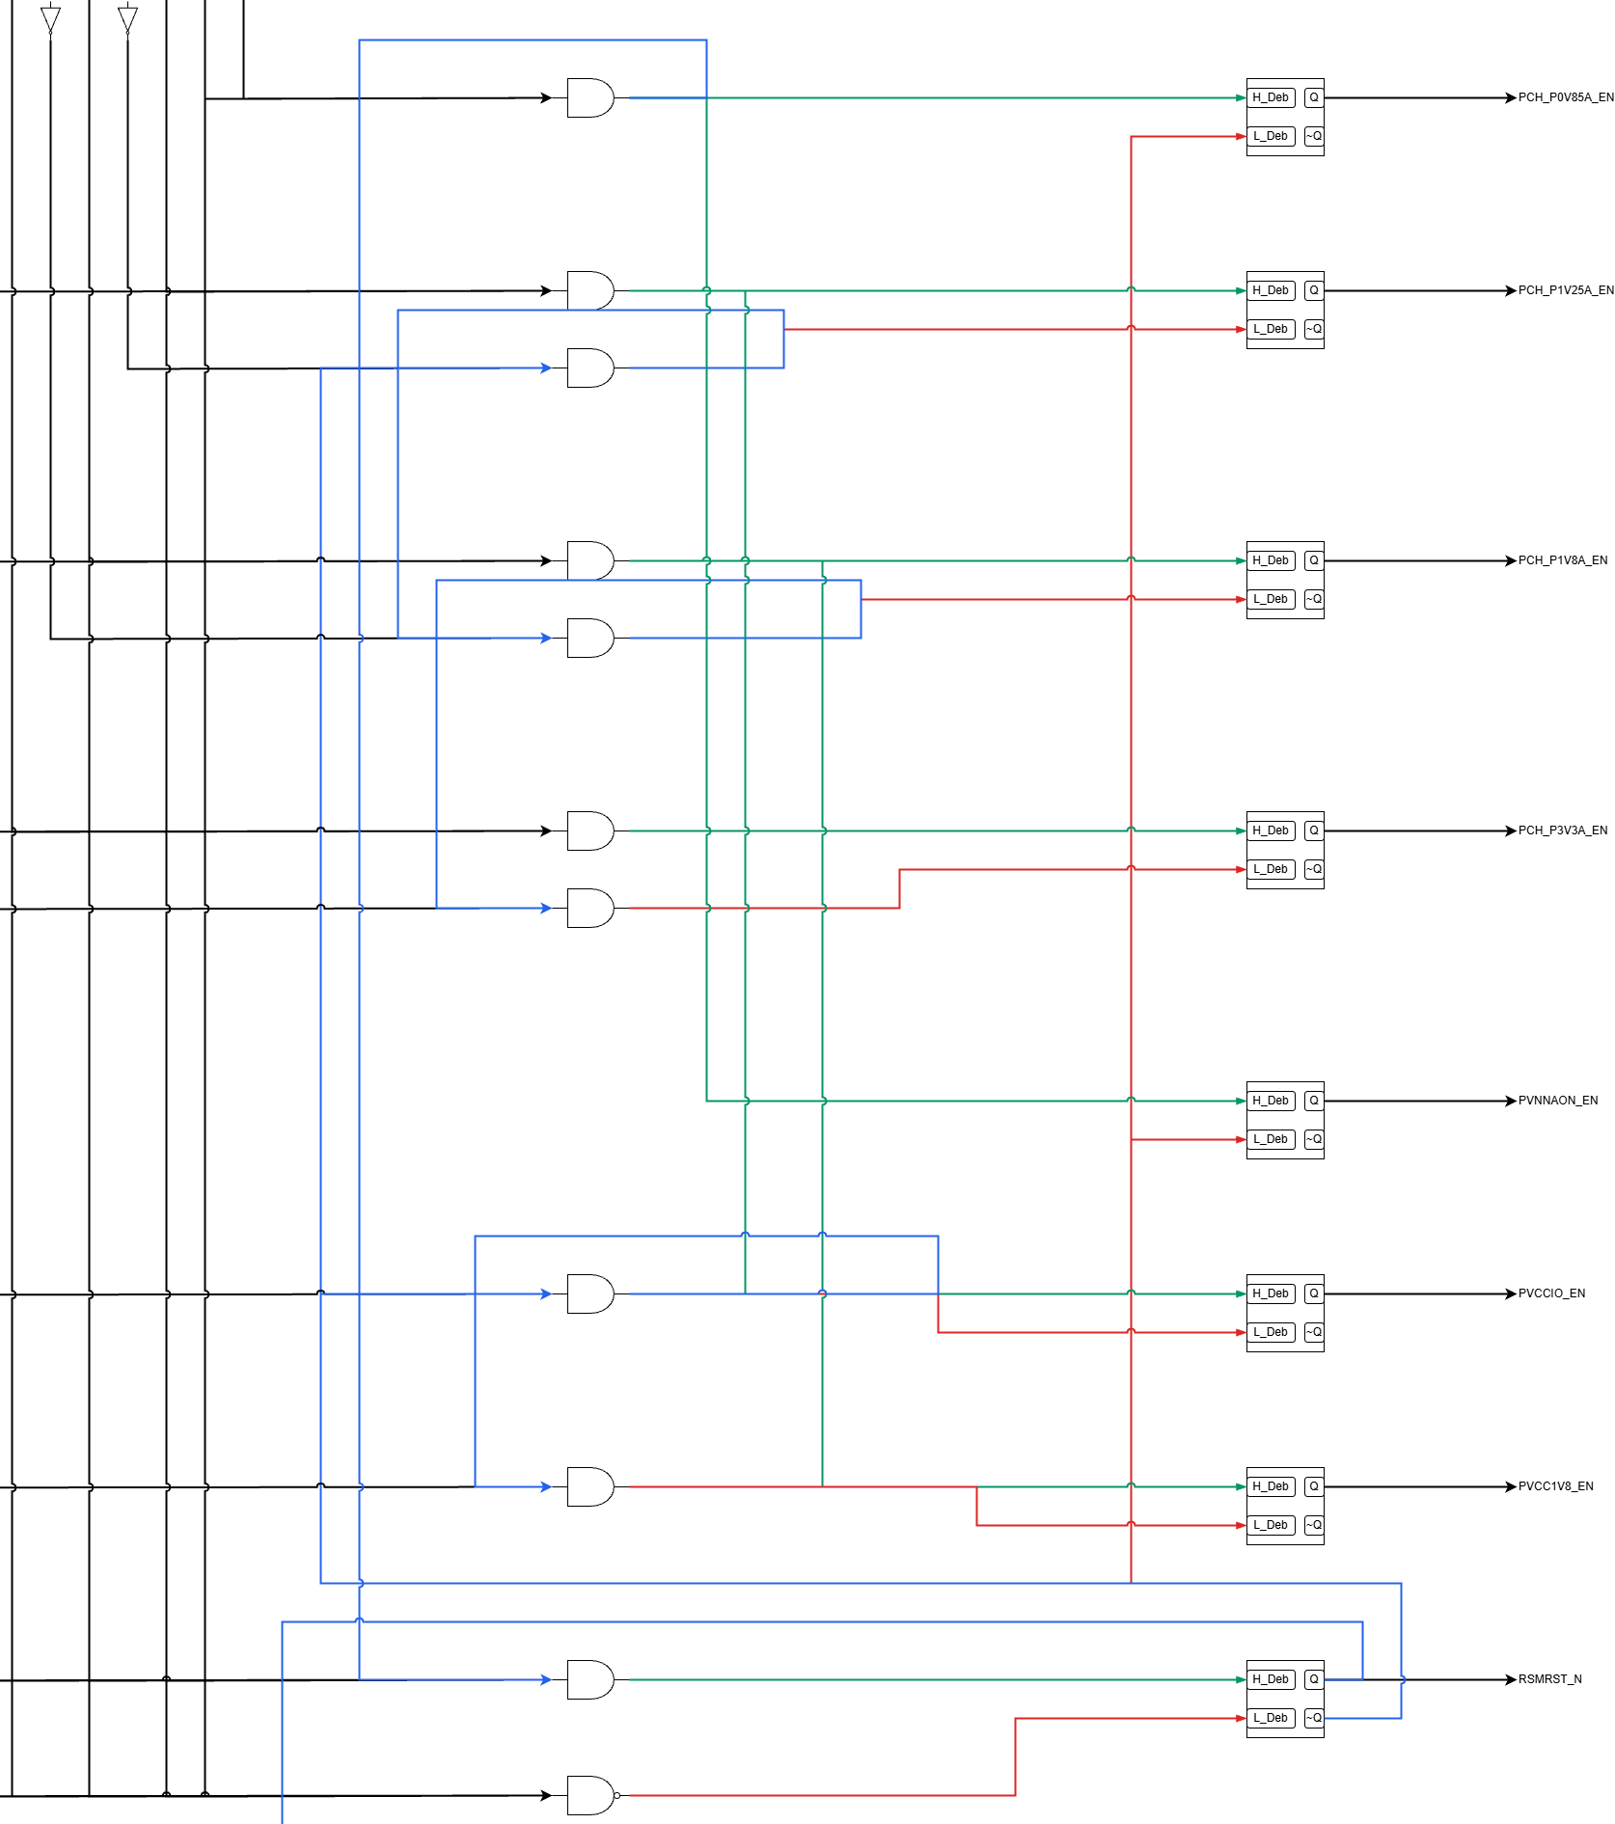
Draw.io routing details
doc/demo_drawio_png.png — layered placement, Hi/Lo color paths, and feedback routing
Zoomed from the provided Draw.io PNG: Input → logic gates → PSEQCELL blocks → output labels.

Slide 8
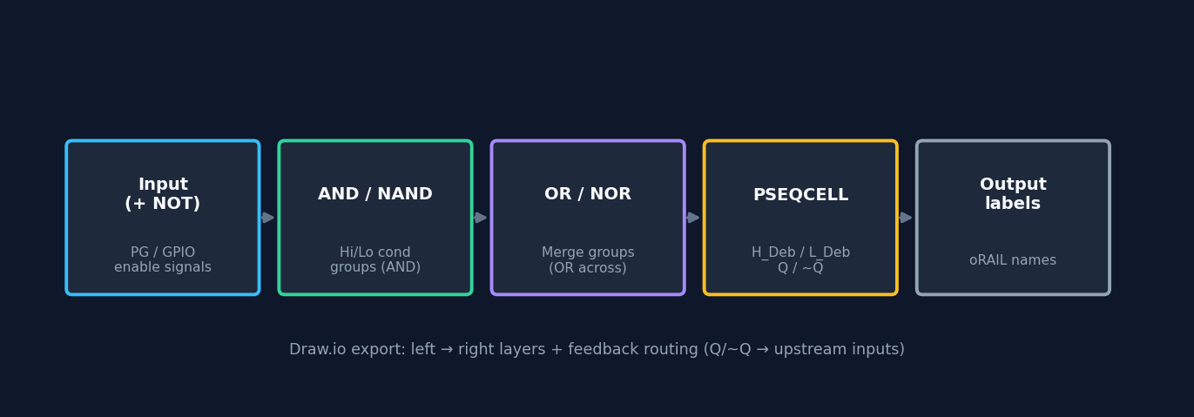
Draw.io layer architecture
Left → right signal flow (doc/DRAWIO_RULES.md)

Slide 9
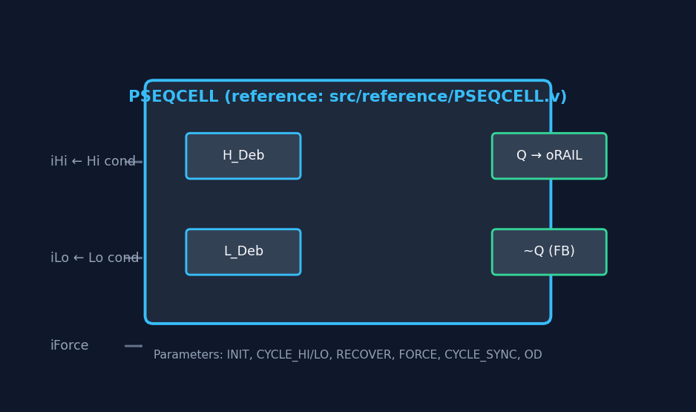
PSEQCELL in RTL
Aligned with src/reference/PSEQCELL.v
Ports: iHi, iLo, iForce → internal seq FSM.
o maps to oRAIL; ~Q used for feedback paths.
Parameters from JSON: CYCLE_HI/LO, RECOVER, etc.
DEB instances for debounced inputs.

Slide 10
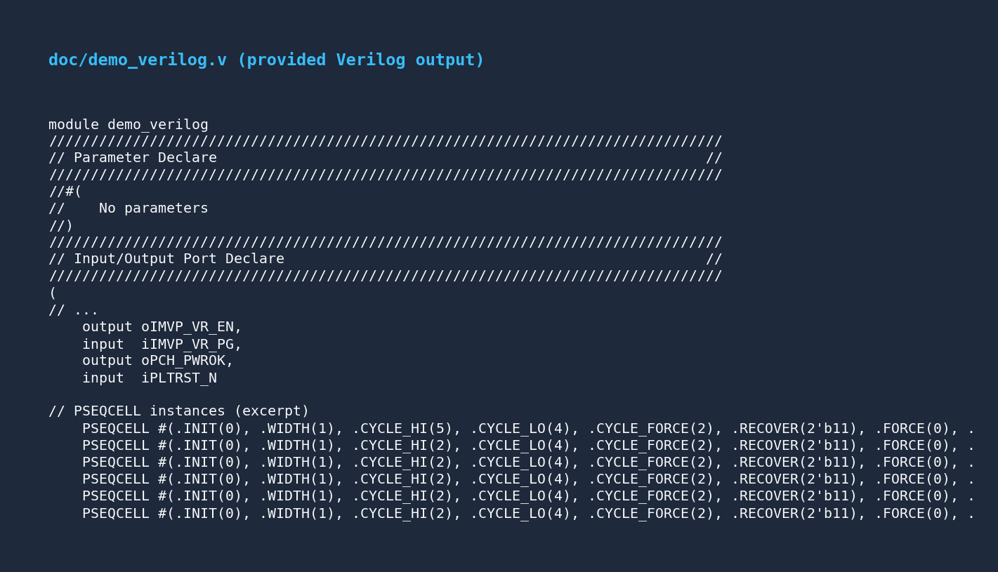
Verilog generation
Auto-generated module + PSEQCELL instances
Source asset: doc/demo_verilog.v. The generator derives ports, condition wires, DEB, and PSEQCELL instances from JSON.

Slide 11
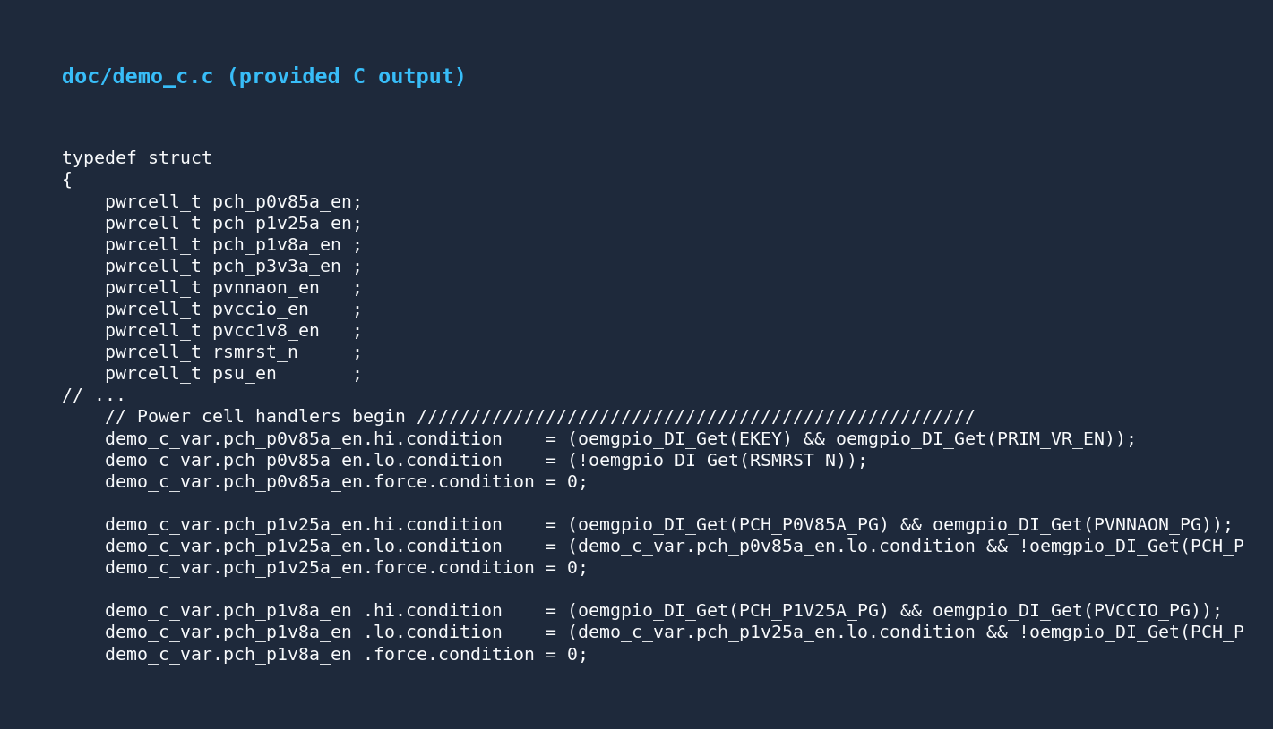
C firmware generation
pwrcell_t scaffolding (reference: pwrcell.c/h)
Source asset: doc/demo_c.c. The output contains per-rail pwrcell_t state and runtime condition hooks.

Slide 12
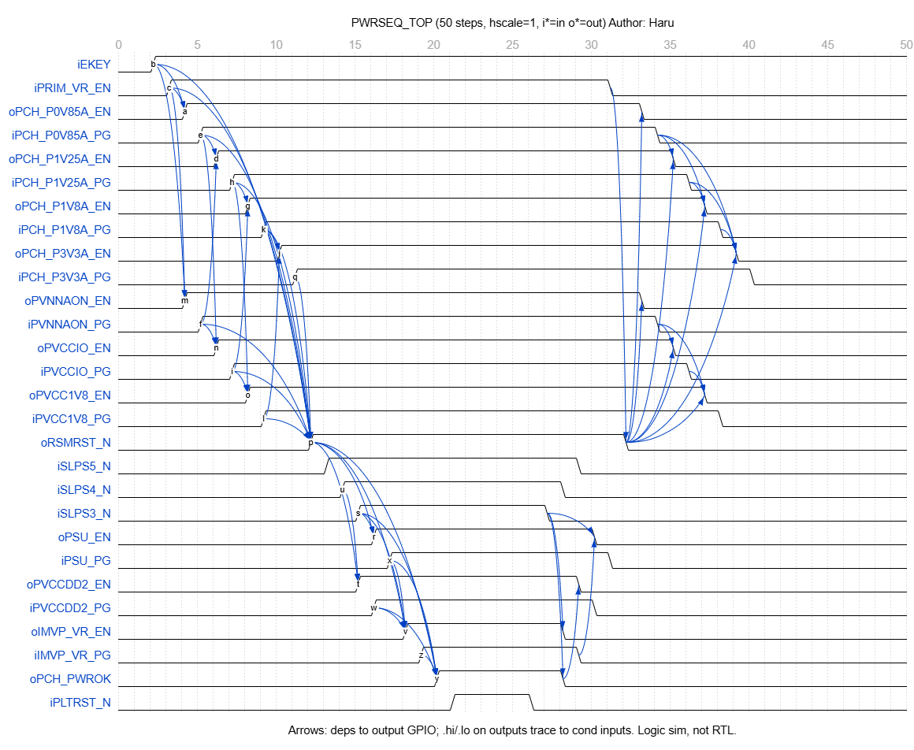
Provided WaveDrom timing
Simulated from dependency graph (not RTL cycle-accurate)
Source asset: doc/demo_wavedrom_png.png, with JSON data in doc/demo_wavedrow_json.json.

Slide 13
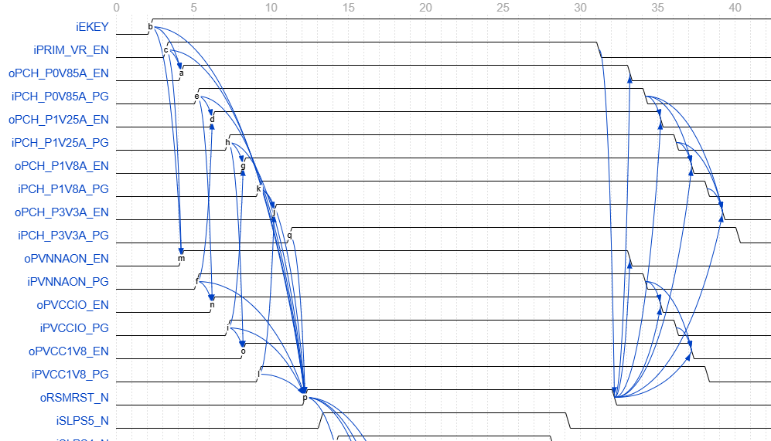
WaveDrom review use case
doc/demo_wavedrom_png.png — 50-step sequencing overview
Zoomed from the provided WaveDrom PNG for dependency arrows and power-up timing review.

Slide 14
Tooling & quality
Build, test, package, and review
Python 3.8+, CustomTkinter GUI, pytest coverage, PyInstaller packaging, and reference libraries.

Slide 15
Getting started
Five steps
1. pip install -r requirements.txt (or run run.bat)
2. python src/main.py — build nodes & conditions
3. Confirm green validation bar
4. Generate → Verilog / C | Export → Draw.io / WaveDrom
5. json2drawio.bat doc\demo_json.json -o doc\demo_drawio_xml.xml

Slide 16
Summary
One JSON model captures power-sequence intent
Code, diagrams, and timing documentation stay synchronized
Questions?

