Slide 1
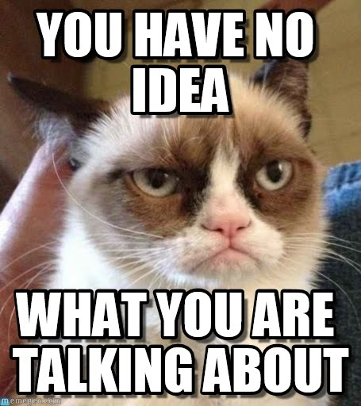
Computer Science in 1 Hour
李海飞 （Max Li）

Slide 2

Self introduction
Have never seen a computer before college
Computer Science, Xi’an Jiaotong University
Software engineer (China years)
ECE and CISE, University of Florida (MS and PhD)
Researcher (IBM)
Professor (Nyack College and Union University)

Slide 3
Contents
Discrete Math Data Structures and Algorithms
Programming Language
Software Engineering
Database
Operating System
Network
Computer Security
Graphics
Computer Ethics
Others

Slide 4
Discrete Math
Different from continuous math: algebra and calculus, differential equation
Logic
Set theory
Number theory
Tree and graph

Slide 5
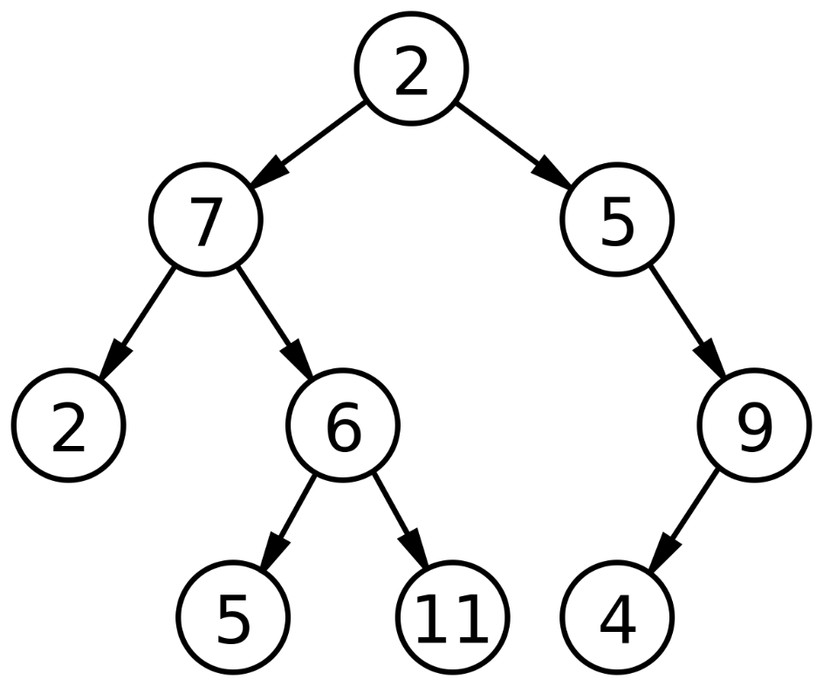
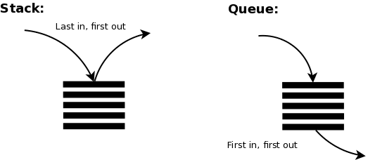
Data Structures and Algorithms (1)
Critical for programming and software development

Slide 6
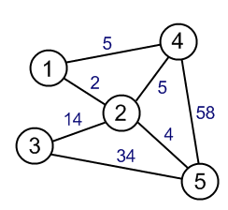
Data Structures and Algorithms (2)
Weighted undirected graph
Example: mileage among cities

Slide 7
Data Structures and Algorithms (3)
Expression evaluation using binary tree
+
8
+
3
9

Slide 8
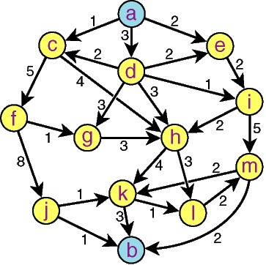
Data Structures and Algorithms (4)
Shortest path
Email from hli@uu.edu to qhzheng@mail.xjtu.edu.cn

Slide 9
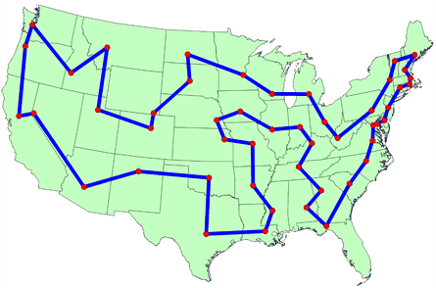
Data Structures and Algorithms (5)
Traveling salesman problems

Slide 10
Programming Languages
Basics:
variable
data type
assignment
if
while
function
Old stuff: Pascal, Fortran, COBOL
Trend: moving from Java to Python
Personal favorite: golang
Golang as a rebel: OOP (Object-Oriented Programming) is NOT that great after all

Slide 11
Software Engineering
Issues involved with the life cycle of large and complex
software systems. Topics include software planning,
specifications, coding, testing, and maintenance.

Slide 12
Database
SQL: Structured Query Language. Declarative approach to data manipulation.
ER Mode: Entity-Relationship Model
Transaction Management: All or Nothing
DBA: DataBase Administrator
Index
Backup and recovery
NoSQL: Not Only SQL
Key-Value Store – It has a Big Hash Table of keys & values {Example – AWS Dynamo DB}
Document-based Store- It stores documents made up of tagged elements. {Example- MongoDB}
Graph-based store -A network database that uses edges and nodes to represent and store data. {Example- Neo4J}

Slide 13

Operating System
OS as a system resource management
Process management:
multi-tasking,
scheduling,
IPC (InterProcess Communication),
mutual exclusion/deadlock/livelock
File management
memory management
Examples: Unix, Linux, Mac OS, Windows, etc

Slide 14
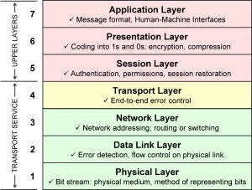
Network
What is the correct relationship between Internet and Web?
TCP/IP, HTTP, HTTPS, SSL, UDP, etc
The Open Systems Interconnection model (OSI model)

Slide 15
Computer Security
I have plugged 10,000 security holes
I just did not have time to plug the 10,001th hole.

Slide 16
Computer Graphics
Not my field.
Collision Detection.

Slide 17
Computer Ethics
Catalysts for Change (Computer history)
Introduction to Ethics (Ethical theories)
Networked Communications (spam, censorship, Internet addiction, etc.)
Intellectual Property
Information Privacy
Privacy and the Government
Computer and Network Security
Computer Reliability
Professional Ethics
Work and Wealth

Slide 18
Others
Big Data
Data Mining
Machine Learning
Artificial Intelligence
Web Programming
Parallel Computing
Digital System
Computer Architecture
HCI (Human Computer Interaction)

