Slide 1
Cloud Computing Using Github and Heroku
Max Li
李海飞
Computer Science
Union University

Slide 2
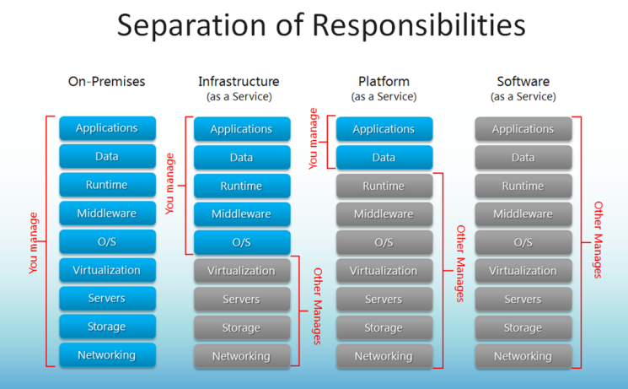
Cloud Computing

Slide 3
Players in CC
Amazon Web Services or AWS
Microsoft Azure
Google Cloud Platform
IBM
Oracle
EMC/Dell
Red Hat

Slide 4

GitHub, Inc.
Type of business | Private
Type of site | Git repository hosting service
Available in | English
Founded | February 8, 2008; 9 years ago
Headquarters | San Francisco, California, United States
Area served | Worldwide
Founder(s) | Tom Preston-Werner Chris Wanstrath PJ Hyett
CEO | Chris Wanstrath
Key people | P. J. Hyett (COO)
Industry | Software
Employees | 745^{[1]}
Slogan(s) | "Build software better, together.", "Where software is built"
Website | GitHub.com
Alexa rank | 72 (January 2018)^{[2]}
Registration | Optional (required for creating and joining projects)
Users | 26 million (March 2017)
Launched | 10 April 2008; 9 years ago
Current status | Active
Written in | Ruby

Slide 5
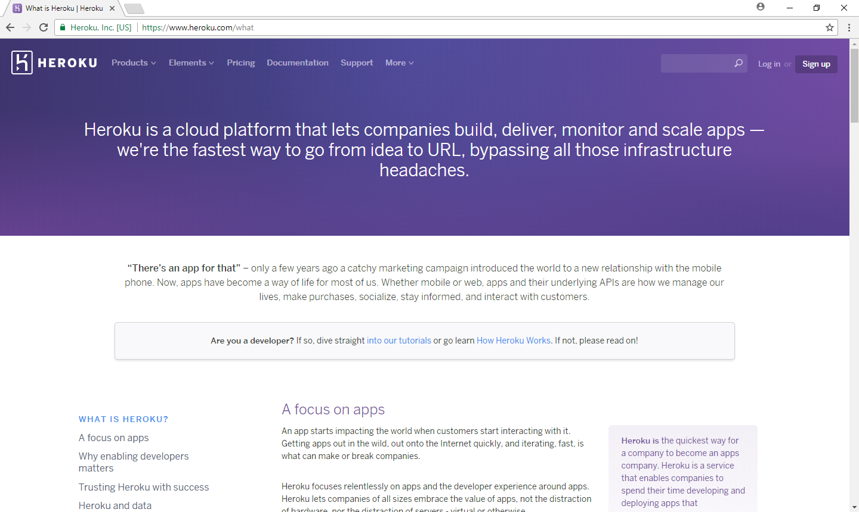

Slide 6
Chinese Wisdom
少说多做
From nashvilleit.herokuapp.com to nashvilleit1.herokuapp.com

