Slide 1

GENERATIONAL Gap
Bridging the generation gap at a workplace
Jian Lee
12/02/2017

Slide 2

WHAT IS GENERATION GAP

Slide 3
Ignition Program – Session 3 – Day 2
WHAT ARE THE GENERATIONS
Values | Events | Assets | Liabilities
Silent Generation | Born 1922-1946
Dedication Sacrifice Honor Hard Work Respect, Law and Order | Stock Market Crash US Depression Pearl Harbor Victory in Europe and Japan Korean War | Stable Detail Oriented Thorough Loyal Hard Working | Change Averse Reluctant to Buck System Uncomfortable with Conflict Become Mired in Tradition
Baby Boomers | Born 1947-1964
Optimism Personal Gratification Personal Growth Health and Wellness Work | Civil rights/Women’s Rights Vietnam War Birth Control Pills Cuban Missile Crisis Assassinations – JFK, RFK, MLK | Driven Willing to “Go the Extra Mile” Good at Relationships Want to Please | Not Budget Minded Avoid Conflict Process First, Results Last Sensitive to Feedback Judgmental of Other Viewpoints
Generation X | Born 1965-1980
Diversity Global Thinking Balance Techno Literacy Fun and Informality | Watergate Scandal PCs Marketed Challenger Disaster Fall of Berlin Wall Rodney King Beating | Adaptable Techno-literate Independent Unintimidated by Authority Creative | Impatient Poor People Skills Inexperienced Cynical Distrust of Leadership
Millennials | Born 1981-1995
Optimism Civic Duty Confidence Sociability Morality Diversity | Child Focus – Protect From All Violence: Oklahoma City Bombing, Schoolyard Shootings, Terror Attacks Technology From birth Busy, Over Planned Lives, Stress War in Iraq | Collective Action Optimism Tenacity Heroic Spirit Multitasking Technology Savvy | Need for Supervision and Structure Inexperience, Particularly with Handling Difficult People Issues Communication Styles can be Misunderstood(IM’ing, Texting) Self-esteem Trumps Achievement

Slide 4
WHAT ARE THE STEREOTYPES
Silent Generation Boomers – “They’re dictatorial and rigid. They’re inhibited.” Gen Xers – “PLEASE learn to use email. They’re set in their ways.” Millennials – “They are trustworthy, dependable and brave. They are good leaders.” | Baby Boomers Silents – “They talk about things they ought to keep private, like their personal lives. They are self-absorbed.” Gen Xers – “They are self-righteous. They are workaholics. They’re too politically correct, always trying to say the right thing to the right person. Lighten up, it’s only a job.” Millennials – “They work too much. They don’t get us. We don’t care about the status symbols they care about.”
Gen X Silents – “They don’t respect experience or follow procedures. They don’t know what hard work is.” Boomers – “they’re slackers and they’re rude. They don’t like to work on teams. They spend too much time online. They should work and be unhappy for 30 years like I did, then talk to me about life balance.” Millennials – “Why so glum? Cheer up already!” | Millennials Silents – “They’re impatient, yet polite. They’re optimistic and business needs that.” Boomers – “They have no work ethic; they give their lives outside work the same importance as their work. They need too much interaction, I don’t have time to parent them. They have no loyalty.” Gen Xers – “They won’t pay their dues. They expect constant attention and instant promotion. They have no respect for experience.”

Slide 5
Ignition Program – Session 3 – Day 2
WHAT ARE THE STRATEGIES
Silent Generation Strategies Be direct Offer time to absorb changes Respect their experience Use as mentors | Boomer Generation Strategies Treat as equals, don’t direct, ask opinions Provide challenging, varied work Reward contribution and impact Understand their work ethic-don’t abuse it Preference for meetings as communication medium
Generation X Strategies Encourage ideas Use performance-based rewards Avoid micromanaging Allow for questioning Preference for email communication | Millennial Generation Strategies Set ground rules, but be flexible Show openness to ideas Take advantage of their speed Coach them towards problem-solving Provide a coach/mentor and training opportunities Social media and trending communication mediums

Slide 6
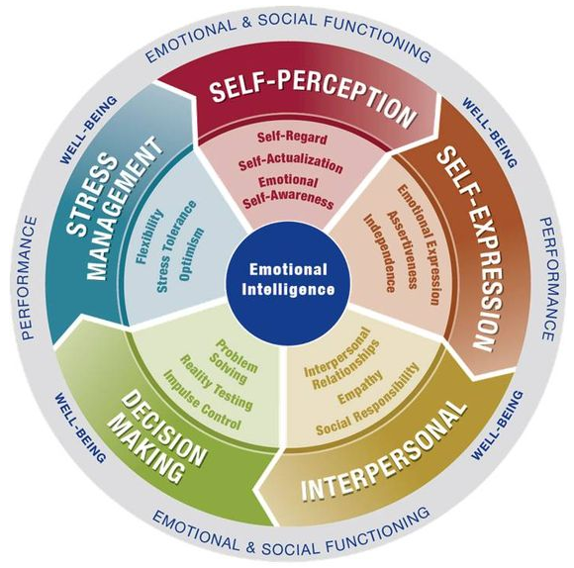
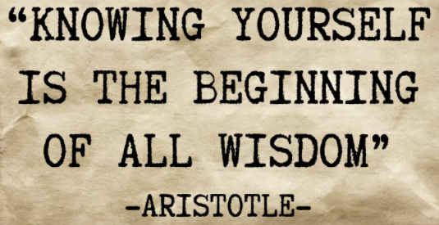
BE YOUSELF

Slide 7
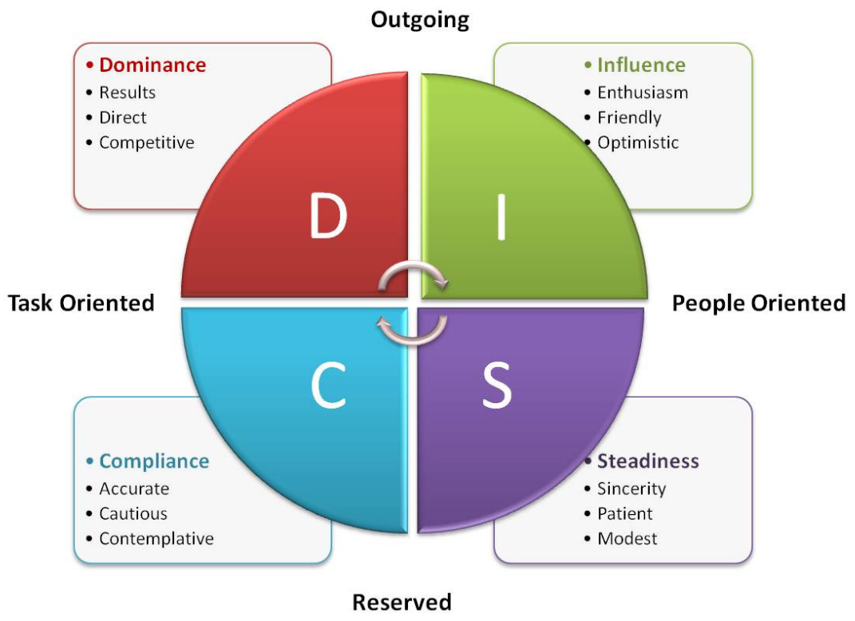
Ignition Program – Session 1
DISC – FOUR TYPES OF PERSONALITIES

Slide 8
QUESTIONS
OPEN DISCUSSION

