Slide 1
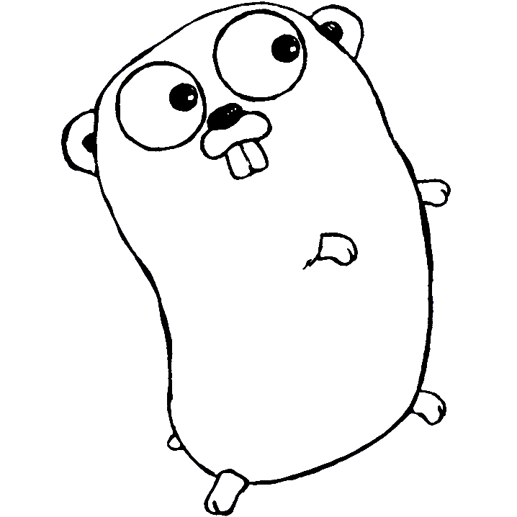

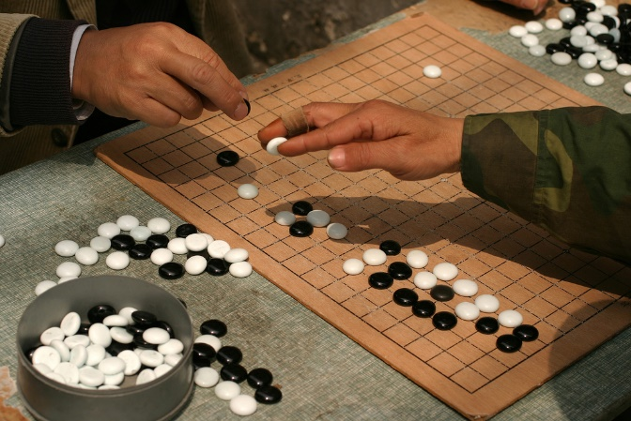

Go: systems programming language for the 21th century
Max Li
李海飞
Computer Science
Union University

Slide 2
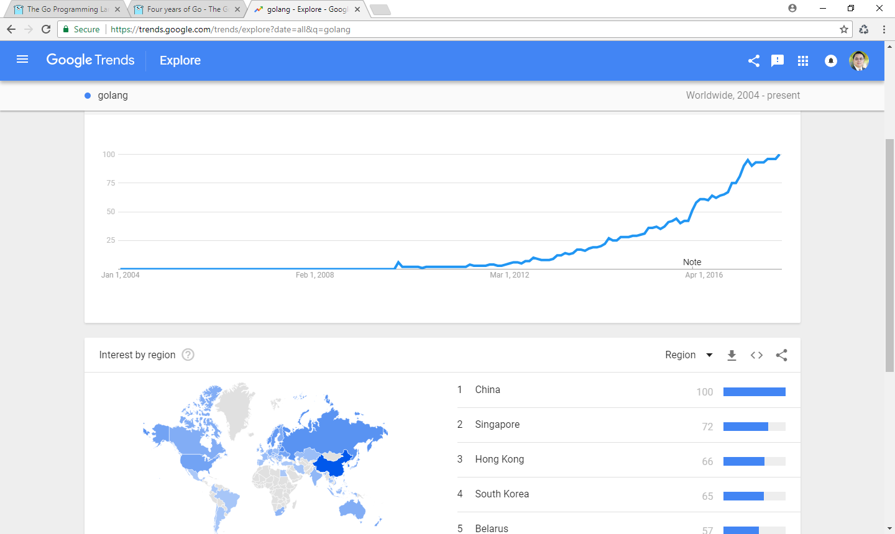
中国人的智慧

Slide 3
Hello World in Go
package main
import "fmt"
func main() {
fmt.Println(“Hello World")
}

Slide 4
Directly from the source
www.golang.org
Go is an open source programming language that makes it easy to build simple, reliable, and efficient software.
Simple: C++
Reliable: C
Efficient: Python, Ruby, Java and others

Slide 5
History for Computer Scientists: Yucky!
C : 1972
C++ : 1983
Python: 1991
Ruby: 1995
Java: 1995
Go: 2009 by Robert Griesemer, Rob Pike, and Ken Thompson
Multicore CPU
Cloud Computing
Web server
Concurrency based on CSP (Communication Sequential Processes)
Julia: 2012 (mainly for scientific computing, replacing Fortran)

Slide 6
So innocent…
package main import "fmt" func main() { c := make(chan int) c <- 1 fmt.Println(<-c) }

Slide 7
So wrong…
fatal error: all goroutines are asleep - deadlock!
goroutine 1 [chan send]:
main.main()
C:/Users/maxli/GoglandProjects/src/unbufferedChannel/main/main.go:6 +0x60
Process finished with exit code 2

Slide 8
Reason
There is only one goroutine: main goroutine
Unbuffered channel is blocking when sending!
fmt.Println(<-c)wait forever

Slide 9
Solution 1: Two goroutines
func main() {
c := make(chan int)
go func(){
c <- 1
}()
fmt.Println(<-c)
}

Slide 10
Solution 2: buffered channel
func main() {
c := make(chan int, 1)
c <- 1
fmt.Println(<-c)
}
Note: buffered channel is non-blocking for sending

Slide 11

Most Important feature: go keyword
i++
go func() {
j++
}()
k++
go j++

Slide 12
Channel
A typed conduit to send and receive values with the channel operator, <-.
ch <- v // Send v to channel ch.
v := <-ch // Receive from ch, and assign value to v.
(The data flows in the direction of the arrow.)
Must be created before use:
ch := make(chan datatype)
blocking until the other side is ready.
Why? To synchronize without explicit locks or condition variables.

Slide 13
Channel Example
package main
import "fmt"
func sum(s []int, c chan int) {
sum := 0
for _, v := range s {
sum += v
}
c <- sum // send sum to c
}
func main() {
s := []int{7, 2, 8, -9, 4, 0}; c := make(chan int)
go sum(s[:len(s)/2], c); go sum(s[len(s)/2:], c)
x, y := <-c, <-c; fmt.Println(x, y, x+y)
}

Slide 14
Multiple Results
A function can return any number of results.
The swap function returns two strings.
package main
import "fmt"
func swap(x, y string) (string, string) {
return y, x
}
func main() {
a, b := swap("hello", "world")
fmt.Println(a, b)
}

Slide 15
Short Variable Declarations
package main
import "fmt"
func main() {
var i, j int = 1, 2
k := 3
c, python, java := true, false, "no!"
fmt.Println(i, j, k, c, python, java)
}

Slide 16
Other cool stuffs
Structs, Not Classes
No Constructors
Access Control
Foo int; // exported - accessible outside package
bar int; // unexported - only accessible within package
No Inheritance
JSON/Serialization Support
Web/HTTP Support

Slide 17
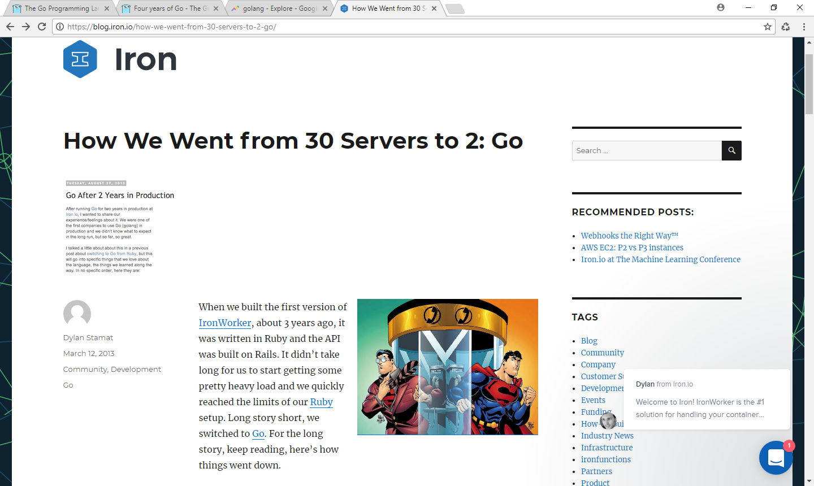

Slide 18
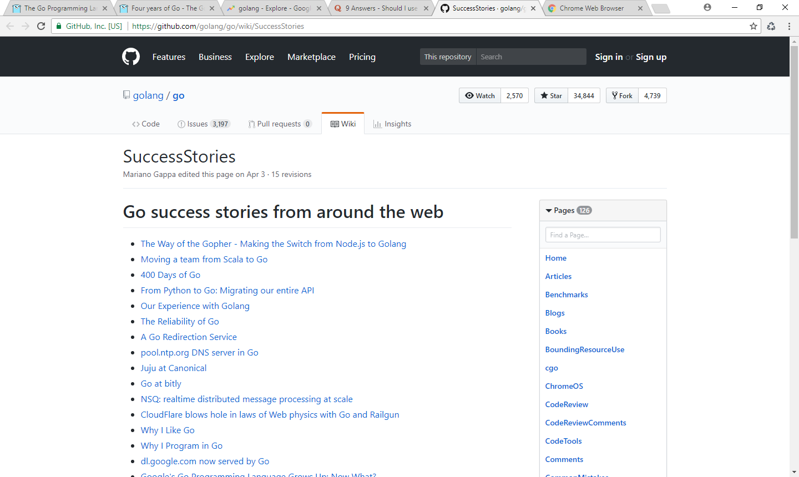

Slide 19
Learn more:
Beginner:
https://tour.golang.org/welcome/1
Expert:
Effective Go
https://golang.org/doc/effective_go.html

