Slide 1

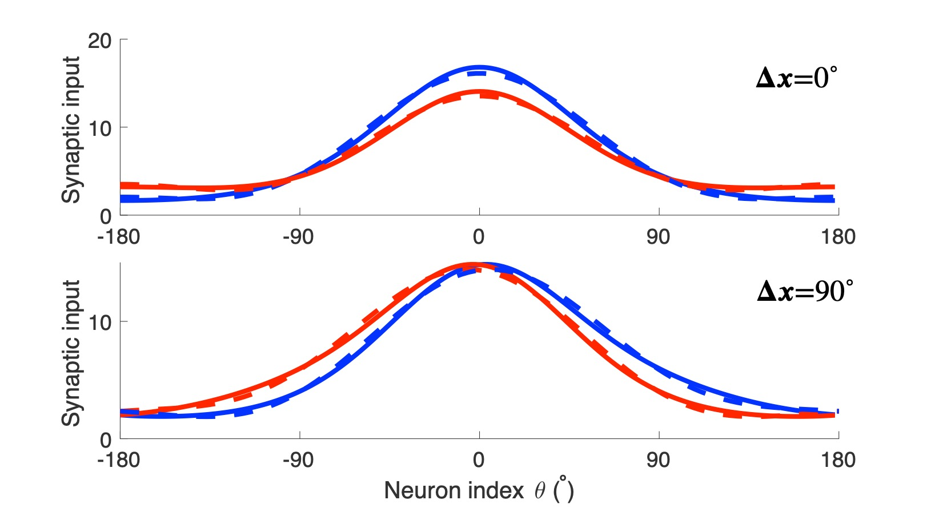
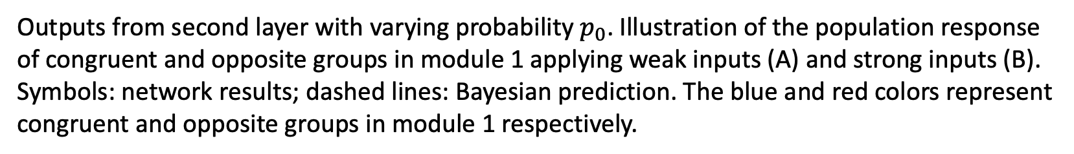
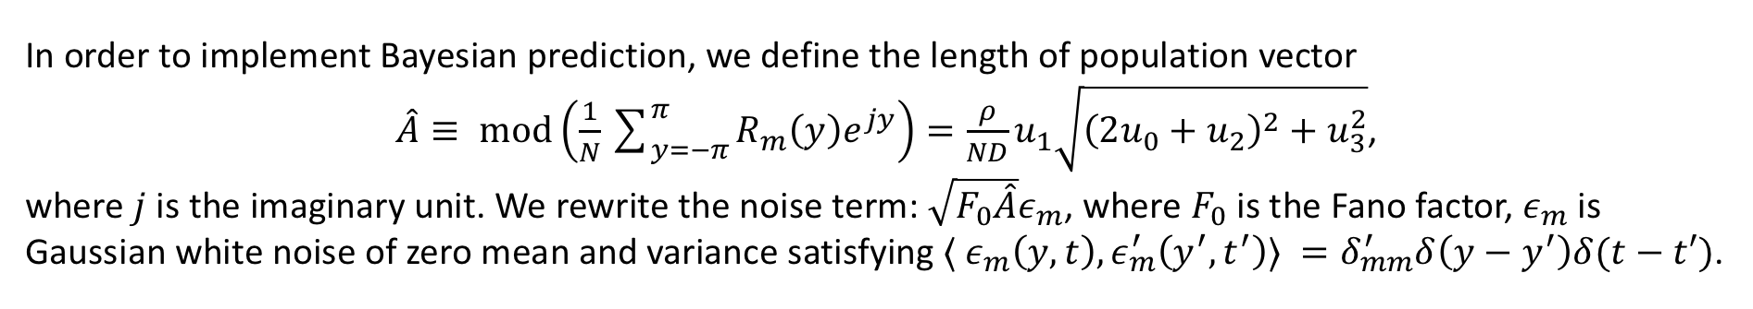
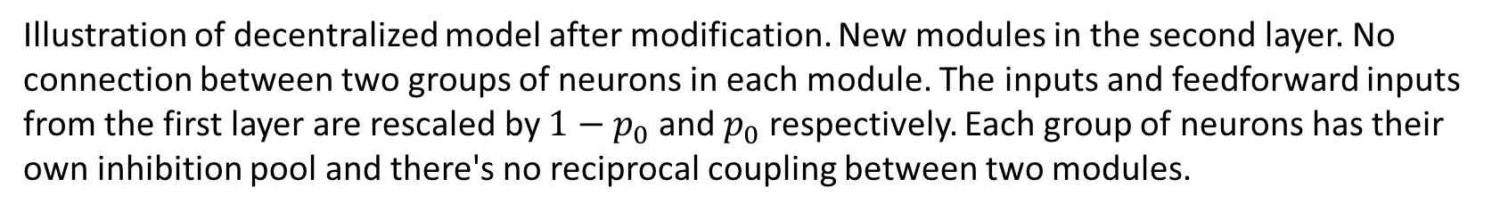



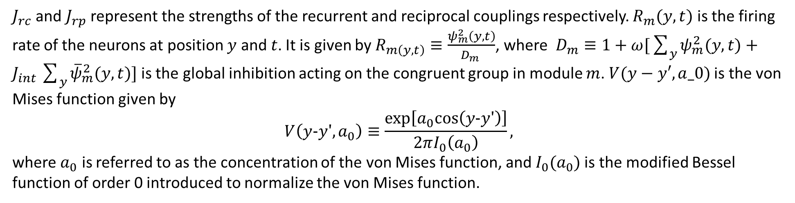
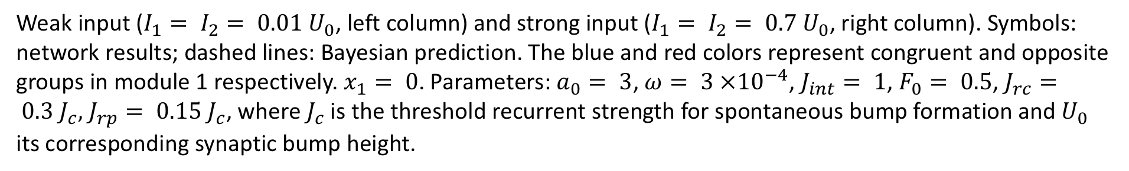
Bayesian Model for Multisensory Integration and Segregation
In order to implement Bayesian prediction, we define the length of population vector
$\hat{A}≡ mod\left(\frac{1}{N}\sum_{y=−π}^{π}{R_{m}\left(y\right)e^{jy}}\right)=\frac{ρ}{ND}u_{1}\sqrt{{\left(2u_{0}+u_{2}\right)}^{2}+u_{3}^{2}}$,
where $j$is the imaginary unit. We rewrite the noise term: $\sqrt{F_{0}\hat{A}}ε_{m}$, where $F_{0}$is the Fano factor, $ε_{m}$is Gaussian white noise of zero mean and variance satisfying $⟨ ε_{m}\left(y,t\right),ε_{m}^{′}\left(y^{′},t^{′}\right)⟩ =δ_{mm}^{′}δ\left(y−y^{′}\right)δ(t−t′)$.
Congruent and opposite neurons in MSTD and VIP. Tuning curves of a congruent neurons (A) and an opposite neuron (B) respectively, and the histogram of two different types of neurons (C). (A-B) adapted from Neural correlates of multisensory cue integration in macaque MSTd, by Gu Yong, 2008, (C) from Visual and nonvisual contributions to three-dimensional heading selectivity in the medial superior temporal area, by Gu Yong, 2006.
Decentralized module. MSTd and VIP refer to different modules, which consist of two groups of neurons, congruent (blue circles) and opposite (red circle) neurons. Neurons are all connected to the inhibitory pool in each module, which receives the feedforward input respectively (up arrow). Adapted from Complementary congruent and opposite neurons achieve concurrent multisensory integration and segregation, by Zhang Wenhao, 2019.
Weak input ($I_{1}= I_{2}= 0.01 U_{0}$, left column) and strong input ($I_{1}= I_{2}= 0.7 U_{0}$, right column). Symbols: network results; dashed lines: Bayesian prediction. The blue and red colors represent congruent and opposite groups in module 1 respectively. $x_{1}= 0$. Parameters: $a_{0}= 3$, $ω= 3 ×{10}^{−4}$, $J_{int}= 1$, $F_{0}= 0.5$, $J_{rc}= 0.3 J_{c},$ $J_{rp}= 0.15 J_{c}$, where$J_{c}$is the threshold recurrent strength for spontaneous bump formation and $U_{0}$ its corresponding synaptic bump height.
We consider the following two-component prior,
$$p(s_{1},s_{2})=\frac{p_{0}}{2π}V(s_{1}−s_{2},κ_{s})+\frac{1−p_{0}}{{\left(2π\right)}^{2}}.$$
The marginal posterior distribution $p(s_{1}|x_{2})$becomes
$$p\left(s_{1} | x_{1},x_{2}\right)=p_{0}CV\left(s_{1}−x_{1},κ_{1}\right)V\left(s_{1}−x_{2},κ_{2s}\right)+\left(1−p_{0}\right)V\left(s_{1}−x_{1},κ_{1}\right),$$
where $C$is the normalization constant. The dynamics of this group of neurons is given by
$$τ\frac{∂Ψ_{2m}(y,t)}{∂t}=−Ψ_{2m}\left(y,t\right)+\sum_{y^{′}=−π}^{π}{J_{rc}V\left(y−y^{′},a_{0}\right)R_{2m}\left(y^{′},t\right)}+p_{0}\sum_{y^{′}=−π}^{π}{c_{k}\cos\left(y−y^{′}\right)R_{\overline{m}}\left(y^{′},t\right)}+I_{m}^{ext}\left(y,t\right).$$
Next, we consider information segregation, the inverse of the disparity information is given by
$$p_{d}{\left(s_{1} | x_{1},x_{2}\right)}^{−1}=p_{0}CV(s_{1}−x_{2},κ_{2s})V(s_{1}−x_{1}+π,κ_{1})+(1−p_{0})V(s_{1}−x_{1}+π,κ_{1}),$$
where $C$ is the normalization constant. Note that the stimulus position is shifted by $π$for the opposite group. Hence, we see that the opposite group in the second layer has the same structure as that of the congruent group, except that the positions of the outputs from the second layer is shifted by $π$.
Illustration of decentralized model after modification. New modules in the second layer. No connection between two groups of neurons in each module. The inputs and feedforward inputs from the first layer are rescaled by $1−p_{0}$ and $p_{0}$ respectively. Each group of neurons has their own inhibition pool and there's no reciprocal coupling between two modules.
Congruent groups:
$$τ\frac{∂ψ_{m}(y,t)}{∂t}=−ψ_{m}(y,t)+\sum_{y′=−π}^{π}{J_{rc}V(y−y′,a_{0})R_{m}(y′,t)}+\sum_{y′=−π}^{π}{J_{rp}V(y−y′,a_{0})R_{\overline{m}}(y′,t)}+I_{m}^{ext}(y,t)$$
Opposite groups:
$$τ\frac{∂{\overline{ψ}}_{m}(y,t)}{∂t}=−{\overline{ψ}}_{m}(y,t)+\sum_{y′=−π}^{π}{J_{rc}V(y−y′,a_{0}){\overline{R}}_{m}(y′,t)}+\sum_{y′=−π}^{π}{J_{rp}V(y−y^{′}+π,a_{0}){\overline{R}}_{\overline{m}}(y′,t)}+I_{m}^{ext}(y,t)$$
$J_{rc}$ and $J_{rp}$ represent the strengths of the recurrent and reciprocal couplings respectively. $R_{m}(y, t)$ is the firing rate of the neurons at position $y$ and $t$. It is given by $R_{m\left(y, t\right)}≡\frac{ψ_{m}^{2}\left(y, t\right)}{D_{m }}$, where $D_{m}≡1+ω[\sum_{y}{ψ_{m}^{2}(y,t)}+J_{int}\sum_{y}{{\overline{ψ}}_{m}^{2}(y,t)] }$is the global inhibition acting on the congruent group in module $m$. $V(y−y′,a_0)$is the von Mises function given by
$$V\left(y−y′,a_{0}\right)≡\frac{exp\left[a_{0}cos\left(y−y′\right)\right]}{2πI_{0}\left(a_{0}\right)},$$
where $a_{0}$ is referred to as the concentration of the von Mises function, and $I_{0}(a_{0})$is the modified Bessel function of order 0 introduced to normalize the von Mises function.
Network architecture for priors with correlated and independent components. Parallel arrows represent congruently connected couplings. Crossed arrows represent couplings shifted by $π$.
Geometric interpretation of vector space. Colored vectors represent the sum of other vectors (black). Outputs from first layer: $κ_{1c}$(congruent) and $κ_{1o}$(opposite), second layer: ${κ′}_{1c}$ (congruent) and ${κ′}_{1o}$(opposite). Note that the vectors (black) have been rescaled by $p_{0}$ and $1−p_{0}$.
We approximate the solution to the dynamical equations to be
$$ψ_{m}=u_{m0}+u_{m1}cos(y_{1}−s_{1})+u_{m2}cos2(y_{1}−s_{1})+u_{m3}sin2(y_{1}−s_{1}), m=1,2.$$
The background, height, position, width and skewness are largely determined by the coefficients $u_{m0}$, $u_{m1}$, $s_{m}$, $u_{m2}$ and $u_{m3}$respectively. Multiplying both sides of dynamic equations of congruent and opposite groups by $1$, $cos⁡(y−s_{m})$, $sin⁡(y−s_{m})$, $cos2(y−s_{m})$ and $sin2(y−s_{m})$ in turn and integrating over $y$, we obtain the steady state equations for this set of coefficients after averaging over noise. By considering the linear perturbation around the steady state, the variance ${\hat{σ}}_{m}^{2}$of the peak positions${\hat{s}}_{m}$ can be found.
Bump profiles (synaptic inputs) of congruent and opposite groups in module 1 without noise. The blue and red colors represent congruent and opposite groups respectively. Solid lines: simulation results, dashed lines: analytic results by using projection method.
Outputs from second layer with varying probability $p_{0}$. Illustration of the population response of congruent and opposite groups in module 1 applying weak inputs (A) and strong inputs (B). Symbols: network results; dashed lines: Bayesian prediction. The blue and red colors represent congruent and opposite groups in module 1 respectively.

