Slide 1

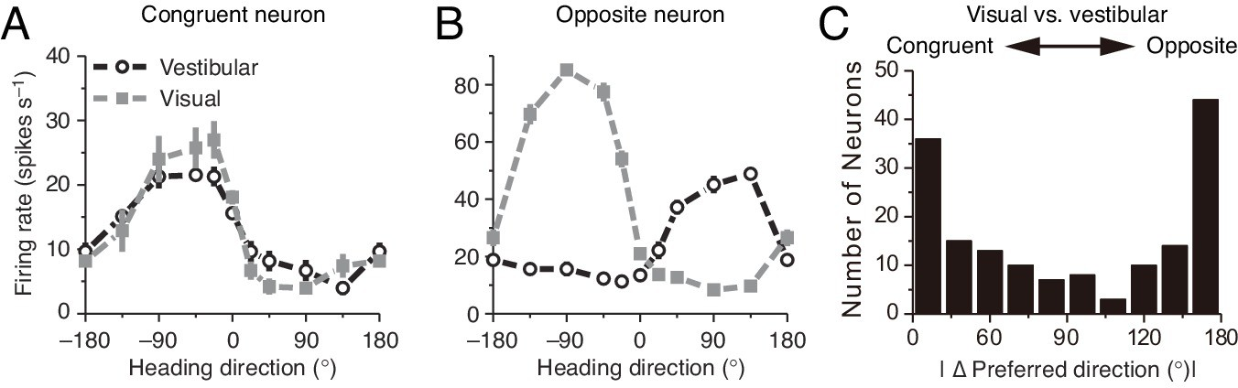
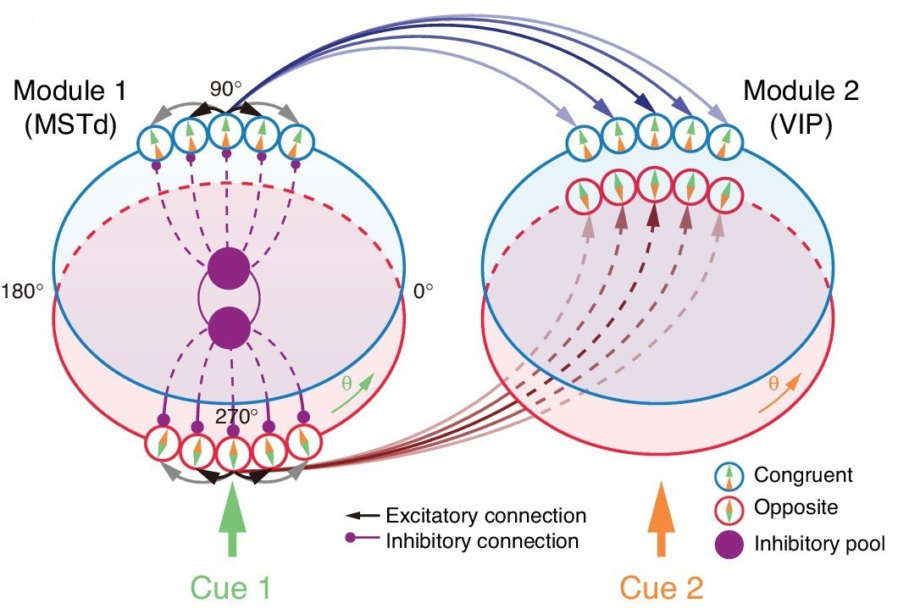
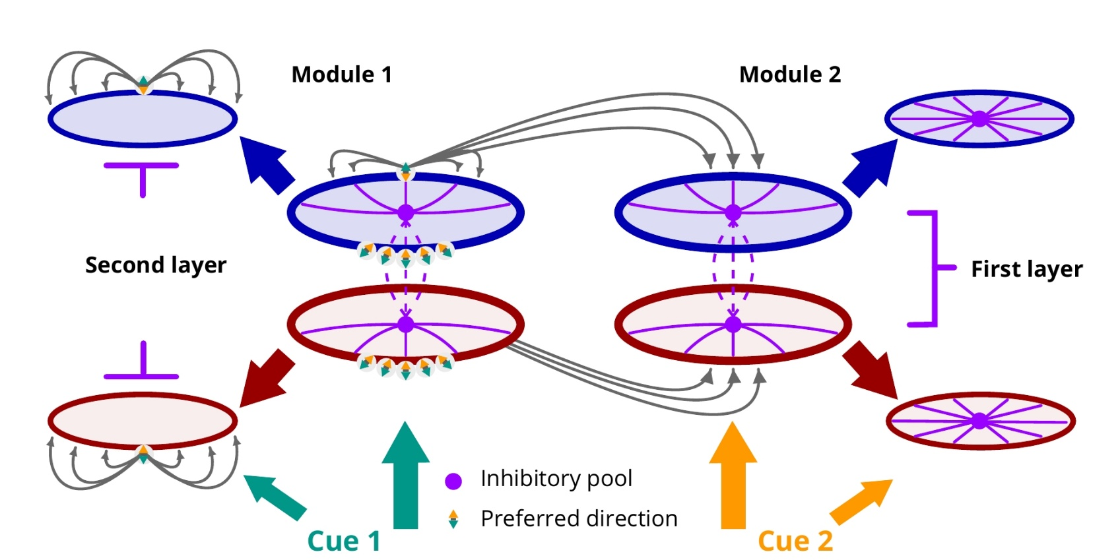
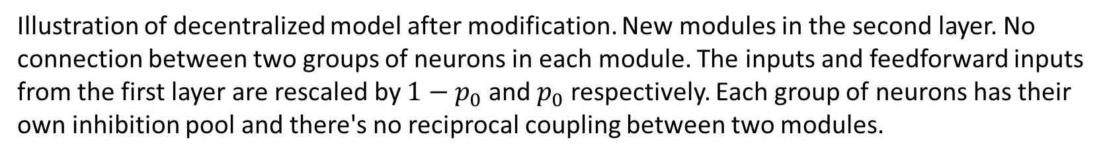
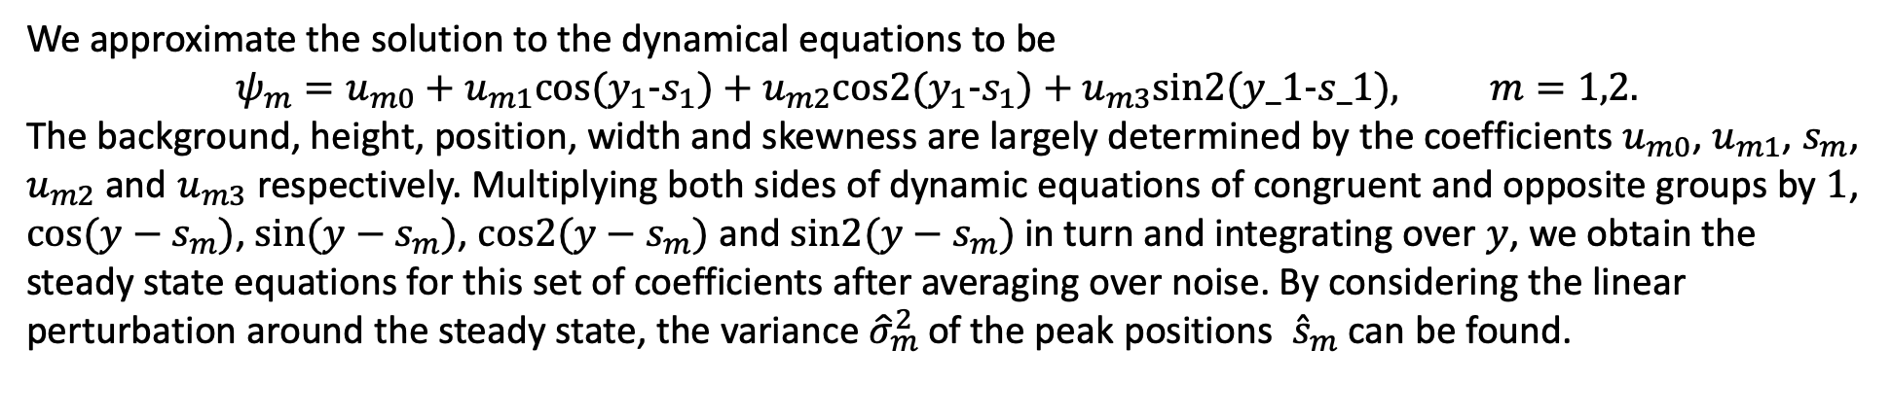
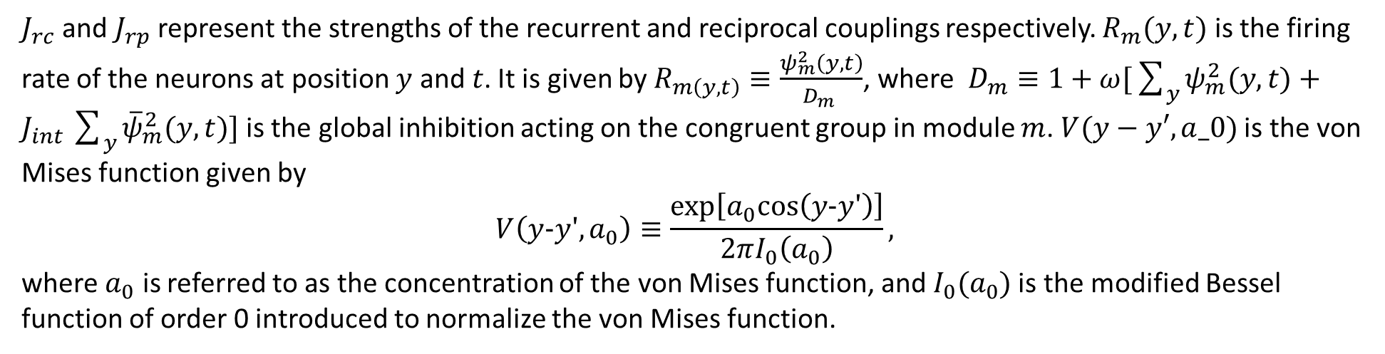
Bayesian Model for Multisensory Integration and Segregation
Congruent and opposite neurons in MSTD and VIP. Tuning curves of a congruent neurons (A) and an opposite neuron (B) respectively, and the histogram of two different types of neurons (C). (A-B) adapted from Neural correlates of multisensory cue integration in macaque MSTd, by Gu Yong, 2008, (C) from Visual and nonvisual contributions to three-dimensional heading selectivity in the medial superior temporal area, by Gu Yong, 2006.
Decentralized module. MSTd and VIP refer to different modules, which consist of two groups of neurons, congruent (blue circles) and opposite (red circle) neurons. Neurons are all connected to the inhibitory pool in each module, which receives the feedforward input respectively (up arrow). Adapted from Complementary congruent and opposite neurons achieve concurrent multisensory integration and segregation, by Zhang Wenhao, 2019.
Illustration of decentralized model after modification. New modules in the second layer. No connection between two groups of neurons in each module. The inputs and feedforward inputs from the first layer are rescaled by $1−p_{0}$ and $p_{0}$ respectively. Each group of neurons has their own inhibition pool and there's no reciprocal coupling between two modules.
Congruent groups:
$$τ\frac{∂ψ_{m}(y,t)}{∂t}=−ψ_{m}(y,t)+\sum_{y′=−π}^{π}{J_{rc}V(y−y′,a_{0})R_{m}(y′,t)}+\sum_{y′=−π}^{π}{J_{rp}V(y−y′,a_{0})R_{\overline{m}}(y′,t)}+I_{m}^{ext}(y,t)$$
Opposite groups:
$$τ\frac{∂{\overline{ψ}}_{m}(y,t)}{∂t}=−{\overline{ψ}}_{m}(y,t)+\sum_{y′=−π}^{π}{J_{rc}V(y−y′,a_{0}){\overline{R}}_{m}(y′,t)}+\sum_{y′=−π}^{π}{J_{rp}V(y−y^{′}+π,a_{0}){\overline{R}}_{\overline{m}}(y′,t)}+I_{m}^{ext}(y,t)$$
$J_{rc}$ and $J_{rp}$ represent the strengths of the recurrent and reciprocal couplings respectively. $R_{m}(y, t)$ is the firing rate of the neurons at position $y$ and $t$. It is given by $R_{m\left(y, t\right)}≡\frac{ψ_{m}^{2}\left(y, t\right)}{D_{m }}$, where $D_{m}≡1+ω[\sum_{y}{ψ_{m}^{2}(y,t)}+J_{int}\sum_{y}{{\overline{ψ}}_{m}^{2}(y,t)] }$is the global inhibition acting on the congruent group in module $m$. $V(y−y′,a_0)$is the von Mises function given by
$$V\left(y−y′,a_{0}\right)≡\frac{exp\left[a_{0}cos\left(y−y′\right)\right]}{2πI_{0}\left(a_{0}\right)},$$
where $a_{0}$ is referred to as the concentration of the von Mises function, and $I_{0}(a_{0})$is the modified Bessel function of order 0 introduced to normalize the von Mises function.
We approximate the solution to the dynamical equations to be
$$ψ_{m}=u_{m0}+u_{m1}cos(y_{1}-s_{1})+u_{m2}cos2(y_{1}-s_{1})+u_{m3}sin2(y_1-s_1), m=1,2.$$
The background, height, position, width and skewness are largely determined by the coefficients $u_{m0}$, $u_{m1}$, $s_{m}$, $u_{m2}$ and $u_{m3}$respectively. Multiplying both sides of dynamic equations of congruent and opposite groups by $1$, $cos⁡(y−s_{m})$, $sin⁡(y−s_{m})$, $cos2(y−s_{m})$ and $sin2(y−s_{m})$ in turn and integrating over $y$, we obtain the steady state equations for this set of coefficients after averaging over noise. By considering the linear perturbation around the steady state, the variance ${\hat{σ}}_{m}^{2}$of the peak positions ${\hat{s}}_{m}$can be found.

