Slide 1


TEMPERATURE AND MOVEMENT FLOATING PROBE
SEALAB
SEALAB 0.1 – 06/2017
MAXIME BORRY – NINA GUERIN

Slide 2

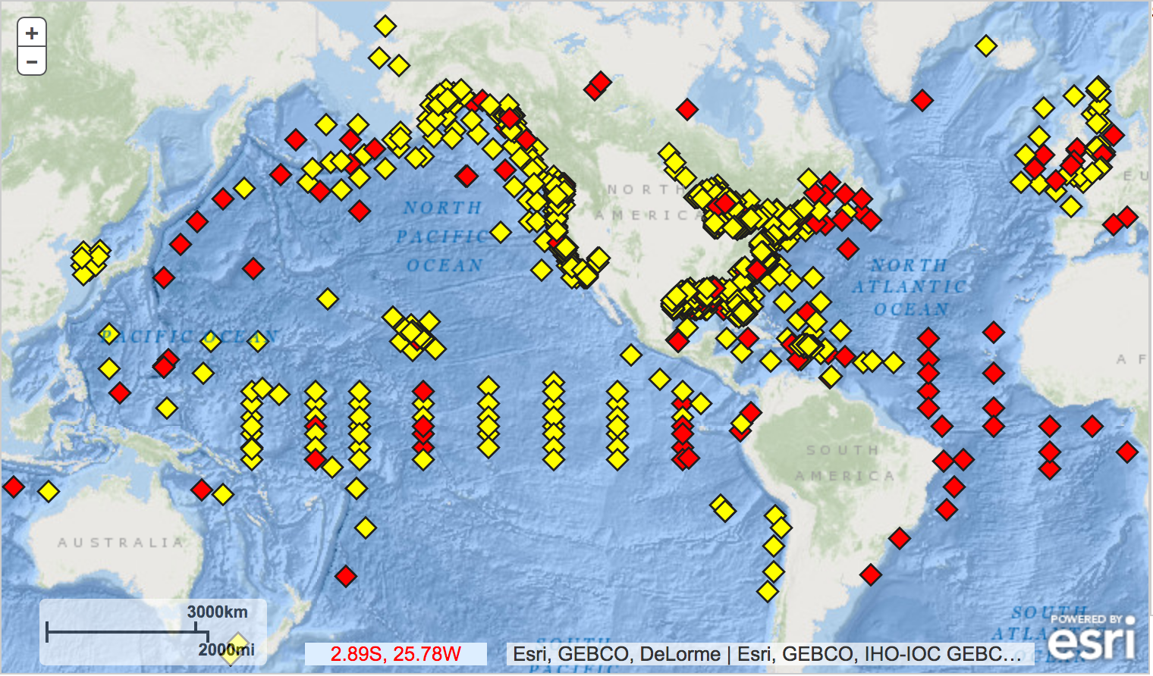
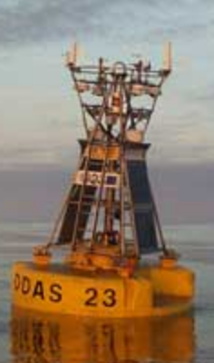
WHY SUCH A PROBE ?
NATIONAL OCEANIC AND ATMOSPHERIC ADMINISTRATION
1354 buoys
None in the Adriatic sea
SEALAB 0.1 – 06/2017
MAXIME BORRY – NINA GUERIN

Slide 3
WHAT TO DO WITH THE DATA ?
??
Temperature
Movement
LINKING WITH OTHER PROJECTS ??
SEALAB 0.1 – 06/2017
MAXIME BORRY – NINA GUERIN

