Slide 1
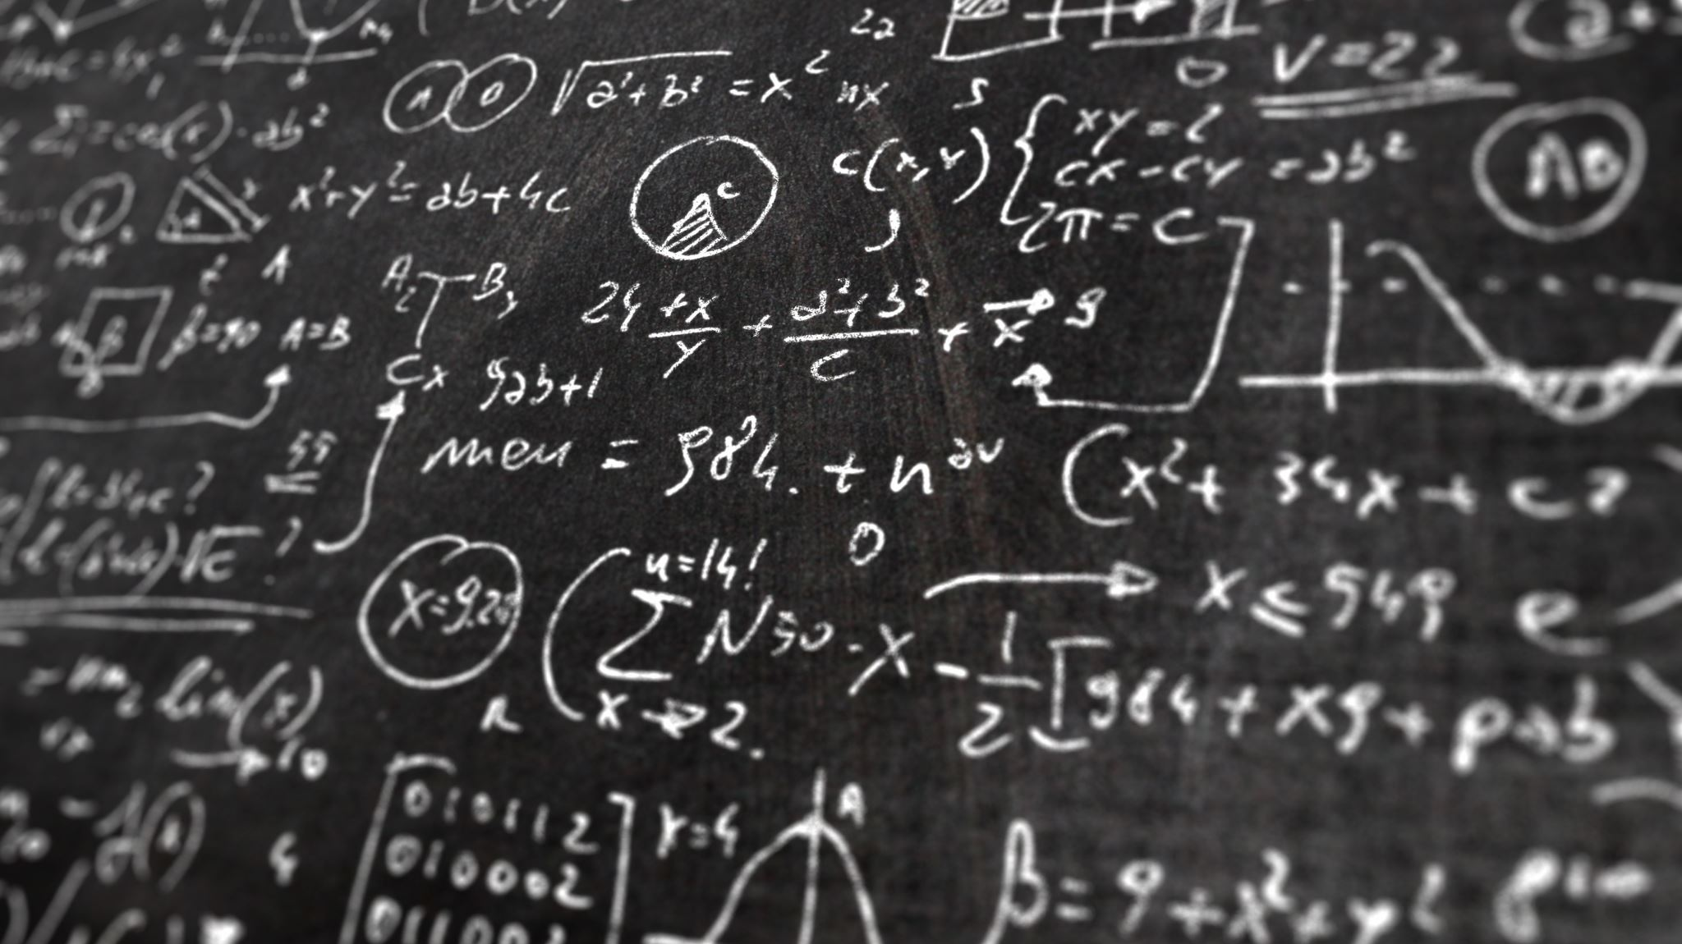
Welcome to
Math 1552
Math 1552 lecture slides adapted from the course materials
By Klara Grodzinsky (GA Tech, School of Mathematics, Summer 2021)

Slide 2
NETIQUETTE
Netiquette is the etiquette of online behavior. In all means of communication in this online course, you will need to follow the same rules of behavior as you would in a face-to-face course when communicating with the other students, teaching assistants, and instructors in the class. This means that you will have to respect others: negative personal comments are strictly prohibited. Please also respect your fellow classmates by turning off your microphone and web cam when appropriate.

Slide 3

How will lectures operate?
Lectures will run "live" at the regularly schedule times.
Pre-recorded lecture material should be watched prior to the class time (beginning second week).
Class time will focus on problem solving and answering questions.
Classes will be recorded if you are unable to attend the live sessions.
Sessions will run on BlueJeans.

Slide 4
What are studios?
Studios are problem-based and will run at the scheduled times.
Your TA will have you work together on weekly problem sets.
Portions of the studio sessions will be recorded.
Attendance is required, beginning on the second week of classes.

Slide 5
Syllabus Basics
Your grade will be determined by:
Participation
Regular homework on MyMathLab (check syllabus schedule)
Attendance will be taken in studio beginning on May 18
Makeup options for missing class are attending office hours or holding a study session with your classmates
Lecture Videos
Lecture Attendance Checks
We may require students to complete an in-class poll on Canvas during lecture for credit towards the participation grade (aperiodically scheduled, not announced beforehand)
Quizzes and Midterm Exam
Five quizzes (lowest raw score dropped)
Midterm exam
Final Examination

Slide 6
Grading Rubric
Assessment | Weight
Lecture Participation | 5%
Studio Attendance | 5%
Studio Participation | 10%
Homework | 10%
Quizzes Midterm Exam Final Exam | 20% 20% 30%

Slide 7
Participation Grade
Homework assignments
Studio: 2X weekly possible for attending and participating in each class, beginning May 18)
Makeup points can be earned by attending office hours or holding a review session with your classmates

Slide 8
Live Proctoring
Quizzes and exams will be proctored in a synchronous online session using Honorlock.
Students must have a broadband internet connection
Students must have a webcam and microphone
Students must have a secure private location to take an exam without others in the room
Students will be asked to provide a picture ID and take a picture of themselves via a webcam as part of the exam process
Honorlock is not compatible with Linux OS, Virtual Machines, tablets, or smartphones
Honorlock requires the installation of Google Chrome and the Honorlock Chrome extension.
Please contact your instructor as soon as possible if you need special accommodations during proctored exams.

Slide 9
Important Websites
Course Information: canvas.gatech.edu
Textbook/Homework Access: http://www.mymathlab.com
BlueJeans meetings will be used for synchronous class and studio sessions.

Slide 10
Textbook: What to purchase?
MyMathLab code is a minimum.
You may sign up for temporary access if you are not yet sure whether or not you want a printed copy of the text.
The bookstore sells codes packaged with a text (cheaper than separate purchases).
DO NOT BUY CODES FROM THIRD-PARTY VENDORS! Only online or at the bookstore.
IMPORTANT: Please register through CANVAS, not the MyMathLab site.

Slide 11
Important Policies
Make-ups
Notify your instructor in advance, if possible
Availability determined on a case-by-case basis
Might be scheduled at a common time
Attendance
Required in studio and Strongly recommended in lectures
Health Concerns
http://health.gatech.edu/coronavirus/students
Calculators
Not allowed on assessments

Slide 12
Policies (cont.)
Academic Misconduct
Any cases will be submitted to the Dean’s office.
Disability Services
Please discuss any accommodations with me.
Regrades
Submit within one week after receiving your graded paper.

Slide 13
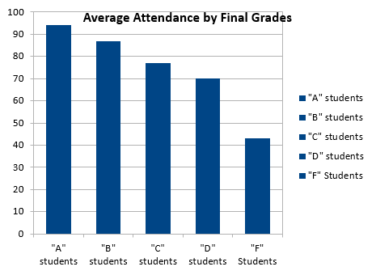
Attendance Matters!
Data from Mrs. G's classes for the past 10 years
Final Grade | Average Attendance
"A" students | 94
"B" students | 87
"C" students | 77
"D" students | 70
"F" Students | 43

Slide 14
What are the keys to success?
Come to class and participate!
Do your homework
Really try to solve the problems, don’t just look up the answers
Ask questions
Come to office hours
Go to the math lab virtual hours

Slide 15
Where can I go for extra help?
The instructors and TAs will be holding their scheduled office hours on MS Teams or on BlueJeans.
You may attend office hours for any of the instructors or TAs.
Please reach out to us with any individual needs over email.

Slide 16
What is Integral Calculus?
Math 1552 lecture slides adapted from the course materials
By Klara Grodzinsky (GA Tech, School of Mathematics, Summer 2021)

Slide 17
Course Goals
Topic 1: Integration
Explore meaning of the integral
Finding the area under the curve
Using integrals to find volumes
Relating the integral to the derivative
Learn methods of integration
Evaluate integrals using various techniques

Slide 18
Course Goals
Topic 2: Infinite Series
Understand the ideas of convergence and divergence
Apply to integrals, sequences, and series
Use Taylor polynomials to approximate values of functions that cannot be otherwise evaluated by hand
(Taylor polynomials occur in almost every field of study; this is the most important topic in our course!)

Slide 19
Core concept of our class:
Definition: We say the function F is an antiderivative of the function f if F’(x)=f(x).
The collection of all antiderivatives is defined as the indefinite integral of the function:

Slide 20
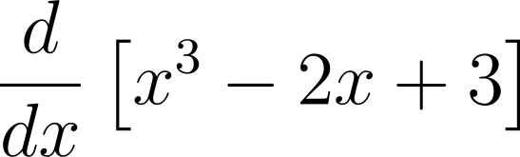

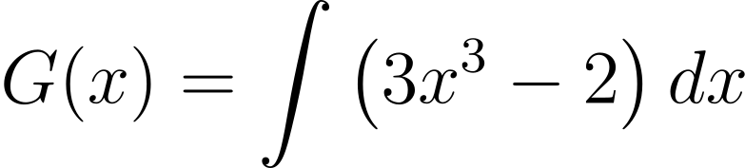

A first example
(much more on this later)

Slide 21
Review of Calculus I
Math 1552 lecture slides adapted from the course materials
By Klara Grodzinsky (GA Tech, School of Mathematics, Summer 2021)
Review these slides on your own!

Slide 22
Derivative Rules (cont.)
Power Rule:
Product Rule:

Slide 23
Derivative Rules
Quotient Rule:

Slide 24
The Chain Rule

Slide 25
Some Derivative Formulas (memorize)
(important formula to know)
(less common, but useful to know)
(less common, but useful to know)
(Suggested methods to help memo-ize these formulas – try flash cards or quickly jot five times a week method)

Slide 26
Derivatives of Inverse Functions
Know (memorize) this formula well:
Understand how to derive these formulas quickly:
Note: ln(x) denotes the natural logarithm (log base-e) whereas log(x) is notation from the textbook that denotes a base-10 logarithm.

Slide 27
Derivatives of Inverse Functions (formulas to know)

Slide 28

Example One:
Differentiate the following function:

Slide 29
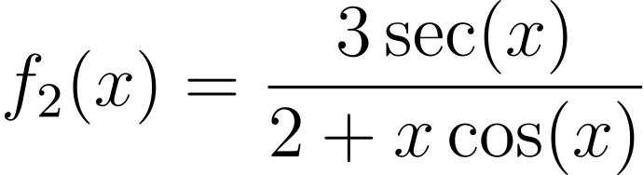
Example Two:
Differentiate the following function:

Slide 31
Example Three:
Differentiate the following function:

Slide 32
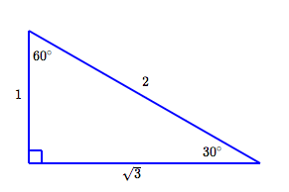
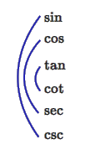
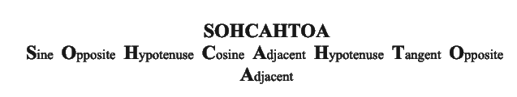
Review of Trigonometry
Special right triangles (ratio of sides):
Trig function inverse relationships diagram:
Rules to compute trig functions of right triangles:
Credits for figures: https://www.onemathematicalcat.org/Math/Precalculus_obj/trigValuesSpecialAngles.htm

Slide 33
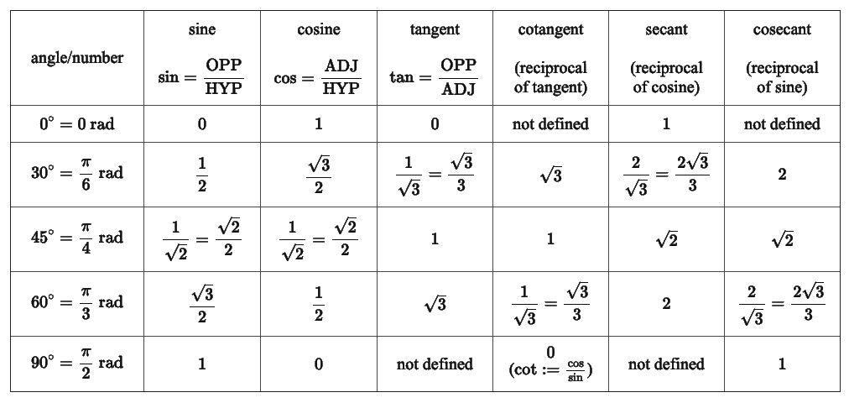
Review of Trigonometry (cont.)
Table of special trig function values (remember them in radians):
Credits for table: https://www.onemathematicalcat.org/Math/Precalculus_obj/trigValuesSpecialAngles.htm

Slide 34
Section 4.8: Antiderivatives
Math 1552 lecture slides adapted from the course materials
By Klara Grodzinsky (GA Tech, School of Mathematics, Summer 2021)

Slide 35
Antiderivatives
Definition: We say the function F is an antiderivative of the function f if F’(x)=f(x).
The collection of all antiderivatives is defined as the indefinite integral of the function:

Slide 36
Some common antiderivatives (memorize)
(Recall the correct formula when n=1)

Slide 37
Example 1.2:
Find an anti-derivative for the function below.

Slide 38
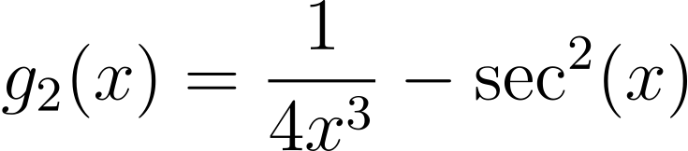
Example 1.1:
Find an anti-derivative for the function below.

Slide 39
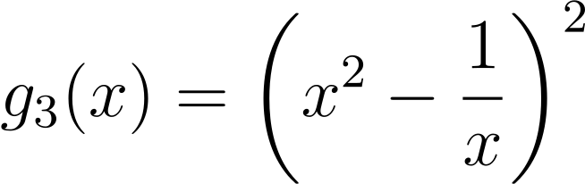
Example 1.1:
Find an anti-derivative for the function below.

Slide 40
Example 2:
A particle travels with an acceleration, in meters per second squared, given by:
Find the particle’s velocity and position at time t=1 second if the initial position is 2 m and the initial velocity is 10 m/s.

Slide 44
Applying the Chain Rule

Slide 45
More Useful Antiderivative formulas
(Understand how to quickly derive this formula)

Slide 46
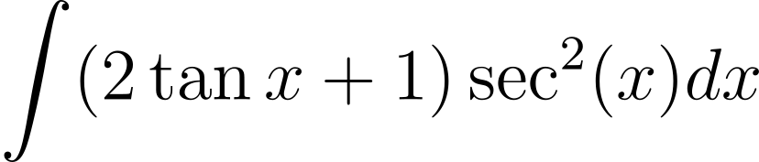
Example 3.1:
Evaluate the following indefinite integral:

Slide 48
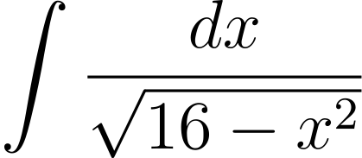
Example 3.2:
Evaluate the following indefinite integral:

Slide 49
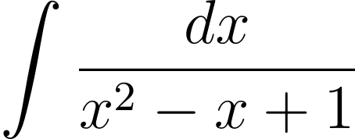
Example 3.3:
How would you find a formula for the following indefinite integral?

Slide 50
Section 5.1-5.3: Area under the curve and the definite integral
Math 1552 lecture slides adapted from the course materials
By Klara Grodzinsky (GA Tech, School of Mathematics, Summer 2021)

Slide 51
Learning Goals
Understand how to partition an interval
Draw a picture to approximate the area under the curve with a given number of rectangles
Compute the Upper and Lower sums
Calculate the midpoint estimate

Slide 52
Basic Methodology
Idea: Find the area bounded by a function f(x), the lines x=a, x=b, and the x-axis.

Slide 53
Riemann Sums
Idea: Find the area bounded by a function f(x), the lines x=a, x=b, and the x-axis.
Procedure: Break the interval [a,b] into n subintervals, and draw a rectangle in each subinterval.
Summing the areas of the rectangles will approximate the area under the curve.

Slide 54
Defining Sigma Notation
We denote the next (finite) sum of terms by:
(Practice some sums – examples)

Slide 55
Riemann Sums (cont.)
Upper estimate: use rectangles that over-approximate the area

Slide 56
Riemann Sums (cont.)
Lower estimate: use rectangles that under-approximate the area

Slide 57
Example 1:
Find the upper and lower sums for the function
on the interval [-1,2] with n=6 subintervals.

Slide 62
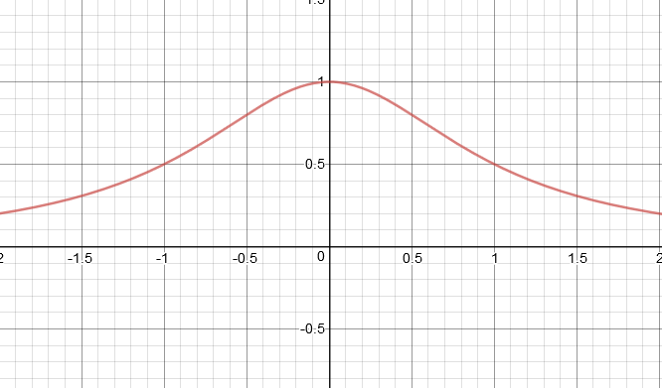
As we take rectangles of smaller and smaller width, and then add in more of them to fill up the interval evenly, we get close to the area under the smooth curve.
Key idea: We will compute a definite integral by writing down a Riemann sum for the area approximation and then take a limit as the size width of the rectangles tends to zero.

Slide 63
Midpoint Estimate
Idea: Go for the middle ground approximation (value in between).
Plug in the midpoint of each subinterval.

Slide 64
Example 2:
Find a midpoint estimate to the area from Example 1.
Recall: We want to approximate the area underneath the function
on the interval [-1,2] with n=6 subintervals.

Slide 67
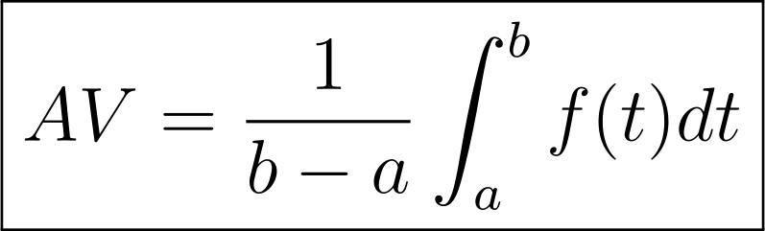
Average Value
The average value of f on [a,b] is the y-value that would generate a rectangle with the same area as f on [a,b].
Later:

Slide 68
Example 3:
Using the same example, find the average value of the function on the interval [-1,2] using the midpoint estimate.

Slide 70
Next Learning Goals
Be able to find the equation for a general Riemann Sum
Take the limit of your answer to find the actual area beneath the curve
Understand the definition of the definite integral
Understand key properties of the definite integral

Slide 71
General Riemann Sum

Slide 72
What is x_{i}* in the formula?
The left-hand endpoint of the subinterval.
The right-hand endpoint of the subinterval.
The midpoint of the subinterval.
Any value on the subinterval.

Slide 73
The Definite Integral
We define the definite integral to be the limit of the Riemann Sum:

Slide 74
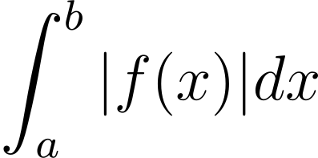
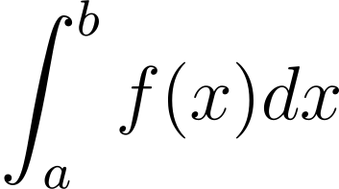
The Definite Integral and Area
If the function is always non-negative on [a,b], we have found TOTAL AREA under the curve.
If the function takes on negative values, then we have found the NET AREA under the curve.

Slide 75
Helpful Summation Formulas (memorize)
(Linearity – use to simplify sums)
(Linearity – use to simplify sums)

Slide 76
Example 4:
Use the method of Riemann Sums to evaluate the following definite integral. Choose x_{i}* to be the left-hand endpoint of each subinterval.

Slide 80
Example 5:
In a memory experiment, the rate of memorization is measured by the function:
f(t) = -c t² + d t, c>0, d>0,
where t is the time in minutes, and f(t) is the number of words per minute.
(a) How many words are memorized in the first 2 minutes (from t=0 to t=2)? USE RIEMANN SUMS.
(b) What is the average number of words memorized each minute?

Slide 85
Properties of the Definite Integral

Slide 86
Properties of the Definite Integral (cont.)

Slide 87
Some More Integral Properties

Slide 88
More Integral Properties (cont.)

Slide 89
Example 6:
-3
1
3
5

Slide 91

Challenge Problem:
Hints:
(1) What are some ways we have seen to simplify this integral?
(2) Recall your special triangle values of trig functions.

Slide 95
Section 5.4: The Fundamental Theorem of Calculus
Math 1552 lecture slides adapted from the course materials
By Klara Grodzinsky (GA Tech, School of Mathematics, Summer 2021)

Slide 96
Today’s Learning Goals
Know the statements of the FTC and the Second FTC
Apply the FTC to evaluating definite integrals using the formulas from Section 4.8
Apply the Second FTC to differentiate an integral

Slide 97
Theorem: The 2nd FTC
Let f be a continuous function on the interval [a,b].
Then if
F’(x)=f(x) for all x in (a,b).

Slide 98
Example 1: Find F’(2).
2/7
2/11
¼
3/44

Slide 101
Antiderivatives
Definition: We say the function F is an antiderivative of the function f if F’(x)=f(x).

Slide 102
Antiderivatives
Definition: We say the function F is an antiderivative of the function f if F’(x)=f(x).

Slide 103
The FTC
The Fundamental Theorem of Calculus:
Let f be a function that is continuous on the interval [a,b], and let F be any antiderivative of f. Then:

Slide 104
Example 2: Evaluate.
2/3
4/3
26/9
26/81

Slide 107
Example 3:
The percent of toxin in a lake, where time is in years, is given by the function:
Find the average amount of toxin in the lake between years 1 and 3.

Slide 111
Example 4: Extension to 2nd FTC (chain rule)
(Does every one see where this comes from?)

Slide 115
Mean Value Theorem
MVT for Integration (statement):

Slide 116
Example 5:
Find the average value of the function:
Then find a c that satisfies the MVT for integration.

