Slide 1

Section 5.5:
Integration by substitution
Math 1552 lecture slides adapted from the course materials
By Klara Grodzinsky (GA Tech, School of Mathematics, Summer 2021)

Slide 2
Today’s Learning Goals
Evaluate integrals using the substitution (usub) method
Understand how to choose u
Understand which functions can be evaluated with the substitution method
The substitution method is a change of variable in the integral that simplifies the integrand into f(u) du for a function f we recognize

Slide 3
Functions we already know how to integrate directly:
Recall the antiderivatives of the following functions we reviewed last week:

Slide 4
Method of u-substitution
This method is the reverse of the chain rule
for derivatives:

Slide 5
u-substitution with Definite Integrals

Slide 6
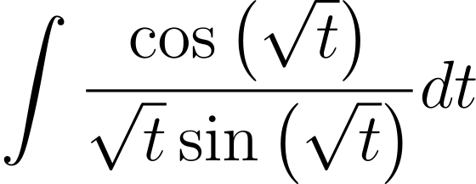
Example 1.1: Evaluate.

Slide 8
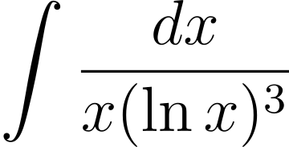
Example 1.2: Evaluate.

Slide 10
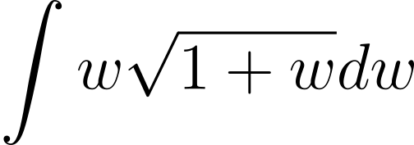
Example 1.3: Evaluate.

Slide 12
Example 2: Evaluate the integral.
1

Slide 14
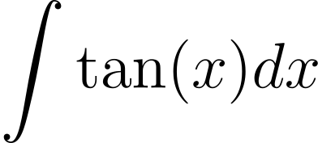
Example 3.2:
Evaluate the following indefinite integral:

Slide 16
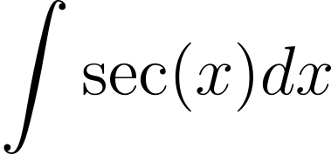
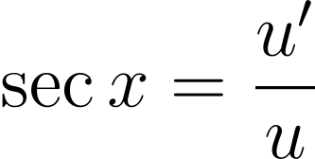
Example 3.1:
Evaluate the following indefinite integral:
Hint:
Take
to get that
(logarithmic derivative)

Slide 18
Additional Trig Formulas (know how to derive these):

Slide 19
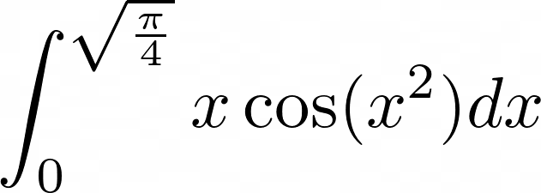
Extra problems (limits of integration)
Evaluate the following indefinite integral:

Slide 21
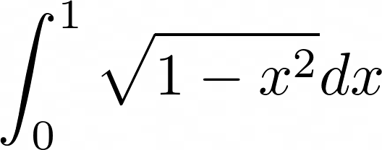
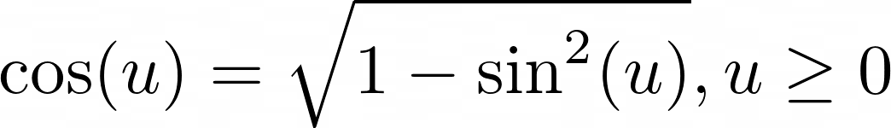
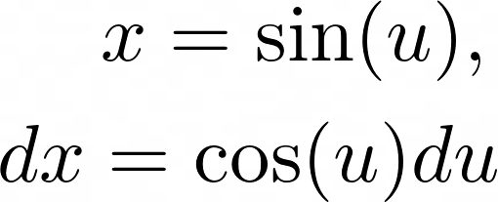
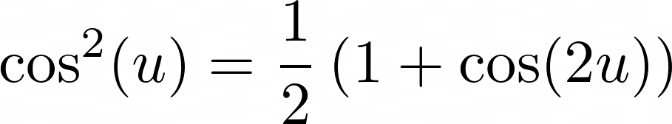
Challenge problem (foreshadowing trig subs – later)
Evaluate the following indefinite integral:
Hints:
See that
Write
Use the identity

Slide 24
Section 5.6:
Area between two curves
Math 1552 lecture slides adapted from the course materials
By Klara Grodzinsky (GA Tech, School of Mathematics, Summer 2021)

Slide 25
Today’s Learning Goals
Understand what is meant graphically by integrating the difference between two functions (solve for intersection points between the two curves on the interval)
Set up an integral to find the total area bounded between two curves
Evaluate numerically the area bounded between two curves
Be able to express the integration in terms of either x or y, depending on the function(s)

Slide 26
Area Between Two Curves
To find the area between two curves, written as functions of x:
To find the area between two curves, written as functions of y:

Slide 27
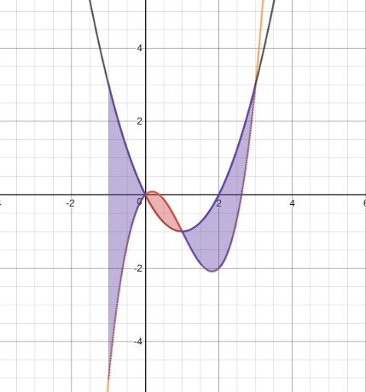

Slide 28
Steps to Evaluating Area
Where do the curves intersect? Break up the interval [a,b] into sub-intervals based on points of intersection.
For each subinterval, which function is bigger?
Integrate top-bottom or right-left on each subinterval.

Slide 29
Example 1:
Find the area bounded by

Slide 30
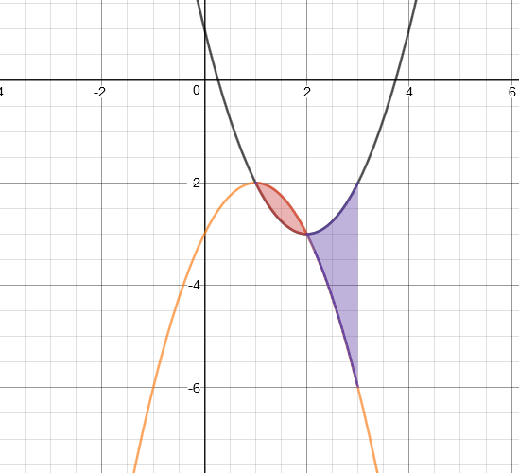

Slide 33
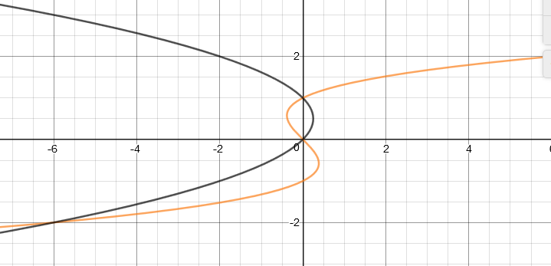
Example 2:
Find the area of the region bounded by

Slide 36
Example 3:
Find the area bounded by the curves
0
1/3
2/3
1

Slide 39
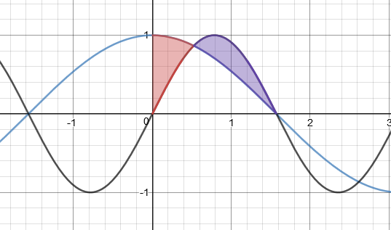
Example 4:
Find the area of the region bounded by the curves

Slide 42
Section 8.2:
Integration by parts
Math 1552 lecture slides adapted from the course materials
By Klara Grodzinsky (GA Tech, School of Mathematics, Summer 2021)

Slide 43
Review Question: Evaluate the integral.
1

Slide 45
Learning Goals
Identify which functions can be solved using the method of integration by parts
Understand how to choose the values of “u” and “dv”
Evaluate integrals using integration by parts

Slide 46

Formula for Integration by Parts
Integration by parts comes from the product rule for differentiation.
Differentiate u to obtain du.
Find v by taking an antiderivative of dv.

Slide 47
Rules to Apply Integration by Parts
The original integral CANNOT be evaluated by a normal u-substitution alone.
Begin by rewriting the original function as the product of two pieces, u and dv.
We must be able to integrate dv!
The new integral should be easier than the original problem. If not, try a different choice for u and dv.

Slide 48
When to use Integration by Parts
Use integration by parts to evaluate the integrals of:
Inverse functions
Logarithmic functions
Functions that are combinations of more than one type of function (i.e., polynomials, trigonometric, exponential, logarithmic functions)
Note: We can combine IBP with the methods we have learned so far (e.g., start with a u-sub and then apply IBP after simplifying)
After practice, you should be able to spot IBP type integrals quickly
K. Grodzinsky, School of Mathematics, Georgia Tech, 2019

Slide 49
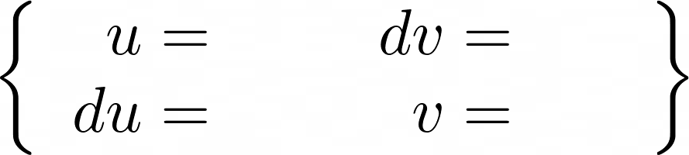
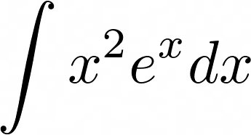

Hints about IBP techniques
DO NOT use tables, or tabular integration methods, you have seen before in this class!
Start with a blank slate of parameters you need to find organized like the following:
Be prepared to apply IBP more than once, e.g., to evaluate
If nothing else works, you can always take
We will see many examples in the next slides

Slide 50
Order in which to choose u
Choose u according to the ILATE rule:
I – Inverse Functions
L – Logarithmic Functions
A – Algebraic Expressions (polynomials, rational functions, etc.)
T – Trigonometric Functions
E – Exponential Functions
Tip: In the event of a “tie” in the ILATE rule, pick u to be the simplest of the two functions.

Slide 51
Example 1 (inverse functions):
Evaluate the integral

Slide 53
What should we choose for the value of u in the integral
Hint:
x
sin(x)
cos(x)
sin(x)cos(x)
1

Slide 54
Example 2:
Evaluate the integral:

Slide 55
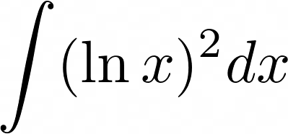
Example 3:
Evaluate the integral:

Slide 57
What should we choose for the value of u in the integral
sin(x)
ln(x)
sin[ln(x)]
dx
1

Slide 58
Example 4:
Evaluate the integral:
Key Idea:
We will do IBP twice and then solve a system for the original integral
(after a substitution)

Slide 60
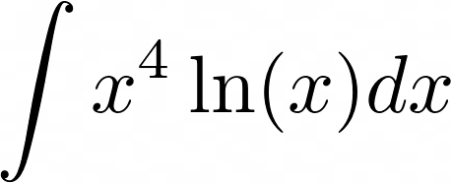
Example 6:
Evaluate the integral:

Slide 62
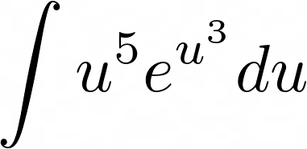
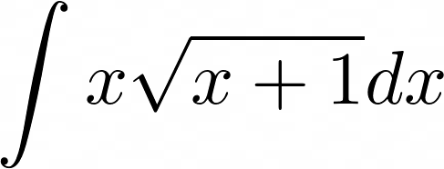
Other examples of the IBP method to try:
Practice which functions to take as u and dv (u-sub first?):

Slide 64
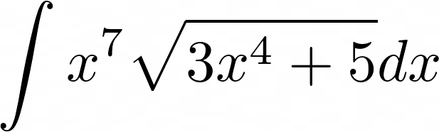
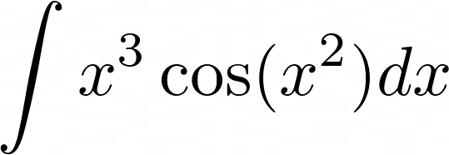
Other examples of the IBP method to try:
Practice which functions to take as u and dv (u-sub first?):

Slide 66
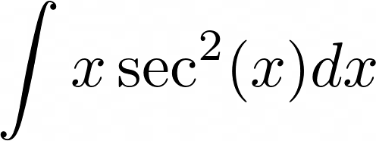
Other examples of the IBP method to try:
Practice which functions to take as u and dv (u-sub first?):

