Slide 1

Math 1552
Review of Week 2
Math 1552 lecture slides adapted from the course materials
By Klara Grodzinsky (GA Tech, School of Mathematics, Summer 2021)

Slide 2
Review Question: Which integrals can we evaluate by parts?

Slide 3
Math 1552
Section 8.3:
Powers and Products of
Trigonometric Functions
Math 1552 lecture slides adapted from the course materials
By Klara Grodzinsky (GA Tech, School of Mathematics, Summer 2021)

Slide 4
Today’s Goal:
Use trigonometric formulas to reduce more difficult integrals until we can perform a u-substitution.
Idea: rewrite the function in terms of just one trig function after “breaking off” its derivative for a u-substitution

Slide 5
Useful Trig Identities
(Where do these come from?)
Special cases: x=at, y=bt

Slide 6

Example 1.1:
Evaluate the following integral:

Slide 9

Example 1.2:
Evaluate the following integral:

Slide 12

Example 1.3:
Evaluate the following integral:

Slide 15

Example 2.1: Evaluate.

Slide 18

Example 2.2: Evaluate.

Slide 21
Evaluate the integral.

Slide 24

Extra Problem: Evaluate the integral.

Slide 27


Extra problem: Evaluate the integral.
Hint:

Slide 30
Math 1552
Section 8.4:
Trigonometric Substitution
Math 1552 lecture slides adapted from the course materials
By Klara Grodzinsky (GA Tech, School of Mathematics, Summer 2021)

Slide 31
Today's Learning Goals
Identify which types of integrals can be solved with a trigonometric substitution
Learn which substitution matches which general form
Evaluate integrals using the method of trigonometric substitution

Slide 32
Trigonometric Substitutions
We use a trig substitution when no other integration method will work, and when the integral contains one of these terms:

Slide 33
Rules to Trig Substitutions
Begin by replacing x with a trig function.

Slide 34
Rules to Trig Substitutions
Begin by replacing x with a trig function.
Don’t forget to also replace dx with the appropriate trig function.

Slide 35
Rules to Trig Substitutions
Begin by replacing x with a trig function.
Don’t forget to also replace dx with the appropriate trig function.
Use trig identities to solve the resulting integral.

Slide 36
Rules to Trig Substitutions
Begin by replacing x with a trig function.
Don’t forget to also replace dx with the appropriate trig function.
Use trig identities to solve the resulting integral.
Be sure to rewrite your final answer in terms of x.
Know how to derive the corresponding right triangle in each of the three cases we consider below without memorizing them

Slide 37
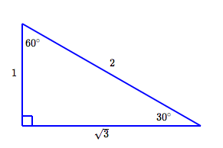
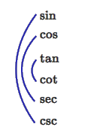
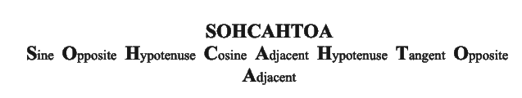
Review of Trigonometry
Special right triangles (ratio of sides):
Trig function inverse relationships diagram:
Rules to compute trig functions of right triangles:
Credits for figures: https://www.onemathematicalcat.org/Math/Precalculus_obj/trigValuesSpecialAngles.htm

Slide 38
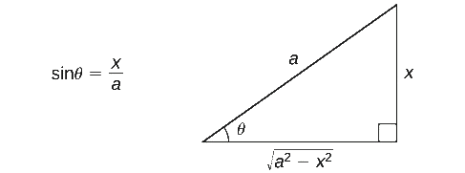
Form 1:
When the integral contains a term of the form
use the substitution:
Credits for figure: https://math.libretexts.org/Bookshelves/Calculus
(Book: OpenStax -> Techniques of Integration -> Trigonometric Substitution – Section 7.3)

Slide 39
Example 1:
Evaluate the integral:

Slide 42
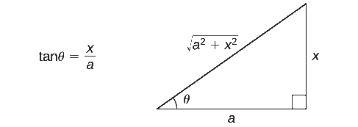
Form 2:
When the integral contains a term of the form
use the substitution:
Credits for figure: https://math.libretexts.org/Bookshelves/Calculus
(Book: OpenStax -> Techniques of Integration -> Trigonometric Substitution – Section 7.3)

Slide 43
Example 2:
Evaluate the integral:

Slide 46
Form 3:
When the integral contains a term of the form
use the substitution:
Credits for figure: https://math.libretexts.org/Bookshelves/Calculus
(Book: OpenStax -> Techniques of Integration -> Trigonometric Substitution – Section 7.3)

Slide 47
Example 3:
Evaluate the integral:

Slide 50

Extra problem:
Evaluate the integral:

Slide 53

Extra problem:
Evaluate the integral:

