Slide 1

Math 1552
Section 8.4:
Trigonometric Substitution (cont.)
Math 1552 lecture slides adapted from the course materials
By Klara Grodzinsky (GA Tech, School of Mathematics, Summer 2021)

Slide 2
Review: Trigonometric Substitutions
We use a trig substitution when no other integration method will work, and when the integral contains one of these terms:

Slide 3
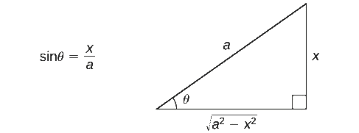
Review of Form 1:
When the integral contains a term of the form
use the substitution:
Credits for figure: https://math.libretexts.org/Bookshelves/Calculus

Slide 4
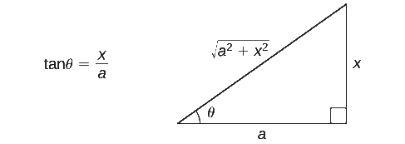
Review of Form 2:
When the integral contains a term of the form
use the substitution:
Credits for figure: https://math.libretexts.org/Bookshelves/Calculus

Slide 5
Review of Form 3:
When the integral contains a term of the form
use the substitution:
Credits for figure: https://math.libretexts.org/Bookshelves/Calculus

Slide 6

Example 1:
Evaluate the integral:

Slide 9

Example 2:
Evaluate the integral:

Slide 12
Math 1552
Section 8.5:
The Method of Partial Fractions
Math 1552 lecture slides adapted from the course materials
By Klara Grodzinsky (GA Tech, School of Mathematics, Summer 2021)

Slide 13
When to Use Partial Fractions:
Use the method of partial fractions to evaluate the integral of a rational function when:
The degree of the numerator is less than that of the denominator.
The denominator can be completely factored into linear and/or irreducible quadratic terms – NO complex numbers in this class!

Slide 14
Partial Fractions Procedure:
If the leading coefficient of the denominator is not a “1”, factor it out.

Slide 15
Partial Fractions Procedure:
If the leading coefficient of the denominator is not a “1”, factor it out.
If the degree of the numerator is greater than that of the denominator, carry out long division first.

Slide 16

Quick refresher on polynomial long division
Question: What do you when asked to evaluate this integral?
Short answer: Observe that
(How?)
(This standard method works for denominator polynomials of degree larger than one.)

Slide 18
Partial Fractions Procedure:
If the leading coefficient of the denominator is not a “1”, factor it out.
If the degree of the numerator is greater than that of the denominator, carry out long division first.
Factor the denominator completely into linear and/or irreducible quadratic terms.

Slide 19
Partial Fractions Procedure:
For each linear term of the form , you will have k partial fractions of the form:
(Note: if k=1, there is only one fraction to handle, etc.)

Slide 20
Partial Fractions Procedure:
For each irreducible quadratic term of the form , you will have m partial fractions of the form:
(Note: if m=1, there is only one fraction, etc.)

Slide 21
Partial Fractions Procedure:
Solve for all the constants A_{i} and B_{i}. To solve:
Multiply everything by the common denominator.
Combine all like terms, then solve equations for all the A_{i} and B_{i} terms; OR plug in values to find equations for A_{i} and B_{i} terms.
Integrate using all the integration methods we have learned.

Slide 22
Example 1:
Evaluate the integral:

Slide 25
Example 2:
Evaluate the integral:

Slide 28
Example 3:
Evaluate the integral:

Slide 31
Example 4:
Evaluate the definite integral:

Slide 34


Challenge Problem I:
Evaluate the following integral (sketch key steps):
Hint: Use the substitution

Slide 36


Challenge Problem II:
Evaluate the following integral (sketch key steps):
Hint: Write
, then factorize the quadratic and apply partial fractions.

Slide 38
Review Question: Which of the following integrals would you evaluate using partial fractions? Why?

Slide 39
Math 1552
Section 4.5:
L’Hopital’s Rule
Math 1552 lecture slides adapted from the course materials
By Klara Grodzinsky (GA Tech, School of Mathematics, Summer 2021)

Slide 40
Today’s Learning Goals
Understand which forms are indeterminate
Apply L’Hopital’s Rule to evaluate limits
Rewrite limits in forms appropriate to applying L’Hopital’s Rule

Slide 41
Indeterminate Forms

Slide 42
Which of the following limits does NOT contain an indeterminate form? Why?

Slide 43
L’Hopital’s Rule
Let f and g be two functions. Then IF:
f and g are differentiable,
has the indeterminate form of OR
THEN:

Slide 44

Example 1.1:
Use L’Hopital’s rule to evaluate the following limit.

Slide 46

Example 1.2:
Use L’Hopital’s rule to evaluate the following limit.

Slide 48
Evaluate the limit:
0
1
ln(3/4)
(ln3)/(ln4)

Slide 50

Example 2.1:
Use L’Hopital’s rule and logarithms to evaluate the following limit.
Logarithm rule:

Slide 52

Example 2.2:
Use L’Hopital’s rule and logarithms to evaluate the following limit.
Logarithm rule:

Slide 54
Evaluate the limit:
e²
e^{1/2}
1
Infinity

Slide 56
Compendia of Common Limits (memorize)

Slide 57

Extra Problem I: Evaluate the following limit:

Slide 59

Extra Problem II: Evaluate the following limit:

Slide 61

Extra Problem III: Evaluate the following limit:

Slide 63
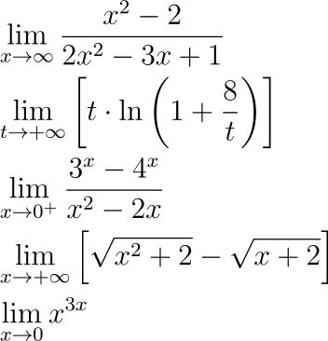


Bonus Practice Problems: Evaluate each of the following limits:
(In class: practice verifying that we get an indeterminate form in each case)
Hint: Multiply through by
, and then take limits
►
►
►
Hint: Multiply through by the conjugate
►
, to simplify the numerator first
►

Slide 67
Math 1552
Section 8.8:
Improper Integrals
Math 1552 lecture slides adapted from the course materials
By Klara Grodzinsky (GA Tech, School of Mathematics, Summer 2021)

Slide 68
Today’s Learning Goals
Be able to identify when an integral is improper
Rewrite an improper integral as a limit
Understand the meaning of convergence and divergence as relating to integration
Evaluate improper integrals

Slide 69
Improper integrals
A definite integral is improper if:
The function has a vertical asymptote at x=a, x=b, or at some point c in the interval (a,b).
One or both of the limits of integration are infinite (positive or negative infinity).

Slide 70
Which of the following integral(s) is (are) improper? Why / which case?

Slide 71
Convergence of an Integral
If an improper integral evaluates to a finite number, we say it converges.
If the integral evaluates to ±∞ or to, ∞- ∞, we say the integral diverges.

Slide 72
Case 1: At Least One Infinite Limit
Redefine the integral into one of the following.

Slide 73

Example 1.1:
Evaluate the integral:

Slide 75

Example 1.2:
Evaluate the integral:

Slide 78
Case 2: f(c)→∞ Between a and b
Case 2 occurs when f has a vertical asymptote on the interval [a,b].
Redefine the integral into one of the following.

Slide 79

Example 2.1:
Evaluate the integral:

Slide 81

Example 2.2:
Evaluate the integral:

Slide 83
Example 3:
Find the area of the region bounded by

Slide 86
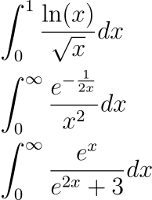
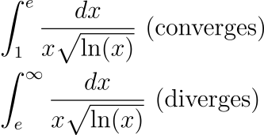
Bonus Problems on Improper Integrals
Evaluate each of the next integrals (if time permits).
▣
▣
▣
◈
◈

