Slide 1
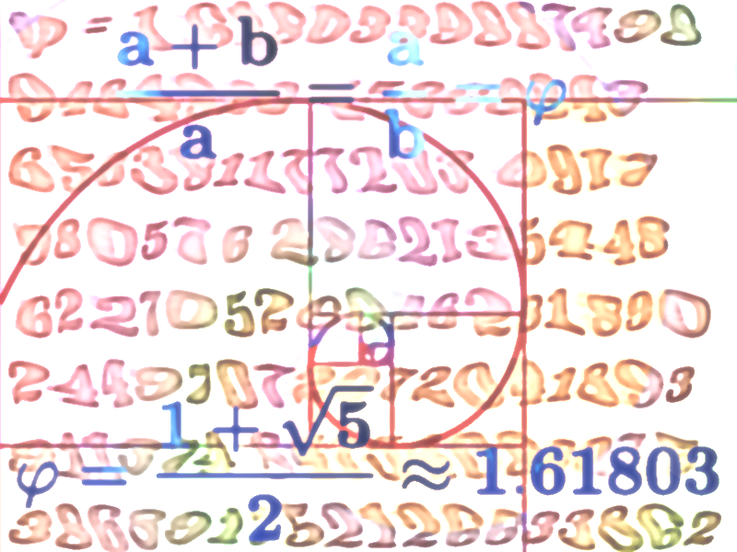
Math 1552
Section 8.8:
Improper Integrals (cont.)
Math 1552 lecture slides adapted from the course materials
By Klara Grodzinsky (GA Tech, School of Mathematics, Summer 2021)

Slide 2

Example B.1:
Evaluate the following integral:

Slide 5

Example B.2:
Evaluate the following integral:

Slide 8

Example B.3:
Evaluate the following integral:

Slide 11

Example B.4:
Evaluate the following integral:

Slide 15

Another example:
Evaluate the following integral:
(What is the geometric interpretation of this integral?)

Slide 17
Math 1552
Review of
integration techniques
Math 1552 lecture slides adapted from the course materials
By Klara Grodzinsky (GA Tech, School of Mathematics, Summer 2021)

Slide 18
Review of integration methods (so far)
What techniques have we seen so far to evaluate definite and indefinite integrals?
Direct integration (know/memorize common formulas)
Substitution, or u-subs
Integration by parts, or IBP
Powers and products of trig functions
Trigonometric substitutions, or trig subs
Partial fractions
Other topics we covered:
Riemann sums, FTC, areas between curves, L’Hopital’s rule, and improper integrals

Slide 19
Hints and suggestions
Practice picking out the relevant methods of integration on the review sheet (bring to class next lecture for Q/A☺)
When in doubt, try using a u-sub first to simplify the integral
You may need to combine multiple techniques we have seen, for example, a u-sub followed by IBP and then a term that involves partial fractions (see Example R.3 in the next slides)
Review key components of each method to study

Slide 20
Method of substitution (u-subs)
This method is the reverse of the chain rule
for derivatives:

Slide 21
Substitution with Definite Integrals

Slide 22

Example
Evaluate the following integral:
Which integration method to invoke? (Explain)

Slide 24

Example R.1
Evaluate the following integral:
Which integration method to invoke? (Explain)

Slide 26
When to Use Partial Fractions:
Use the method of partial fractions to evaluate the integral of a rational function when:
The degree of the numerator is less than that of the denominator.
The denominator can be completely factored into linear and/or irreducible quadratics

Slide 27
Partial Fractions Procedure:
If the leading coefficient of the denominator is not a “1”, factor it out.
If the degree of the numerator is greater than that of the denominator, carry out long division first.
Factor the denominator completely into linear and/or irreducible quadratic terms.

Slide 28
Partial Fractions Procedure:
For each linear term of the form , you will have k partial fractions of the form:
(Note: if k=1, there is only one fraction to handle, etc.)

Slide 29
Partial Fractions Procedure:
For each irreducible quadratic term of the form , you will have m partial fractions of the form:
(Note: if m=1, there is only one fraction, etc.)

Slide 30
Partial Fractions Procedure:
Solve for all the constants A_{i} and B_{i}. To solve:
Multiply everything by the common denominator.
Combine all like terms, then solve equations for all the A_{i} and B_{i} terms; OR plug in values to find equations for A_{i} and B_{i} terms.
Integrate using all the integration methods we have learned.

Slide 31

Example R.2
Evaluate the following integral:
Which integration method to invoke? (Explain)

Slide 33

Integration by Parts - Summary
Integration by parts comes from the product rule for differentiation.
Differentiate u to obtain du.
Find v by taking an antiderivative of dv.

Slide 34

Example R.3
Evaluate the following integral:
Which integration method to invoke? (Explain)

Slide 36
Antiderivatives of powers and products of trig functions

Slide 37





What to expect with powers / products of trig functions:
For integrals of the form
OR
we need to apply appropriate trig identities from the last slide to handle respective separate cases of n and m even or odd.
Apply other identities for integrals of the form
OR
OR

Slide 38

Example R.4
Evaluate the following integral:
Which integration method to invoke? (Explain)

Slide 40

Example R.5
(Sketch solution)
Evaluate the following integral:
Which integration method to invoke? (Explain)

Slide 42
Trigonometric Substitutions (trig subs)
We use a trig substitution when no other integration method will work, and when the integral contains one of these types of terms:

Slide 43
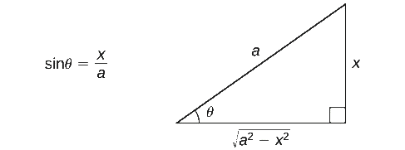
Trig subs - Form 1:
When the integral contains a term of the form
use the substitution:
Credits for figure: https://math.libretexts.org/Bookshelves/Calculus

Slide 44
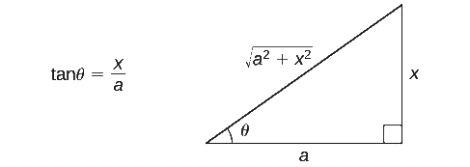
Trig subs - Form 2:
When the integral contains a term of the form
use the substitution:
Credits for figure: https://math.libretexts.org/Bookshelves/Calculus

Slide 45
Trig subs - Form 3:
When the integral contains a term of the form
use the substitution:
Credits for figure: https://math.libretexts.org/Bookshelves/Calculus

Slide 46

Example R.6
Evaluate the following integral:
Which integration method to invoke? (Explain)

Slide 48
Improper integrals
A definite integral is improper if:
The function has a vertical asymptote at x=a, x=b, or at some point c in the interval (a,b).
One or both of the limits of integration are infinite (positive or negative infinity).

Slide 49
Convergence of an Integral
If an improper integral evaluates to a finite number, we say it converges.
If the integral evaluates to ±∞ or to, ∞- ∞, we say the integral diverges.

Slide 50
Case 1: At Least One Infinite Limit
Redefine the integral into one of the following.

Slide 51
Case 2: f(c)→∞ Between a and b
Case 2 occurs when f has a vertical asymptote on the interval [a,b].
Redefine the integral into one of the following.

Slide 52

Example R.7
Evaluate the following integral:
Which integration method to invoke? (Explain)

Slide 55
Math 1552
Review for the
Midterm Exam
Math 1552 lecture slides adapted from the course materials
By Klara Grodzinsky (GA Tech, School of Mathematics, Summer 2021)

Slide 56
Let’s open things up for general questions and specific questions on the review sheet?
(List and enumerate problems)

