Slide 1
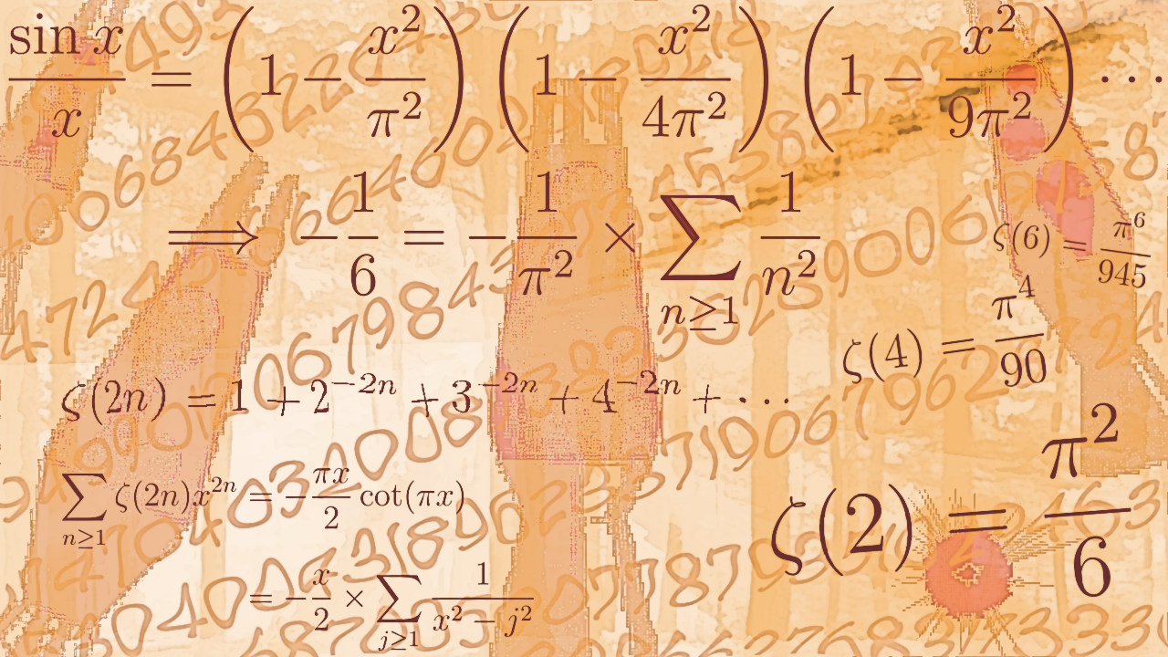
Math 1552
Sections 10.1:
Sequences
Math 1552 lecture slides adapted from the course materials
By Klara Grodzinsky (GA Tech, School of Mathematics, Summer 2021)

Slide 2
Today’s Learning Goals
Use proper notation to denote a sequence.
Understand how to find lower and upper bounds for sequences.
Determine if a sequence is monotonic.
Find limits of sequences when possible.

Slide 3

Sequences
A sequence is a function from the set of positive integers to the set of real numbers.
OR
The values of n are all positive integers, unless otherwise specified, e.g., starting from n=0 in the third form above.
Notes:
3

Slide 4
Find an expression for the general term of the sequence below:
Example:

Slide 6
LUB and GLB
An upper bound of a set S is a number M that is greater than or equal to each element in S.
The smallest possible upper bound is called the least upper bound (l.u.b.) – cf. the supremum.

Slide 7
LUB and GLB
An upper bound of a set S is a number M that is greater than or equal to each element in S.
The smallest possible upper bound is called the least upper bound (l.u.b.) – cf. the supremum.
A lower bound of a set S is a number m that is less than or equal to each element in S.
The largest possible lower bound is called the greatest lower bound (g.l.b.) – cf. the infimum.

Slide 8
Find the l.u.b. and g.l.b. of the sequence:
Example:
l.u.b.=1, g.l.b.=0
l.u.b.=2, g.l.b.=0
l.u.b.=2, g.l.b.=1
No l.u.b., g.l.b.=0

Slide 10
Monotone Sequences
A sequence is called monotonic if any one of the following statements holds:
(cf. non-decreasing)
(cf. non-decreasing)
(cf. non-increasing)
(cf. non-increasing)

Slide 11
Limit of a Sequence
If the sequence has a finite limit L, then the sequence is said to converge to L.
Otherwise, the sequence is said to diverge.

Slide 12

Convergence Theorem
If a sequence is monotonic and bounded,
then it converges (to some finite limit L).
If the sequence is increasing, then L=l.u.b.
If the sequence is decreasing, then L=g.l.b.
Equivalent statement:
An unbounded sequence diverges.

Slide 13

Example A:
Determine whether the sequence converges.
If so, find the limit.

Slide 15

Example B:
Determine whether the sequence converges.
If so, find the limit.

Slide 17

Example C:
Determine whether the sequence converges.
If so, find the limit.

Slide 19

Example D:
Determine whether the sequence converges.
If so, find the limit.

Slide 21

Example E:
Determine whether the sequence converges.
If so, find the limit.

Slide 23
Example: Find the limit of the following sequence, if it exists:
(Justify your answer carefully.)
0
-2/3
2/3
Diverges

Slide 25

Some Common Limits (memorize)
8) If p is a positive integer, then:
(Do you see why?)

Slide 27
An interesting example
Why is the harmonic series divergent?
Can we prove that it diverges using the material we have seen so far?

Slide 28


An interesting example
Why is the harmonic series divergent?
Can we prove that it diverges using the material we have seen so far?
Consider using a Riemann sum to approximate the sums
for integers n where we let n go to infinity where we take the side widths of the rectangles on the x-axis to be one.
Recall:

Slide 29
An interesting example
Why is the harmonic series divergent?
Can we prove that it diverges using the material we have seen so far?
Consider using a Riemann sum to approximate the sums
for integers n where we let n go to infinity where we take the side widths of the rectangles on the x-axis to be one.
Recall:
Sources for figures:
https://www.cantorsparadise.com/the-euler-mascheroni-constant-4bd34203aa01
https://brilliant.org/wiki/euler-mascheroni-constant/

Slide 30


An interesting example
Why is the harmonic series divergent?
Can we prove that it diverges using the material we have seen so far?
Consider using a Riemann sum to approximate the sums
for integers n where we let n go to infinity where we take the side widths of the rectangles on the x-axis to be one.
Recall:
Define:
We can show using elementary methods that
AND
EXISTS!
(by monotonicity and boundedness)

Slide 31
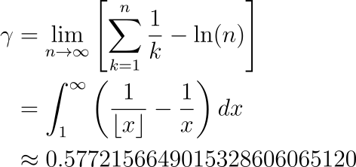
An interesting example
Why is the harmonic series divergent?
Can we prove that it diverges using the material
we have seen so far?
This constant is called Euler-Mascheroni’s gamma
(or the Euler gamma constant for short):
Consider using a Riemann sum to approximate the sums
for integers n where we let n go to infinity where we take the side widths of the rectangles on the x-axis to be one.
Recall:
Define:
We can show using elementary methods that
AND
EXISTS!
(by monotonicity and boundedness)

Slide 32
An interesting example
Why is the harmonic series divergent?
Can we prove that it diverges using the material
we have seen so far?
This constant is called Euler-Mascheroni’s gamma
(or the Euler gamma constant for short):
Consider using a Riemann sum to approximate the sums
for integers n where we let n go to infinity where we take the side widths of the rectangles on the x-axis to be one.
Recall:
The harmonic series is an example of a
p-series (with p=1) that diverges.
Now you can see why! ☺
Define:
We can show using elementary methods that
AND
EXISTS!
(by monotonicity and boundedness)

Slide 33


Challenge problem on limits of sequences I:
Suppose that
Does the sequence converge? If so, what is ?

Slide 36
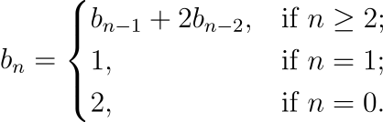

Challenge problem on limits of sequences II:
Suppose that
Does the sequence converge? If so, what is ?

Slide 39

Bonus problems on limits I:
Evaluate the following limit:

Slide 41

Bonus problems on limits II:
Evaluate the following limit:

Slide 43

Bonus problems on limits III (extra):
Show that

Slide 46
Math 1552
Sections 10.1:
Review of Sequences
Math 1552 lecture slides adapted from the course materials
By Klara Grodzinsky (GA Tech, School of Mathematics, Summer 2021)

Slide 47
Review Question:
Which of the following sequences converge?

Slide 49
Math 1552
Sections 10.2:
Infinite Series
Math 1552 lecture slides adapted from the course materials
By Klara Grodzinsky (GA Tech, School of Mathematics, Summer 2021)

Slide 50
Learning Goals
Understand what is meant by an infinite series
Understand the general rule of when an infinite series converges
Identify geometric series and find their sums
Identify telescoping series and find their sums
Determine convergence or divergence with the nth term test

Slide 51
Recall: Limit of a Sequence
If the sequence has a finite limit L, then the sequence is said to converge to L.
Otherwise, the sequence diverges.

Slide 52
Review of Sigma Notation
Recall from the sections on Riemann sums that
(Linearity)
(Linearity)

Slide 53
Infinite Series
An infinite series is a sum of infinitely many terms:

Slide 54
Infinite Series
An infinite series is a sum of infinitely many terms:
The series converges if the sequence of partial sums converges.
The series diverges otherwise.

Slide 55
Which of these series do you think converges?
(That is, à priori – we will cover precise criteria for each case in the next slides.)
1

Slide 56
The Harmonic Series
The Harmonic Series diverges!
(Recall that we saw a proof of this fact in the Week 5 slides!)

Slide 57
Telescoping Series
A telescoping series has the form:
These series converge.
To find the sum, use partial fractions.

Slide 58

An Example:
Evaluate the following sum:

Slide 60
Geometric Series
A geometric series has the form:
It converges when |r|<1 and diverges otherwise.
If |r|<1, the sum is:

Slide 61
Example 1.1:
Sum the series:

Slide 63
Example 1.2:
Use series to write the decimal 1.42424242… as a rational number.

Slide 65
Divergence (n^{th} term) Test

Slide 66
Important: n^{th} term test only tests for divergence!!
If the limit of the terms is equal to 0, you do not have enough information!
For instance:
The harmonic series, the terms go to 0 but the series diverges!
Telescoping series, the terms go to 0 and these series converge!
So… in order to converge, we need the limit to go to zero, but it is NOT a sufficient condition to determine convergence!

Slide 67

Example A:
Does the series diverge by the n^{th} term test?

Slide 69

Example B:
Does the series diverge by the n^{th} term test?

Slide 71

Example C:
Does the series diverge by the n^{th} term test?

Slide 73
Which statement is always true?
The series converges.
The sequence converges.
The sequence of partial sums converges.
The series diverges.

Slide 75
Some Convergence Theorems

Slide 76
Math 1552
Sections 10.3, 10.4 and 10.5 :
Convergence Tests for
Infinite Series
Math 1552 lecture slides adapted from the course materials
By Klara Grodzinsky (GA Tech, School of Mathematics, Summer 2021)

Slide 77
Learning Goals
Learn how to apply the integral, comparison, limit comparison, ratio and root series to determine whether an infinite series converges or diverges
Learn when to apply which test
Summarize the results into a formal mathematical justification

Slide 78
Quick review…
The harmonic series DIVERGES.

Slide 79
Quick review…
The harmonic series DIVERGES.
Telescoping series CONVERGE. Find the sum using partial fraction decompositions.

Slide 80
Quick review…
The harmonic series DIVERGES.
Telescoping series CONVERGE. Find the sum using partial fraction decompositions.
A geometric series

Slide 81
Divergence (n^{th} term) Test

Slide 82
Integral Test
Let f be a continuous, positive, and decreasing function. Then:

Slide 83
Example I:
Use the integral test to determine whether the series converges:

Slide 85
Example II:
When does a p-series converge?

Slide 87
Series we know:
The harmonic series DIVERGES.
A geometric series
A p-series

Slide 88
Some Convergence Theorems

