Slide 1
DDPG Locomotion in Continuous Environments
By Maxim Shelopugin

Slide 2

Reinforcement Learning
A Machine Learning paradigm concentrated on agent learning from environment
Does not need labels for training – just rewards
Is used mostly in simulations – due to the convenient data flow
Does not necessarily need to learn the model
Can be tailored to a specific application

Slide 3
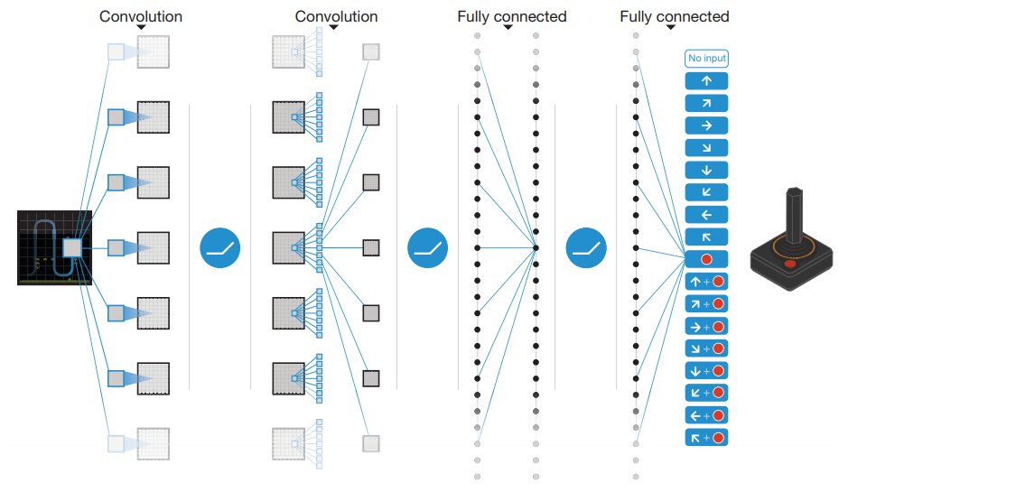
Q-learning
Approximate the expected sum of discounted future rewards starting from a state
Directly measure the quality of each action
Tries to learn a complex function – improbable that it is the true function
Can be approximated by Neural Networks
No convergence guaranteed

Slide 4
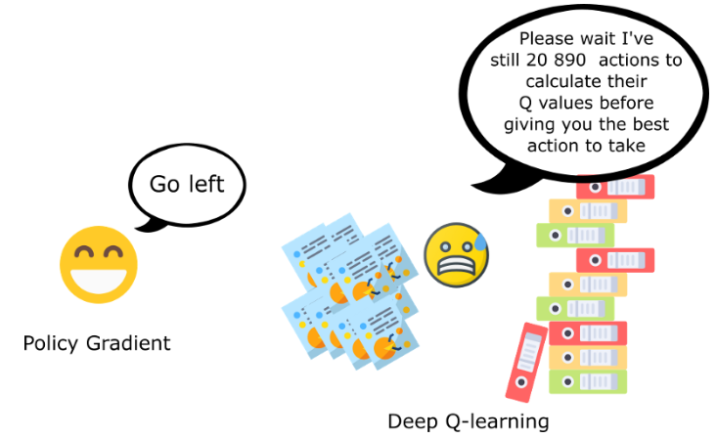
Policy Gradient
Rather than quantifying the return, just learn policy - often easier
Useful in continuous output space – don’t have to represent each action
Useful even in stochastic environments – returns the probability distribution
Tries to improve every action in isolation
Convergence takes a long time

Slide 5
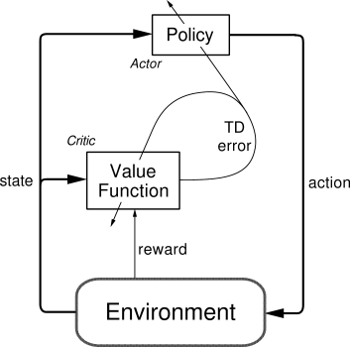
Actor Critic
Combine both policy-based and value-based strategies
Actor is a policy – what action is the best?
Critic is a value – how good is this action in a current state?
Is advantageous in most cases

Slide 6
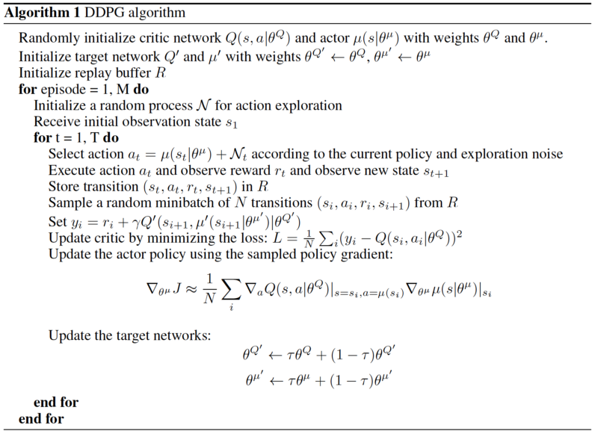
DDPG
Actor Critic algorithm
Use Batches – to simulate iid data
Use separate target networks to train
Add noise to all actions
Update targets only slightly

Slide 7
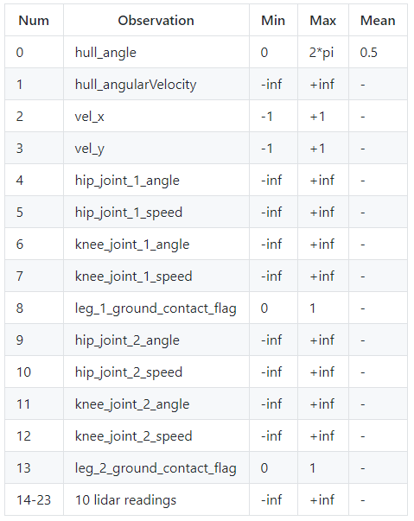
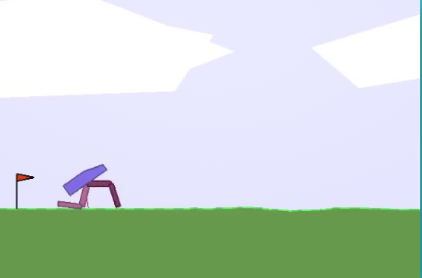
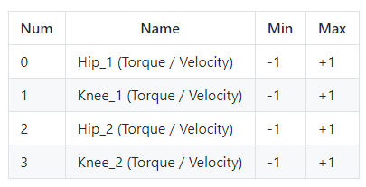
Bipedal Walker
Hard Open Ai Gym environment – control a bipedal robot
Actions are 4 dimensional, Observations are 24 dimensional
Actions are bounded but continuous
Great playground for reinforcement learning algorithms

Slide 8
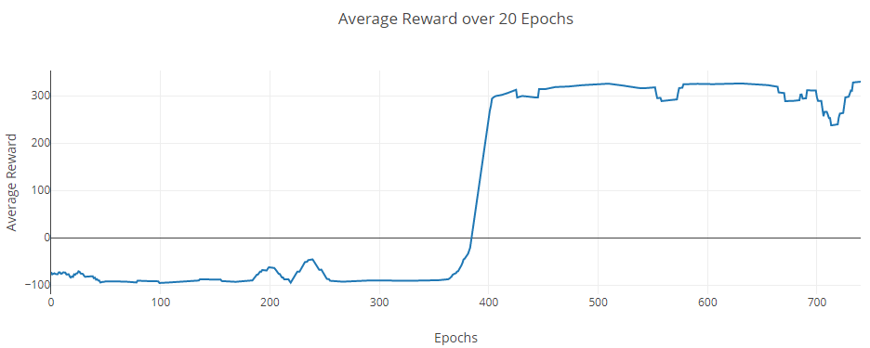
Testing and hyperparameters
Actor critic - two neural networks
Both are dense, three layers each with different width [128,256]
Very small learning rate = 0.00001
Very high discount = 0.999

Slide 9
Results
After 30 min After 8 hrs

