Slide 1
Cyberbullying Detection Survey
Rolando Nieves, Marc Mailloux and Maxim Shelopugin
4/25/2019

Slide 2
Problem Statement
Given the data driven world, cyberbullying is a big issue
The impact of cyberbullying can be catastrophic
Not only from ethical but security perspective
Given a set of tweets/messages detect bullying instances
Separate each instance into categories
Non-bullying
Cultural Attack
Sexual Attack
Personal Attack

Slide 3
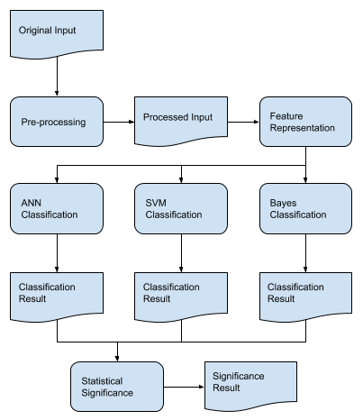
Methodology
Pre-processing:
Stemming
Normalization
Feature Representation:
3 - gram
4 - gram
3-4 - gram
Statistical Significance:
Performance comparison

Slide 4
Dataset and Evaluation Metrics
Dataset of 10000 Tweets
Distribution of 81.7 – 2.9 – 3.0 – 12.4
Double count categories 2 and 3
Originally labeled as bullying / non-bullying
Had to manually re-label to satisfy the criteria
Compare the performance over all classifiers
Each metric is reported across 5-fold validation
Optimize for Recall score ( aim to catch as many bullying instances as possible, false positives are acceptable)

Slide 5
Evaluation Results
ANN
SVM
Naïve Bayes
Precision Recall F1
0.866 | 0.875 | 0.840
0.855 | 0.882 | 0.853
0.431 | 0.695 | 0.459

Slide 6
Discussion
Mostly cultural and sexual harassment are categorized perfectly
Although the dataset is very unbalanced, these small categories are detected
An issue is to detect personal attacks
The category is just too broad
Many words/expressions overlap (“it sucks” vs “it sucks to be you”)
Both ANN and Bayes are trained in minutes
ANN gives a lot better performance overall
SVM takes too long to be used routinely, but gives impressive results

Slide 7
Conclusion
If a category is broad simple methods do not perform well
Overlap between slang and bullying is high
Even complicated models miss the meaning
When the category is well defined, even simple algorithms perform well
Unbalanced data is not as big of an issue as was anticipated

Slide 8
Work Distribution
Rolando | Marc | Maxim
Data labeling | Data labeling | Data labeling
 | Tokenization
N-gram |  | N-gram
 |  | Cross Validation
ANN | SVM | Naïve Bayes
Report
 |  | Presentation
https://github.com/marctheshark3/UCF-NLP-Bullydetection

