Slide 1
Derivatives
By Sandra Lorente

Slide 2
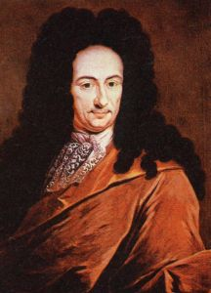
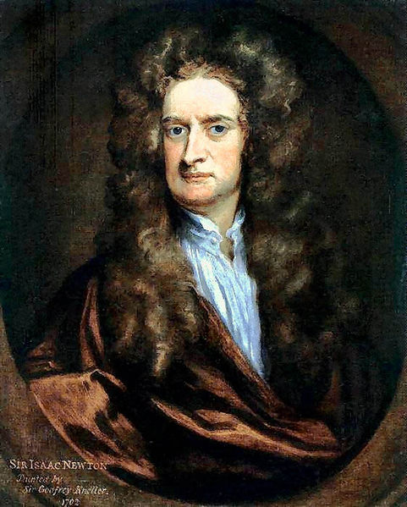
what are you going to see in the next 2 min?
What is a Derivative?
How it looks
General rules to derivate

Slide 3
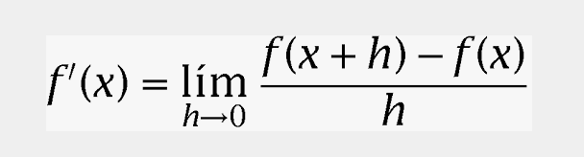
what is a derivative
Derivatives are actually functions applied on functions in order to know the rate of change in a specific point.
Geometrically, the derivative can be represented as the slope of the tangent line to the curve of the function at the point x=a.
Its general formula is:

Slide 4
now:

Slide 5
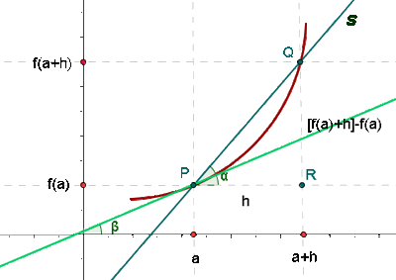

Slide 6
examples:

Slide 7
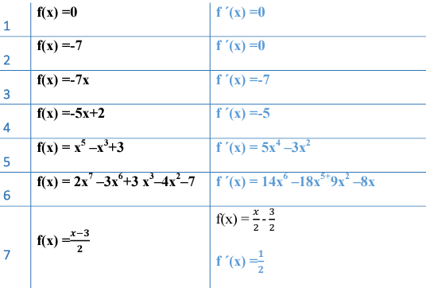

Slide 8
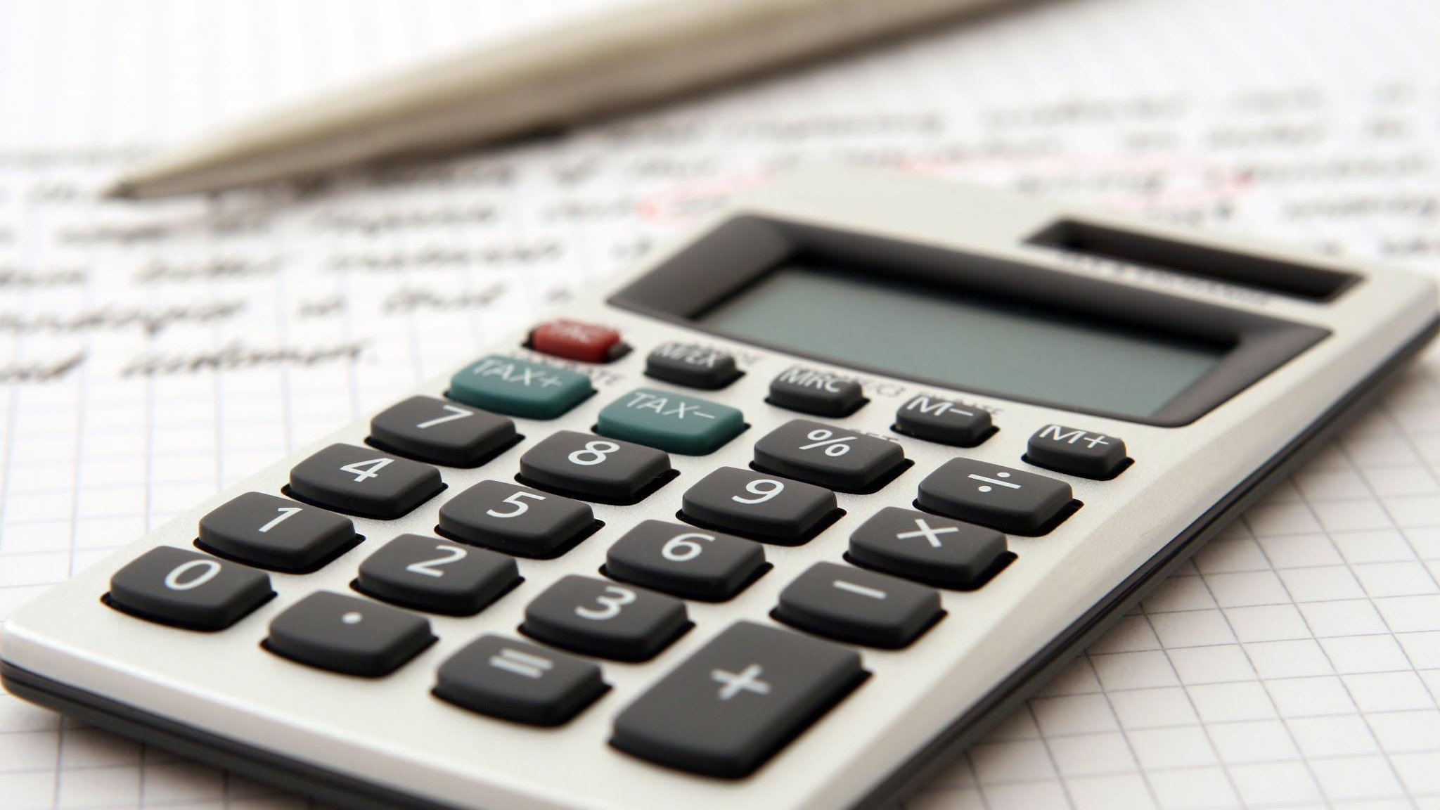
Thank you for your attention

