Slide 1




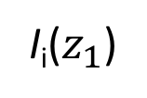

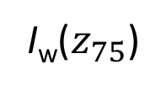

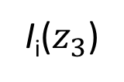


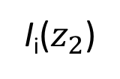
sea ice
open water
0
forcing
I_{i}(0⁻)
I_{w}(0⁻)
forcing
$$z_{1}$$
I_{i}($z_{1}$)
I_{w}($z_{1}$)
$$z_{2}$$
I_{w}($z_{2}$)
I_{i}($z_{2}$)
$$z_{3}$$
I_{i}($z_{3}$)
I_{w}($z_{3}$)
depth (m)
$$z_{75}$$
I_{i}($z_{75}$)
I_{w}($z_{75}$)

