Slide 1
Data-driven control of a quadrotor with reinforcement learning
EI Data-Driven Control · Track B · Group 1
6 November 2026
Notes:
No reminder of the context. Same data-driven chain applied three times: data, identified model, Gymnasium environment, SAC agent, test on the MATLAB simulator.

Slide 2
Outline
1. Data processing — cleaning, split, physical analysis
2. Identified models — ARX, FNN, RNN, LSTM
3. RL environments and rewards — observation, reward, SAC agent
4. Objective 1: landing on the ground — results per model, robustness
5. Objective 2: rotation on itself — yaw control
6. Objective 3: landing on a moving car — 2D extension
Group 1 · Introduction
Notes:
Parts 1 to 3 are the common method, parts 4 to 6 the objectives.

Slide 3
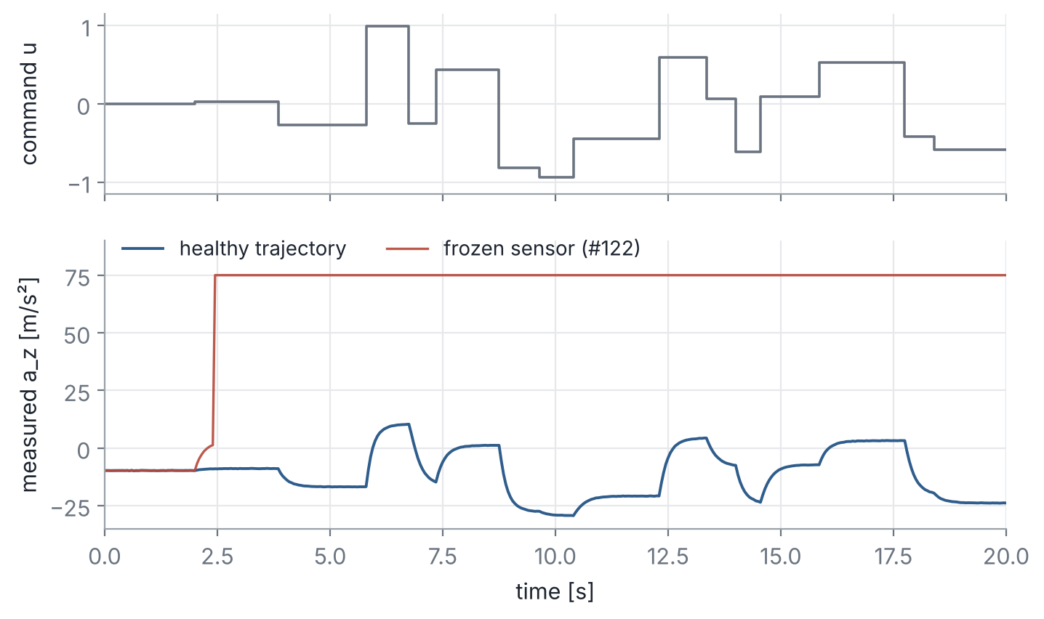
Data cleaning
3000 trajectories of 100 s, T_s = 0.05 s; input u in [−1, 1] (random steps), output a_z
4 trajectories removed: frozen sensor (#122, #1677) or random values (#455, #1233); a_z outside [−35, 15] m/s²
Split by whole trajectory 70 / 15 / 15 %, never sample by sample (data leakage)
Scalers fitted on the training set only
Group 1 · Data processing
Notes:
Healthy data stays in [-30, 11] m/s². A corrupted trajectory is removed entirely instead of interpolated: 4 out of 3000.

Slide 4
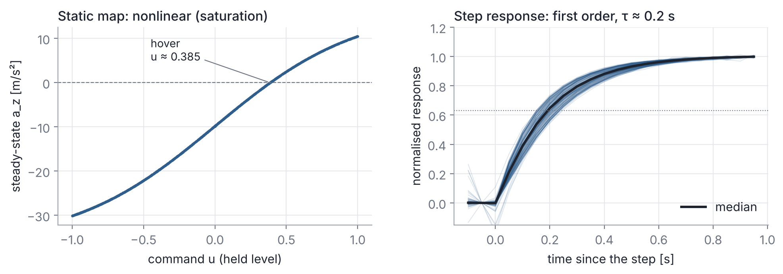
Data analysis: a nonlinear first-order system
a_z = −9.81 m/s² at u = 0: the output is the vertical acceleration; hover at u ≈ 0.385
Static gain ≈ 24 m/s² around u = 0, ≈ 16 near ±1: saturation, a linear model cannot fit it
Step responses: first order, time constant τ ≈ 0.2 s (motor dynamics)
Group 1 · Data processing

Slide 5
Identified models: u → a_z
Model | Structure | Equation | Size
ARX | Linear, least squares on all trajectories | y[k] = −a·y[k−1] + b₁u[k−1] + b₂u[k−2] | 3 parameters
FNN | Feedforward network, output fed back (NARX) | a_z[k+1] = f(a_z[k], u[k]) | 2→64→64→1, tanh
RNN | Recurrent network, memory in the hidden state | h[k] = tanh(A·u[k] + B·h[k−1] + b) | 64 units
LSTM | Recurrent with forget / input / output gates | c[k] = f[k]⊙c[k−1] + i[k]⊙g[k] | 32 units
FNN inputs chosen from physics: a first-order system only needs the current state a_z[k]
RNN / LSTM read the whole command sequence; trained by backpropagation through time
Same criterion for all: free-run simulation (the model is fed back on its own predictions, as in the RL environment)
Group 1 · Models
Notes:
ARX: linear regression on delayed y and u. FNN: static function, the dynamics come from feeding the output back. LSTM: the cell state is updated additively through gates, which avoids vanishing gradients.

Slide 6
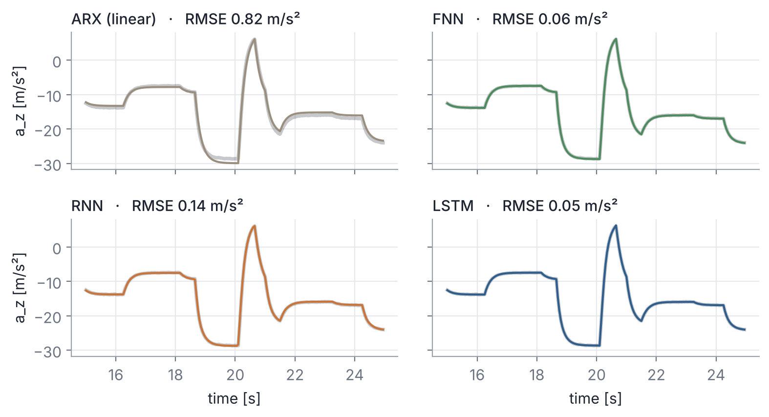
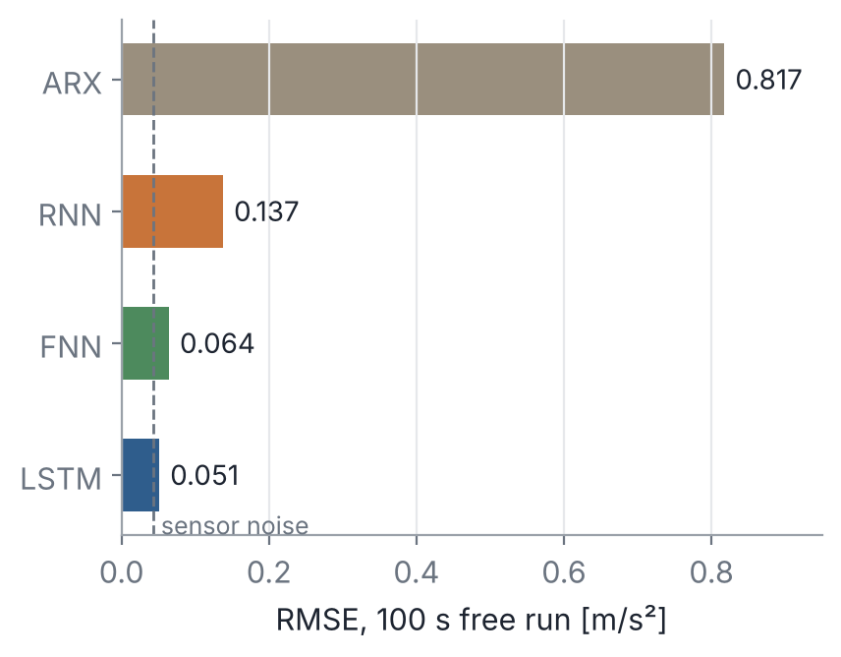
Model comparison on the test set
ARX: 0.82 m/s² — misses the saturation at large commands
FNN 0.064, RNN 0.137, LSTM 0.051 m/s² — close to the sensor noise (0.043)
LSTM kept for the environments; 94 test trajectories common to the four models, 100 s free run
Group 1 · Models

Slide 7
Gymnasium environment around the identified model
SAC agent
policy π(obs)
Frozen model
u → a_z
Mission: 0 m → 0.5 m at t = 1 s → ground (−0.25 m) at t = 5 s
Observation: z_ref − z, v_z, previous a_z and u, z_ref, integral of the error
Domain randomisation: constant bias on a_z (±1 m/s²) and noise per episode, so that the policy copes with model errors
No ground in the data nor in UAV_model.slx: landing = tracking −0.25 m without going below
u
Observation
and reward
Integration
a_z → v_z → z
T_s = 0.05 s, 10 s episodes, action u ∈ [0, 0.8]
Group 1 · RL environments

Slide 8
Reward functions
Term | LSTM agent | RNN agent | Purpose
Tracking | exp(−(e/0.15)²) | wide bell (0.3 m) + narrow bell (3 cm) | maximal on the reference, bounded
Damping | −0.05·min(v_z², 4) | −0.02·min(v_z², 4) | slow landing, no overshoot
Smoothness | −0.2·(u − u_prev)² | −0.2·(u − u_prev)² | no bang-bang on the motors
Integral of e | in the observation | in the observation, reset / conditional | removes the steady-state error
RNN: the agent did not converge on the plateaus without an integral term. Two fixes: reset the integral at each new setpoint, or integrate only near convergence (low speed, small error) — anti-windup
Episode ends if |e| > 2 m. With a reward of −|e|, the agent stayed on the platform (local optimum); the bell fixed it
SAC: actor + two critics, entropy bonus, replay buffer; 64×64 networks
Group 1 · RL environments
Notes:
Integral term for the RNN agent: without it the policy kept a steady-state error on each plateau. A plain integral winds up during the steps; resetting it at each setpoint or integrating only close to convergence solved it.

Slide 9
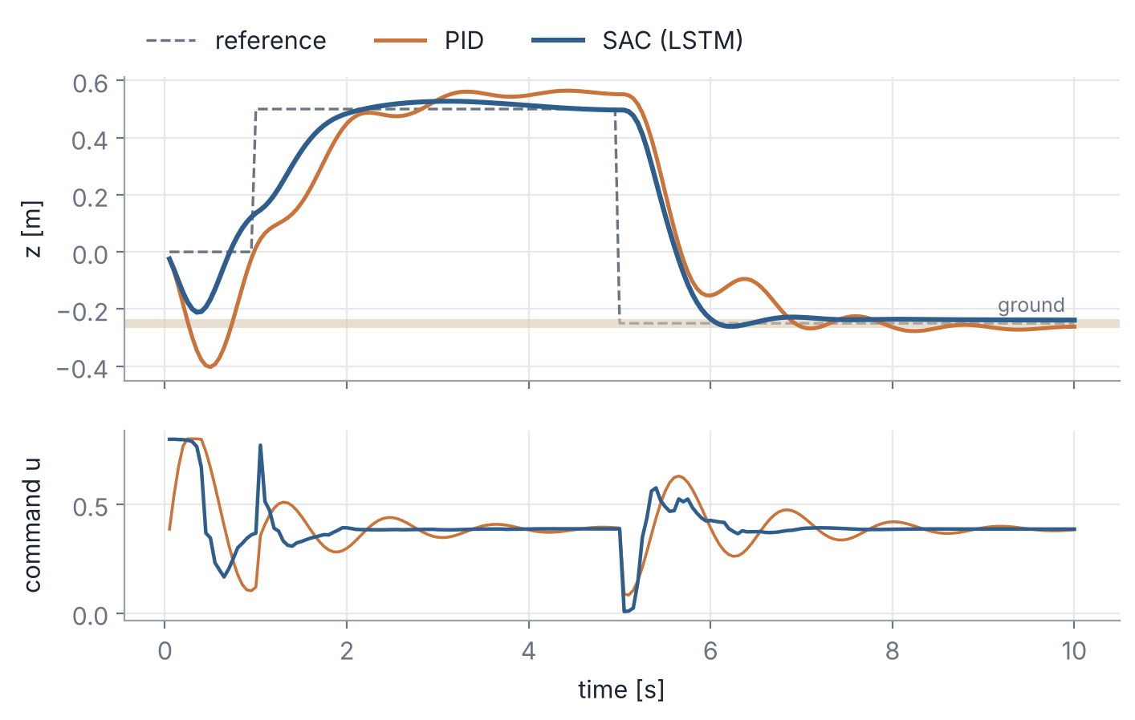
Landing on the ground: LSTM model + SAC
 | SAC | PID
Tracking RMSE | 0.17 m | 0.22 m
Lowest point (ground −0.25 m) | −0.26 m | −0.40 m
PID tuned by grid search on the same environment (Kp 0.4, Ki 0.05, Kd 0.3)
Policy exported to policy.mat and flown in UAV_model.slx
Flight in the LSTM environment, no randomisation
Group 1 · Objective 1: landing

Slide 10
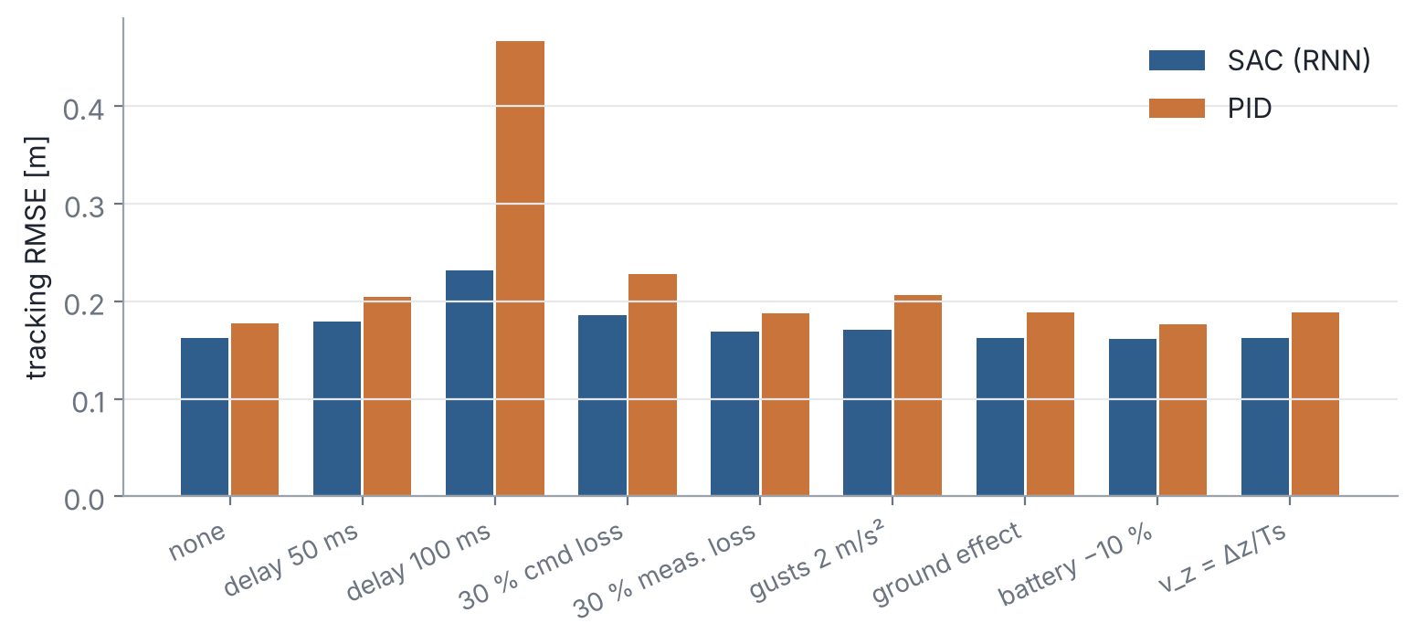
Landing on the ground: RNN model + SAC, robustness
Trained with simulated defects: delay up to 100 ms, 10 % packet loss, gusts, battery drift, quantisation
Test: one defect at a time, 10 flights each
100 ms delay: RMSE 0.23 m (SAC) vs 0.47 m (PID)
ARX and FNN: identification only. The FNN gave the hover command and gain used for the rotation.
Group 1 · Objective 1: landing

Slide 11
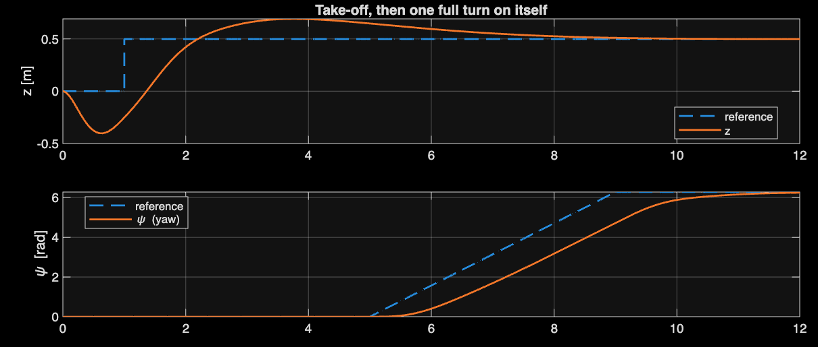
One full turn on itself at constant altitude
Motor test: motors 1 and 3 turn the drone one way, 2 and 4 the other way
+Δu on 1 and 3, −Δu on 2 and 4: yaw torque without changing the total thrust
Two loops: altitude PID (gain from the FNN static map) and yaw PD
Result: ψ reaches 2π, z stays at 0.5 m, roll and pitch stay at 0
Group 1 · Objective 2: rotation

Slide 12
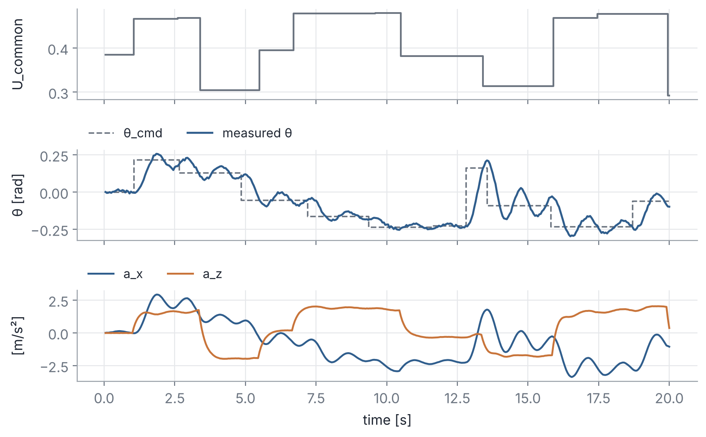
2D data: cascade control of an unstable drone
Without attitude loop the drone flips in < 1 s: data collected with an attitude PD, which becomes part of the system
500 flights of 20 s on the 4-motor drone model, sensor noise included
Inputs (U_common, θ_cmd) are exogenous random steps, like the provided CSV files
First attempt: θ_cmd depended on the measured speed, so the LSTM read θ from θ_cmd instead of learning the dynamics (closed-loop identification)
Group 1 · Objective 3: moving car

Slide 13
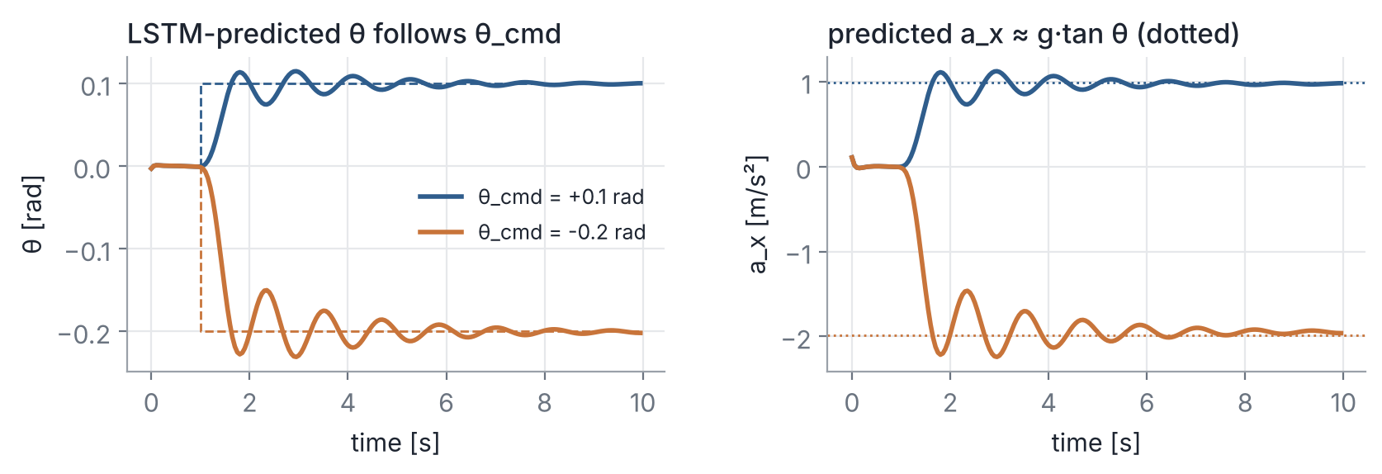
2D LSTM model and landing environment
2D LSTM, test RMSE | Environment | Reward
θ: 0.007 rad | Car at 0.5–1.5 m/s, drone 0.5 m above and behind | Wide bell (0.5 m) + narrow bell (0.15 m) on x − x_car
a_x: 0.047 m/s² | SAC → θ_cmd (horizontal) | Touchdown: 100·q − 20·(1 − q), q ∈ [0, 1]
a_z: 0.010 m/s² | PID → descent once aligned | + remaining reward if the landing succeeds
Group 1 · Objective 3: moving car
Notes:
With both commands the agent tracked the car but never descended: a fixed −50 penalty at touchdown made it avoid the platform. Graded touchdown reward q and a classical descent law fixed it.

Slide 14
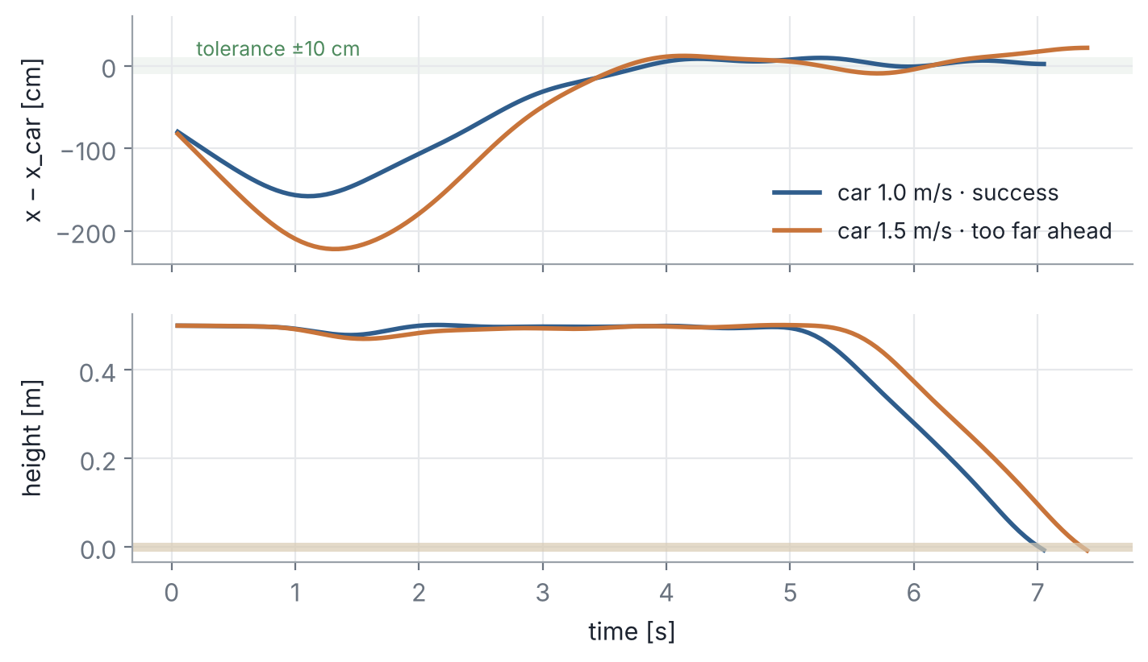
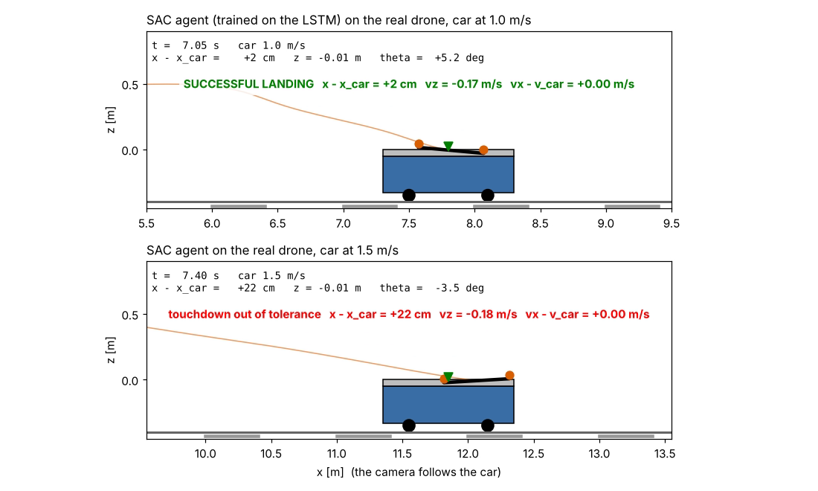
2D results on the 4-motor drone
Side view, camera following the car
Car speed | 0.5 m/s | 1.0 m/s | 1.5 m/s | LSTM env. (randomised)
Successful landings | 2 / 3 | 2 / 3 | 0 / 3 | 10 / 50
Success: |x − x_car| < 10 cm, |v_z| < 0.3 m/s, |v_x − v_car| < 0.2 m/s. Failures: drone 19–26 cm ahead at 1.5 m/s (model / drone mismatch).
Group 1 · Objective 3: moving car

Slide 15
Summary
Objective | Model | Controller | Result
Landing on the ground | LSTM | SAC | RMSE 0.17 m vs 0.22 m (PID), no overshoot below the ground
Landing on the ground, with defects | RNN | SAC | Better than the PID in all 9 scenarios
Rotation on itself | FNN (gain) | PID + PD | One full turn, altitude kept
Landing on a moving car | 2D LSTM | SAC + descent law | 4 / 9 on the 4-motor drone
Limits: the 2D policy lands ahead of the car at high speed; ARX and FNN were not used for RL
Next step: retrain the models on flights of the agent to reduce the model / drone mismatch
Group 1 · Conclusion

