Slide 1


Movie Line Chat Bot
Charrière Maxime
Morocutti Dylan
I’ll try to finish it for tommorow.
Do. Or do not. There is no try. - Yoda
I visited my father today.
No. I am your father. - Darth Vader
Projet Machine Learning
Notes:
Explication du projet chat bot

Slide 2
La base de données
LineID |  | ConversationID |  | FilmID |  | Character |  | Line
L192086 | +++$+++ | u5092 | +++$+++ | m337 | +++$+++ | BEN | +++$+++ | We've come this far ... He is our only hope.
L192085 | +++$+++ | u5105 | +++$+++ | m337 | +++$+++ | YODA | +++$+++ | Will he finish what he begins?
L192083 | +++$+++ | u5105 | +++$+++ | m337 | +++$+++ | YODA | +++$+++ | He's too old. Yes. Too old to start the training.
L192082 | +++$+++ | u5092 | +++$+++ | m337 | +++$+++ | BEN | +++$+++ | He'll learn.
L192073 | +++$+++ | u5092 | +++$+++ | m337 | +++$+++ | BEN | +++$+++ | He can do it.
L192072 | +++$+++ | u5105 | +++$+++ | m337 | +++$+++ | YODA | +++$+++ | We've discussed this before.
L192071 | +++$+++ | u5092 | +++$+++ | m337 | +++$+++ | BEN | +++$+++ | Much anger in him, like in his father.
…
Notes:
Structure de la DB

Slide 3


Mise en forme du texte
"Hello my name is Maxime. I'd like to give you 1'000'000 $ !"
Tokenisation | Hello | my | name | is | Maxime | . | I | ‘d | like | to | give | you | 1’000’000 | $ | !
Lemmatisation | hello | PRON | name | be | Maxime | . | PRON | would | like | to | give | PRON | 1'000'000 | $ | !
Stop words | hello |  |  |  | Maxime | . |  |  | like |  |  |  | 1'000'000 | $ | !
Punctuation | hello |  |  |  | Maxime |  |  |  | like |  |  |  | 1'000'000 | $
Digit | hello |  |  |  | Maxime |  |  |  | like |  |  |  | DIGIT
Currency | hello |  |  |  | Maxime |  |  |  | like |  |  |  | DIGIT | CURRENCY
To lower | hello |  |  |  | maxime |  |  |  | like |  |  |  | digit | currency

Slide 4
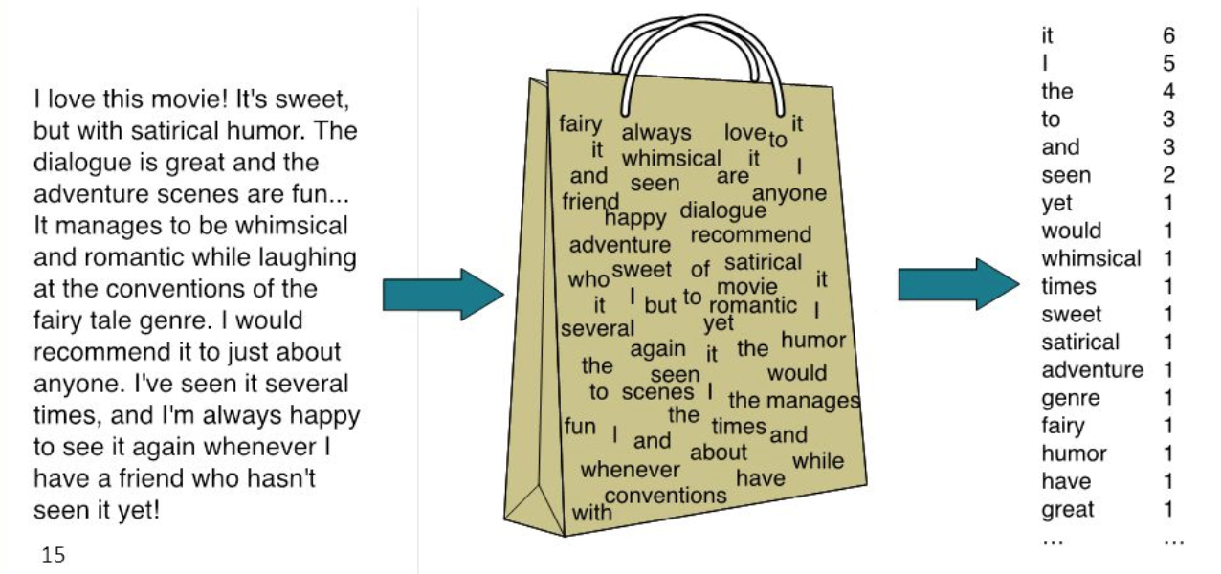
Extraction de features: Bag of words
Poids d’un mot:
Binary
Count
Frequency
Term Frequency – Inverse Document Frequency (TF-iDF)

Slide 5
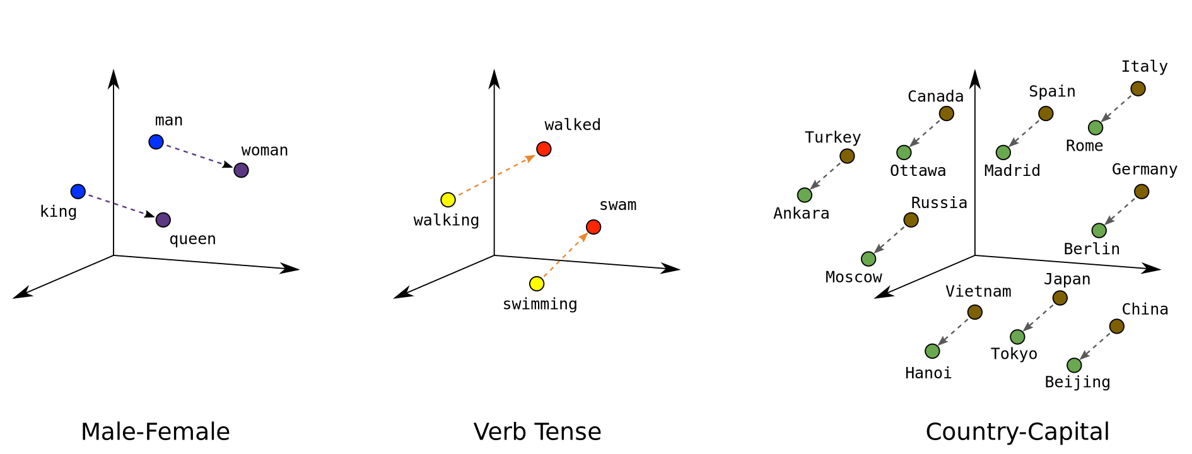

Extraction de features : Word embedding
King – Man + Woman = Queen
Ces correspondances doivent d’abord être apprise.
Cela demande de grandes bases de données.
Mais des librairies existent.

Slide 6

Extraction de features : Bag of words VS Word embedding
$$\frac{\text{Nbr}\text{ é}\text{chantillons}}{\text{Nbr} \text{mots} \text{par}\text{ é}\text{chantillons}}$$
<1500
>1500
Bag of words
Articles de presse / scientifique
Journaux
Livres
Word embedding
Mot
Dialogue
Tweet

Slide 7


Application sur notre base de donnée :
Lier par paire les réplique/réponses
Réplique: "Obi Wan never told you what happened to your father.“ Réponse: "He told me enough! He told me you killed him!"
Mise en forme des répliques
[obi, wan, tell,
happen, father]
Vectoriser les répliques
[[ -0.3 0.24 … -0.61 1.92 ]
[ -0.02 1.09 … 1.83 1.86 ]
[ … … … … … ]
[ -0.56 0.72 … -0.71 0.08 ]
[ -0.61 -1.31 … -1.05 -1.48 ]]
(Word embedding)
Stocker ces paires

Slide 8
Solutions proposées
Best-fit
Unsupervised Clustering
Supervised Classification
Notes:
Proposition des solutions

Slide 9


Best-fit :
Ce n’est pas du machine learning !
Input utilisateur
Mise en forme
Afficher la réponse correspondante
Best-fit
Input: “Hello my name is Dylan. Would you be my friend?”
&
Vectorisation
[hello,
dylan,
friend]
[[ -0.3 0.24 … -0.61 1.92 ]
[ -0.02 1.09 … 1.83 1.86 ]
[ … … … … … ]
[ -0.56 0.72 … -0.71 0.08 ]
[ -0.61 -1.31 … -1.05 -1.48 ]]
[[ -0.21 0.22 … -0.48 1.99 ]
[ -0.08 1.13 … 1.78 1.80 ]
[ … … … … … ]
[ -0.51 0.59 … -0.70 0.15 ]
[ -0.75 -1.26 … -1.15 -1.32 ]]
≈
[[ -0.3 0.24 … -0.61 1.92 ]
[ -0.02 1.09 … 1.83 1.86 ]
[ … … … … … ]
[ -0.56 0.72 … -0.71 0.08 ]
[ -0.61 -1.31 … -1.05 -1.48 ]]
"They're my friends"
Luke - Star Wars: The empire strikes back

Slide 10
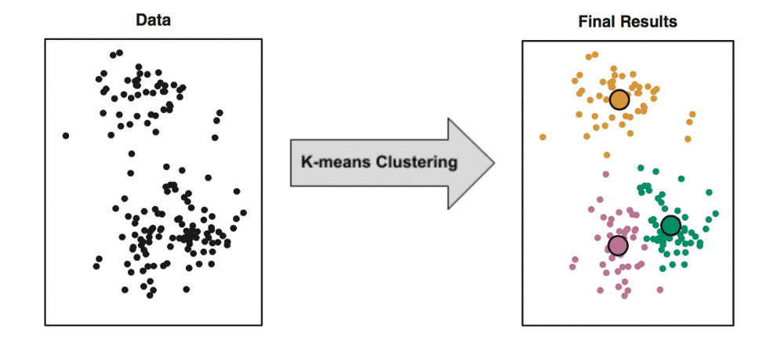
Unsupervised clustering :
[[ -0.3 0.24 … -0.61 1.92 ]
[ -0.02 1.09 … 1.83 1.86 ]
[ … … … … … ]
[ -0.56 0.72 … -0.71 0.08 ]
[ -0.61 -1.31 … -1.05 -1.48 ]]
600 clusters
8300 répliques

Slide 11
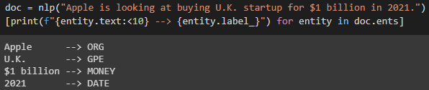
Supervised Classification :
“Nice to meet you! Do you know where the HEIG-VD is?”
Greeting
Question
School
Positive
La base de donnée n’est pas catégorisé.
Il n’est donc pas possible d’appliquer cette méthode.

Slide 12

Résultats à l’aide du K-MEANS :

Slide 13
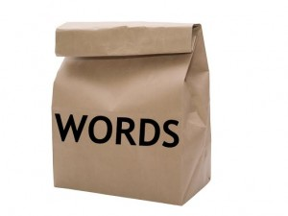
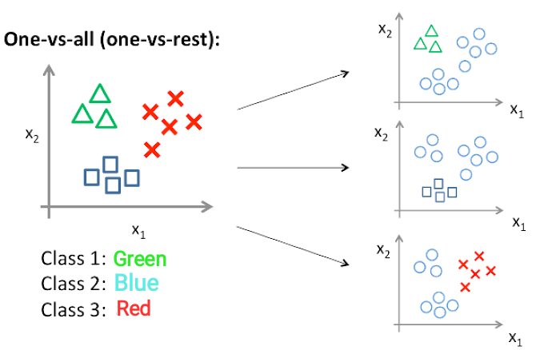
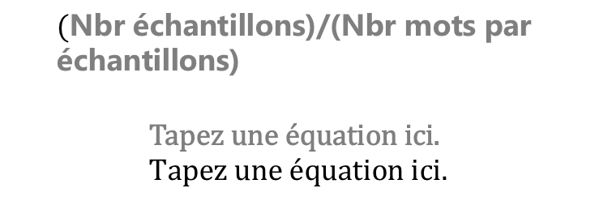
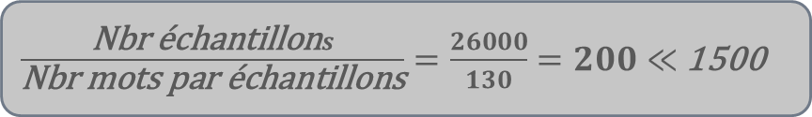
Supervised Classification : Classification de films
Wikipedia Movie
DataSet
~35,000 movies
Features
Features
$\frac{\text{Nbr}\text{ é}\text{chantillon}s}{\text{Nbr} \text{mots} \text{par}\text{ é}\text{chantillons}}=\frac{26000}{130}=200≪$ 1500
Algorithme
$$(\text{Nbr}\text{ é}\text{chantillons}\text{)/(}\text{Nbr} \text{mots} \text{par}\text{ é}\text{chantillons}\text{)}$$

Slide 14



“It is the future you see”
Yoda - Star Wars: The empire strikes back
By Charrière Maxime
Morocutti Dylan
github.com/maximecharriere/movie-chatbot

