Slide 1
HIDS
Hostbased Intrusion Detection system

Slide 2

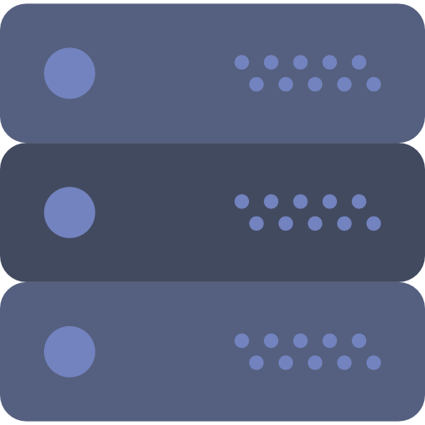


Thierry

Slide 3




Slide 4



Slide 5






Slide 6



Slide 7








