Slide 1
Robotics Self-reconfiguring
modular robots, …
Material Sciences Metamaterials, …
PROGRAMMABLE
MATTER
Human-Computer Interaction Shape-Changing Interfaces, …

Slide 2
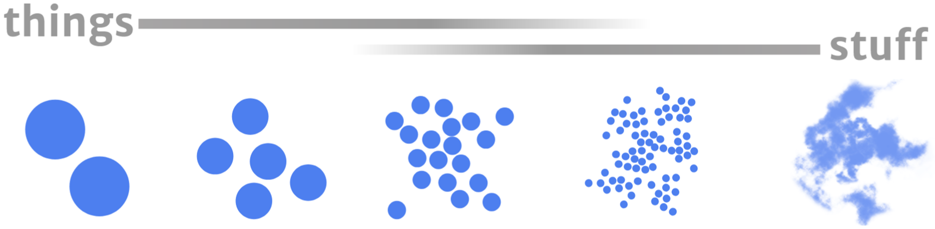
meters
centimeters
millimeters
micrometers
nanometers

Slide 3
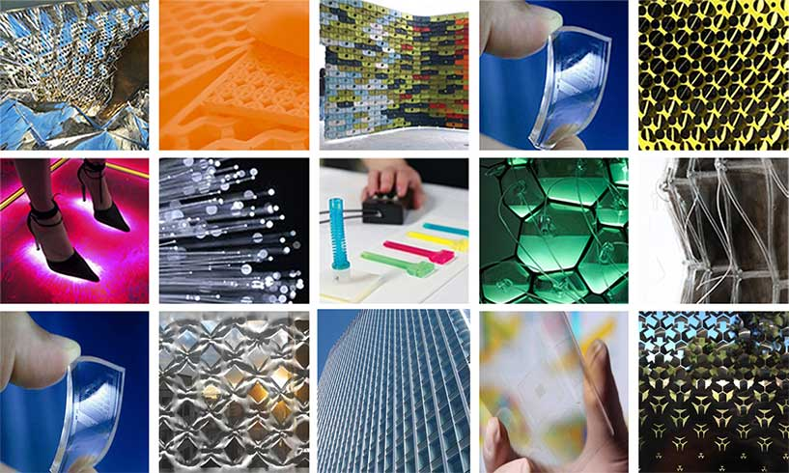
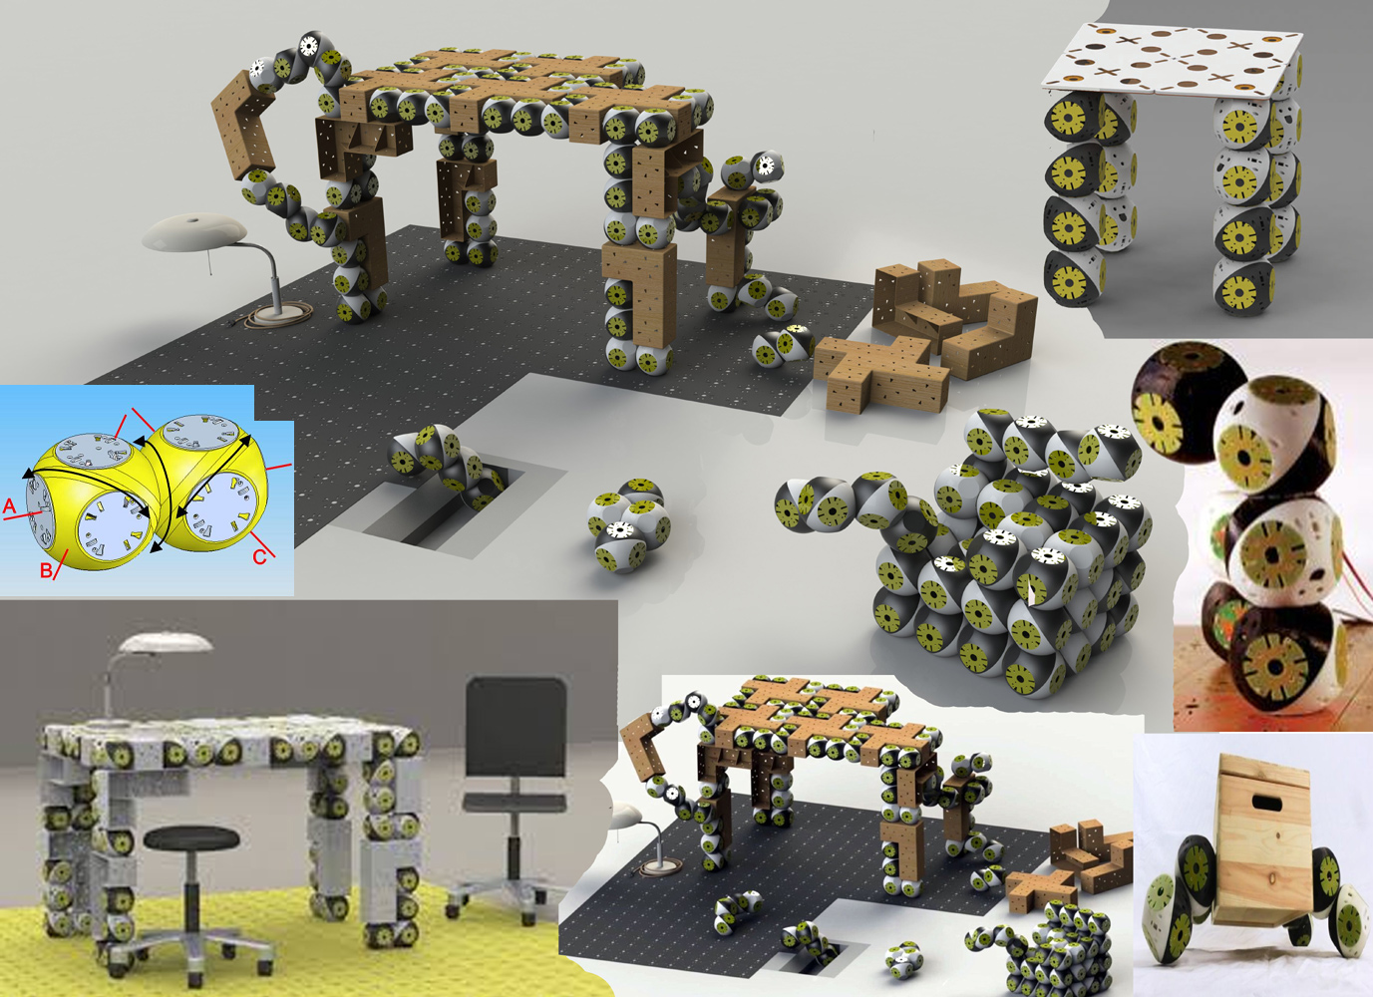
Robotics Self-reconfiguring
modular robots, …
Material Sciences Metamaterials, …
PROGRAMMABLE
MATTER
Human-Computer Interaction Shape-Changing Interfaces, …

Slide 4
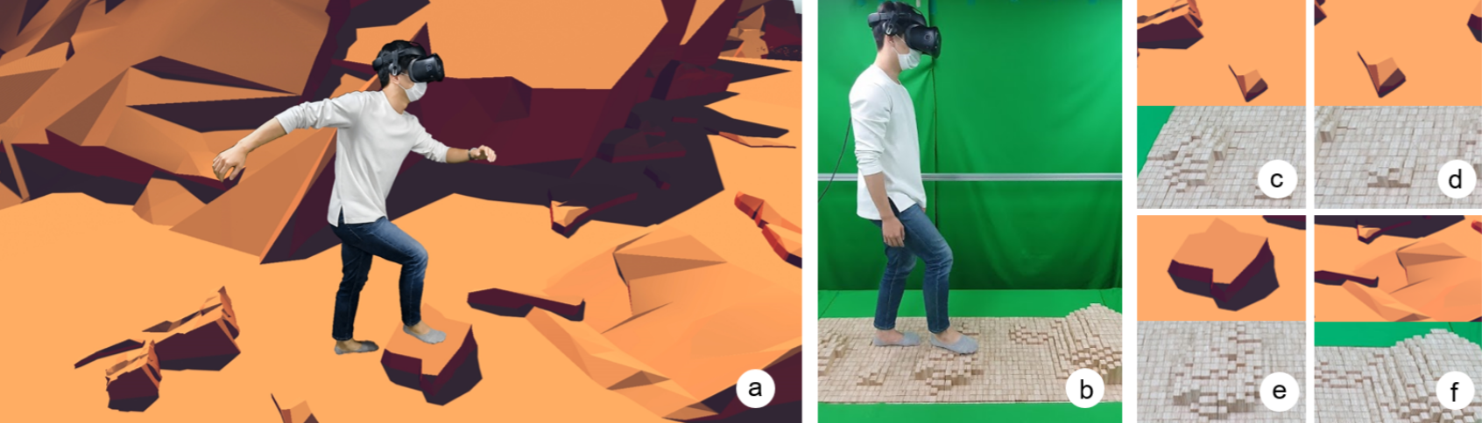

Slide 5
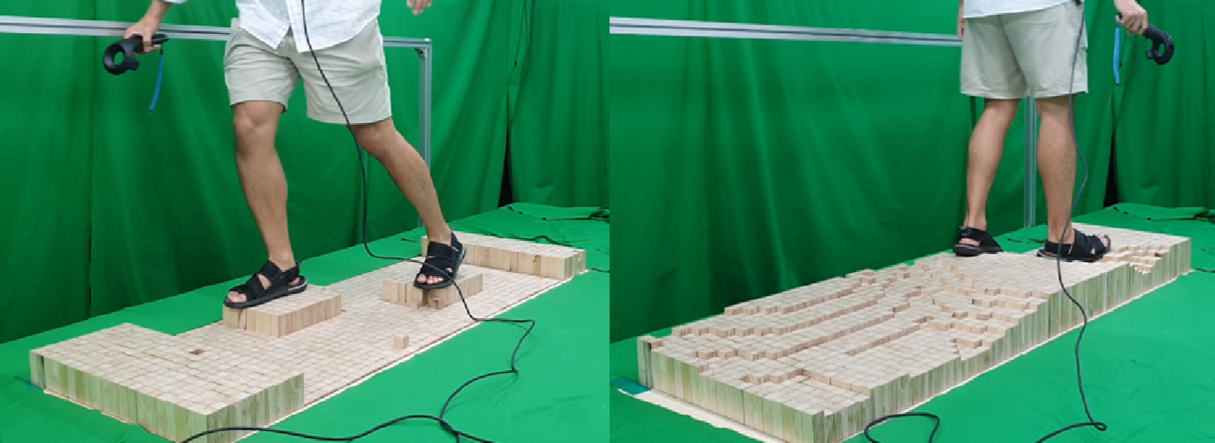
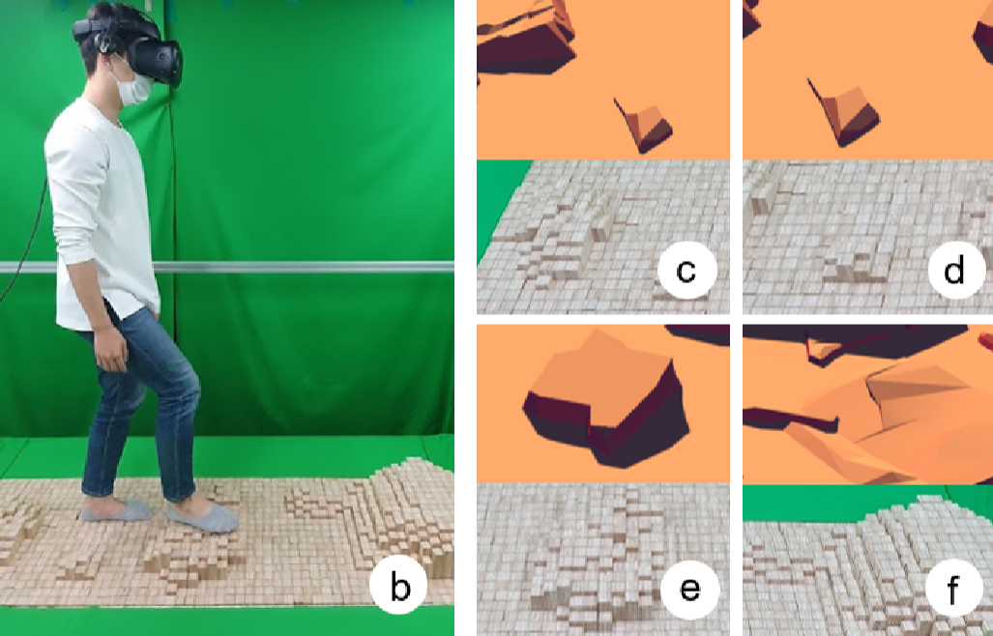

Slide 6
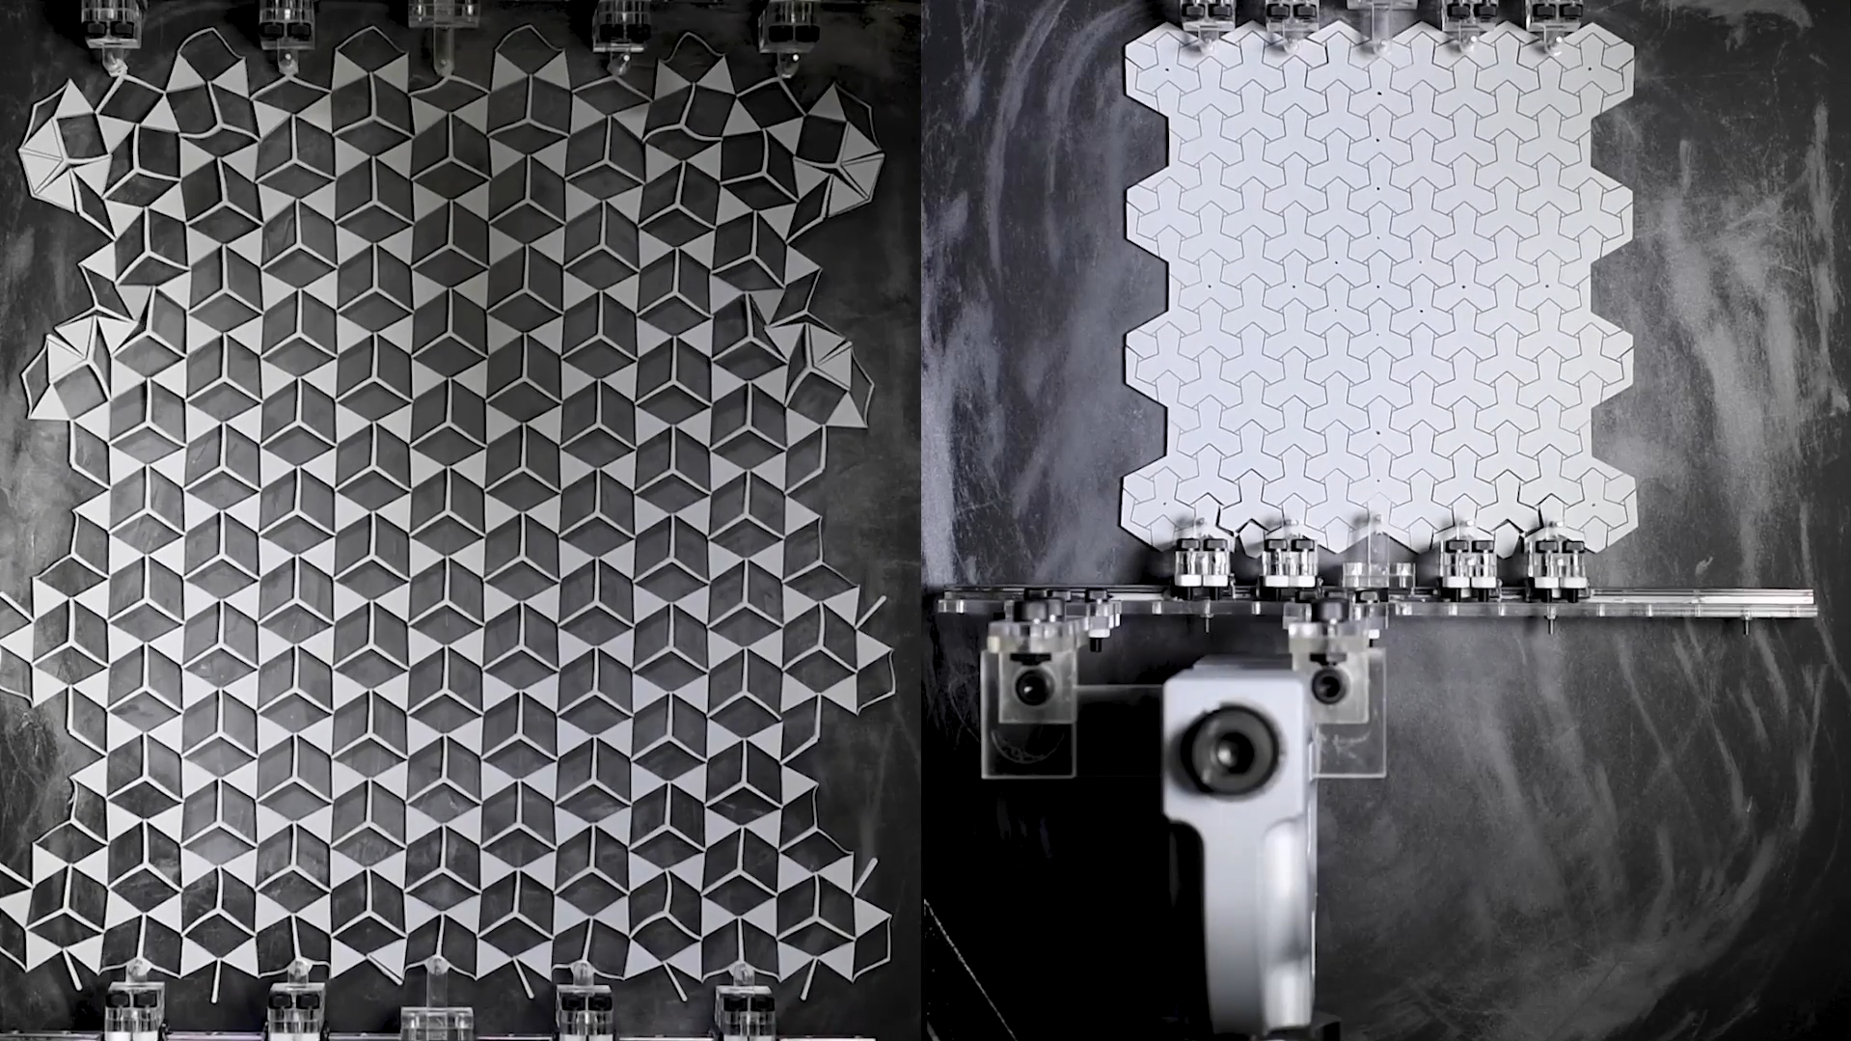

Slide 7
M
S
C
W
MUST HAVE
All the requirements that are necessary for the successful completion of the project.
SHOULD HAVE
Requirements that are important for project completion but not necessary.
COULD HAVE
Requirements that are nice to have, but have a much smaller impact when left out of the project.
WILL NOT HAVE
All the requirements that have been recognized as not a priority for the project’s timeframe.

Slide 8
Strengths
Weaknesses
Opportunities
Threats

Slide 9
Problem statement
Why?
Why?
Why?
Why?
Why?
Root cause

Slide 10






PROCESS
Thinking about thinking.
What thinking is needed?
Organizing the thinking.
Planning for action.
CREATIVITY
Ideas, alternatives, possibilities. Solution to black hat problems.
FACTS
Information and data. Neutral and objective.
What do I know?
What do I need to find out?
How will I get the information I needed?
BENEFITS
Positives, plus points.
Why an idea is useful.
Logical reasons are given.
FEELINGS
Intuition, hunches, gut instinct.
My feelings right now.
Feelings can change.
No reasons are given.
CAUTIONS
Difficulties, weaknesses, dangers.
Spotting the risks.
Logical reasons are given.

Slide 11
Univers 1 vs Univers 2 | Variable 1 | Variable 2 | Variable 3 | Variable 4 | Variable 5
Variable A
Variable B
Variable C
Variable D
Variable E

Slide 12
Past
Present
Futur
Super-System
System
Systems/Problems
Sub-System

Slide 13
S
C
A
M
P
E
R
SUBSTITUTE
Replace a part, material, or process with something else.
COMBINE
Join elements, ideas, or functions together in new ways – or find a new element you can merge with.
ADAPT
Modify something to better suit a new purpose, person or context.
MODIFY
Enlarge, reduce, change the shape, or alter attributes. Can a small change have a big effect?
PUT to another use
Rather than changing the thing itself, consider changing the context it exists in.
ELIMINATE
Remove elements. Simplify, or pare down to essentials.
Is less more?
REVERSE
Flip the script, re-order your priorities, invert cause and effect, and turn it all upside-down.

