Slide 1



The SEAS Ontology(ies)
https://w3id.org/seas/
For now, please use:
Maxime Lefrançois, Jarmo Kalaoja, Takoua Ghariani, Antoine Zimmermann, The SEAS Knowledge Model, ITEA2 12004 Smart Energy Aware Systems Deliverable 2.2, Jan 2017
Maxime Lefrançois
MINES Saint-Etienne, CNRS,
Laboratoire Hubert Curien UMR 5516

Slide 2





















Feb 2014 - Dec 2016
3 years, 6 countries, 34 partners, 16M€, 160 person-year
Design and develop a global ecosystem of distributed services that all target energy efficiency.
WP 1 - use cases, business models, requirements, architecture
WP 2 - knowledge model, knowledge based services
WP 3 - Smart Building
WP 4 - Microgrids, and Electric Vehicles
WP 5 - Simulations
WP 6 - Prototypes and Pilots
WP 7 - Standardization
ITEA Award of Excellence 2017
Maxime Lefrançois – the SEAS ontology: instantiating ontology-patterns

Slide 3
Domains to be modelled
Demands, offers, transactions
Contracts for demand-response or aggregators
The infrastructures characteristics and limitations
Energy generation/load/storage/transfer
Smart Building zones and environmental factors
Smart Building and its interaction with the environment
Controllable and non-controllable appliances / loads
Controllable and non-controllable energy generators
electric vehicles and charging equipment
Characteristics specific to batteries
Time series: history, observations, forecast
Data privacy and access control – contracts
Describing very light messages sent to/from sensor/actuators
Describing SEAS service and their interfaces to ease their registration and discovery
Maxime Lefrançois – the SEAS ontology: instantiating ontology-patterns

Slide 4
Several ontologies exist
Or were under development in 2015 (SAREF)
They are often not open source and extensible
They use custom and unpredictable RDF structure
They do not cover all of the domains we need
We needed a simple core that:
covers most of the partner needs,
can be implemented easily in OOP,
can be extended to other domains.
Maxime Lefrançois – the SEAS ontology: instantiating ontology-patterns

Slide 5
Ease their extension to other domains ? simple core + extensible + open-source
Smart Grid
Core of SEAS
Ontology patterns
Simple
Smart Home
Transport
Maxime Lefrançois – the SEAS ontology: instantiating ontology-patterns

Slide 6
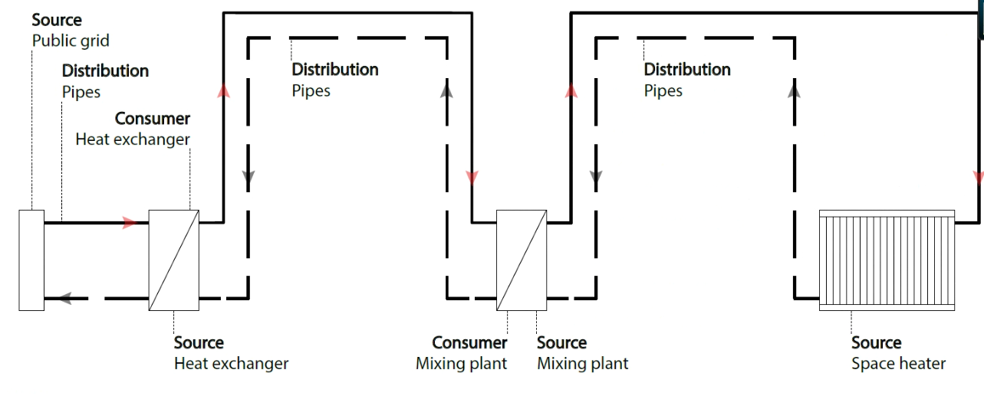
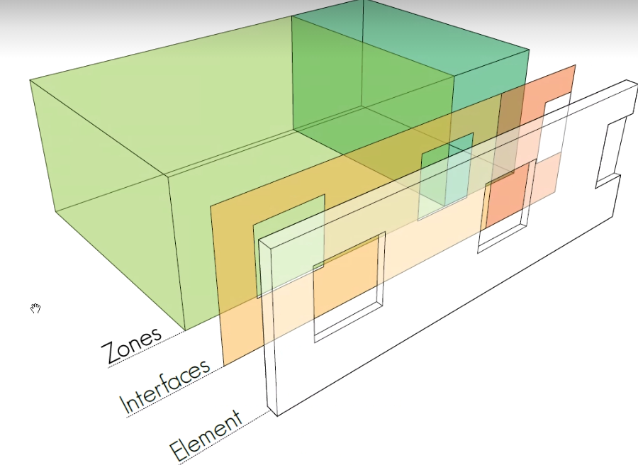
Ease their extension to other domains ? simple core + extensible + open-source
HVAC
Smart Grid
Core of SEAS
Ontology patterns
Simple
Smart Home
Transport
Building
Maxime Lefrançois – the SEAS ontology: instantiating ontology-patterns

Slide 7
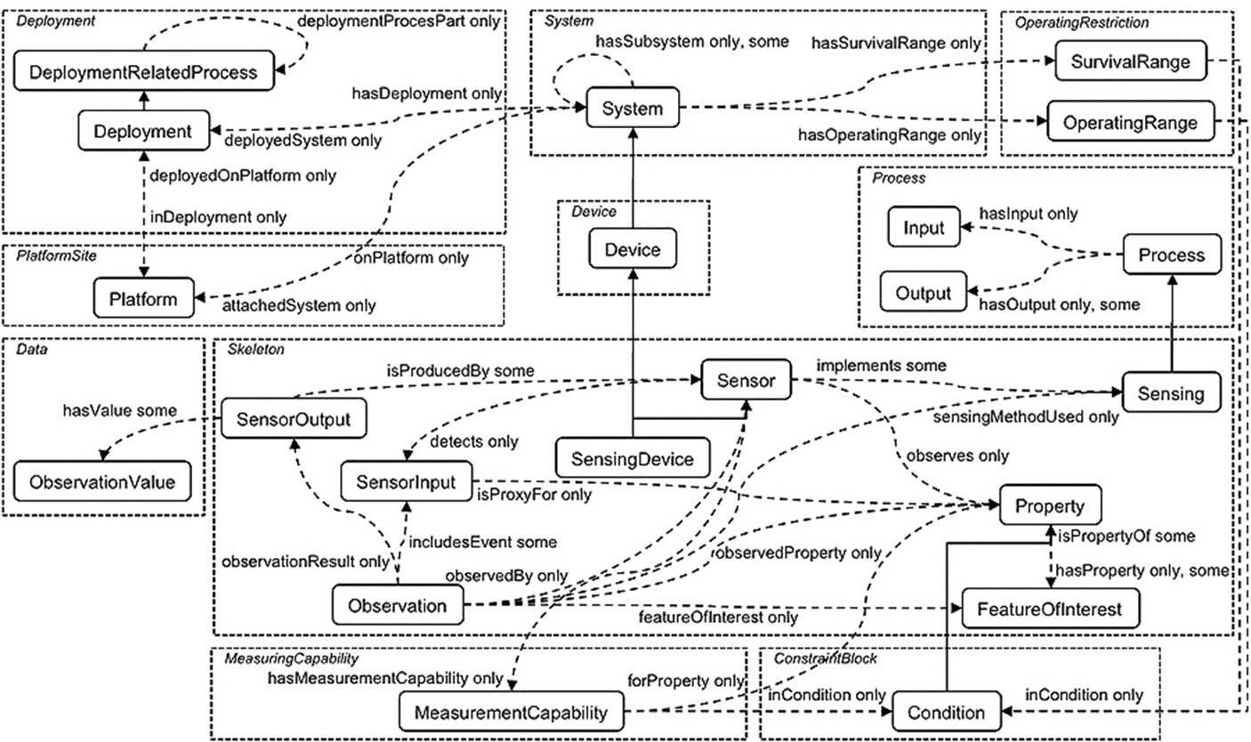
Main source of inspiration: the SSN ontology
W3C, next version should be released late June 2017
Maxime Lefrançois – the SEAS ontology: instantiating ontology-patterns

Slide 8
Main source of inspiration: the SSN ontology
Maxime Lefrançois – the SEAS ontology: instantiating ontology-patterns

Slide 9
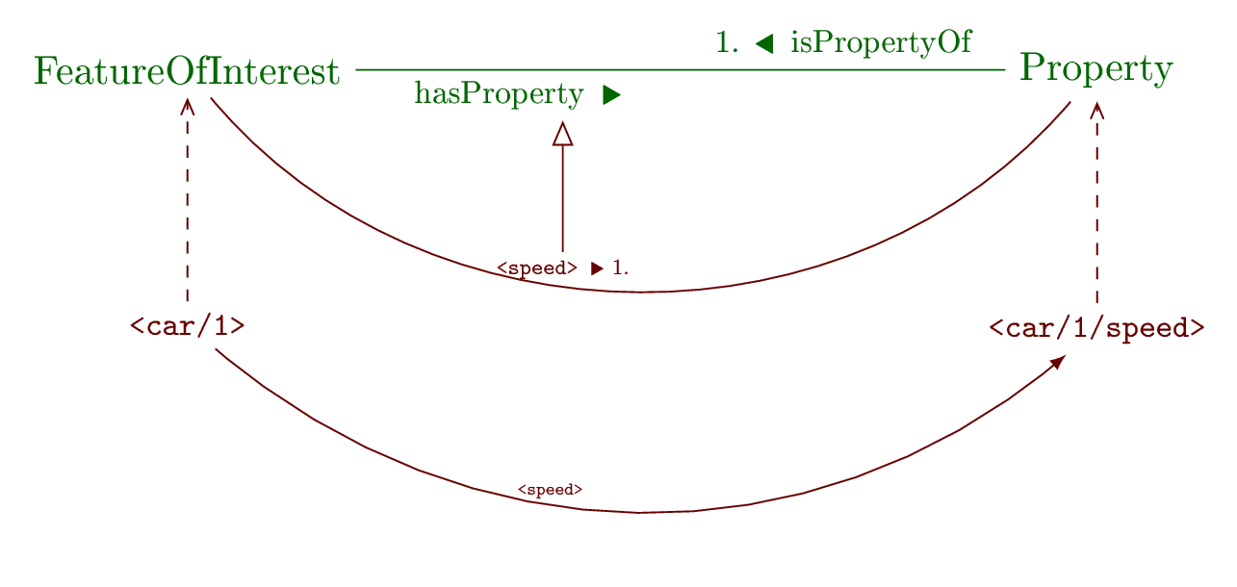
the Property ontology pattern
Maxime Lefrançois – the SEAS ontology: instantiating ontology-patterns

Slide 10
the Property ontology pattern
ex:speed a owl:ObjectProperty , owl:FunctionalProperty ;
rdfs:subPropertyOf seas:hasProperty ;
rdfs:domain ex:MovingThing ;
rdfs:range ex:SpeedProperty .
<car/1> a ex:MovingThing ;
seas:hasProperty <car/1/speed> .
Maxime Lefrançois – the SEAS ontology: instantiating ontology-patterns

Slide 11
Main source of inspiration: the SSN ontology
Maxime Lefrançois – the SEAS ontology: instantiating ontology-patterns

Slide 12
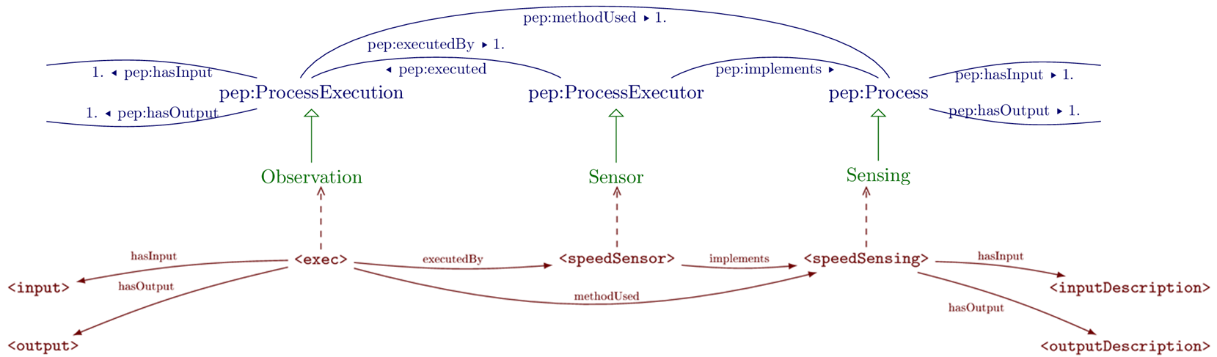
the Process Execution ontology pattern
Disclaimer: naming may be updated depending on the discussions with W3C
i.e., former terms will be deprecated, not removed
Maxime Lefrançois – the SEAS ontology: instantiating ontology-patterns

Slide 13
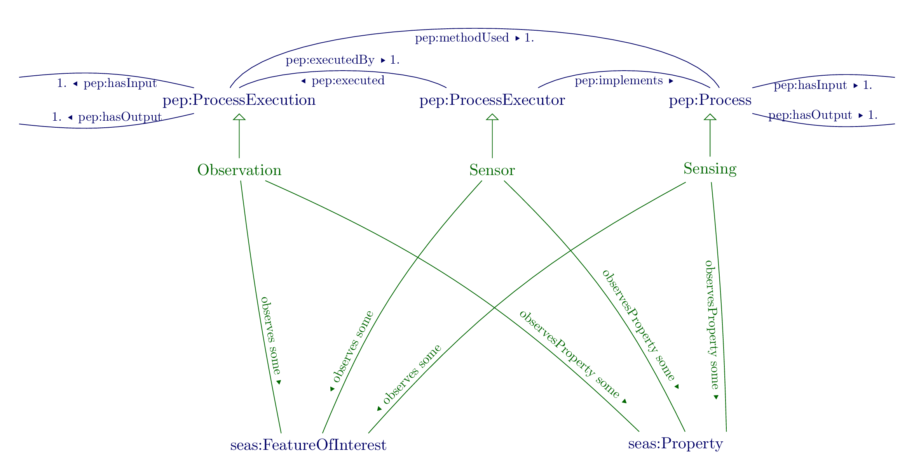
the Process Execution ontology pattern
Maxime Lefrançois – the SEAS ontology: instantiating ontology-patterns

Slide 14
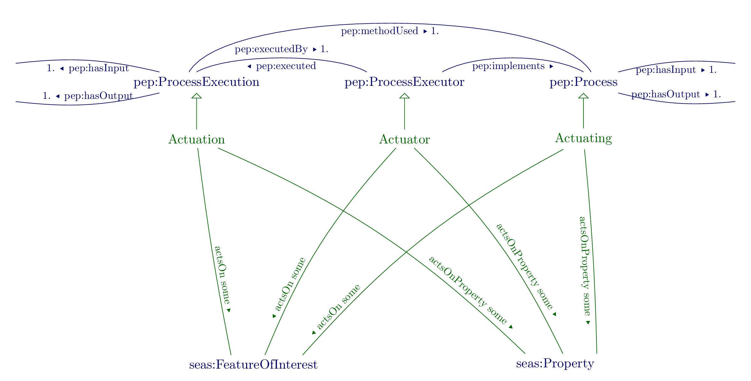
the Process Execution ontology pattern
Maxime Lefrançois – the SEAS ontology: instantiating ontology-patterns

Slide 15
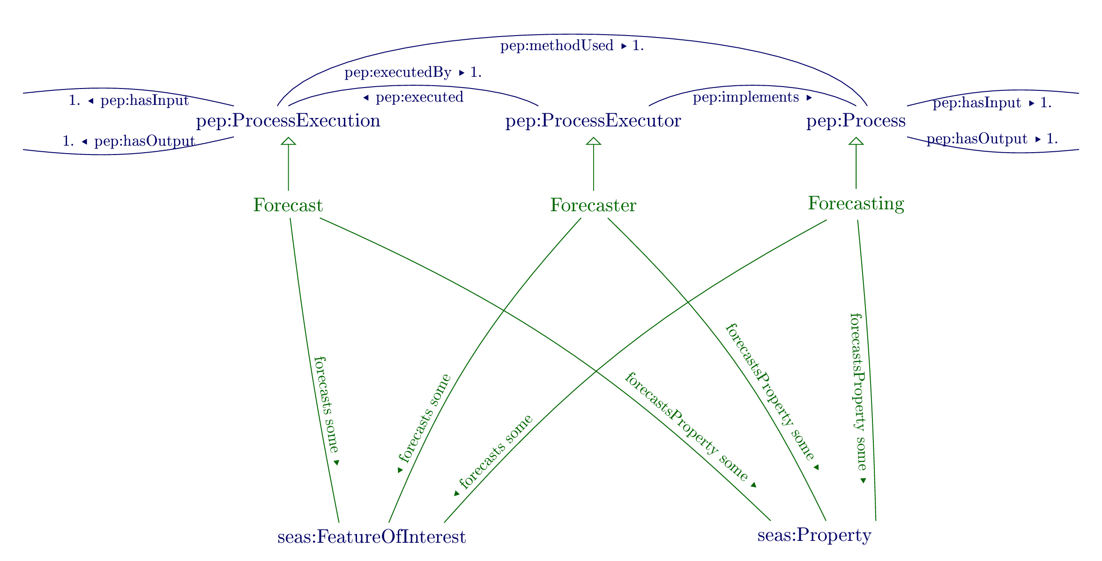
the Process Execution ontology pattern
Maxime Lefrançois – the SEAS ontology: instantiating ontology-patterns

Slide 16
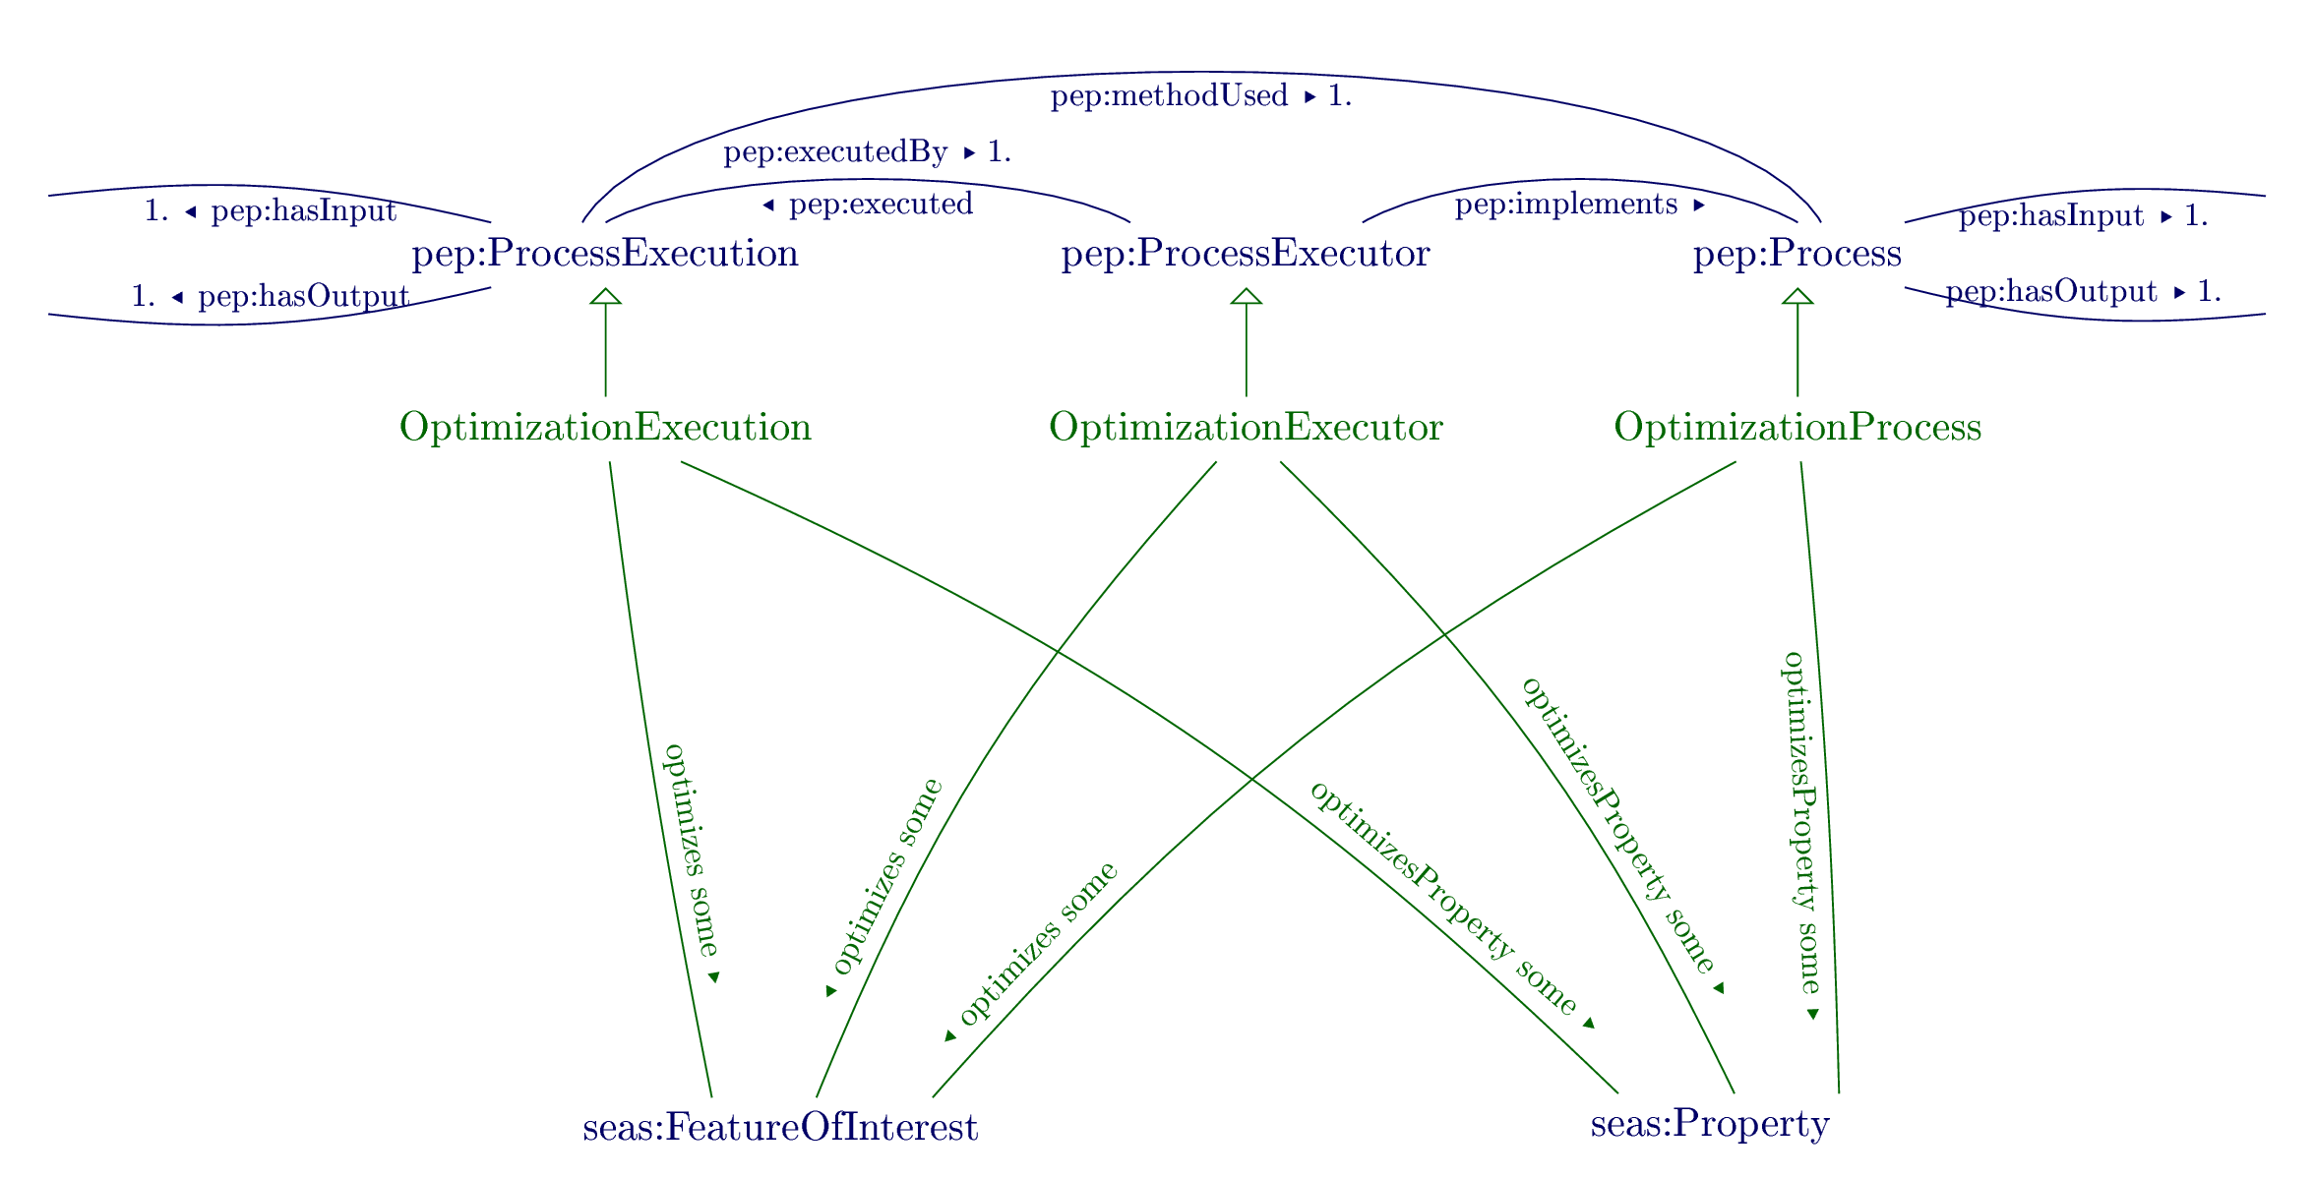
the Process Execution ontology pattern
Maxime Lefrançois – the SEAS ontology: instantiating ontology-patterns

Slide 17
Main source of inspiration: the SSN ontology
Maxime Lefrançois – the SEAS ontology: instantiating ontology-patterns

Slide 18
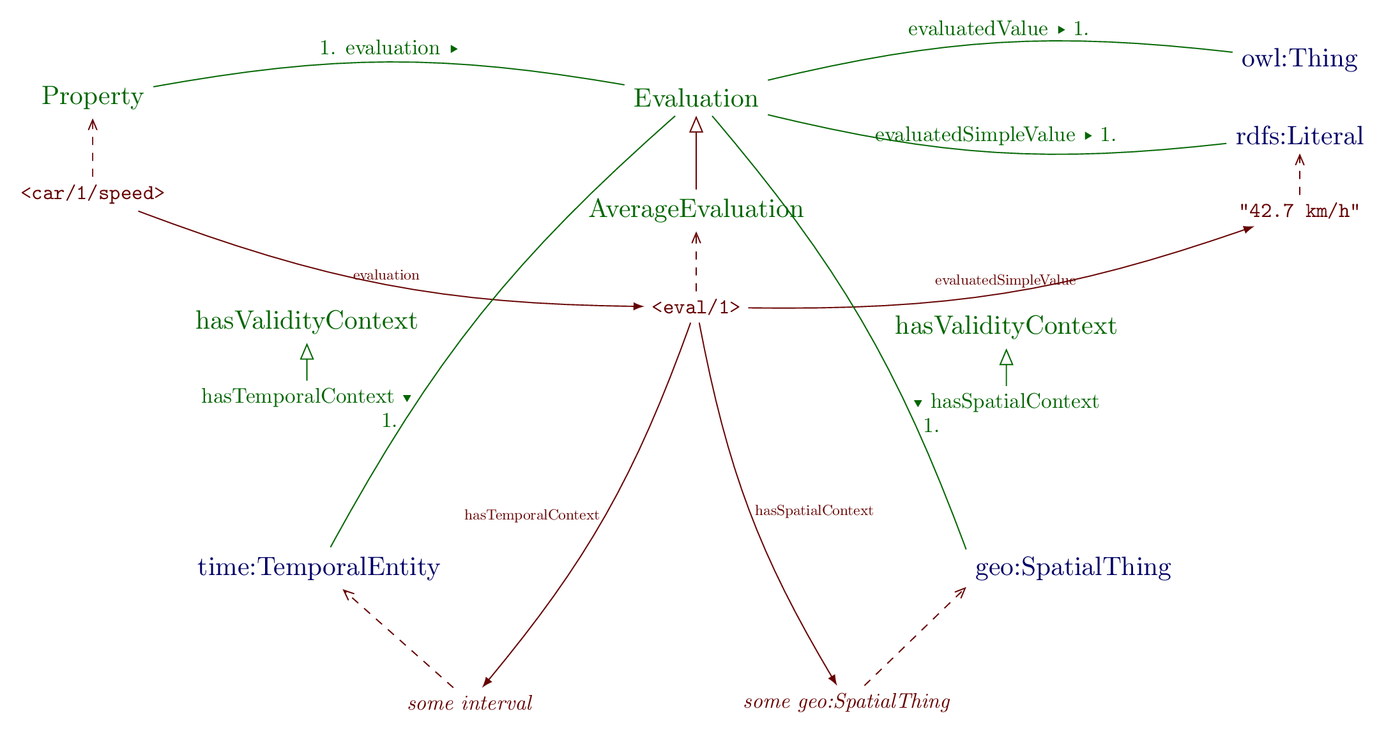
the Evaluation ontology pattern
Maxime Lefrançois – the SEAS ontology: instantiating ontology-patterns

Slide 19
the Evaluation ontology pattern
Extensible taxonomy
Instead of duplicating « hasProperty » sub-properties,
-> us a single « hasProperty » sub-property, and one or more sub-classes of Evaluation
-> <fridge/1/consumption> + AverageEvaluation;
<fridge/1/consumption> + NominalOperatingEvaluation;
<fridge/1/consumption> + ReductionFlexibilityEvaluation;
<fridge/1/consumption> + …
Maxime Lefrançois – the SEAS ontology: instantiating ontology-patterns

Slide 20
the Evaluation ontology pattern
Use QUDT, OM, custom ontology,…
Use literals, custom literals…
Maxime Lefrançois – the SEAS ontology: instantiating ontology-patterns

Slide 21
Main source of inspiration: the SSN ontology
Maxime Lefrançois – the SEAS ontology: instantiating ontology-patterns

Slide 22


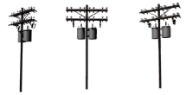


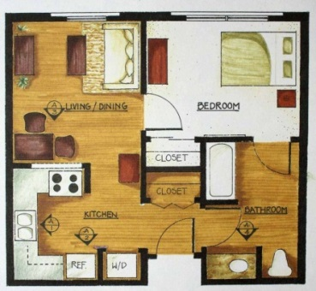

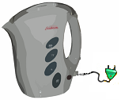

the System ontology pattern
E
Qualify systems
The environment in a specific place
A building, a room
An appliance
A set of appliances
A business partner
E
E 800 W
Maxime Lefrançois – the SEAS ontology: instantiating ontology-patterns
E €

Slide 23
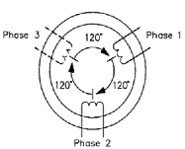


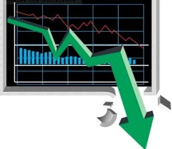
the System ontology pattern
E
Qualify systems
The environment in a specific place
A building, a room
An appliance
A set of appliances
A business partner
Qualify their connection points
Wall, window, ceiling
Plug, Socket
Offer, demand
E 230 V
E €/MWh
offer/demand
Maxime Lefrançois – the SEAS ontology: instantiating ontology-patterns

Slide 24


the System ontology pattern
E
Qualify systems
The environment in a specific place
A building, a room
An appliance
A set of appliances
A business partner
Qualify their connection points
Wall, window, ceiling
Plug, Socket
Offer, demand
Qualify the connections between these systems (flows)
Electric energy flows
Water volume/ thermic energy / light flows
...
E - km/h
E 400 A
E - thermic energy / power
E
€
MWh
penalties
Maxime Lefrançois – the SEAS ontology: instantiating ontology-patterns

Slide 25
Current modules
(IT) ArchitectureOntology,
BatteryOntology,
BooleanPropertyOntology,
BuildingOntology,
ComfortOntology,
CommunicationOntology,
ComplexOntology,
DeviceOntology,
ElectricLightSourceOntology,
ElectricPowerSystemOntology,
ElectricVehicleOntology,
EnergyFormOntology,
EvaluationOntology,
FailableSystemOntology,
FeatureOfInterestOntology
Maxime Lefrançois – the SEAS ontology: instantiating ontology-patterns

Slide 26
Example of extension: HVAC, Mads Holten Rasmussen, Alectia
Maxime Lefrançois – the SEAS ontology: instantiating ontology-patterns

Slide 27
Example of extension: HVAC, Mads Holten Rasmussen, Alectia

Slide 28
Example of extension: HVAC, Mads Holten Rasmussen, Alectia

Slide 29
Example of extension: HVAC, Mads Holten Rasmussen, Alectia

Slide 30
Example of extension: HVAC, Mads Holten Rasmussen, Alectia

Slide 31
Publish in conformance with the best practices ?
Follow the recommended best practices for metadata and access
Modular,
Versioned,
One single namespace for all SEAS concepts
https://w3id.org/seas/
+ Register on prefix.cc, the LOV, …
Maxime Lefrançois – the SEAS ontology: instantiating ontology-patterns

Slide 32
Ease the contributions from experts ?
Open source on GitHub https://github.com/thesmartenergy/seas
Use automatic quality checking tools
Naming conventions,
Metadata existence and consistence,
Use automatic pattern instantiation techniques
Ongoing, release planned April 2017
Use continuous integration techniques on GitHub
Ongoing, release planned April 2017
Maxime Lefrançois – the SEAS ontology: instantiating ontology-patterns

Slide 33
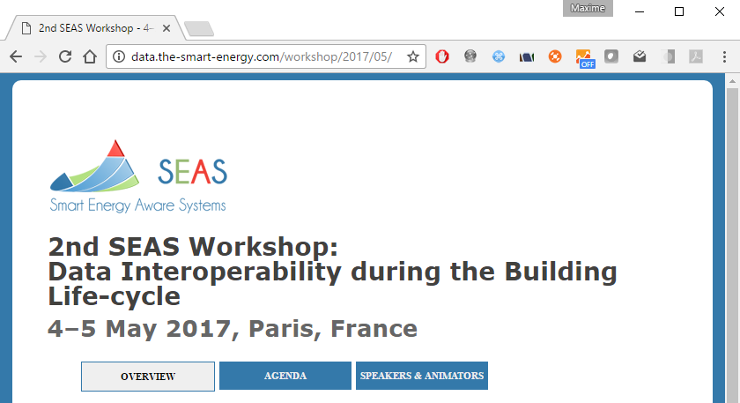
Ease the contributions from experts ?
Workshops with domain experts to promote Linked Data, and extend SEAS to a specific domain

Slide 34
The SEAS Ontology(ies)
https://w3id.org/seas/
For now, please use:
Maxime Lefrançois, Jarmo Kalaoja, Takoua Ghariani, Antoine Zimmermann, The SEAS Knowledge Model, ITEA2 12004 Smart Energy Aware Systems Deliverable 2.2, Jan 2017
Maxime Lefrançois
MINES Saint-Etienne, CNRS,
Laboratoire Hubert Curien UMR 5516

