Slide 1





Reasoning with Dependency Structures and Lexicographic Definitions using Unit Graphs
Depling’13, August 30th 2013, Prague
Maxime Lefrançois, Fabien Gandon
[ maxime.lefrancois | fabien.gandon ] @inria.fr

Slide 2
Knowledge Representation
Lefrançois, Gandon, Reasoning with Dependency Structures and Lex. Definitions using Unit Graphs
answers recurrent needs
represent
manipulate
query
reason
share
...
here: applied to the linguistic domain
Meaning-Text Theory

Slide 3
Lefrançois, Gandon, Reasoning with Dependency Structures and Lex. Definitions using Unit Graphs
Choose Formalism
Populate
Applications
t

Slide 4
Lefrançois, Gandon, Reasoning with Dependency Structures and Lex. Definitions using Unit Graphs
Choose Formalism
Populate
Applications
t
1. Choose Formalism

Slide 5

Lefrançois, Gandon, Reasoning with Dependency Structures and Lex. Definitions using Unit Graphs
Need 1: Theory of Semantic Actants
(Mel’cuk, 2004)
Linguistic Predicates
Semantic Actant Slots (SemASlots)
= Participants of the linguistic situation denoted by L
that have a favoured position in sentences constructed with L
Notes:
Tesnière, 1893-1954, U.Montpellier, FR,
Elements de syntaxe structurale, 1959
Chomsky, 1928- MIT, US,
1950: grammaire générative et transformationnelle, linguistique générative
- Distinction compétence performance - Structure de surface et structure profonde
- Règles de réécriture pour générer – analyser le langage
Cherche une grammaire universelle, avec des universaux et des variables
Sowa 1940
1984 Conceptual Structures - Information Processing in Mind and Machine.
Mel’cuk
1974 développement de la théorie sens-texte
1988 dependency syntax

Slide 6
Lefrançois, Gandon, Reasoning with Dependency Structures and Lex. Definitions using Unit Graphs
Need 1: Theory of Semantic Actants
(Mel’cuk, 2004)
Linguistic Predicates
Semantic Actant Slots (SemASlots)
= Participants of the linguistic situation denoted by L
that have a favoured position in sentences constructed with L
+ linguistic criterions
Notes:
Tesnière, 1893-1954, U.Montpellier, FR,
Elements de syntaxe structurale, 1959
Chomsky, 1928- MIT, US,
1950: grammaire générative et transformationnelle, linguistique générative
- Distinction compétence performance - Structure de surface et structure profonde
- Règles de réécriture pour générer – analyser le langage
Cherche une grammaire universelle, avec des universaux et des variables
Sowa 1940
1984 Conceptual Structures - Information Processing in Mind and Machine.
Mel’cuk
1974 développement de la théorie sens-texte
1988 dependency syntax

Slide 7

Lefrançois, Gandon, Reasoning with Dependency Structures and Lex. Definitions using Unit Graphs
Need 1: Theory of Semantic Actants
(Mel’cuk, 2004)
≠
Linguistic Predicates
logical
predicate
optional
⁽to eat⁾(Paul ; eggs ; plate)
Notes:
Tesnière, 1893-1954, U.Montpellier, FR,
Elements de syntaxe structurale, 1959
Chomsky, 1928- MIT, US,
1950: grammaire générative et transformationnelle, linguistique générative
- Distinction compétence performance - Structure de surface et structure profonde
- Règles de réécriture pour générer – analyser le langage
Cherche une grammaire universelle, avec des universaux et des variables
Sowa 1940
1984 Conceptual Structures - Information Processing in Mind and Machine.
Mel’cuk
1974 développement de la théorie sens-texte
1988 dependency syntax

Slide 8
Lefrançois, Gandon, Reasoning with Dependency Structures and Lex. Definitions using Unit Graphs
Need 1: Theory of Semantic Actants
(Mel’cuk, 2004)
≠
Linguistic Predicates
logical
predicate
optional
⁽to eat⁾(Paul ; eggs ; plate)
split
⁽outil⁾(Paul ; Untangle)
⁽outil⁾(Paul ; Carpenter)
Notes:
Tesnière, 1893-1954, U.Montpellier, FR,
Elements de syntaxe structurale, 1959
Chomsky, 1928- MIT, US,
1950: grammaire générative et transformationnelle, linguistique générative
- Distinction compétence performance - Structure de surface et structure profonde
- Règles de réécriture pour générer – analyser le langage
Cherche une grammaire universelle, avec des universaux et des variables
Sowa 1940
1984 Conceptual Structures - Information Processing in Mind and Machine.
Mel’cuk
1974 développement de la théorie sens-texte
1988 dependency syntax

Slide 9
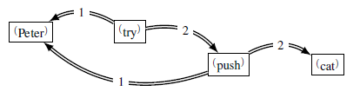
Lefrançois, Gandon, Reasoning with Dependency Structures and Lex. Definitions using Unit Graphs
Need 1: Theory of Semantic Actants
(Mel’cuk, 2004)
≠
Linguistic Predicates
logical
predicate
optional
⁽to eat⁾(Paul ; eggs ; plate)
split
⁽outil⁾(Paul ; Untangle)
⁽outil⁾(Paul ; Carpenter)
an actant may be a predicate
Notes:
Tesnière, 1893-1954, U.Montpellier, FR,
Elements de syntaxe structurale, 1959
Chomsky, 1928- MIT, US,
1950: grammaire générative et transformationnelle, linguistique générative
- Distinction compétence performance - Structure de surface et structure profonde
- Règles de réécriture pour générer – analyser le langage
Cherche une grammaire universelle, avec des universaux et des variables
Sowa 1940
1984 Conceptual Structures - Information Processing in Mind and Machine.
Mel’cuk
1974 développement de la théorie sens-texte
1988 dependency syntax

Slide 10
Existing KR Formalisms
Lefrançois, Gandon, Reasoning with Dependency Structures and Lex. Definitions using Unit Graphs
Semantic Web Formalisms
RDF - oriented labelled graphs
OWL - Description Logics
SPARQL - Query, ...

Slide 11
Existing KR Formalisms
Lefrançois, Gandon, Reasoning with Dependency Structures and Lex. Definitions using Unit Graphs
Semantic Web Formalisms
RDF - oriented labelled graphs
No Semantics
OWL - Description Logics
Only binary relations Reify ? -> No Semantics

Slide 12
Existing KR Formalisms
Lefrançois, Gandon, Reasoning with Dependency Structures and Lex. Definitions using Unit Graphs
Conceptual Graphs
SowaOriented labelled Graphs
Sowa drew his inspiration from Tesnière
Rules, reasoning, (Baget, Mugnier, Chein, ...)
Concepts and Relations definitions, (Sowa, Leclère, ...)

Slide 13
Existing KR Formalisms
Lefrançois, Gandon, Reasoning with Dependency Structures and Lex. Definitions using Unit Graphs
Conceptual Graphs
Alternation Concept – Relation

Slide 14
Lefrançois, Gandon, Reasoning with Dependency Structures and Lex. Definitions using Unit Graphs
Choose Formalism
Populate
Applications
t
The Unit Graphs Formalism
a graph-based formalism,
to represent linguistic units

Slide 15
Lefrançois, Gandon, Reasoning with Dependency Structures and Lex. Definitions using Unit Graphs
Choose Formalism
Populate
Applications
t
The Unit Graphs Formalism
Draw inspiration from GC
and
Develop a RDF syntax to exchange knowledge

Slide 16
Lefrançois, Gandon, Reasoning with Dependency Structures and Lex. Definitions using Unit Graphs
Choose Formalism
Populate
Applications
t
The Unit Graphs Formalism
Draw inspiration from GC
and
Develop a RDF syntax to exchange knowledge

Slide 17
Lefrançois, Gandon, Reasoning with Dependency Structures and Lex. Definitions using Unit Graphs
Choose Formalism
Populate
Applications
t
The Unit Graphs Formalism
What reasoning capabilities ?

Slide 18
1. Choose Formalism
Lefrançois, Gandon, The Unit Graphs Framework: Linguistic Knowledge Representation
Needs, problems
Existing Knowledge Representation Formalisms
The Unit Graphs formalism
Unit Graphs
Rules and Definitions
Reasoning with Unit Graphs
Logical Semantics
Entailment problem

Slide 19
Lefrançois, Gandon, Reasoning with Dependency Structures and Lex. Definitions using Unit Graphs
Unit Types – Lexicon
Units – Representations
(c.f., Mel’čuk, 2004)

Slide 20
Lefrançois, Gandon, Reasoning with Dependency Structures and Lex. Definitions using Unit Graphs
Unit Types
Specify How their units are to be linked to other units in Unit Graphs
through Actantial Structure:
Actant Slots (ASlots)
Signatures

Slide 21


Lefrançois, Gandon, Reasoning with Dependency Structures and Lex. Definitions using Unit Graphs
Unit Graphs
are defined over a Support

Slide 22
Lefrançois, Gandon, Reasoning with Dependency Structures and Lex. Definitions using Unit Graphs
Unit Graphs
are defined over a Support
Hierarchy of Unit Types
Primitive Unit Types (PUTs)
Lexical unit type ANIMAL Grammatical unit type Verb, Noun, plur Surface Semantic unit type ⁽animal⁾
Conjunctive Unit Types (PUTs) A Unit may consist of several conjoint PUTs
{ def, plur, ANIMAL } (⁽the animals⁾)

Slide 23

Lefrançois, Gandon, Reasoning with Dependency Structures and Lex. Definitions using Unit Graphs
Unit Graphs
are defined over a Support
Hierarchy of Unit Types
Primitive Unit Types (PUTs)
Lexical unit type ANIMAL Grammatical unit type Verb, Noun, plur Surface Semantic unit type ⁽animal⁾
Are pre-ordered
plur pluralizable
/animal\ /dog\

Slide 24
Lefrançois, Gandon, Reasoning with Dependency Structures and Lex. Definitions using Unit Graphs
Unit Graphs
are defined over a Support
Hierarchy of Unit Types
Unit Types specify how their units are to be linked through Actantial Structure
Actant Slots (ASlots)
Signatures

Slide 25
Lefrançois, Gandon, Reasoning with Dependency Structures and Lex. Definitions using Unit Graphs
Unit Graphs
are defined over a Support
Hierarchy of Unit Types
Actant Slots
Have Symbols
Deep Semantics: lexicalized semantic roles Surface Semantics: Numbers
Deep Syntax: Roman numerals
May be Obligatory, Optional, Prohibited

Slide 26





Lefrançois, Gandon, Reasoning with Dependency Structures and Lex. Definitions using Unit Graphs
radix
obligat
prohibet
absurd
≃
Organization of the Unit Types Hierarchy
with respect to a unique ASymbol s
The complete Unit Types Hierarchy
is an intricated superposition of such figures

Slide 27

Lefrançois, Gandon, Reasoning with Dependency Structures and Lex. Definitions using Unit Graphs
Unit Graphs
are defined over a Support
Hierarchy of Unit Types
Signatures
denote the type of units that fill an ASlot s of a unit of a type t

Slide 28
Lefrançois, Gandon, Reasoning with Dependency Structures and Lex. Definitions using Unit Graphs
As we go down the hierarchy,
signatures may only be specialized

Slide 29


Lefrançois, Gandon, Reasoning with Dependency Structures and Lex. Definitions using Unit Graphs
Unit Graphs
are defined over a Support
Hierarchy of Circumstantial Symbols
Circumstantial Symbols:
Deep and Surface Semantics: none
Deep Syntax: ATTR, COORD, APPEND
...
Are organized in hierarchy
ex: ATTR deep syntactic CSymbol
Are signed

Slide 30
Lefrançois, Gandon, Reasoning with Dependency Structures and Lex. Definitions using Unit Graphs
Unit Graphs
are defined over a Support
Unit Node Markers
Arbitrary Symbols
Every Element of M identifies a specific unit;
Multiple elements of M may identify the same unit.

Slide 31

Lefrançois, Gandon, Reasoning with Dependency Structures and Lex. Definitions using Unit Graphs
Unit Graphs
are defined over a Support
Unit nodes
Unit nodes labels : a type + a marker
Actantial triples
Circumstantial triples
Declared equivalences of unit nodes

Slide 32
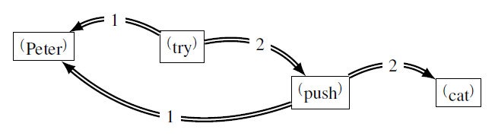
Lefrançois, Gandon, Reasoning with Dependency Structures and Lex. Definitions using Unit Graphs
Unit Graphs
are defined over a Support

Slide 33
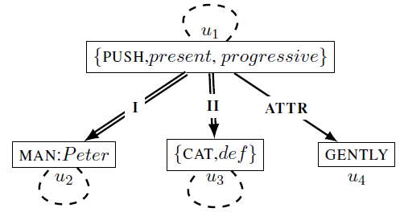
Lefrançois, Gandon, Reasoning with Dependency Structures and Lex. Definitions using Unit Graphs
Unit Graphs
are defined over a Support

Slide 34
1. Choose Formalism
Lefrançois, Gandon, The Unit Graphs Framework: Linguistic Knowledge Representation
Needs, problems
Existing Knowledge Representation Formalisms
The Unit Graphs formalism
Unit Graphs
Rules and Definitions
Reasoning with Unit Graphs
Logical Semantics
Entailment problem

Slide 35
Unit Graphs Homomorphism
Lefrançois, Gandon, Reasoning with Dependency Structures and Lex. Definitions using Unit Graphs
« Is UG G contained in UG H ? »
Oriented Labelled Graphs Homomorphism
arcs must be preserved
labels may get specialized

Slide 36
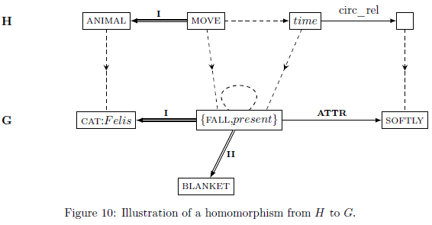
Unit Graphs Homomorphism
Lefrançois, Gandon, Reasoning with Dependency Structures and Lex. Definitions using Unit Graphs

Slide 37

Unit Graphs Rules
Lefrançois, Gandon, Reasoning with Dependency Structures and Lex. Definitions using Unit Graphs
A Hypothesis H
A Conclusion G
A partial mapping from nodes of H to nodes of C

Slide 38
Unit Graphs Rules
Lefrançois, Gandon, Reasoning with Dependency Structures and Lex. Definitions using Unit Graphs
A rule R is Applicable to G iif there is a homomorphism H->G
Apply rule R: add C to G and merge nodes

Slide 39

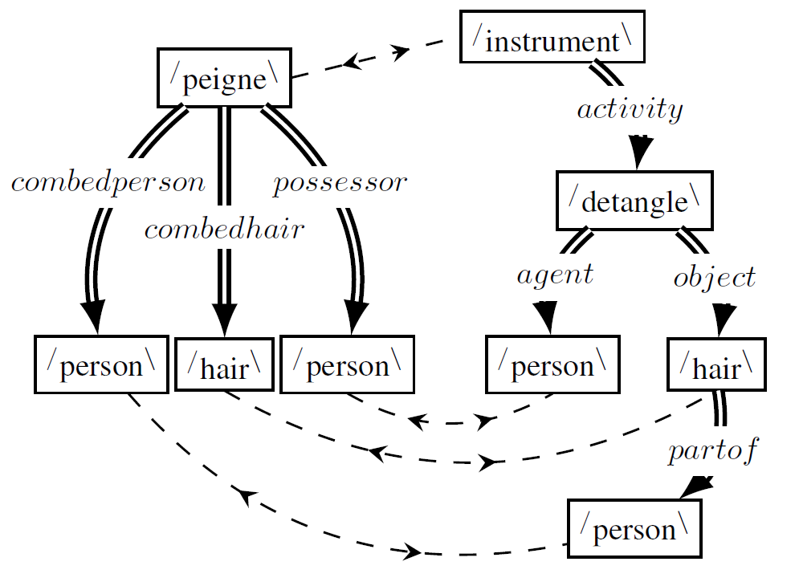
PUT Definitions
Lefrançois, Gandon, Reasoning with Dependency Structures and Lex. Definitions using Unit Graphs

Slide 40
1. Choose Formalism
Lefrançois, Gandon, The Unit Graphs Framework: Linguistic Knowledge Representation
Needs, problems
Existing Knowledge Representation Formalisms
The Unit Graphs formalism
Unit Graphs
Rules and Definitions
Reasoning with Unit Graphs
Logical Semantics
Entailment problem

Slide 41
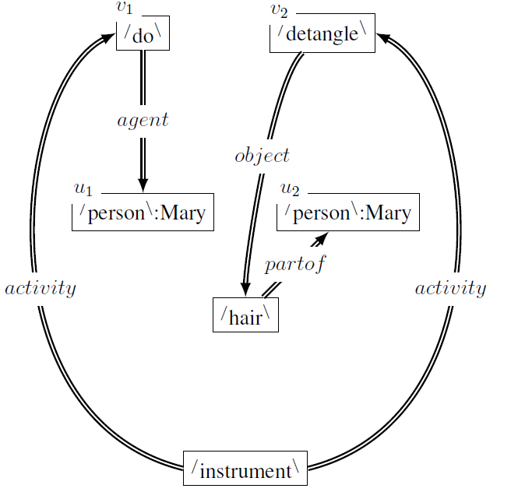
Lefrançois, Gandon, Reasoning with Dependency Structures and Lex. Definitions using Unit Graphs
Reasoning with Unit Graphs

Slide 42
Lefrançois, Gandon, Reasoning with Dependency Structures and Lex. Definitions using Unit Graphs
Logical Semantics of UGs: Closure

Slide 43
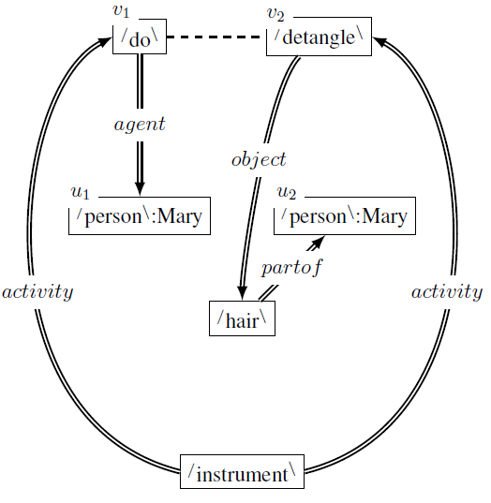
Lefrançois, Gandon, Reasoning with Dependency Structures and Lex. Definitions using Unit Graphs
Logical Semantics of UGs: Closure

Slide 44
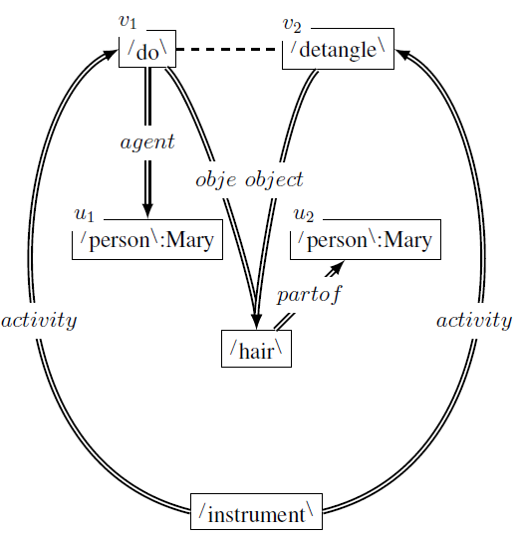
Lefrançois, Gandon, Reasoning with Dependency Structures and Lex. Definitions using Unit Graphs
Logical Semantics of UGs: Closure

Slide 45
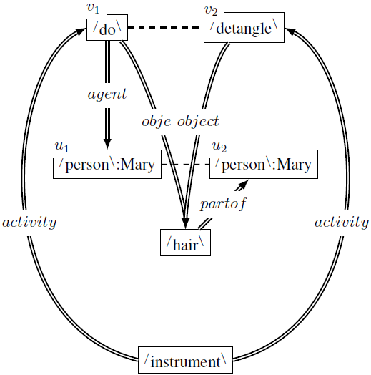
Lefrançois, Gandon, Reasoning with Dependency Structures and Lex. Definitions using Unit Graphs
Logical Semantics of UGs: Closure

Slide 46
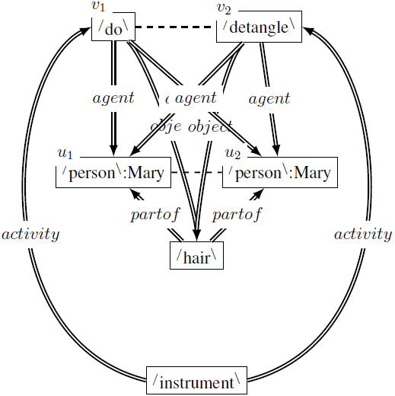
Lefrançois, Gandon, Reasoning with Dependency Structures and Lex. Definitions using Unit Graphs
Logical Semantics of UGs: Closure

Slide 47
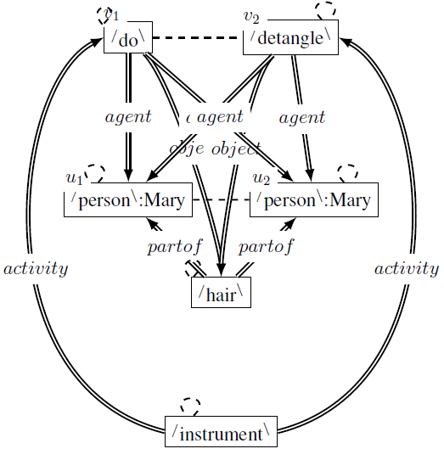
Lefrançois, Gandon, Reasoning with Dependency Structures and Lex. Definitions using Unit Graphs
Logical Semantics of UGs: Closure

Slide 48
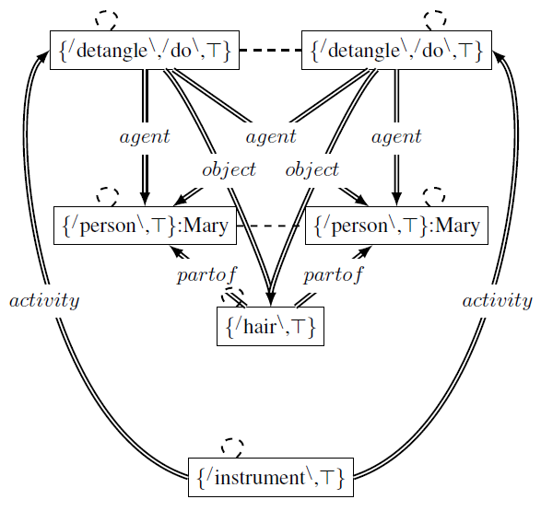
Lefrançois, Gandon, Reasoning with Dependency Structures and Lex. Definitions using Unit Graphs
Logical Semantics of UGs: Closure

Slide 49
Lefrançois, Gandon, Reasoning with Dependency Structures and Lex. Definitions using Unit Graphs
Logical Semantics of UGs: Closure

Slide 50
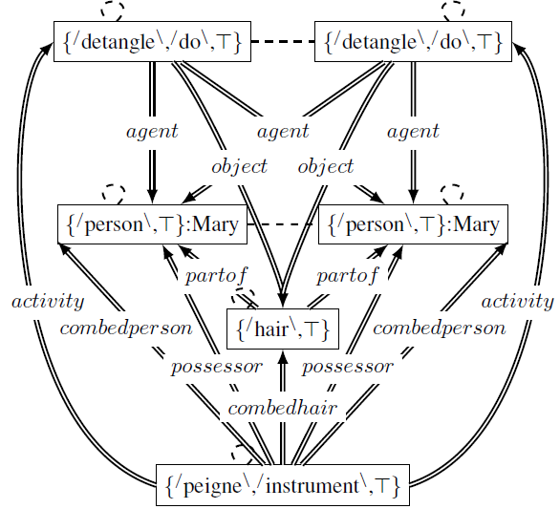
Lefrançois, Gandon, Reasoning with Dependency Structures and Lex. Definitions using Unit Graphs
Logical Semantics of UGs: Closure

Slide 51
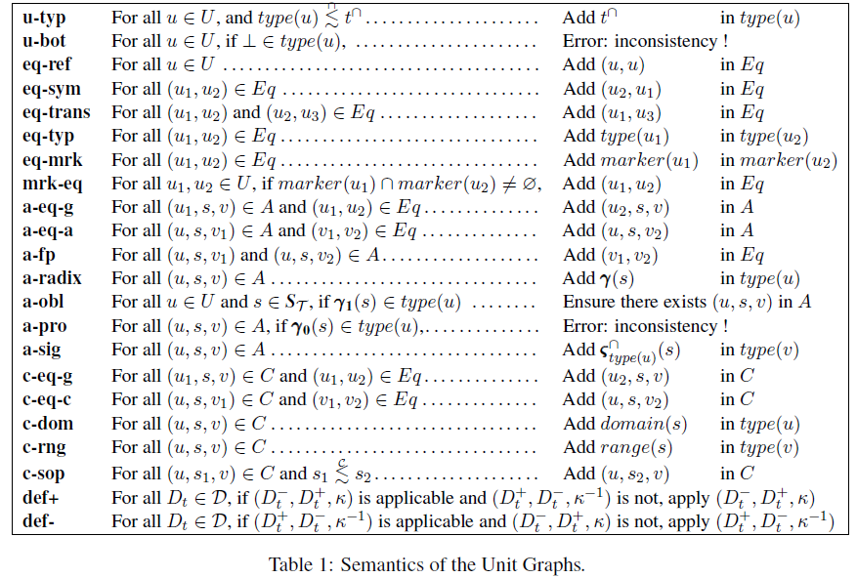
Lefrançois, Gandon, Reasoning with Dependency Structures and Lex. Definitions using Unit Graphs
Logical Semantics of UGs: Closure

Slide 52
1. Choose Formalism
Lefrançois, Gandon, The Unit Graphs Framework: Linguistic Knowledge Representation
Needs, problems
Existing Knowledge Representation Formalisms
The Unit Graphs formalism
Unit Graphs
Rules and Definitions
Reasoning with Unit Graphs
Logical Semantics
Entailment problem

Slide 53
Lefrançois, Gandon, Reasoning with Dependency Structures and Lex. Definitions using Unit Graphs
Reasoning with Unit Graphs
G entails H
if and only if
there is a homomorphism from H to cl(G)

Slide 54
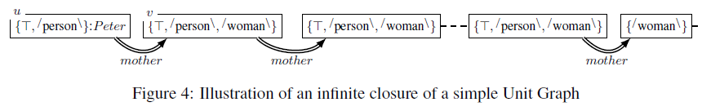
Lefrançois, Gandon, Reasoning with Dependency Structures and Lex. Definitions using Unit Graphs
Future Work
Problem: risk of infinite closure
need to find conditions :
on the hierarchy of Unit Types
on the set of definitions

Slide 55
Conclusions
Lefrançois, Gandon, Reasoning with Dependency Structures and Lex. Definitions using Unit Graphs
Linguistic Knowledge Representation
The Unit Graphs Formalism
Hierarchy of Unit Types
Hierarchy of Circumstantial Symbols
Unit Graphs
Rules and Definitions
Reasoning with UGs
Logical Semantics: Unit Graph Closure
Entailment equivalent to the homomorphism problem

Slide 56
Reasoning with Dependency Structures and Lexicographic Definitions using Unit Graphs
Depling’13, August 30th 2013, Prague
Thank you

