Slide 1
Supporting Arbitrary Custom Datatypes in RDF and SPARQL
Maxime Lefrançois, Antoine Zimmermann
Univ Lyon, MINES Saint-Étienne, CNRS, Laboratoire Hubert Curien UMR 5516, F-42023 Saint-Étienne, France
Notes:
use cases

Slide 2
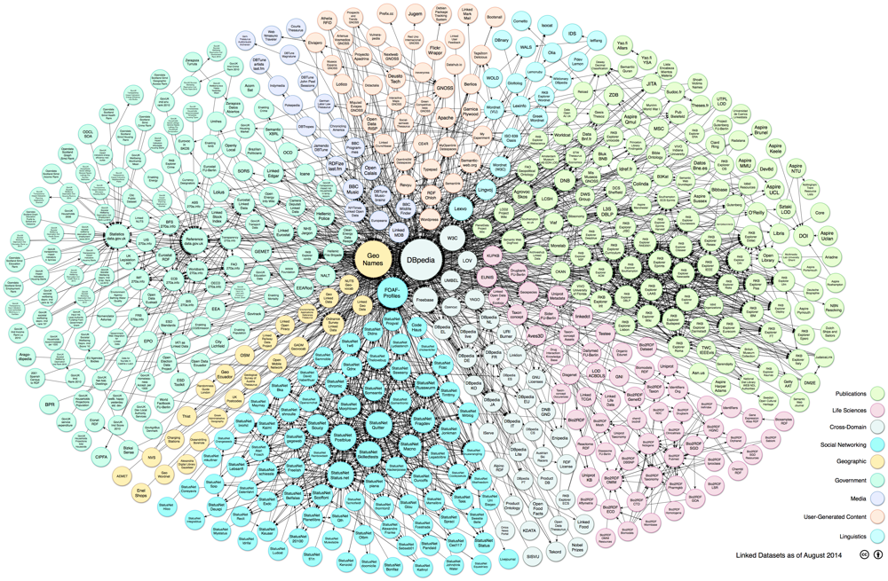
IRIs, Blank Nodes and Literals in the Web of Data
IRIs offer a way of traversing linked data towards the discovery of literal values
Literals are the carriers of the data
"hello"^^<world>
a UNICODE string
any IRI

Slide 3
Questions
Well formed or not ?
"hello"^^xsd:string
"1.23"^^xsd:decimal
"hello"^^xsd:decimal
"darkturquoise"^^css3:color
Equal value or not ?
"1.2e3"^^xsd:double -- "12000"^^xsd:double
"darkturquoise"^^css3:color -- "#00CED1"^^rgb:color
Greater value or not ?
"1 cm"^^ex:length -- "5 mm"^^ex:length

Slide 4
Questions
More concise or not ?
[] <size> [ qudt:quantityValue
[ qudt:numericValue "17983.2"^^xsd:double ;
qudt:unit qudt-unit:millimetre ] ] .
vs [] <size> "17983.2"^^<millimetre> .
[] ex:p ( ( -4 1 ) ( 3 2 ) ) .
vs [] ex:p "[ [ -4 , 1 ] , [ 3 , 2 ] ]"^^ex:2dmatrix .

Slide 5
Literals in RDF 1.1
"1234"^^ xsd:double
the datatype xsd:double ^{I}
L(xsd:double ^{I})
"1234"
"hello" ∉ L(xsd:double ^{I})

Slide 6
Literals in RDF 1.1
"1234"^^xsd:double
the datatype xsd:double^{I}
L2V(xsd:double ^{I})("1234" )
reals
V(xsd:double ^{I})
L(xsd:double ^{I})
L2V(xsd:double ^{I})
"1234"

Slide 7
Literals in RDF 1.1
"1234"^^xsd:double
the datatype xsd:double ^{I}
L2V(xsd:double ^{I})("1234" )
= L2V(xsd:double ^{I})("12.34e2")
reals
V(xsd:double ^{I})
L(xsd:double ^{I})
L2V(xsd:double ^{I})
"1234"
" 12.34e2"

Slide 8
Literals in SPARQL
"1234"^^xsd:double
the datatype xsd:double ^{I}
L2V(xsd:double ^{I})("1234" )
L2V(xsd:double ^{I})("2000" )
reals
V(xsd:double ^{I})
L(xsd:double ^{I})
"1234"
"2000"

Slide 9
Datatypes recognition by processors
Processors recognise a fixed set of datatypes
mostly XSD datatypes
Implementation specific
What about new datatypes ?
not many custom datatypes exist in the wild
some processors offer implementation specific extension points
new datatypes appear
"LINESTRING(0 0, 1 1, 1 2, 2 2)"^^<http://www.opengis.net/ont/geosparql#wktLiteral>
"Point(33.95 -83.38)"^^<http://www.opengis.net/ont/geosparql#wktLiteral>
"<http://www.opengis.net/def/crs/EPSG/0/4326> Point(33.95 -83.38)"^^geo:wktLiteral

Slide 10
On-the-fly recognition of a new datatype ?
Need for an agreement between the datatype publisher and the RDF/SPARQL processor
Centralized datatype registration service ?
or leverage the linked data principles, as suggested by RDF 1.1 semantics
use HTTP IRIs to identify datatypes
when someone looks up that IRI, make it retrieve the definition of the datatype

Slide 11
Definition of the datatype ?
No need to define the value space
only well-formedness, equality, comparison are necessary
Processor-specific modules
Functions accessible through a web service
Functions defined in a script
Declarative vocabulary-based description

Slide 12



Script-based Support of Arbitrary Datatypes
http://w3id.org/lindt
<watt>
1 - use HTTP IRI
3, 4 - this code implements APIs to process the datatype
2 – serve executable code
L(D)
Comparison
<watt> and <kW>
L2V(D)

Slide 13
Interface CustomDatatype
http://w3id.org/lindt
For datatypes with disjoint value spaces
String getIri()
Boolean isWellFormed (lexicalForm)
Boolean isEqual (lexForm1, lexForm2)
String getNormalForm (lexicalForm1)
Integer compare (lexForm1, lexForm2)

Slide 14
Interface CustomDatatype
http://w3id.org/lindt
For datatypes with overlapping value spaces
String getIri()
Boolean isWellFormed (lexicalForm)
Boolean isEqual (lexForm1, lexForm2[, datatypeIri2])
String getNormalForm (lexicalForm1)
Boolean recognisesDatatype (datatypeIri)
String[] getRecognisedDatatypes ()
Integer compare (lexForm1, lexForm2[, datatypeIri2])
String importLiteral (lexicalForm, datatypeIri)
String exportLiteral (lexicalForm, datatypeIri)

Slide 15
Interface CustomDatatype
http://w3id.org/lindt
Plus intra- and inter- conformance constraints

Slide 16
Publication of a simple custom datatype
http://w3id.org/lindt/custom_datatypes#length
"1 mile"^^cdt:length "5280 ft"^^cdt:length
"63360 inches"^^cdt:length "1.609344km"^^cdt:length
"1609.344 metre"^^cdt:length "1.609344E+6 mm"^^cdt:length
http://github.com/thesmartenergy/jena
Implementation over Apache Jena

Slide 17
Experiment
From DBpedia 2014 English specific mapping-based properties
819,764 triples, 21 custom datatypes for units of measures
223,768 triples describe lengths
http://dbpedia.org/datatype/millimetre
http://dbpedia.org/datatype/centimetre
http://dbpedia.org/datatype/metre
http://dbpedia.org/datatype/kilometre
( 404)
dbpedia:Bathyscaphe_Trieste
<http://dbpedia.org/ontology/MeanOfTransportation/length>
"17983.2"^^dbpdt:millimetre .

Slide 18
Experiment - Datasets
Dataset DBPEDIA
Dataset CUSTOM
Dataset QUDT
dbpedia:Bathyscaphe_Trieste
<http://dbpedia.org/ontology/MeanOfTransportation/length>
"17983.2"^^dbpdt:millimetre .
dbpedia:Bathyscaphe_Trieste
<http://dbpedia.org/ontology/MeanOfTransportation/length>
"17983.2 mm"^^cdt:length .
dbpedia:Bathyscaphe_Trieste
<http://dbpedia.org/ontology/MeanOfTransportation/length>
[ qudt:quantityValue
[ qudt:numericValue "17983.2"^^xsd:double ;
qudt:unit qudt-unit:millimetre ] ] .

Slide 19
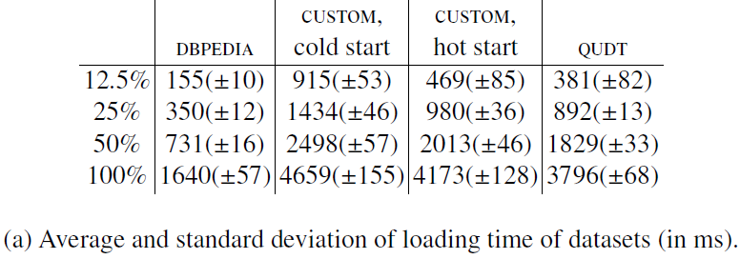
Loading time
% full dataset
very close to QUDT
penalty of 470 ms for loading the datatype
implementation specific

Slide 20
Queries
Return the 100 triples that concern the biggest lengths that are lower than 5 m, order the results according to the descending order of the length
for DBPEDIA
PREFIX dbpdt: <http://dbpedia.org/datatype/>
SELECT ?x ?prop ?length ?metres WHERE {
VALUES (?factor ?unit)
{ (0.001 dbpdt:millimetre)
(0.01 dbpdt:centimetre)
(1 dbpdt:metre)
(1000 dbpdt:kilometre)
}
?x ?prop ?length .
BIND (?factor*xsd:decimal (?length) as ?metres)
FILTER(datatype(?length) = ?unit)
FILTER( ?metres < 5 )
}
ORDER BY DESC ( ?metres )
LIMIT 100

Slide 21
Queries
for QUDT
PREFIX qudt: <http://qudt.org/schema/qudt#>
PREFIX qudt-unit: <http://qudt.org/vocab/unit#>
SELECT ?x ?prop ?length (?factor*?length as ?metres) WHERE {
VALUES (?factor ?unit)
{ (0.001 qudt-unit:millimetre)
(0.01 qudt-unit:centimetre)
(1 qudt-unit:metre)
(1000 qudt-unit:kilometre)
}
?x ?prop [
qudt:quantityValue [
qudt:numericValue ?length ;
qudt:unit ?unit ] ] .
FILTER( ?factor*?length < 5 )
}
ORDER BY DESC (?metres)
LIMIT 100

Slide 22
Queries
for CUSTOM
PREFIX cdt: <http://w3id.org/lindt/v1/custom_datatypes#>
SELECT ?x ?prop ?length WHERE {
?x ?prop ?length .
FILTER(datatype(?length) = cdt:length )
FILTER( ?length < "5m"^^cdt:length )
}
ORDER BY DESC (?length)
LIMIT 100

Slide 23
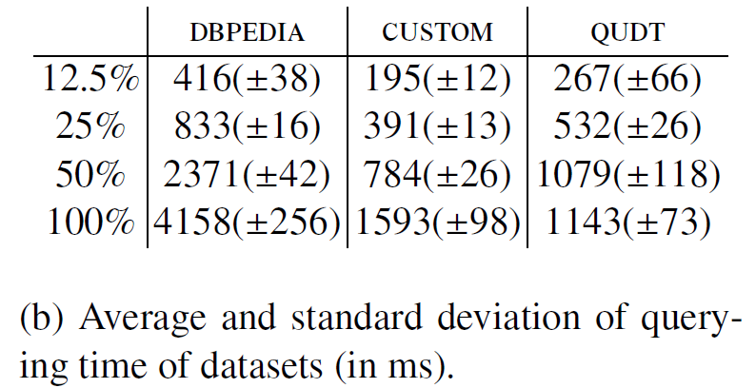
Querying time
% full dataset
overall better performances
33% to 47% of DBPEDIA (which hides 4 queries)
QUDT has an anchor IRI, to start the search from

Slide 24
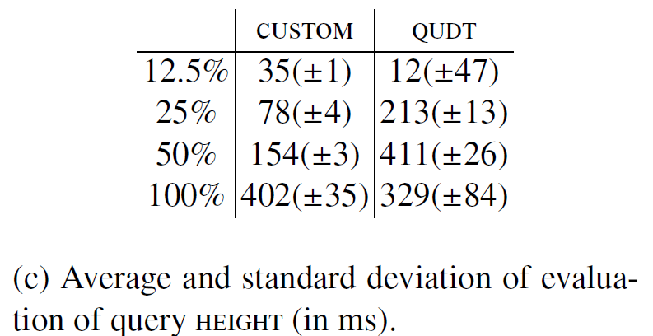
Querying time
what if we anchor the predicate ? http://dbpedia.org/ontology/Person/height
has a greater impact on CUSTOM than QUDT

Slide 25
Pros
arbitrarily complex datatypes
Drawbacks
security issues ?
full-fledged programming language is an overkill ?
Precautions
unlimited expressivity in the datatype
may lead to undecidabliltiy
ex: L(D) is the set of valid turtle documents L2V(D) maps a RDF Graph to the set of equiv. OWL 2 Full ontologies

Slide 26
Conclusions
Using recogniseable custom datatypes would increase interoperability on the web of data
Ease the publication of some domain-specific datasets
First proposal to support arbitrarily complex datatypes on-the-fly
A datatype for lengths published
Implementation on top of Apache Jena
Specification and experimentations at http://w3id.org/lindt

Slide 27
Future work
Library of custom datatypes
Implementation on other processors
Strategies for inter-datatype comparisons
Exploring other ways to retrieve the definition of datatypes
Functions accessible through a web service
Declarative vocabulary-based description e.g., sequence of primitive types with a separator, ...

Slide 28
Supporting Arbitrary Custom Datatypes in RDF and SPARQL
Maxime Lefrançois, Antoine Zimmermann
Univ Lyon, MINES Saint-Étienne, CNRS, Laboratoire Hubert Curien UMR 5516, F-42023 Saint-Étienne, France
Notes:
use cases

